Slide 1
British Actors

Slide 2
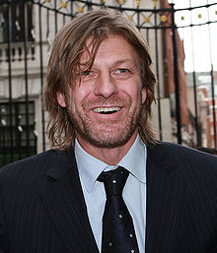
Shaun Mark "Sean" Bean (born 17 April 1959) is an English actor of stage and screen. He is known for portraying Boromir in The Lord of the Rings film trilogy. Bean's most prominent role was as Boromir in Peter Jackson's The Lord of the Rings trilogy. His major screen-time occurs in the first installment, The Lord of the Rings: The Fellowship of the Ring. He appears briefly in flashbacks in the theatre releases of The Lord of the Rings: The Two Towers and The Lord of the Rings: The Return of the King, as well as in a scene from the extended edition of The Two Towers. He became a repentant, poetry-reading Grammaton cleric who succumbs to his emotions in 2002's Equilibrium.

Slide 3
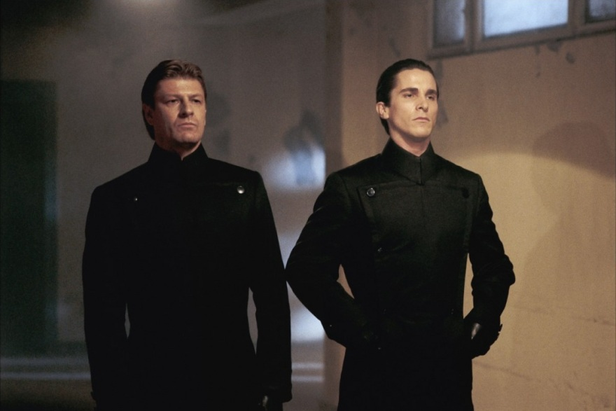

Slide 4
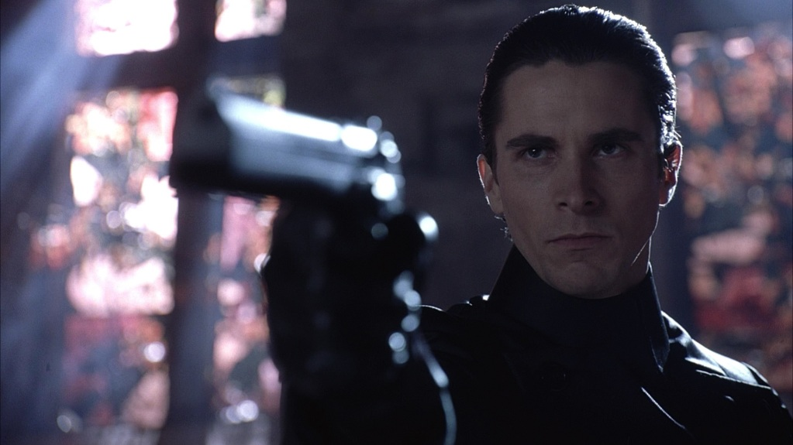
Christian Charles Philip Bale (born 30 January 1974) is an English Bale first caught the public eye at the age of 13, when he was cast in the starring role of Steven Spielberg's Empire of the Sun (1987). Based on the original story by J. G. Ballard, Bale played an English boy who is separated from his parents and subsequently finds himself lost in a Japanese internment camp during World War II. actor. He is also famous for his acting in: Batman, Equilibrium, Public Enemies and e.t.c.

Slide 5
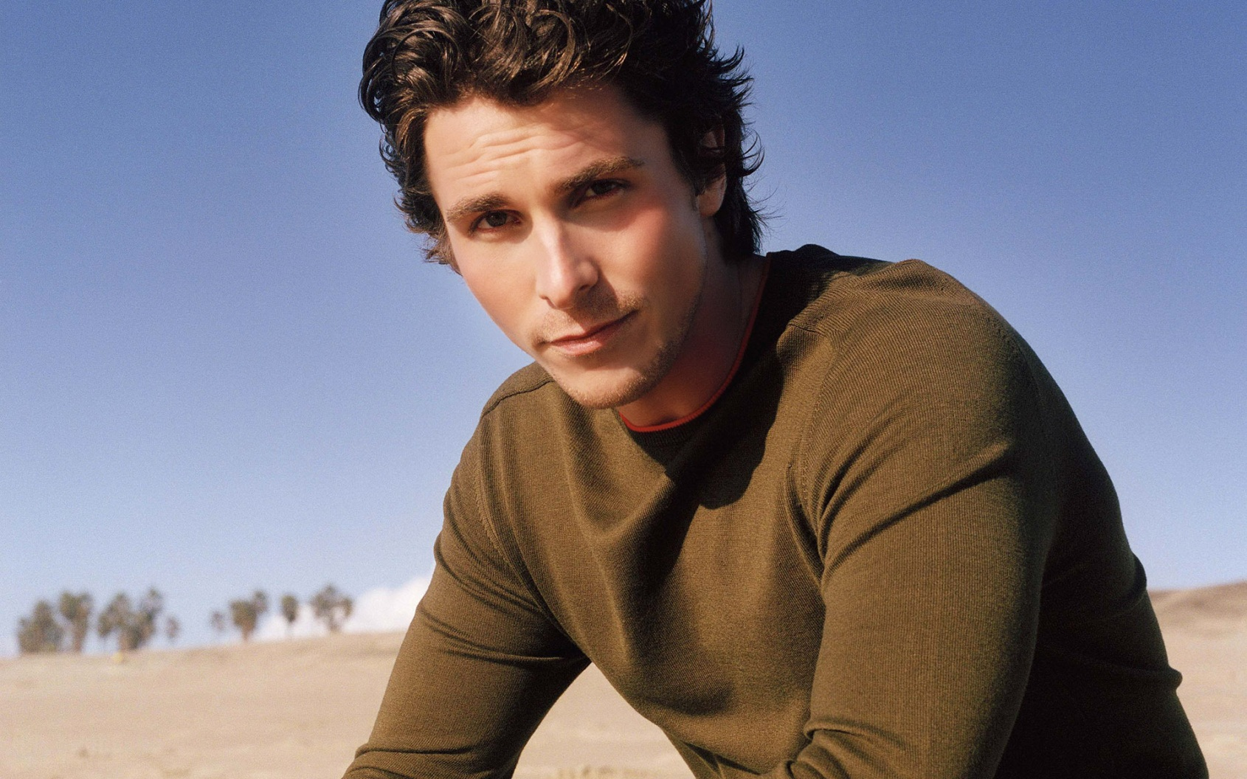

Slide 6
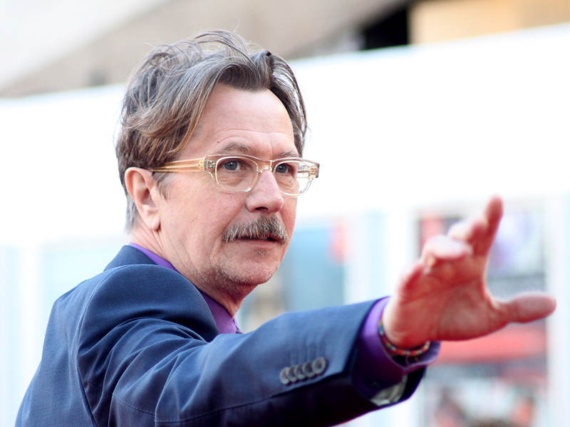
Gary Leonard Oldman (born 21 March 1958) is an English screen and stage actor, filmmaker and musician. As an actor, he has collaborated with many of Hollywood's biggest filmmakers, including Robert Zemeckis, Christopher Nolan, Oliver Stone, Ridley Scott, Quentin Tarantino, Luc Besson and Francis Ford Coppola. Oldman has had a keen interest in music from an early age. He is a proficient pianist and stated in a 1995 interview with Charlie Rose that he would rather be a musician than an actor.^{[17]} Oldman sang several tracks on the Sid and Nancy soundtrack, on which he performed alongside original Sex Pistols bassist Glen Matlock, and sang and played live piano in the 1988 movie Track 29. He traced over Beethoven compositions in 1994's Immortal Beloved. He also tutored Harry Potter star Daniel Radcliffe on bass guitar.

Slide 7
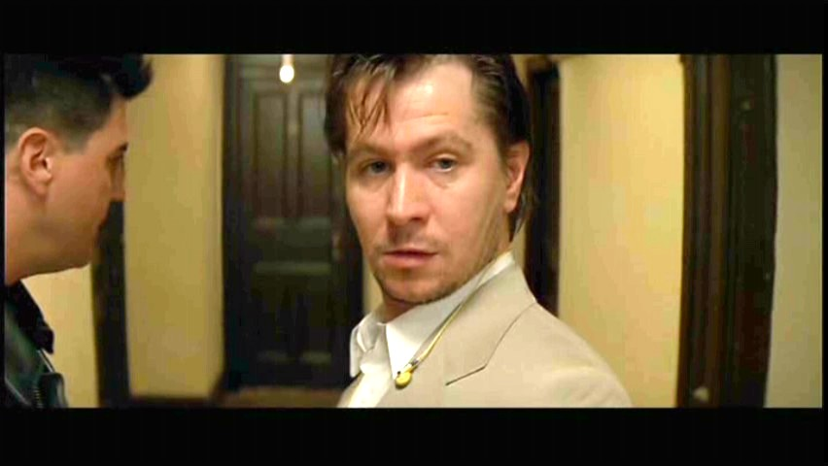

Slide 8
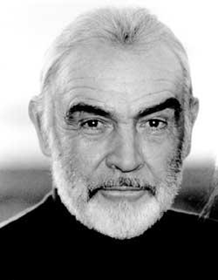
Sir Thomas Sean Connery Kt. (born 25 August 1930) known professionally as Sean Connery, is a Scottish actor and producer who has won an Academy Award, two BAFTA Awards (one of them being a BAFTA Academy Fellowship Award) and three Golden Globes (including the Cecil B. DeMille Award and a Henrietta A Connery's breakthrough came in the role of secret agent James Bond. He was reluctant to commit to a film series, but understood that if the films succeeded his career would greatly benefit.^{[27]} He played the character in the first five Bond films: Dr. No (1962), From Russia with Love (1963), Goldfinger (1964), Thunderball (1965), and You Only Live Twice (1967) – then appeared again as Bond in Diamonds Are Forever (1971) and Never Say Never Again (1983). All seven films were commercially successful.ward).

Slide 9
