Slide 1
Recovery and improvement of athletes performance
Theme 4: Pedagogical means of recovery

Slide 2
The central place in the problem of recovery is given to pedagogical means involving the management of athletes' performance and recovery processes through purposefully organized muscular activity

Slide 3
Classification of pedagogical means of recovery of working capacity
Load planning and construction of the physical training process
Compliance of the load with the capabilities of the students
Compliance with the content of training stages of long-term training, micro cycle period, etc.
Rational dynamics of the load in different parts of the workout
Planning exercises, classes, micro cycles of a restorative type
Locomotors shifts in the programs of classes and micro cycles

Slide 4
Classification of pedagogical means of recovery of working capacity
Rational warm-up in training and competitions
Rational construction of the final parts of classes
Proper lifestyle and playing sports
Favorable conditions for training and rest
Combining work or study with sports
The constancy of the time of training sessions, study, work, rest
Rational use of individual and collective forms of training
Avoidance of training and competitions in the presence of diseases and injuries
Taking into account the individual characteristics of those involved

Slide 5
It should be noted
There is a great variability and features of the combination of methods and means in the process of building training programs, the variety and features of the combination of loads in the construction of microcycles, the use of recovery microcycles in the planning of mesocycles. The possibilities of pedagogical means of recovery are very diverse

Slide 6
The main pedagogical means of recovery are:
Rational planning of the training process in accord with the functional capabilities of the athlete's body
The right combination of general and special training methods
Optimal construction of training and competitive micro- and macrocycles
Extensive use of shifts in activities and a clear organization of work and rest
The correct construction of a single training session using means to ease fatigue (full-fledged personal warm-up, selection of equipment and places for training, exercises for active rest and relaxation, creation of a positive emotional background)
Variation of rest intervals between individual exercises and training sessions

Slide 7
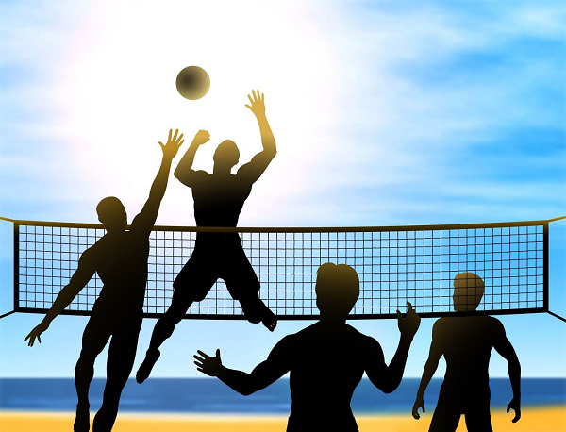
Pedagogical means of recovery also include the use of various forms of outdoor activities

Slide 8
Special attention should be paid to the organization of the preparatory and final parts of classes when constructing training programs.
Rational construction of the first part of the lesson contributing to more effective performance and helps to achieve a high level of efficiency in the main part of training.

Slide 9
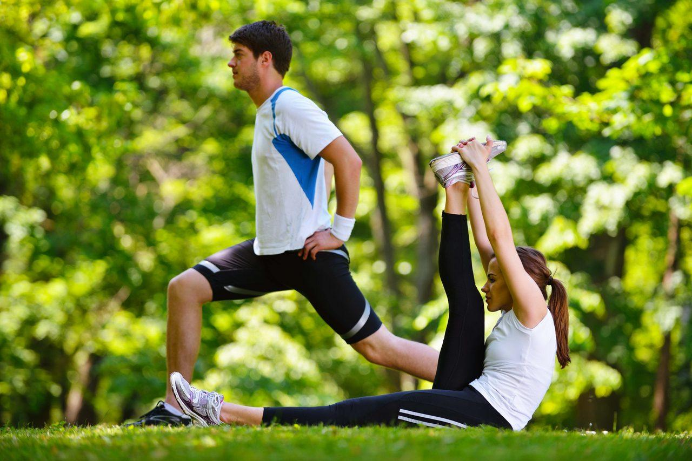
The main goal of the warm-up is to achieve optimal excitability of the central nervous system, to mobilize the physiological functions of the body to perform relatively more intense muscular activity and to "work out" the musculoskeletal system before a training session or competition

Slide 10
The physiological essence of the warm-up is that
it helps to increase the excitability and mobility of nervous processes
it increases breathing and blood circulation
it accelerates the physic-chemical processes of metabolism in skeletal muscles
it contributes to a faster warming-up period of the athlete's body
it helps to reduce or eliminate pre-start fever or apathy

Slide 11
Acceleration of physic-chemical metabolic processes in skeletal muscles during warm-up is carried out as follows
During the warm-up the body temperature rises and the reserve capillaries open.
In particular, with an increase in temperature in working muscles and organs the ability of hemoglobin to retain oxygen decreases, the oxygen output to tissue cells increases, the elasticity and contractility of muscles improves which protects them from damage

Slide 12
The warm-up consists of a general part and a special one
The general part of the warm-up includes various exercises: walking, running, general development exercises for the arms, legs, torso, etc.
The nature of the exercises, their rhythm, form should correspond to the kind of sport
The aim of the general warm up is simply to elevate the heart rate and respiratory rate. This in turn increases the blood flow and helps with the transportation of oxygen and nutrients to the working muscles. This also helps to increase the muscle temperature, allowing for a more effective static stretch.

Slide 13
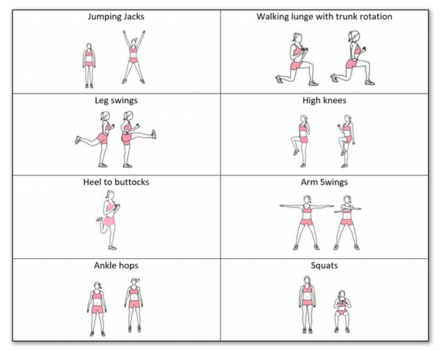
Examples of exercises for general warm-up

Slide 14
Special part of the warm-up
The special part of the warm-up includes special, imitation and other exercises that according to the structure of movements correspond to one or another part of the integral motor act in the sport chosen for specialization
The use of special exercises in the warm-up is mainly related to the preparation of nerve coordination processes that ensure the interaction of muscles that participate in the upcoming exercise

Slide 15
Special part of the warm-up
The intensity of performing special exercises depends on the character of the work to be performed and should be individual
With the help of special exercises are achieved strengthening of metabolism and heat generation in the body, mobilization of respiration, blood circulation and other systems of internal organs
Of great importance is not only the duration of the warm-up, but also the rhythm of movements corresponding to the upcoming exercise and the intensity of their performance. This ensures intermuscular coordination.
Relaxation exercises and stretching of individual muscles are important for high coordination. this also increases the amplitude of movements in the joints.

Slide 16
The value of a special warm-up
Warming up before short-term anaerobic exercise increases the intensity of glycolysis in the muscles
Performing loads after warm-up is accompanied by increased activity of a number of oxidative enzymes, more economical consumption of creatine phosphate and less increased glycolysis. As a result, the muscle system creates the best conditions for anaerobic ATP resynthesis when performing short-term work of maximum power.
Warm-up is also of great importance for improving blood circulation in working muscles. This is due to an increase in the number of open capillaries and the redistribution of blood flow to intensively working muscles (blood supply to muscles that are relatively less involved in this motor act decreases)

Slide 17
The value of the final part of the training
The rational organization of the final part allows you to quickly eliminate the symptoms of acute fatigue
The correct selection of exercises and methods of their use in the main part ensures the proper level of performance and emotional state of athletes and the effective course of recovery processes when performing training programs. This is also supported by an optimal combination of group and individual forms of work and the use of outdoor activities

Slide 18
Compensatory exercises as a means of recovery
Compensatory work is of great importance as a means of recovery, which is exercises performed with low intensity (significantly below the threshold of anaerobic metabolism - 30-50% VO2max)
Such work ensures intensive blood flow in the muscles and does not lead to the production of lactate, but on the contrary, contributes to the intensification of the process of its elimination
Slow running, swimming, cycling or rowing are an effective means of accelerating the recovery processes between training and competitive exercises

Slide 19
Compensatory exercises as a means of recovery
The duration of compensatory work between the main exercises during training usually ranges from 30-120 seconds and between starts in competitions – 5-15 minutes
In sports related to endurance (swimming at medium and long distances, running at medium and long distances, etc.), compensatory work can be performed at the level of 50% VO2max, in other types – 30-40% VO2max.

Slide 20
Lactate removal rate depending on the intensity of work
Low-intensity work in the pauses between individual exercises has a greater positive effect the higher the intensity of the previous exercises
Using relatively strenuous activity as an active recreation is usually effective only with a slight fatigue. However, this is not observed in all cases. For example, recovery processes after anaerobic loads leading to a significant accumulation of lactate proceed much faster when performing quite intensive physical work

Slide 21
The method of constructing a training microcycle from the point of view of athlete recovery
The method of constructing a training microcycle depends on various factors. These include, first of all, the features of the course of the processes of fatigue and recovery after the loads of individual training sessions
In order to correctly construct a microcycle, you need to know exactly what effect different loads have on an athlete and what is the dynamics and duration of the recovery processes after them
No less important is also information about the cumulative effect of several different loads, about the possibility of using low and medium loads in order to intensify recovery processes after large and significant loads

Slide 22
The method of constructing a training microcycle from the point of view of athlete recovery
An important role is played by the optimal balance of loads and rest in training microcycles as well as the use of unloading cycles
The main function of unloading microcycles is to ensure full recovery after hard training in previous microcycles and to create optimal conditions for the course of adaptive processes in the athlete's body

Slide 23
The method of constructing a training microcycle from the point of view of athlete recovery
Rational construction of various parts of the training process, (starting from the selection of training exercises and ending with the planning of macrocycles) involves the use of the entire complex of pedagogical means that can have a positive impact on the course of recovery processes after individual exercises, training sessions, microcycles
At the same time, we should not forget about the conditions that contribute to the effective course of recovery processes – the creation of a favorable psychological microclimate during training and competitions and rational organization of recreation and free time

Slide 24
The end

