Slide 1
The history of communication theories

Slide 2

Communication theory is a field of information theory and mathematics that studies the technical process of information and the process of human communication

Slide 3
Communication technology influences the ways in which we think about the world．It changes the things we think about，the symbols we use to form and communicate ideas, and the arenas in which our thoughts develop．
The beginning
In the history of communication, there have been many revolutionary technologies, among them the printing press in the fifteenth century and electronic media in the nineteenth century

Slide 4

The development of writing was a major advancement in the ability to communicate over distances and to preserve information accurately．Writing conveyed knowledge of the arts and sciences, which provided foundations for other areas of investigation．However, before books and the printing press, written language was limited to a few clay tablets and parchment scrolls．It was not until books became available that writing made a major impact．

Slide 5

For centuries，books were rare and expensive because each one was handwritten， a process that took several months．The printing press with movable type made it possible to produce hundreds of copies of a book in a single day．

Slide 6
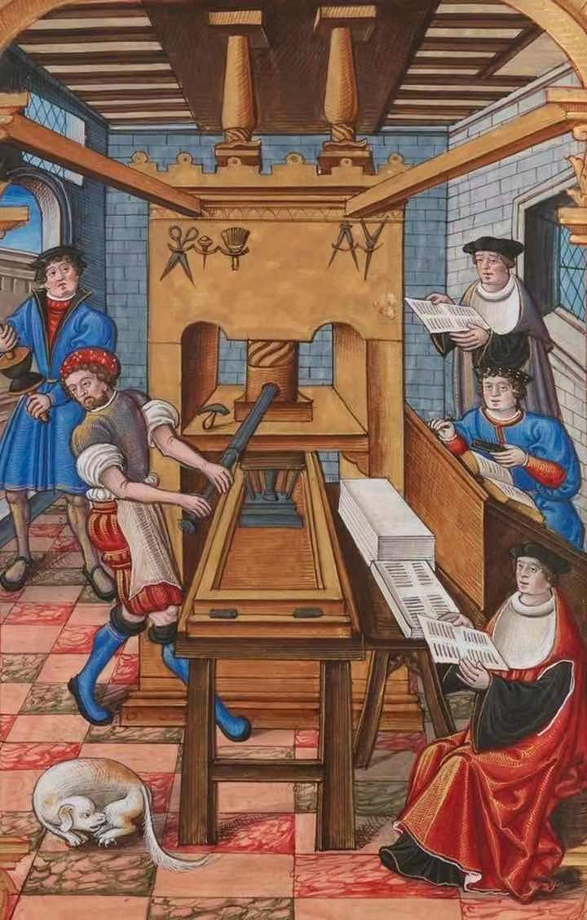
The invention of the printing press in 1450 launched a new era in the technology of communication．The printing press opened to large groups of people a body of information that had previously been confined to the educated few. The printing press brought books to the common people, increasing the ranks of the literate．Rapid expansion of the arts and sciences and the use of printed materials required a higher level of education．

Slide 7
Reading stimulates its development
Education became a formalized institution, and children earned adulthood by achieving literacy．The proliferation of books and reading changed how people thought and what they thought about．Reading entailed the linear organization of ideas, stimulating abstract thought and reasoning．The ability to read required a significant increase in a person’s attention span, resulting in a higher degree of intellectual discipline．Higher rates of literacy led society to a broader，more global perspective．

Slide 8
Communication technology
Another significant revolution in communication technology began in the nineteenth century with the advent of electronic media．The invention of the telegraph in 1843 signaled a new era in communication technology, the electronic era―so called because the telegraph used electrical signals to carry information along an electrical wire．The telegraph fed society’s growing appetite for immediate access to information，and it provided a foundation for Successive technologies：the telephone in 1876．the phonograph in 1878, film and movies in the 1890s, radio in 1919, and television in 1925．

Slide 9
Radio technology
As with the earliest handwritten books, radio technology was at first restricted to the educated few, scientists and researchers, but later spread to the greater society．By the 1930s, the middle classes were listening to news, drama, comedy, and musical performances from thousands of miles away．Radio was the first mass broadcast medium and, together with television a few decades later, it was responsible for altering both the pattern and volume of information that flowed into people’s homes．

Slide 10

The invention of electronic media changed communication more than any other technological event since the development of writing．The spread of electronic media occurred with a speed never seen before，thus intensifying commercial and social interaction．There was a tremendous shift in how people received the information that contributed to their understanding of the world．Voices or pictures could create ideas that appeared authentic―more so than ideas conveyed by the printed word．The graphic, intensely human nature of electronic media enhanced the belief that if it was on the air, it had to be true

Slide 11
Thanks for watching

