Slide 1
The functions and characteristics of communication

Slide 2
1.The four function of communication
2.The character of communication

Slide 3
1.control
2. excitation
3.expression of emotion
4.information

Slide 4
First, improving work efficiency and good communication are essential to the implementation of the project. With the acceleration of the modernization process, communication has become more and more convenient, but people's communication skills have become more and more stretched. Efficient communication can significantly improve the work efficiency of employees. Smart leaders can stimulate employees' innovation and ensure their sense of accomplishment through efficient communication, give full play to their subjective initiative, and bring together their views, opinions, and propositions to form a project. Solutions to improve work efficiency.

Slide 5
Second, stimulating additional creativity and efficient communication is one of the most common forms of creativity bursting. A typical example is the brainstorming method. In the communicator, everyone can speak freely, regardless of level, right or wrong, regardless of pros and cons, everyone thinks and explores together, and creativity is inspired by each other, and each other Comment is often a fission-like growth of creativity, while at the same time it can find problems and pain points, solve problems, and promote innovation

Slide 6
Third, the most important function of communication to break through information barriers is to efficiently transmit information. With the rapid development of informatization in today's society, success will favor those who are prepared, and will favor those who have key information. The information transmission between government and enterprise, between departments, and between customers is even more important. If the direction of government policy-related enterprise development is not grasped correctly, the development will inevitably be different, and even big problems will occur; if the sales department and the logistics department cannot Effective communication cannot serve customers efficiently, let alone improve service quality; if customers cannot communicate efficiently, transaction information cannot be effectively transmitted, and business cannot be done.

Slide 7
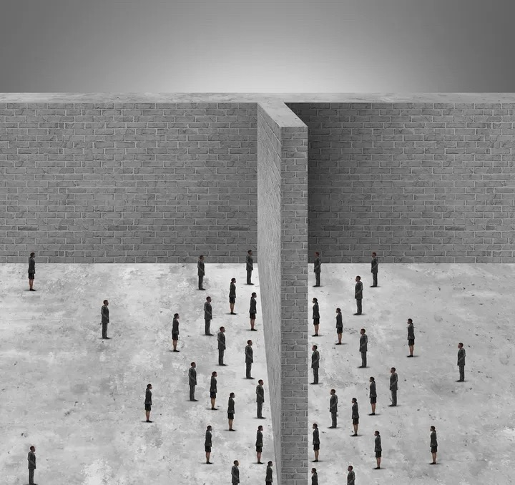
Fourth, grasp the lifeblood of development

Slide 8
Information such as the industrial environment, customer needs, industry trends, and shareholder requirements is a prerequisite for enterprise managers to grasp and make scientific decisions. Individuals cannot be isolated, and companies cannot become an island either. Only by forming efficient and benign interactions with the outside world through the transmission of information can they accurately grasp business opportunities, avoid risks, grasp the lifeblood of enterprise development, and control the rise and fall of the enterprise.

Slide 9
George Homans, the founder of social exchange theory, believes that interpersonal communication is basically a process of interest exchange. Although this theory has the suspicion of "pretentiousness", it is undeniable that it has a certain degree of rationality, and the principle of coordinating this interest relationship is the basic behavior principle of communication: mutual benefit and mutual benefit. Of course, this principle should not be regarded as merely an equivalent transaction of material. Noble moral values, human relationships, and friendship are also important exchange weights in communication.
The principle of "mutual benefit" in interpersonal communication has three characteristics: First of all, this kind of mutual reward is often asynchronous. You cannot ask you to help me materially. I will reward you immediately, but always keep the sentiment in mind and give it at the appropriate time. Thanks. Secondly, this kind of mutual reward is often not equal. You give me some benefits, and I can't pay you back some benefits right away. Third, there is generally not only a form of currency as a general equivalent in communication, but also other forms of compensation in real life. In fact, people will use different forms of compensation according to different objects. According to the general law, people always hope to get the support and encouragement of friends in spirit, and pin the desire to get practical help in the living environment and working environment on the relationship between neighbors and colleagues.

Slide 10
Communication is the process of transferring or exchanging understandable information, thoughts and emotions among two or more individuals or groups by means of certain means. The role of communication in management: (1) Communication is the cohesive agent for coordinating various entities and elements to make the enterprise a whole; (2) Communication is the basic way for leaders to motivate their subordinates and realize their leadership functions; (3) Communication is Establish a bridge between the enterprise and the external environment.

Slide 11
Thanks for your watching～

