Slide 1
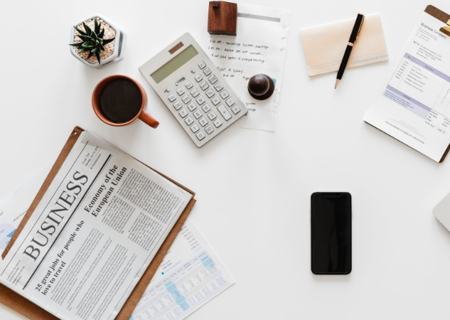
Rituals in communication
沟通仪式
Shang MingJunKe

Slide 2
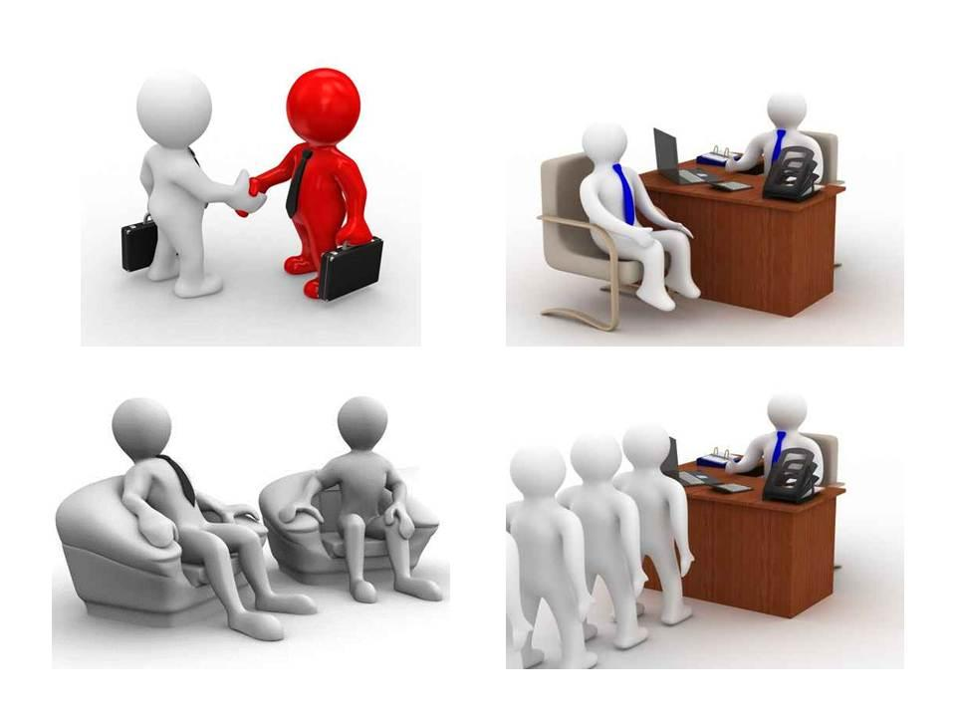
Dialogue is a noun meaning "conversation", a transitive verb meaning "to express in conversation", and an intransitive verb meaning "to converse".
对话是名词，意思是“对话”;及物动词，意思是“在对话中表达”;不及物动词，意思是“交谈”。
Discussion means 'discussion'. A conversation between two or more people.
讨论意味着“讨论”。两个或更多的人之间的对话。
Conversation means "to talk, to converse; to socialise; to interact; to meet; to have a human-computer conversation".
交谈意思是“交谈，交谈;社交;互动;为了满足;进行人机对话”。

Slide 3
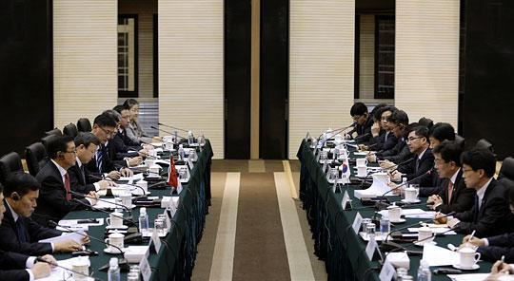
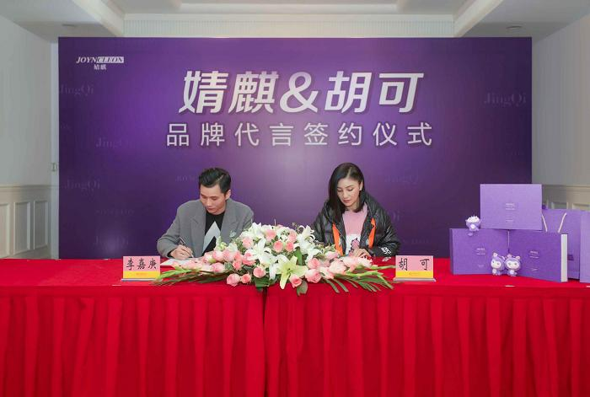
Meetings :assemblies; (collectively) participants; meetings;
会议:程序集;(集体)参与者;会议;
Negotiation is a noun meaning "negotiation; transfer; smooth passage".
谈判是一个名词，意思是“谈判;转移;光滑的通道”。
Presentation means "to show; to describe, state; to present; to give away"
Presentation的意思是“展示;来描述,状态;现在的;放弃”
Admission on personal matteers is generally defined as the admission of new students to individual schools and training institutions.
个人事务录取一般被定义为招收新生到个别学校和培训机构。

Slide 4
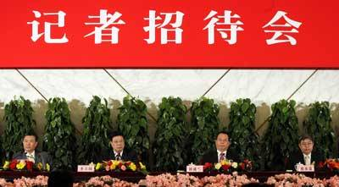
Press conference is an information and press event held by a government or a social organisation on a regular, occasional or ad hoc basis to release government policies or organisational information directly to the press and to explain major government or organisational policies and events.
记者招待会是指政府或社会团体定期、不定期或临时举行的资讯及新闻活动，目的是直接向新闻界公布政府的政策或机构资料，以及解释政府或机构的主要政策和活动。

Slide 5
Social etiquette (rituals in communication) as a culture is a symbol that people use to express friendship and goodwill towards others as they deal with interpersonal relationships in their social life. Speaking of manners can make a person moral, speaking of manners can create an ideal personal image, speaking of manners can make your career successful and speaking of manners can make society more stable. Etiquette is an important component of the quality of an individual and even a nation.
社交礼仪(交际礼仪)作为一种文化，是人们在社会生活中处理人际关系时，用来表达对他人友谊和善意的一种符号。讲究礼仪可以使人有道德，讲究礼仪可以塑造理想的个人形象，讲究礼仪可以使你的事业成功，讲究礼仪可以使社会更加稳定。礼仪是一个人乃至一个民族素质的重要组成部分。
Rituals
in communication

Slide 6
Social etiquette:
1.When talking to someone, your eyes should look squarely at each other. You can use hand gestures to help talk, but do not point your finger at each other, not to mention pointing your finger directly at each other, so as not to make people feel that you are rude and impetuous.
1.与人交谈时，眼睛要正视对方。可以用手势帮助说话，但不要用手指指着对方，更不要用手指直接指着对方，以免让人觉得你很粗鲁、很冲动。
2. When there are more than two people in a conversation, don't just talk to one of them and leave the others out. You should listen intently when others are talking, not look to the right or left, or frequently raise your wrist to look at your watch, and not to make careless and rude movements such as stretching or yawning.
2. 当谈话中有两个以上的人时，不要只和其中一个人说话，而把其他人排除在外。在别人说话时要专心听讲，不要左顾右盼，也不要经常抬起手腕看表，更不要做伸懒腰、打哈欠等粗心、不礼貌的动作。

Slide 7
3. If you are talking to someone of the opposite sex, you should pay more attention to being discreet and generous. If it is the first time, male guests generally do not touch on women's age, marriage, education and other "sensitive topics"; especially avoid talking about women's fat, thin, tall and short, otherwise it will be seen as low aspirations and lack of education.
3. 如果是与异性交谈，更要注意谨慎、大方。如果是第一次，男客人一般不要触及女性的年龄、婚姻、学历等 "敏感话题";尤其要避免谈论女性的胖瘦、高矮，否则会被视为志向低下、缺乏教养。

Slide 8
4. If you need to leave during a conversation, you should apologise to the other person before leaving. If you see someone leaving the group for an individual conversation, it is generally not advisable to listen in. If there is an urgent need to interrupt the other party, you should first say "sorry for the interruption" and leave as soon as possible after you have finished interrupting.
4. 如果在谈话过程中需要离开，应在离开前向对方道歉。5.如果看到有人因个别谈话而离开群体，一般不宜旁听。如果急需打断对方的谈话，应先说 "对不起，打扰了"，打断完后尽快离开。
5. If you are not a close friend or relative, it is not advisable to ask about the other person's personal affairs, and do not pursue the other person if you find that he or she has a subject that he or she does not want to mention. As this is a conversation, it is important not to be in a position where one person is talking incessantly. If there is a difference of opinion, as long as it is not a major right or wrong, you should not argue with the other person to the point of being red-handed, so as not to upset the table.
5. 如果不是亲朋好友，就不宜过问对方的私事，如果发现对方有不愿提及的话题，也不要追问。既然是谈话，就不要处于一个人滔滔不绝的状态。如果有不同的意见，只要不是大是大非，就不要和对方争论到面红耳赤的地步，以免扰乱桌面。

Slide 9
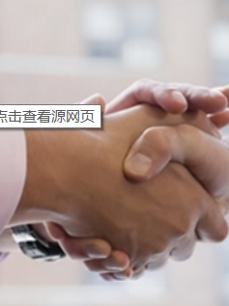
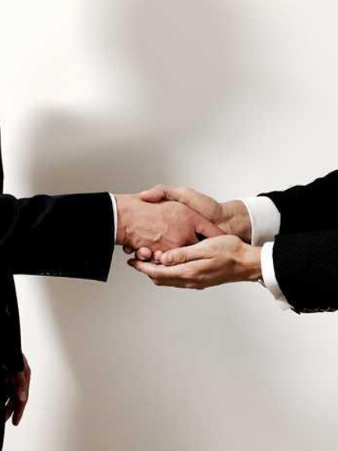
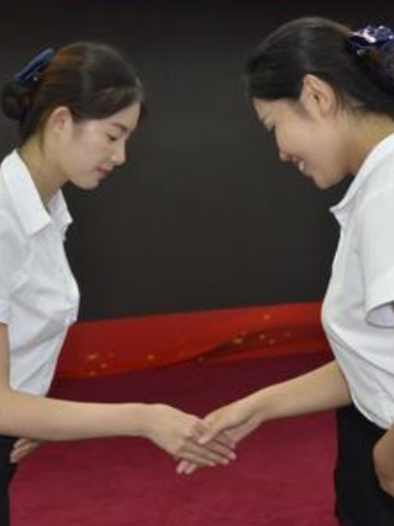

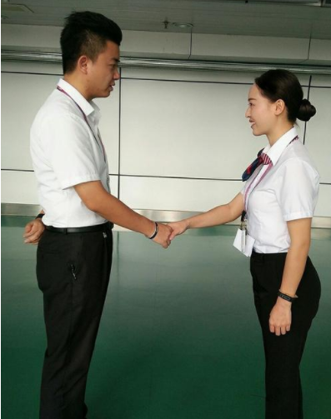
握手礼仪也是交际礼仪的一种，不同的人握手的礼仪不同，从下面的图片可以看出。
Handshake etiquette is also a form of communicative etiquette in which different people shake hands with different etiquette, as can be seen in the following pictures.

Slide 10
THANK YOU

