Slide 1
Evolution of communication: 交流的演变：
From language culture to multimedia
从语言文化到多媒体
Development of communications facilities
发展通讯设施

Slide 2
First, from language and culture to multimedia 一，从语言文化到多媒体
1. society, interpersonal communication is the basic condition of language evolution
Social and interpersonal communication is the basic condition of language evolution. With the development of society, new things and new concepts emerge in endlessly. People's thinking is more and more complicated. These will put forward new requirements to communication, promote the continuous enrichment of vocabulary and improve grammar.
1、社会 、人际交流是语言演变的基本条件
社会、人际交流是语言演变的基本条件随着社会的发展，新事物、新概念层出不穷人们的思维愈来愈细致复杂，这些都会向交际提出新的要求，推动语言的不断丰富词汇，改进语法。

Slide 3
2. from the comparison between modern Chinese and ancient Chinese, it can be seen that although some ancient words also died out because of the disappearance of many things in ancient times, with the emergence of more new things, a large number of new words continue to appear, such as "mobile phone "," short message "," email" and so on. In addition, there are also a variety of sentence-making format.
2、从现代汉和古代汉语的比较中可以看出，虽然由于古代许多事物的消失，一些古词也随之消亡了，但随着更多新事物的出现大量的新词不断出现，如“手机”、“短信”、“电子邮件”等，词的语音形式也从单音节过渡到双音节为主并出现了大量的多音节。此外，还有组词造句的格式也多样化了。

Slide 4
The Interaction of Various Factors in Language and the Evolution of Language 语言中各种因素的相互影响和语言的演变
The way of language development is determined by the interrelation of various factors within the language system, and has no direct connection with social development. As a system, the internal elements are in a balanced state to maintain the stability of the whole system. If one of the factors changes for reasons such as new expression needs, it will destroy the original balance, and other factors related to this change will readjust the relationship to achieve a new balance.
语言发展的方式，是由语言系统内部各种因素的相互关系决定的，与社会发展没有直接的联系。语言作为系统，内部各要素相互处于一种平衡的状态，才能保持整个系统的稳定性。如果其中一种因素为了新的表达需要等原因而发生变化，就会破坏原有的平衡，而此时与这种变化有关的其他因素就会重新调整相互的关系以达到新的平衡。

Slide 5
The gradual change and imbalance of language development make language not only meet the needs of society, but also ensure the stability of the foundation and keep the development and stability of language balanced.
语言发展的渐变规律和不平衡规律使语言既能不断满足社会需要，又能确保基础的稳固、使语言的发展和稳定始终维持着平衡的态势。

Slide 6
Translation of language 语言的化分
I. Language Differentiation with Social Differentiation
Social dialects: small community language differences among residents living in the same area due to social factors such as age, sex, occupation, education, class, etc
Regional dialects: branches of the same language in different regions
kinship language: several separate languages differentiated from the same language
一、 语言随着社会的分化而分化
社会方言:在同一地区居住的居民因年龄性别、职业、文化程度、阶级等的社会因素的不同而产生的小社团语言差异
地域方言:同一语言在不同地域的分支
亲属语言:从同一种语言分化出来的几种独立的语言

Slide 7
Classification 分类
Gender variants in 1. languages
a language variant produced by the speaker due to gender differences.
Different physiological characteristics; different norms of behavior, dress and etiquette
1、语言的性别变体
说话人因性别上的不同而产生的语言变体。
生理特征不同;行为、服饰、礼节方面的规范不同

Slide 8
Age variant of 2. language
Language variants produced by age differences
Individual age variants
Age variants of population
2、语言的年龄变体
由人们年龄上的差别而产生的语言变体
个人的年龄变体
群体的年龄变体

Slide 9
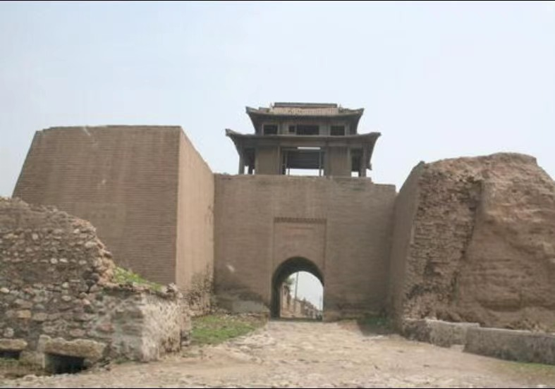
II. Development of communication facilities 二 、发展通讯设施
I. Ancient communication tools
1. horses, post stations:
In ancient times, the post was for the government, but also for the private,
Another is through the merchant.
一 、古代通讯工具
1、马匹、驿站：
古代的驿站是为官府传递公文，同时也为私人传递信件，
再有就是通过商人传递。

Slide 10
2. Flying Pigeon:
Flying pigeon biography (the wild goose biography is the same meaning, but the pigeon is smarter),
It is to tie letters to pigeons and send them to their destination
2、飞鸽传书：
飞鸽传书(鸿雁传书是一个意思,只不过是鸽子更聪明点)，
就是将书信系在鸽子身上，把书信送到目的地

Slide 11
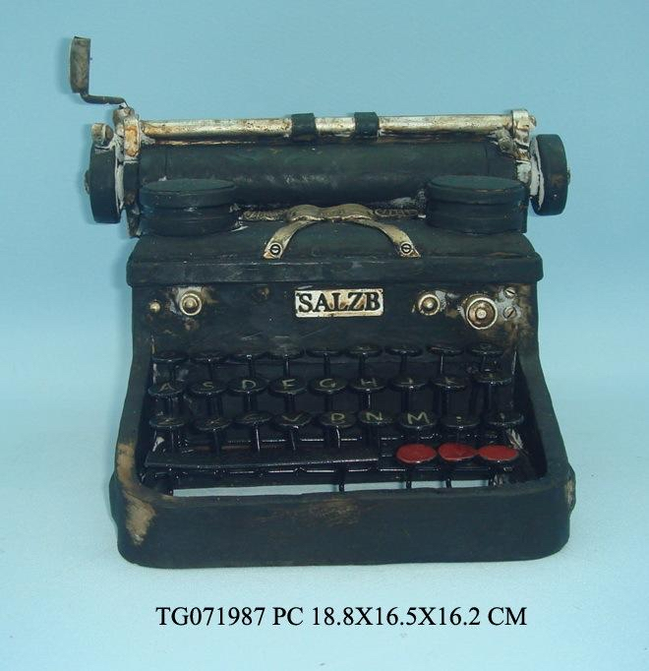
II. Modern communication tools
1. telegram:
Telegram was the first form of electricity used to transmit information
Reliable instant long - distance communication,
It was developed in Britain and the United States in the 1830s.
二、现代通讯工具
1、电报：
电报是一种最早用电的方式来传送信息的、
可靠的即时远距离通信方式，
它是19世纪30年代在英国和美国发展起来的。

Slide 12
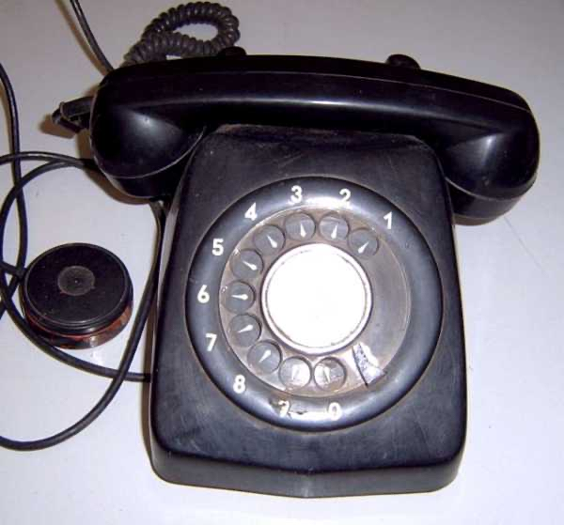
2. Tel:
A telephone is a remote communication device that can transmit and receive sound
2、电话：
电话是一种可以传送与接收声音的远程通信设备

Slide 13
II. The Internet 二、互联网
The Internet began in 1969 in the United States. Usually internet refers to the Internet, while Internet refers to the Internet. This method of connecting computer networks to each other can be called "network interconnection ". On this basis, a global interconnected network covering the world, called the Internet, is a network structure connected together.
互联网始于1969年美国的阿帕网。通常internet泛指互联网，
而Internet则特指因特网。这种将计算机网络互相联接在一起的
方法可称作“网络互联”，在这基础上发展出覆盖全世界的全球
性互联网络称互联网，即是互相连接一起的网络结构。

