Slide 1



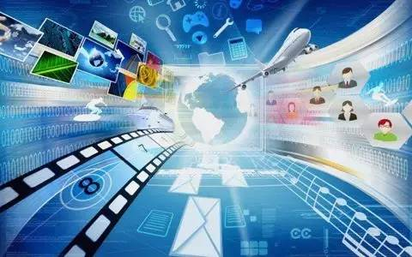

Information society

Slide 2
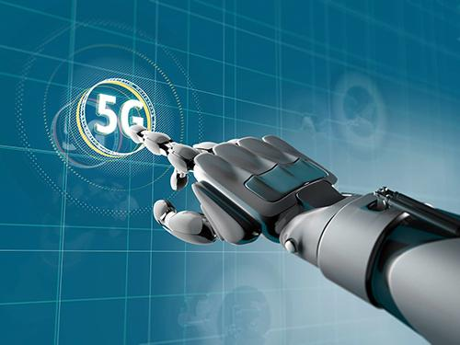
The meaning of information society
Information society, also known as information society, is a society in which information will play a major role after it is divorced from the industrialized society. The socalled information society is a new society based on electronic information technology, with information resources as the basic development resources, with information service industry as the basic social industry, and with digitization and networking as the basic way of social communication.

Slide 3
The main characteristics of information society
1. Characteristics of social concept
(1) The value of respecting knowledge has become a social fashion;
(2) People in the society tend to create the future more actively.

Slide 4
2. Social, cultural and life characteristics
(1) Computerization and automation of social life;
(2) It has a wide range of longdistance fast communication network system to provide all kinds of data centers with fast and convenient remote access;
(3) The diversification and individuation of life mode and culture mode are strengthened;
(4) The free time and space for personal activities have been greatly increased.

Slide 5
3. Characteristics of economic field
(1) The structure of the labor force has changed fundamentally, and the number of people engaged in information occupation is absolutely superior to that of other departments;
(2) In the gross output value of the national economy, the output value created by information economy has an absolute advantage over that created by other economic sectors;
(3) Energy consumption is low and pollution can be controlled;
(4) Knowledge has become a huge resource for social development

Slide 6






Slide 7
The current situation and problems of information society
In the era of traditional media before the birth of the Internet, newspapers, radio and television are the main carriers of information dissemination. By playing the function of agenda setting, they screen information and pass some information to the audience. With the popularity of network communication, the information in the online era presents the characteristics of complexity, diversity, viral transmission, large quantity and easy to receive, which also exposes a series of problem.

Slide 8

Thank you teacher
Team members：
1. Sun Chang Ming+Owen 2. Hu Xiao+barry
3. Li Chuang+Thor 4.Guo Song+Ade
5.Chu Honggui+Hogen 6.Liu yang+Tom

