Slide 1
Social and communicative technologies in professional activities HOMEWORK
Nuances of non-verbal communication in different national culture
Reporter: Zhao Wenlong(Bruce)
XU Lulu(Bonny)
Zhu Huaxing(Danes)
Wei Feng(Max)
Tian Zhiwen(Kevin)
Zhang Shuai(James)

Slide 2
01
Classification and communicative function of nonverbal communicative acts
02
Cultural differences in nonverbal communication behavior
CONTENT
03
Our Inspiration

Slide 3
PART.01
Classification and communicative function of nonverbal communicative acts

Slide 4
Classification of nonverbal communicative acts
01
chronemics
05
physical appearance
02
proxemics
06
oculesics
03
kinesics
07
paralanguage/vocalics
04
haptics
08
olfactics

Slide 5
communicative function of nonverbal communicative acts
complementin
substituting
accenting
suggested
contradicting

Slide 6
PART.02
Cultural differences in nonverbal communication behavior

Slide 7
01
Time to use
Different point of view
02
Body behavior
03
Outward appearance

Slide 8
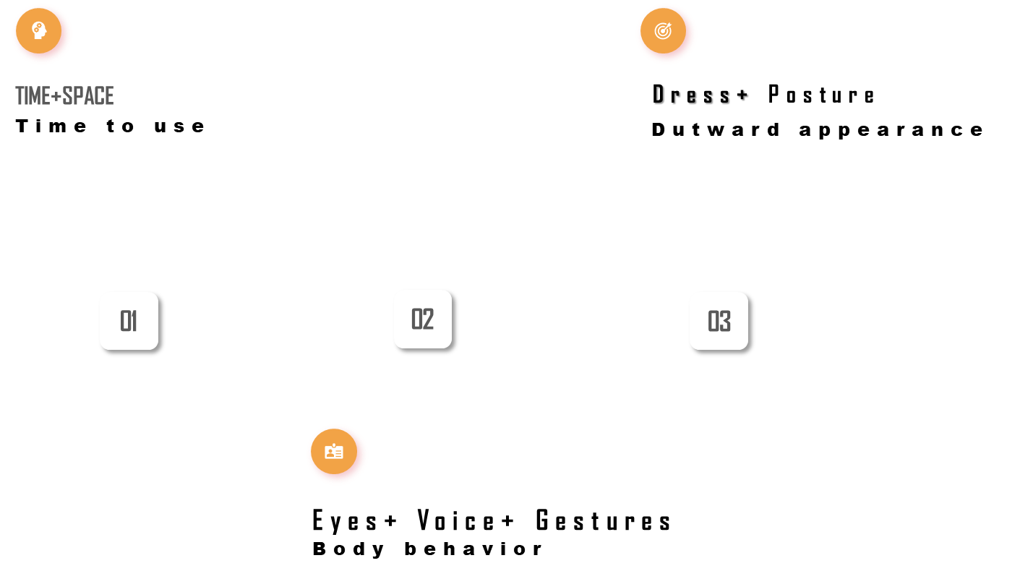
Different point of view

Slide 9
PART.03
Our Inspiration

Slide 10
Our Inspiration
Nonverbal communication acts play an important role in supporting verbal acts in intercultural communication. Successful verbal communication requires the tacit coordination of verbal communication and non-verbal communication. so In cross-cultural communication, we should be in the context of specific environment and to understand the nonverbal behavior, want to use the development view and study it, not only need to understand the language of others, it is more important is the ability to observe his silent signals, and be able to correct use of the language in different situations, through communication, through the running-in, feel the beauty and charm of alien culture in communication, only in this way, can only succeed smoothly in cross-cultural communication and communication.

Slide 11
PART.04
concepts

Slide 12
Dialogue
A conversation between two or more persons or a contact or meeting between two or more persons
Press conference
It is an information and news release activity held regularly, irregularly or temporarily by the government or a social organization, which directly releases government policies or organizational information to the press and explains the major policies and events of the government or organization.
Briefing
A briefing is a meeting at which information or instructions are given to people, especially before they do something
Presentation
It's an interactive question-and-answer ceremony for the release of information. Usually there are press conferences, new product conferences, media conferences and so on.

Slide 13
-2020
THANKS
Reporter: Zhao Wenlong(Bruce)
XU Lulu(Bonny)
Zhu Huaxing(Danes)
Wei Feng(Max)
Tian Zhiwen(Kevin)
Zhang Shuai(James)

