Slide 1
The Development of Advertising Dissemination
Mode and channel of transmission and modern influence
Reporter
：Guo Yuanhao

Slide 2
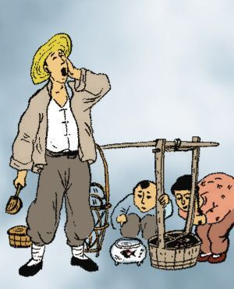
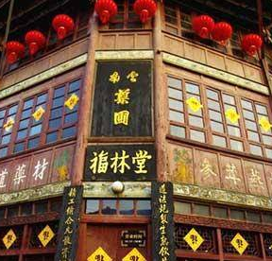
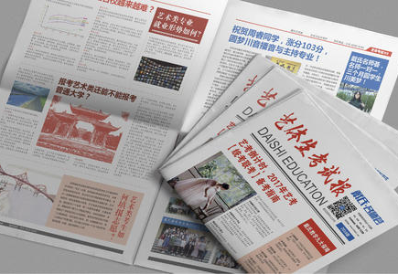
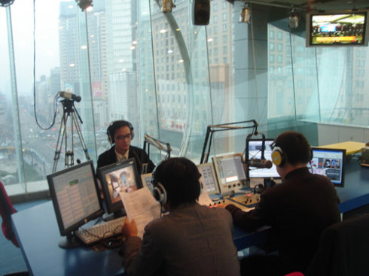
Advertising Development:
1. Ancient times -- physical advertising and hawking
The most primitive method is to display items in the booth with rhythmic slogans as advertisements.
2. Brand name -
originated in the ancient Roman Empire and used a brand name as an advertisement for a circus.China also experienced this period, such as the appearance of signboard advertisements in the Song Dynasty, which were called "hanging banners" in the Song Dynasty,
3, modern advertising - newspaper leaflets
After the emergence of printing in various countries, this stage of paper communication began.
4, Modern communicationmodern
The use of telecommunications technology to transmit information, through television, radio, network and other advertising dissemination.

Slide 3

The composition of advertising communication:
The basic elements of the advertising communication process include: information source, coding process, information, communication channel (channel), decoding process, audience, feedback, noise.
From the perspective of communication, the cooperation between advertisers and advertising agencies (production companies) and advertising media does not mean that advertising activities can be completed. Only after the participation of consumers can advertising become a complete activity.

Slide 4
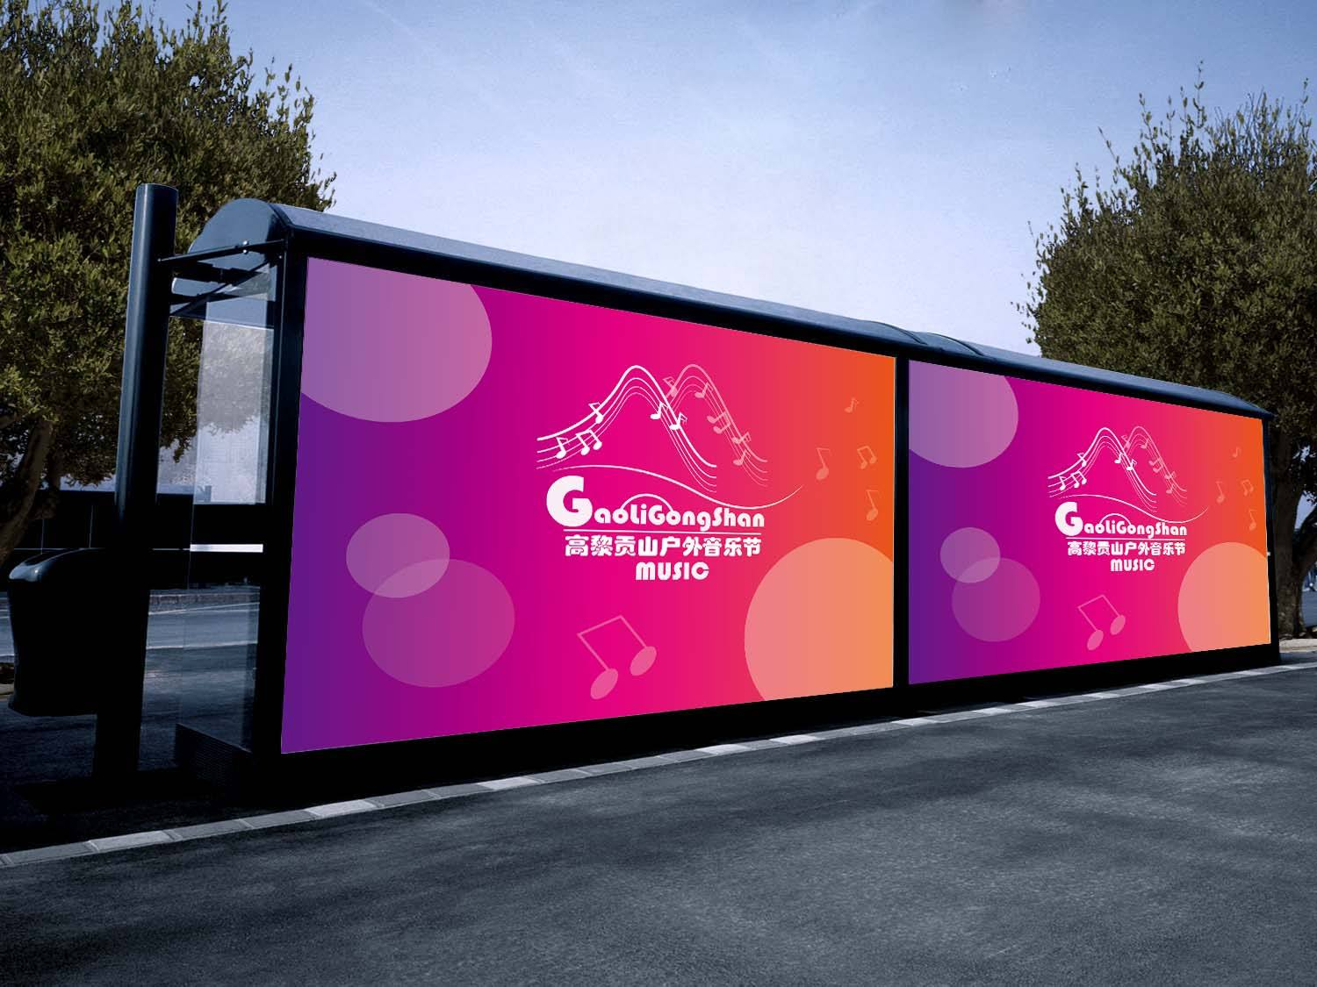
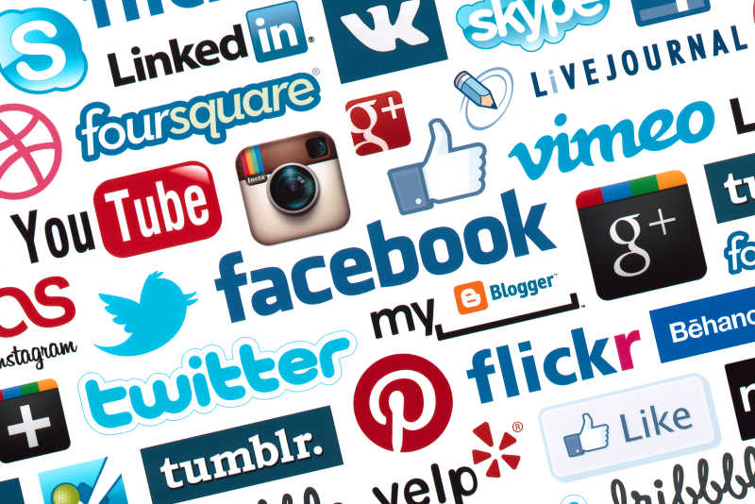
The evolution of advertising
Leaflets: targeted, opportunities to contact groups,
Newspaper: static display, the content tends to be rational and official, and the performance ability of pictures is insufficient.
Magazines: better aesthetic feeling and visual sense, more targeted.
Magazine readers are more culturally and socially advanced,
Billboards (subway stations, elevators, bus stations) : they generally harvest attention by visual impact, with limited coverage and low transmission efficiency
Radio: relatively simple, the audience group is very wide, and the audience has interaction, partial emotional, strong appeal, but the memory is relatively poor.
Television: it is easier to be remembered by the audience by the way of viewing and audio-visual display. It has a certain ability to guide, but the cost is very high.
Network media: the most representative new media fastest, most comprehensive and most open communication mode, including sound, video, text and picture, and equipped with the conditions for communication.

Slide 5

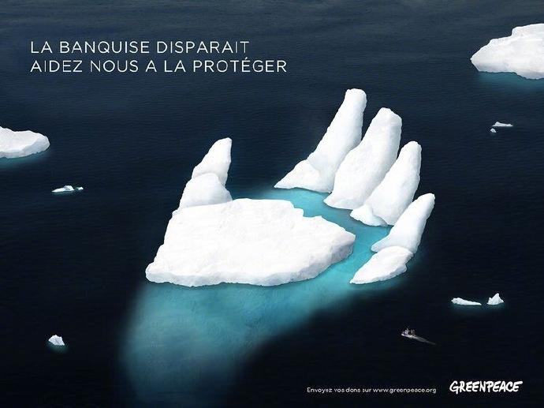
Pattern： roughly two kinds
1. Non-for-profit: it is used by the government and the government to issue social notices, update policies, publicize public welfare, spread and carry forward spiritual culture and ideas, and guide the social direction.。
2, profitability: for the main advertiser of the related commodities, ideas and other aspects of advertising information communication, as a for-profit enterprise is to pursue the enterprise information as soon as possible to the potential target audience, to achieve product sales, the goal of profit.

Slide 6

The influence of advertising
1. Promotional function: strengthen the existing needs and desires of consumers, and enable them to perceive and understand the advertising information.
2. Persuasion function: enhance consumers' feelings and emotions and make them prefer a certain product.
3. Enhanced functions: to ensure consumers' purchase decisions, which are often used to ensure small purchases of certain products or services.
4, prompt function: trigger consumers' habitual purchase behavior, often is the product that consumers often buy.

Slide 7

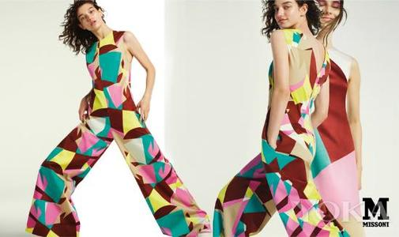
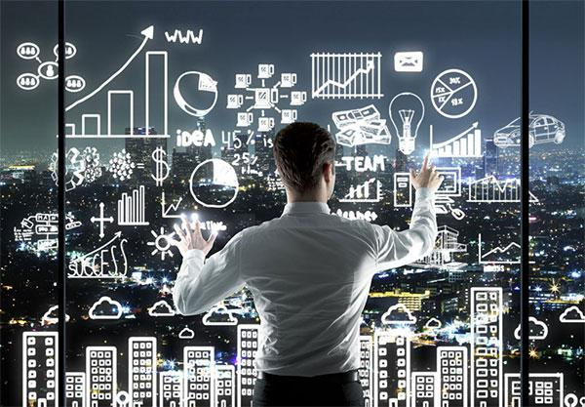
Modern Advertising
1, more inclined to show the use of product taste, temperament and quality of life mood, not only by the performance of the product to attract customers,
2. In addition, the brand will be endorsed with the help of star aura or virtual images, making good use of consumers' empathy.
3, give full play to the innovation ability, create gimmicks, attract the attention of consumers, sometimes combined with real-time social events, public opinion,
4, through modern technology, big data analysis, to the appropriate groups for advertising, precise positioning, more efficient.
With the power of an idol
Taste to attract
Analyze potential customers

Slide 8
Thank you for viewing!
Guo Yuanhao

