Slide 1
FITNESS
The problems of studying training loads used in sports and their impact on the athlete's body.
研究运动中训练负荷的问题及其对运动员身体的影响。
Team members：Hu Xiao

Slide 2
1、Load intensity is the tension degree of each functional system when the organism completes the exercise effectively. The energy consumed per unit time to complete the exercise is a comprehensive index reflecting the work intensity. To a great extent, load intensity determines the direction and extent of exercise on Athletes' organism. It plays a more important role in organism adaptation than load.
Exercise load
1、负荷强度是有机体有效完成练习时各机能系统活动的紧张程度，单位时间内完成练习所消耗的能量是反映工作强度的综合指标。负荷强度在很大程度上决定练习对运动员有机体的作用方向和程度。对有机体的适应影响起着比负荷量更为重要的作用。
2、Load intensity determines the nature of energy supply. Mobilize each organ system to participate in the exercise and form the movement coordination structure. Changing the load intensity can change the way of energy supply and the activity degree of each functional system, which will have a positive impact on the formation of basic parameters of sports technology. Therefore, the selection of exercise load intensity determines the adaptive characteristics of energy supply system.
2、负荷强度决定了能量供应性质。动员参与练习的各个器官系统以及形成动作协调性结构。改变负荷强度可以改变能量供应的方式，改变各机能系统活动的程度，会对运动技术基本参数的形成产生积极影响。因此，运动负荷强度的选择决定了能量供应系统的适应特点。

Slide 3
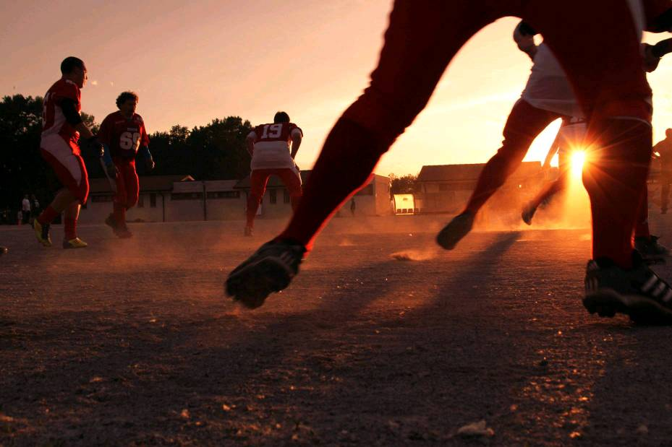
Match of exercise load and intensity
运动负荷量和强度的搭配
The response of load amount and load intensity to organism stimulation is different. Organism's response to load Generally speaking, the reaction is not strong, and the degree of adaptation is relatively low. If an organism can bear a greater strength, it can bear a greater amount to a lesser extent, and if an organism can bear a greater amount, it can bear a greater strength to a lesser extent.
负荷量和负荷强度对有机体刺激所引起的反应是不同的。有机体对负荷量的反应一般来说不强烈，比较缓和所产生的适应程度比较低。有机体能承受较大的强度，就能承受较小程度的较大的量，有机体能承受较大的量，就能承担较小量的较大强度。

Slide 4
Control load
Reasonable control of load and load intensity. In sports training, it is generally the first load, in the amount of product Gradually increase the load intensity on the basis of accumulation. When the strength is increased, the load is reduced appropriately. When the body of an athlete is economized, the load will be increased, and the load intensity will be reduced, so as to gradually upgrade and continuously improve the level of sports training. If the load and load intensity increase at the same time, not only the whole exercise load can not be added, but also overtraining is easy to occur. In a training cycle, the arrangement of load and load intensity should present a wave like fluctuation.
Control the intensity of the load
Control the amount of load
控制负荷的强度
控制负荷的量
合理的控制负荷量和负荷强度。在运动训练中一般是先上负荷量，在量的积累的基础上，逐渐加负荷强度。在上强度时，负荷量又适当降低。当运动员机体产生节省化现象后，再加负荷量，负荷强度又适当降低，这样逐步升级，不断提高运动训练水平。如果负荷量和负荷强度一直同时增加，不但整个运动负荷加不上去，而且容易产生过度训练，在一个训练周期中，负荷量和负荷强度的安排要呈现出波浪式的起伏状态。

Slide 5
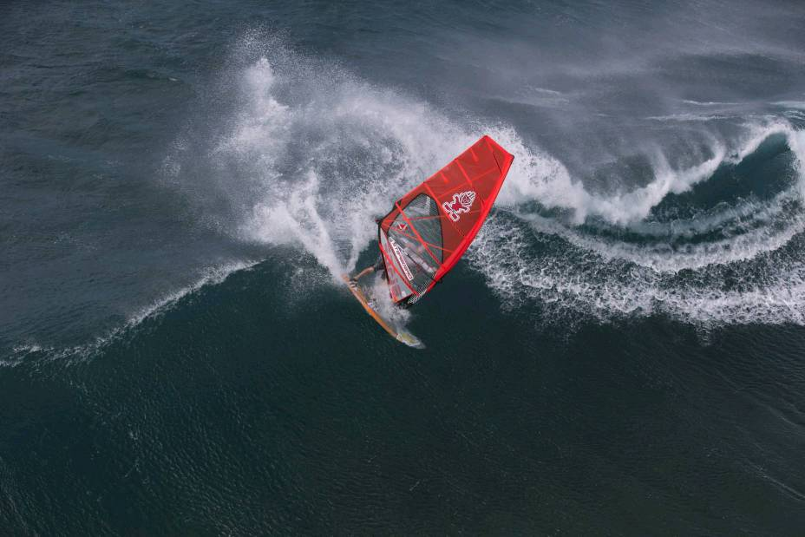
Exercise load of sports training
Exercise load is the most active factor in sports training, which should be carried out from beginning to end. Athletes can How much exercise load can and should bear, and how to bear it, and how to control it scientifically in the whole training process. These are the problems that need to be considered in sports training. To make clear the importance of sports load in sports training is of guiding significance for future teaching and training. At the same time, it plays an important role in sports training to control the match and implementation of exercise load and intensity.
运动负荷是运动训练中最为活跃的因素，应该贯彻训练的始终。运动员能够和应该承受多大的运动负荷，又如何去承受这一负荷，并在整个训练过程中对其实施科学的控制。这些都是运动训练需要考虑的问题，明确运动负荷在运动训练中的重要性，对于在以后的教学和训练中具有指导性的意义。同时，控制好运动负荷与运动强度的搭配、实施对于运动训练起着重要作用。

