Slide 1
Methods of research of respiratory systems 呼 吸 系 统 研 究 方 法
Determination of PWC170
PWC170的测定
Wu Hao Physical culture and sport.

Slide 2
呼吸系统介绍：
respiratory system:
Respiratory System, the general term for a series of organs in which the body exchanges gas with outside air, including the nose, pharynx, throat, trachea, bronchial tubes, and lungs made up of large amounts of alveoli, blood vessels, lymphatic tubes, nerves, and pleural tissues. Clinically, the nose, pharynx and throat are often referred to as the upper respiratory tract, and the gas passages below the trachea (including the bronchial tubes at all levels of the lungs) are called the lower respiratory tract
呼吸系统（Respiratory System），人体与外界空气进行气体交换的一系列器官的总称，包括鼻、咽、喉、气管、支气管及由大量的肺泡、血管、淋巴管、神经构成的肺，以及胸膜等组织。

Slide 3
The energy required by the human body in the process of metabolism in the new city is obtained through oxidation of nutrients in the body, for this reason, the human body must constantly ingest oxygen from the outside world, while constantly excluding the carbon dioxide produced in the body.
人体在进行新城代谢过程中所需要的能量，都是通过氧化体内的营养物质而获得，为此，人体必须从外界不断的摄取氧气 ，同时不断地的将体内所产生的二氧化碳排除体外。

Slide 4
Determination of PWC170 PWC170的测定
Is a functional experimental method of quantitative exercise. It indicates the power that the body can accomplish in unit time when the care rate reaches 170 times per minute. the relationship between heart rate and power to evaluate the individual cardiopulmonary function and the level of physical exercise and training.
是一种功能性的定量运动实验方法。它表示当护理率达到每分钟 170 次时，身体在单位时间内能够完成的力量。心率与能力的关系，以评估个人心肺功能与体育锻炼和训练水平

Slide 5
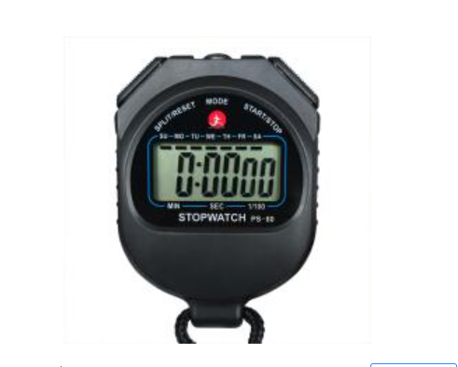
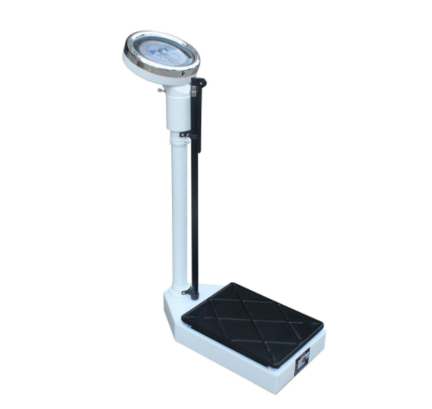
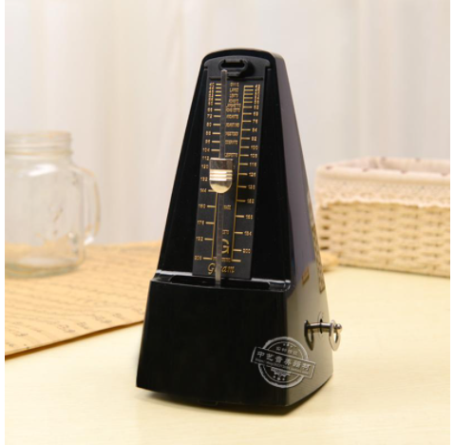
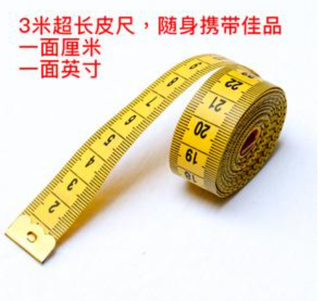
[equipment]设备;
weight meter, stopwatch, metronome, step, meter

Slide 6
[steps]测试步骤
(1) The experiment was conducted by 4 people in a group, one person for testing, one for time, one for heart rate and one for recording.
实验由4人一组进行，1人进行测试，1人进行时间测试，1人进行心率测试，1人进行记录。

Slide 7
[steps]测试步骤
(2) Weigh the weight and measure the height of the steps with a meter (about 25-45cm).
（2） 用一米（约25-45厘米）称重和测量台阶的高度

Slide 8
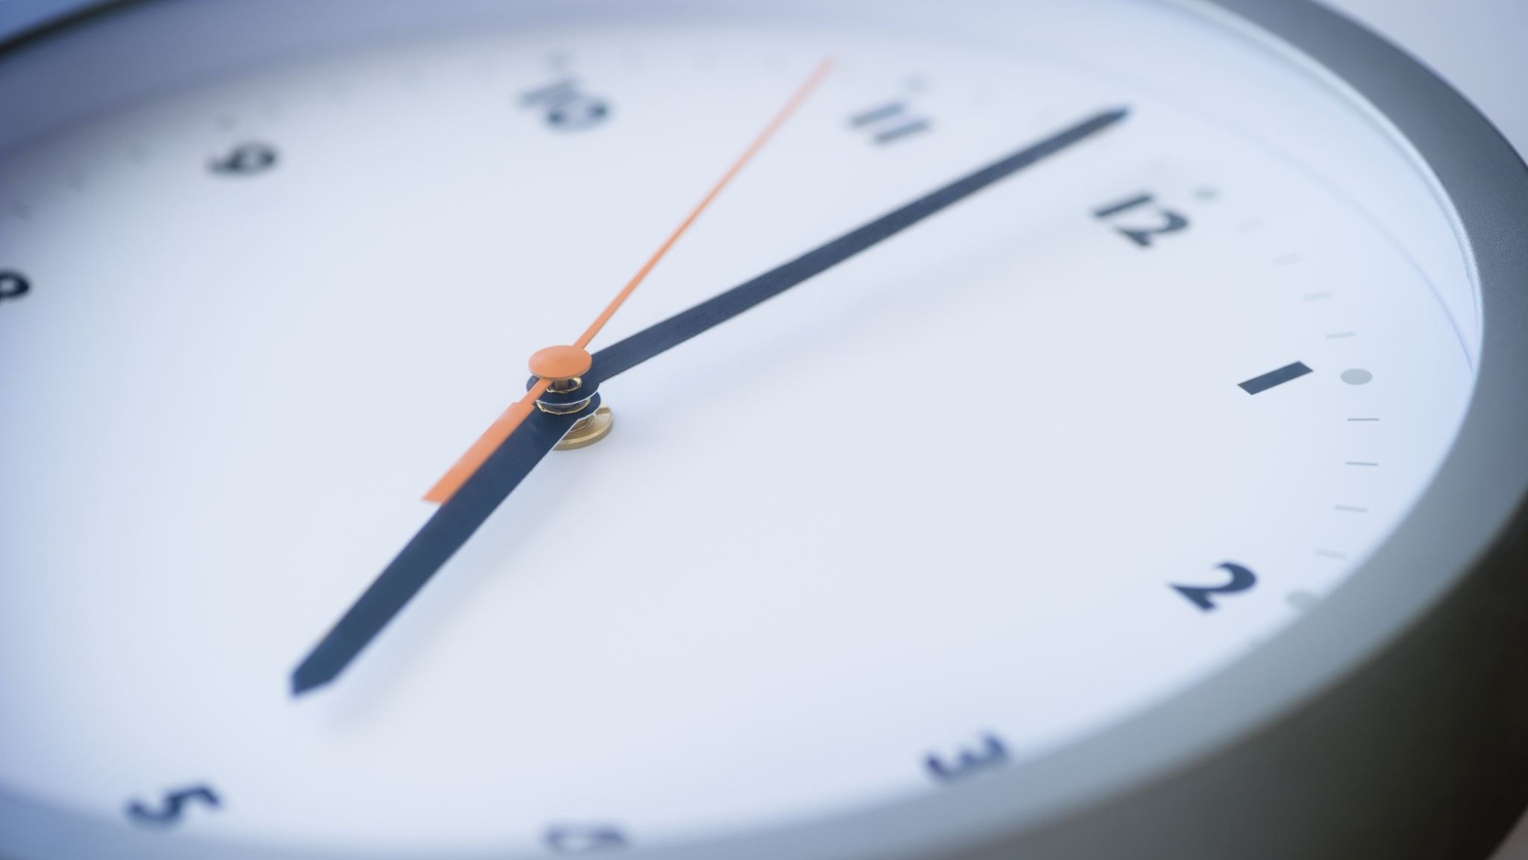
[steps]测试步骤
(3) The frequency of the metronome was adjusted to 30times / minute, and the subjects stood in front of the steps to prepare, and the tester took the stopwatch to prepare the time.
节拍器的频率调整为30次/分钟，受试者站在准备的步骤前，测试者用秒表准备时间。
第一次测试台阶高度为30厘米

Slide 9
[steps]测试步骤
（4） The tester prompts "preparation start". The subjects shall step up and down the steps according to the rhythm of the metronome. The action shall be carried out according to the requirements, and the subjects shall continue to go up and down for 5min.
测试者提示"准备开始"。受试者应根据节拍器的节奏上下步。行动按照要求进行，主体继续上下5分钟。
Test the heart rate data in 10 seconds, multiply by 6, and remember the heart rate at this time
在 10 秒内测试心率数据，乘以 6，并记住此时的心率

Slide 10
[steps]测试步骤
(5) The subjects took a three-minute break for a second load test. Adjust the step height to 45 cm and perform a second load test in the same manner.
受试者休息了三分钟进行第二次负荷测试。将步高度调整到 45 厘米，并以同样的方式进行第二次负载测试。

Slide 11
[steps]测试步骤
6) Clean up the instrument.
清理仪器。

Slide 12
computing method

Slide 13
Interpretation（解释）
W1 is the power of the first load (KGM / min)
W2 is the power of the second load (KGM / min)
P1 is the heart rate of the first load (beats / min)
P2 is the heart rate of the second load (beats / min)
W1是第一个负载的功率（KGM/分钟） W2是第二个负载的功率（KGM/分钟） P1是第一个负载的心率（节拍/分钟） P2是第二个负载的心率（节拍/分钟

Slide 16
In the whole course of the experiment, combined with the calculation method, it is not difficult to find three variables: namely, weight, the tester can bear weight;
延申：在整个实验过程中，结合计算方法，不难发现可变量有3个：分别是,体重，测试者可以负重；其次就是高度；可改变台阶高度；最后就是频率 。

