Slide 1
Teaching Method of Integrated Control in Sports
运动中综合控制的教学法
Reporter: Zeng Lin, Li Zhengrui
汇报人：曾林 李政锐

Slide 2
01
Control competition and training impact
控制竞争和培训影响
CONTENT
目录
02
Control the athlete's readiness
控制运动员的准备状态
03
Control environmental factors
控制环境因素

Slide 3
The first part
第一部分
Control competition and training impact
控制竞争和培训影响

Slide 4
Control competition and training impact
控制竞争和培训影响
1.Control the outcome of a match
控制比赛结果
Evaluate the validity of performance over a certain (usually one year) training cycle. An athlete is considered athletic if his performance fluctuates within a 2-3% range.
评估某个（通常为一年）训练周期中比赛表现的有效性，如果运动员的比赛成绩波动在2-3％的范围内，他就处于运动状态。
2.Measure and evaluate the effectiveness of competitive activities
衡量和评估竞争活动的有效性
Modern measurement and computer technology can record many different indicators of competitive exercise and competitive activity.
现代测量和计算机技术可以记录竞争锻炼和竞争活动的许多不同指标。

Slide 5
The main contents of integrated control and its types
Multiple set control 多种集成控制 | Control the direction
 | Control competition and training impact （SD) 控制竞争和培训的影响 |  | Control the physical condition and health of the athletes 控制运动员的身体状况和健康状况 | Control environmental factors 控制环境因素
 | Control of competitive activities 控制竞争活动 | Control training activities 控制培训活动
staged 上演 | A. Measure and evaluate various indicators during the competition and complete certain preparation stages B. Analyze the dynamics of SD indicators in all stages of the competition a.在比赛中测量和评估各种指标，完成一定的准备阶段 b.分析所有阶段比赛中SD指标的动态 | A. Construct and analyze load dynamics in the preparation phase B. Summize the load of all indicators in the phase and determine their ratios a.在准备阶段构造和分析负载的动力学 b.总结阶段中所有指标的负载并确定其比率 | At the end of the preparation phase, control indicators are measured and evaluated under organized conditions 在准备阶段结束时，在有组织的条件下对控制指标进行测量和评估 | For climatic factors (temperature, humidity, wind, solar radiation), quality of stock, equipment, coverage of sports facilities, characteristics of competition and training tracks, skidding, spectator behavior, and objectivity of competition judging and its impact on sports competition and control of performance in training professions 对于气候因素（温度，湿度，风，太阳辐射），库存质量，设备，体育设施的覆盖范围，比赛和训练跑道的特征，滑行，观众行为以及比赛评判的客观性及其影响体育比赛和控制训练职业的成绩
The current 当前的 | Measurement and evaluation of in-competition indicators at the end of the training macro cycle 在培训宏观周期结束时进行的比赛中指标的测量和评估 | A) Construction and analysis of load dynamics in training microcycles; B) Determination of all characteristics of load summation microcirculation and its content a）训练微周期中负载动态的构造和分析； b）负荷总和微循环的所有特征及其含量的确定 | Perform registration and analysis of daily measurements of athlete readiness through systematic training courses 通过系统的培训课程对运动员准备情况的日常测量进行注册和分析
operation 操作 | Evaluate and evaluate performance in any competition 评估和评估任何比赛中的表现 | Measurement and evaluation of physiological and physiological characteristics of exercise load, series of exercises, training 运动负荷的生理和生理特性的测量和评估，系列运动，训练 | The measurement and analysis of index can fully reflect the state change of athletes after exercise and training 指标的测量和分析，可充分反映运动员在运动和训练后或之后的状态变化

Slide 6
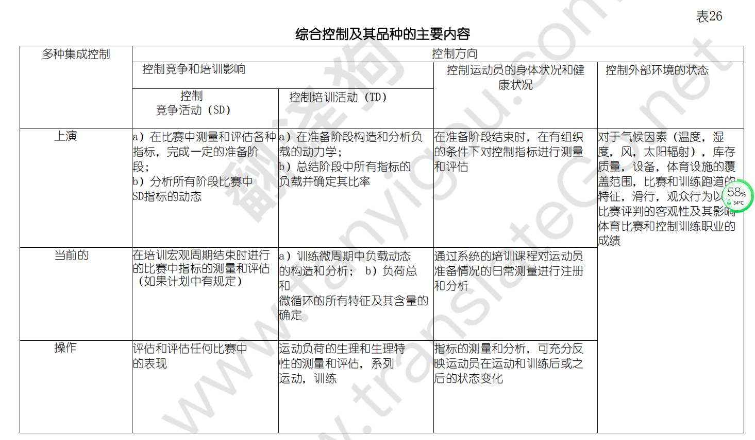

Slide 7
The second part
第二部分
Control the athlete's readiness
控制运动员的准备状态

Slide 8
During testing or during competition, the physical condition of the athletes is evaluated:
在测试过程中或比赛过程中，对运动员的身体状况进行评估：
01
Assess specific physical attributes: strength, speed, endurance and flexibility
评估特殊身体素质：力量，速度， 耐力和柔韧性
02
Assess technical and tactical readiness: monitor the use of skills and tactics by visual and instrumentation
评估技术和战术准备情况：通过视觉和仪器检测运动员技术和战术的运用情况
03
Assess mental state and behavior during the game
评估比赛中的心理状态和行为

Slide 9
The third part
第三部分
Control environmental factors
控制环境因素

Slide 10
AthLETES 'sports level is very high, but the performance is not ideal due to the influence of external factors (climate, sports venues and equipment, spectators and judges, food and accommodation, etc.). Only by evaluating the influence of these external factors on the process of competition and training activities, can we have a complete understanding of the athletes' preparation level.
运动员的运动水平很高，但因外部因素（气候、运动场地和器材、观众和裁判、饮食和住宿等）影响导致成绩不理想，通过评估这些外部因素对比赛和训练活动过程的影响，才可能完整地了解运动员的准备水平。
1.Information received from athletes (about health, attitudes towards what is happening, emotions, etc.)
从运动员那里获得的信息（关于健康，对正在发生的事情的态度，情绪等）
2.Information about the athlete's behavior (what competitive behavior was performed, how it was performed, technical mistakes, etc.)
有关运动员行为的信息（进行了哪些竞技行为，如何进行，技术上的失误等）
3.Data on the effects of emergency training (the magnitude and nature of competition under the influence of individual body loads)
有关紧急训练效果的数据（在单个身体负荷的影响下，竞争性的大小和性质）
4.Information on cumulative training effects (changes in athletes' physical fitness)
有关累积训练效果（运动员身体素质的变化）的信息

Slide 11
Thank you for listening to
感谢聆听

