Slide 1
运动员心理生理状况评估 Athletes psychological and physiological status evaluation
lihaotian
李浩天

Slide 2
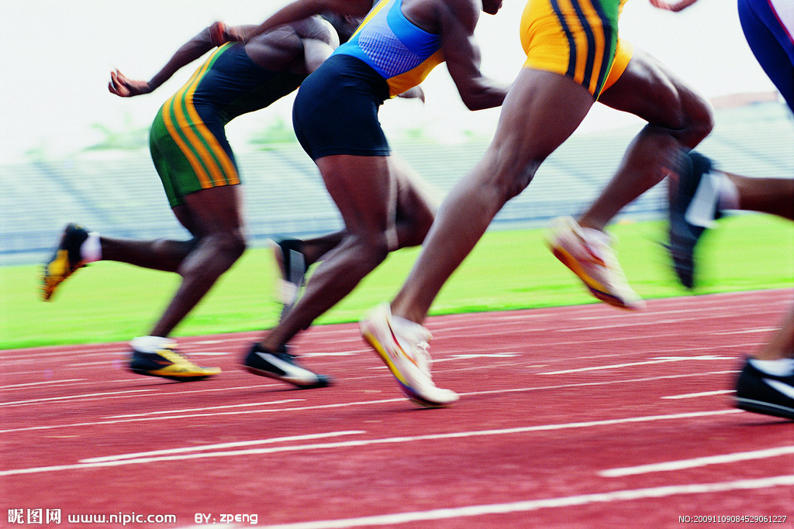
目录
实验目的
实验过程
实验结果
Purpose of the experiment
Experimental process
experimental result

Slide 3
实验目的
为了根据中枢神经系统的主要功能特征（兴奋性，反应性，活动性，反应稳定性）确定中枢神经系统的功能储备，根据TD。进行了视运动反应测试。
In order to determine the functional reserve of the central nervous system according to the main functional characteristics of the central nervous system (excitability, reactivity, activity, and reaction stability), according to TD. The visual motor response was tested.

Slide 4
实验过程
运动反应的时间取决于刺激物的特征，功能状态和受试者神经系统的个体型特征。
简单的视觉运动反应时间的顺序值的分布形状根据中枢神经系统 功能状态的变化而变化。这种对应关系使得可以确定三个定量标准， 这些定量标准表征了反映中枢神经系统功能状态的曲线形状的理论上可能的变化。
The time of motor response depends on the characteristics of the stimulus, the functional state and the Somatotype Characteristics of the subject's nervous system.
The order of simple visual motor response time changes according to the functional state of the central nervous system. This correspondence makes it possible to determine three quantitative criteria that represent theoretically possible changes in the shape of the curve reflecting the functional state of the central nervous system.

Slide 5
第一个标准是系统的功能级别（FUS）
它的值主要由反应时间的绝对值确定，并反映当前的功能在中枢神经系统的状态下，疲劳发展的程度受到环境因素的影响。
该指标的值越大，简单运动反应时间的值的可变性就越小。由于反应时间的变化是中枢神经系统状态持续波动的表现，因此UR指标被视为中枢神经系统状态稳定的标准。因此，UR指标越高，中枢神经系统的当前功能状态就越稳定。
第二个标准是反应的稳定性（SD）。
第三个标准是功能级别（UFB）
它最充分地表征了中枢神经系 统的状态，并允许人们判断其长期形成和维持相应功能状态的能力。

Slide 6
Its value is mainly determined by the absolute value of reaction time, and reflects the current function. In the state of central nervous system, the degree of fatigue development is affected by environmental factors.
The first criterion is the functional level of the system (FUS)
The greater the value of this index, the less the variability of the simple motion response time. Since the change of reaction time is the manifestation of continuous fluctuation of central nervous system state, ur index is regarded as the standard of stable central nervous system state. Therefore, the higher ur index, the more stable the current functional state of the central nervous system.
The second criterion is the stability of the reaction (SD).
It fully represents the state of the central nervous system and allows people to judge the ability to form and maintain the corresponding functional state for a long time.
The third standard is the function level (ufb)

Slide 7
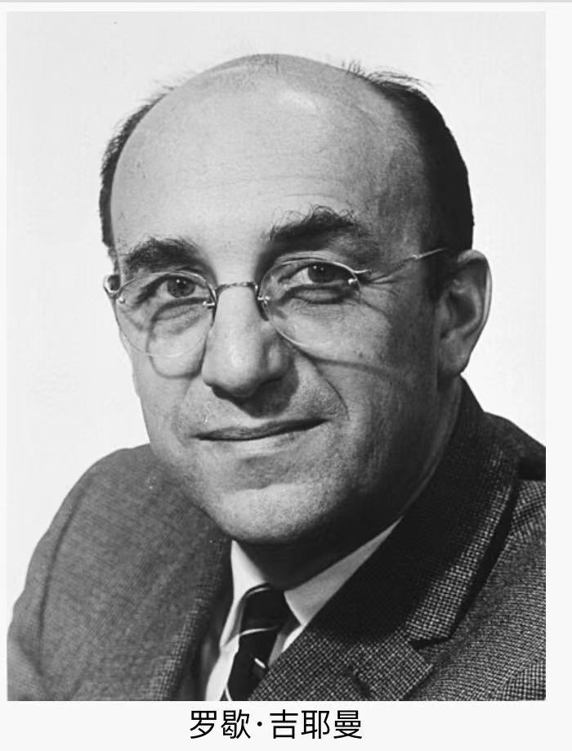
这项研究对于全面评估身体和心理情绪过度紧张的运动员的健康状况非常重要。
一般非特异性适应性反应的理论是基于由国内科学家L.Kh提出的离散的稳态调节系统的发现。哈卡维（L.B.）克瓦基纳（M.A.） 1975年的乌科洛娃（Ukolova）。该系统包括4种类型的反应，这些反应在相应强度的外部或内部刺激的影响下在体内发生。
这些反应之一是众所周知的-这是G. Selye在1936年发现的对强刺激的一般非特异性反应，他称之为压力。该反应是分阶段进行的，其特征在于神经内分泌系统的某些复杂变化，并影响生物体的非特异性抗性（稳定性）水平，炎症，流明电位和新陈代谢。

Slide 8
This study is very important for a comprehensive assessment of the physical and mental health of athletes with emotional stress.
The general theory of non-specific adaptive response is based on the discovery of discrete steady-state regulation system proposed by domestic scientist L. Kh. Ukolova of L.B. and M.A. in 1975. The system consists of four types of reactions, which occur in vivo under the influence of external or internal stimuli of corresponding intensity.
One of these responses is well known - this is a general nonspecific response to strong stimuli, which g. Selye discovered in 1936, and he called it stress. The response is carried out in stages, which is characterized by some complex changes in the neuroendocrine system, and affects the non-specific resistance (stability) level, inflammation, lumen potential and metabolism of organisms.

Slide 9
激活疗法
L.Kh详细发现并研究了生物体对较弱刺激的非特异性适应性反应。身体的反应不是通过加深压力，而是通过发展训练反应，而已经是较高的反应范围。生物反应性范围的存在解释了生物能够适应的广泛影响。生物体的一个重要特性解释了疾病自发地从疾病状态恢复为健康状态的原因，它能够从多种影响中选择最强的，而不是最有帮助的。正是这样，在实践中打开了在抗应激反应方向上实现所需变化的可能性，并使得有可能创建适当的技术，现在将其整体称为“激活疗法”。抵抗力是生物体体内稳态潜力的一种合适的，具有丰富信息的评估， 因为它本质上是定量的。
50. KH found and studied the non-specific adaptive response of organism to weak stimulus in detail. The body's response is not through deepening stress, but by developing training responses, but has been a higher range of responses. The existence of the biological reactivity range explains the wide influence that organisms can adapt to. An important characteristic of organism explains the reason why disease spontaneously returns from disease state to health state, and it can choose the most from many influences, not the most helpful. It is in practice that opens the possibility of achieving the required changes in the direction of the anti stress response and makes it possible to create appropriate technologies, now collectively referred to as "activation therapy.". Resistance is an appropriate and informative assessment of homeostasis potential in vivo, because it is essentially quantitative.

Slide 10
方法“简单的视觉运动反应”。简单的视觉运动反应（VEMR）是人们对 视觉刺激做出自愿反应的基本形式。一个简单的视觉运动反应包括两个顺序的成分：感觉（潜伏期）和运动期。潜伏期是感知和识别刺激信号 的时期。用前手进行感觉运动反应时，运动时间会缩短。
例如:在运动和训练期间，感觉运动反应时间稳定并减少0.03-0.05秒。视觉马达对红色刺激的反应时间短于对绿色刺激的反应时间.
反应时间取决于浓度的性质。在注意力集中的情况下，暴露于刺激与执行响应运动之间的时间会减少，在注意力集中的情况下，会增加时间
Methods "simple visual motor response". Simple visual motor response (vemr) is a basic form of voluntary response to visual stimuli. A simple visual motor response consists of two sequential components: sensory (latency) and motor. Latency is the period of perceiving and recognizing stimulus signals. When the forehand is used for sensorimotor reaction, the movement time will be shortened.
For example, during exercise and training, the sensory motor response time is stable and reduced by 0.03-0.05 seconds. The response time of visual motor to red stimulus was shorter than that to green stimulus
The reaction time depends on the nature of the concentration. In the case of concentration, the time between exposure to stimulus and execution of response movement will decrease, while in the case of concentration, the time will increase

Slide 11
感觉运动反应的时间取决于神经系统的类型学特征，主要取决于神经 过程的活动性及其平衡。
感觉运动反应的速度受身体功能状态的影响。在低功能状态下， 速度指示器会降低（而MWCH时间会增加）。
The time of sensorimotor response depends on the typological characteristics of the nervous system, mainly on the activity and balance of neural processes.
The speed of sensorimotor response is affected by the state of body function. In the low function state, the speed indicator will decrease (and the mwch time will increase).

Slide 12
调查结果
According to the results of the "simple visual motor response" method, we can draw conclusions about the characteristics and current functional state of the central nervous system, which can indicate the performance of the subjects and whether there are pathological changes. Neuroticism, temperament type, etc
根据“简单视觉运动反应”方法得出的结果可以得出有关中枢神经系统的特性和当前功能状态的结论，从而可以表明受试者的表现， 是否存在病理改变。神经性，气质类型等

Slide 13
为了确定神经过程的特性，有必要进行多次检查，以消除影响单 次检查的可能的外部因素。简单的视觉运动反应时间可以诊断神经 过程的活动性：反应时间越短，反应速率越高，神经系统的活动性 就越强。标准偏差指标可证明神经过程的平衡程度：标准偏差越小， 神经系统就越平衡。使用这种技术，还可以通过基于单独检查的结 果和一天中进行的几次检查的结果来分析反应时间指示器的动态， 从而诊断神经过程的强度。如果神经系统较强，则白天和一次检查 范围内的反应时间不会显着改变，而较弱的则会增加。
In order to determine the characteristics of the neural process, it is necessary to carry out multiple examinations to eliminate the possible external factors that affect the single examination. Simple visual motor reaction time can diagnose the activity of neural process: the shorter the reaction time, the higher the reaction rate, the stronger the activity of the nervous system. The standard deviation index can prove the balance degree of neural process: the smaller the standard deviation, the more balanced the nervous system is. With this technique, the dynamic of the response time indicator can also be analyzed based on the results of individual examination and several examinations conducted in a day, so as to diagnose the intensity of neural process. If the nervous system is strong, the response time in the daytime and once examination range will not change significantly, while the weaker will increase.

Slide 14
谢谢观看

