Slide 1
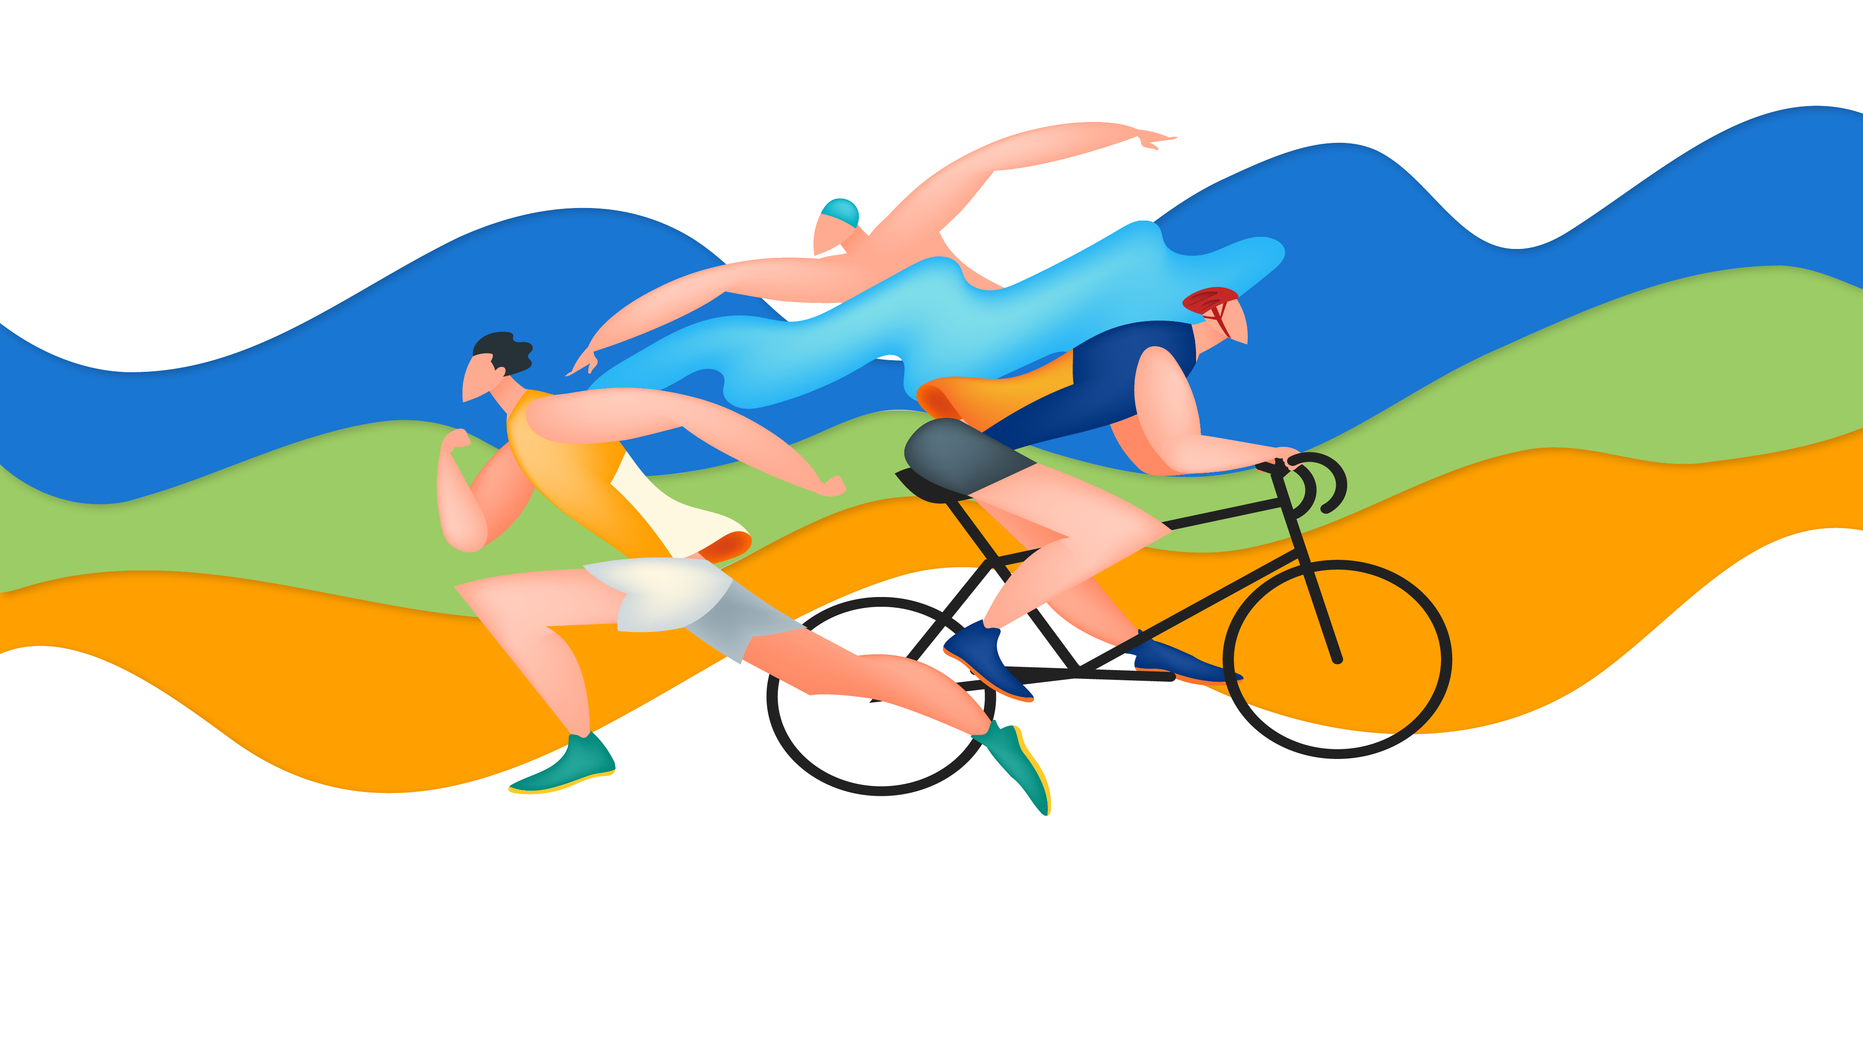
Research on functional ability of athletes
1.1Physical characteristics of athletes
运动员功能能力的研究 1.1. 运动员的身体特征
Reporter:Guo Yuanhao

Slide 2
Performance and Purpose:表现和目的
It is embodied in the overall response of the human body to the effects of environmental conditions (the content of physical activity), purpose is to maintain a relatively constant internal environment (homeostasis).
A person is influenced by two powerful factors - ecology - biology and
Society.
In turn, ecological biology has two vectors - ecological biology
And biology.
1. Select external factors in the environment, such as sea level and gravity
2. biological（It includes endogenous factors） such as genetics, sex, and biological age
它体现 在人体对环境条件影响的全部反应中（体育活动的内容），目的
是保持人体内部环境的相对恒定（体内平衡）一个人受到两个强大因素
的影响-生态-生物和 社会。反过来，生态生物学有两个向量-生态生物学
和生物生物学。一、环境中选择外在因素，例如海平面，重力二、是
生物学的；它包括内源性因子，例如遗传，性别，生物学年龄

Slide 3
cyclical movement
周期性运动
Among the factors that influence the shape of morphological and functional characteristics, scientists suggest selecting an area of relative physical strength or an area of energy supply in which the main training is performed.
And competitive practice。
在影响形态和功能特征形 成的因素中，科学家建议选择一个相对的生理力量区域或一个能量 供应区域，在该区域中进行主要的训练。以及竞争性练习
Aperiodic movement
非周期性运动
The main factors that form the influence of sports activities are sports roles, sports equipment, and physical exercise on or with them.
形成影响力的体育活动的主要因素是体育角色，体育器材，在其上或以 其进行体育锻炼

Slide 4
It identifies the possibility of achieving high working ability in specific areas of physical (human) activity, and puts forward the requirements for the main performance of athletic (physical) qualities:
确定了在特定的体育（人类）活动领域实 现高工作能力的可能性，对运动（身体）素质的主要表现提出了要求：
1
2
3
4
5
6
speed
速度
strength
力量
endurance
耐力
flexibilityn柔韧性
agility
敏捷性
coordinatio
协调性

Slide 5
A new concept is emerging of the commonality of growth processes shared by changes in the size and composition of somatic cellular parameters of the child and by the rate of development according to its genetic program.
These processes can not only constitute the physical education system of the younger generation through in-depth study of longitudinal studies, but can also outline the main provisions of early childhood sports engagement and be subsequently disclosed.
Their backup ability.
Scientifically-based systems that can address the theoretical and practical research questions of preschoolers and elementary school age children in the development and formation of personality in motor movements have not yet been created with the purpose of further orienting movement in motion to demonstrate its backup ability.
正在出现一种新的概念，即对儿童身体活动 的反应的统一性，其体细胞参数的尺寸和组成变化以及根据其遗传 程序的发展速度所共有的生长过程的共同性（古巴副总裁，2012 年）。
一种新的教学方法的构建伴随着早期的确定的生物学特征训练运动技能以及身体素质的不协调发展。通过纵向研究的深入研 究，这些过程不仅可以构成年轻一代的体育教育体系，而且可以概
述儿童早期从事体育运动的主要规定，并随后披露。他们的后备能力。
有科学依据的系统可以解决学龄前和小学年龄儿童在发展 和形成运动动作方面的个性的理论和实践依据的研究问题尚未创建的目的是在运动中进一步定向运动，以显示其后备能力。
CONTENTS
01
02
03
04
01
02
03
此处添加标题
此处添加标题
此处添加标题
此处添加标题
此处添加标题
此处添加标题
此处添加标题

Slide 6
The basis of different external factors
不同外部因素的基础
Life in biological systems is subject to complex genetic and biochemical processes that can deviate from the "norm" to create new individuals that are similar to each other but do not replicate each other.
Each person is unique and has many levels, and each level can distinguish its own system by some more or less obvious function.
生物系统中的生命受制于复杂的遗传生化过程，这些过程 可能会偏离“规范”，从而创造出彼此相似但互不复制的新个体。每 个人都是唯一的，具有许多层次级别，每个层次都可以通过某种或多或少明显的功能来区分自己的系统。

Slide 7
How to identify the advantages of physical exercise?
By means of simple somatic measurements and their mathematical processing, it is possible to obtain the reliability characteristics of individuals in a single movement and to trace their morphological reserve in dynamics.
Measured at different time intervals, we can follow the morphological parameters necessary for a particular movement (length, perimeter, muscle, bone,A combination of fats).
如何识别体育锻炼过程中的优势？
依靠简单的躯体测量和它们的数学处理，就有可能获得单个运动中个人的可靠性特征，并在动力学中追踪其形态学储备。在不同的时间间隔进行测量， 我们可以遵循特定运动所必需的形态参数（长度，周长，肌肉，骨 骼，脂肪形成的组合）。

Slide 8
genotype基因型
The material basis of individual differences as a prerequisite for the development of motor ability is anatomical morphology and biomechanical characteristics.
Many factors influence the differences between indicators that are significant for athletic talent.
Most of them are attributed to the nature of the individual, his constitution.
作为运动能力发展的前提的个体差异的物质基础是解剖形 态学和生物力学特征。许多因素影响着对体育天赋具有重要意义的 指标之间的差异。它们中的大多数归因于个人的性质，他的体质，

Slide 9
“Core” and “Shell”
”核心“和“外壳”
Although constitution is a fusion of inheritance and acquisition, its use in predicting the state of an organism is based on a relatively stable representation over time, and the latter has a clear genetic condition.
Thus, the basis of composition is formed by highly genetically determined characteristics.
A) genetic stability;
B) Relating to the reactive state of organisms;
C) Associated with the engine of organ growth and development - spirit
D) Include a function in the "human" system of the "human-society" super system;
E) In combination with other characteristics of the organism, its organizational properties cannot be denied.
尽管体质是继承和获得的融合体，但其用于预测生物体状态的用
途是基于随时间推移相对稳定的表现形式，并且后者具有明确的遗
传状况。因此，构成的基础由高度遗传确定的特征形成。
a）遗传稳定性；
b）与生物的反应状态有关；
c）与器官生长和发展的动力相关联- 精神
d）在“人-社会”超级系统的“人”系统中包含一个功能；
e）与生物体的其他特征相结合，其组织性质不可否认。

Slide 10
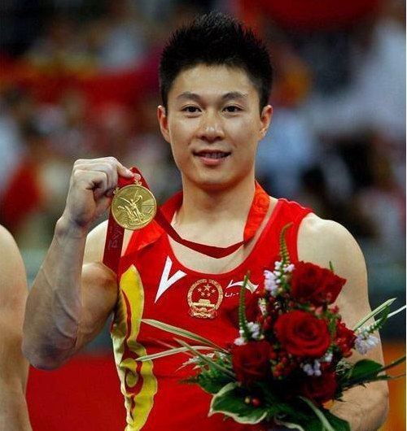
One example of the highest level of athletic quality is modern sports, which have special demands on those who pursue sports.
The issue of using the accumulated experience of coaches and sports researchers to uncover hidden and unused human abilities was repeatedly raised.
最高水平的运动品质的例子之一是现代运动，它对追求运动的人有特殊的要求。反复提出了利用教练和体育研究人员积累的经验来揭示隐藏和未使用的人类能力的问题。

Slide 11
Thanks for your patience.
Guo Yuanhao (Olivia))

