Slide 1
Chapter 4.Conclusion on the results of medical examination
« Medical and pedagogical control in physical culture and sports»
关于体检结果的结论
Zhao Yujie

Slide 2
目录
01.
Health assessment 健康评估
CONTENTS
02.
Physical development assessment身体发育评估
03.
Functional status assessment
功能状态评估
04.
Importance of physical examination results 体检结果的重要性

Slide 3
1.Health assessment 健康评估
The assessment of health status is the main part of the conclusion, because health mainly determines the solutions to major problems such as classes and competitions, and to a large extent determines the latter's programs and methodology. For athletes, even insignificant physical changes, the deviation in health is obvious, because under the action of physical exercise, they may deteriorate and lead to overload and various diseases. For non-athletes, these deviations may not be so important. Only when the athlete's health is checked without any (even small) deviations and complaints, can the conclusion of "health" be reached. If any health abnormality is found, the diagnosis of the disease is indicated with all its characteristics (form, stage, course, cause, degree of compensation, etc.).
对健康状况的评估是结论的主要部分，因为健康主要决定了上课和比赛等主要问题的解决方案，并且在很大程度上决定了后者的方案和方法论。对于运动员而言，即使是微不足道的身体变化，在健康方面的偏差也很明显，因为在体育锻炼的作用下，它们可能会恶化并导致超负荷和各种疾病的发生。而对于非运动员，这些偏差可能没有那么重要。只有在没有任何（甚至很小的）偏差和抱怨的情况下检查运动员身体健康时，才能得出“健康”的结论。如果发现任何健康异常，则以其全部特征（形式，阶段，病程，病因，补偿程度等）指示疾病的诊断。

Slide 4
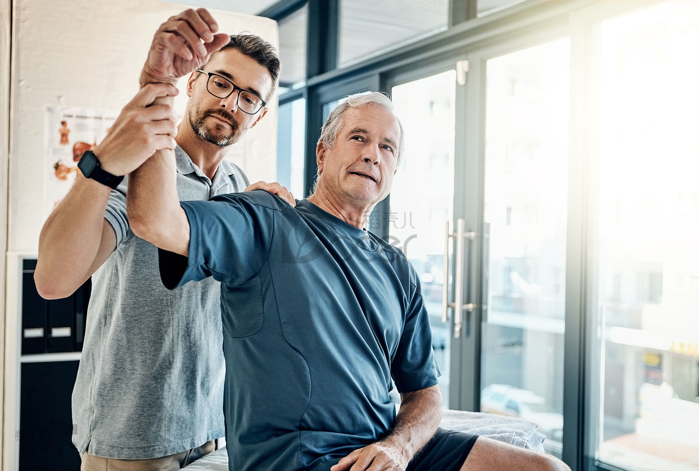
2.Physical development assessment身体发育评估
This assessment is based on external inspections, anthropometric indicators (in some cases, based on other research data: calipers, biophotometry, radiography, photometry, determination of specific gravity, etc.). At the same time, assess whether the physical development is normal or abnormal (in the case of any defects in the body and posture). Compare anthropometric indicators with a given gender and age, and make an assessment of "average", "below average" or "above average" respectively. When checking adolescents, it is also necessary to point out the corresponding relationship between the registered age and the physiological age, because the latter mainly determines the load that the human body can bear, as well as the direction of movement and training methods.
这项评估是基于外部检查的，人体测量学指标（在某些情况下，还基于其他研究数据：卡尺，生物光度法，放射线照相，光度法，比重的确定等）进行的。同时评估身体发育是否正常或不正常（在身体和姿势有任何缺陷的情况下）。将人体测量指标与给定性别，年龄进行比较，并分别做出评估“平均”，“低于平均水平”或“高于平均水平”。在检查青少年时，还必须指出登记年龄与生理年龄的对应关系，因为后者主要决定了人体所能承受的负荷以及运动方向和训练方式。

Slide 5
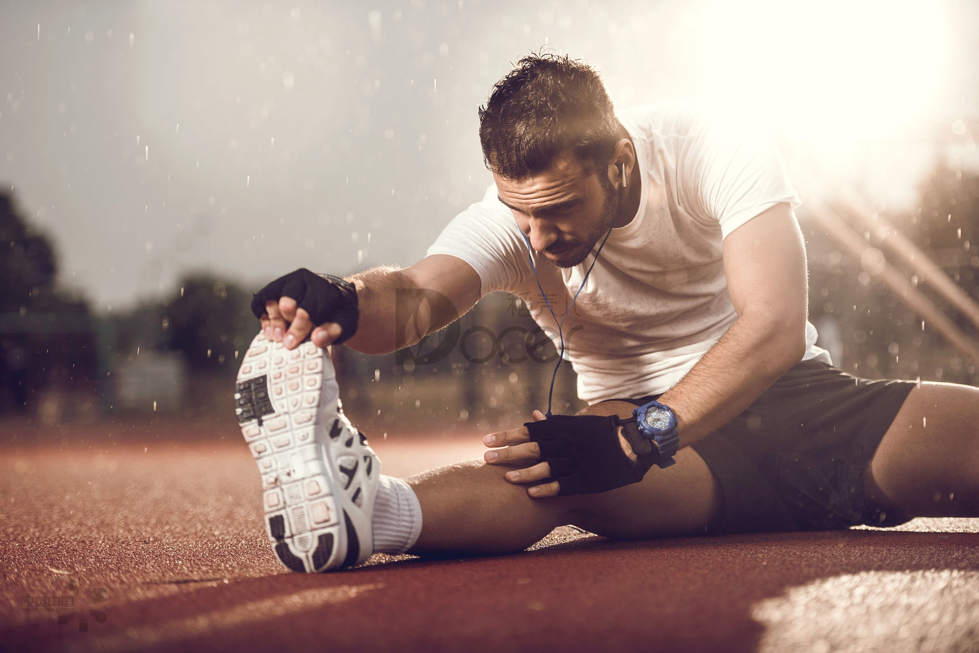
3.Functional status assessment功能状态评估
Functional status assessment is based on research results obtained using functional diagnostic methods and medical and educational observation data. In the conclusion, the functional status can be assessed as good, satisfactory or defective (exhaustion, overtraining, etc.)
功能状态评估是基于使用功能诊断方法获得的研究结果以及医学和教学观察数据得出的。在结论中，可以将功能状态评估为良好，令人满意或存在缺陷（出现劳累，过度训练等）

Slide 6
4.Importance of physical examination results 体检结果的重要性
We can determine the actual physical condition of athletes or non-athletes based on the assessment of health, physical development and functional status, and formulate treatment, prevention, rehabilitation and training programs based on the results of physical examinations. These are also used in physical education, setting up a physical education curriculum that is more in line with the students based on the results of the physical examination
我们可以根据对健康，身体发育和功能状态的评估来决定运动员或非运动员的实际身体情况，并根据体检结果进行治疗，预防，康复和训练方案的制定。这些同样作用于体育教学当中，根据体检结果设置更加符合学生的体育课程

Slide 7
The results of the physical examination can also help athletes participate in competitions. On the basis of the preliminary examination, according to the health status, physical characteristics and functional status, the doctor can determine specific personal data, based on these data to choose the most suitable sports, as well as which physical exercises and which competitions you can participate in.
The results of the physical examination can allow us to better know whether we can participate in some sports and how to choose the sports that suit us. When diagnosed with absolute exercise contraindications, such as heart disease, emphysema, heart sclerosis, etc. These people should be encouraged to participate in various types of physical exercise. When sports have relative contraindications, this means that the person cannot engage in any sport, while others can. Therefore, perforation of the tympanic membrane caused by patients with otitis media is a contraindication for water sports. For certain postural obstacles (bending backwards, hunched back, etc.), sports such as biking, rowing, boxing, etc. are not recommended
体检结果还可以给运动员参加比赛提供帮助。在初步检查的基础上，根据健康状况，体格特征和功能状态，医生可以决定特定的个人数据，根据这些数据来选择最适合的运动项目，以及进行哪种体育锻炼和可以参加哪些比赛。
体检结果可以让我们更好的知道自己能否参加一些运动，怎么去选择适合自己的运动。当诊断有绝对的运动禁忌症时，如心脏病，肺气肿，心硬化等。应该鼓励这些人参加各种类型的体育锻炼。运动有相对的禁忌症时，这意味着此人不能从事任何一项运动，而其他人可以从事。因此，中耳炎患者导致的鼓膜穿孔是水上运动的禁忌。对于某些姿势障碍（向后弯腰，驼背等），不建议进行如骑自行车，划船，拳击等运动

Slide 8
The results of the physical examination can also give methods and suggestions about physical exercise. According to the health and functional status indicators in the conclusion of the physical examination, it can be confirmed whether the load and training program are sufficient. If the inspection finds undesirable changes in the body, it indicates that the current training plan and methods are not scientific enough and are inconsistent with the exercise period. This requires us to carefully analyze and test the status indicators of each athlete to adjust. This may be related to the amount and intensity of training load, the period of physical fatigue, the length and nature of continuous exercise time, the introduction or exclusion of exercise methods, and the frequency of participation in competitions.
体检结果还可以给出有关体育锻炼的方法和建议。根据体检结论中健康和功能状态指标可以确认负荷和训练方案是否足够。如果检查发现身体有不良的变化，则表明当前的训练计划和方法不够科学并且是与运动时期不相符合的，这就需要我们仔细分析并检测每个运动员的状态指标进行调整。这可能涉及到训练负荷的数量和强度，身体疲劳期，持续运动时间的长短和性质，锻炼方式的引入或排除，参加比赛的频率有关。

Slide 9
The last excellent conclusion should include the previous three parts of health assessment, physical development assessment, and functional status assessment. And at the end should write healthy exercise methods and recommended exercise recommendations, as well as what should be done during the next comprehensive examination. Submit the conclusion to the school archives office for personal health management, and teachers and coaches will use this for teaching and training.
最后一个优秀的结论应该包括之前的三个部分健康评估、身体发育评估、功能状态评估。并且在最后应该写上健康的锻炼方法和推荐运动建议，以及下次全面检查时应该做什么。将结论上交到学校档案处进行个人身体健康情况管理，老师和教练员以此进行教学和训练。

Slide 10
Thank you

