Slide 1
Laboratory work
“Study of maximum muscle effort and strength endurance of the hand muscles, comparison of male and female indicators”

Slide 2
One of the indicators of the physical development of the body is the strength of the muscles. Currently, the strength of individual muscles is well studied. However, most often use the definition of the strength of the muscles of the hand and the back force, which are the total indicators of the strength of the muscles involved in the implementation of a certain type of movement.
Muscle strength refers to the maximum expression of voluntary effort that a group of muscles can develop under certain conditions. These conditions are largely determined by the interest of the person being examined or the ability to perform the maximum effort. Usually, a certain group of muscles contracts at the same time, so it is difficult to accurately determine the work of each muscle in the total manifestation of force. In addition, bone levers are involved in the action of the muscles.

Slide 3
Measuring the isometric force does not require much time and does not tire the subject. Here, the force manifests itself in a single cyclic maximum contraction. However, several factors can affect the measurement result. Thus, the isometric tension developed by each muscle fiber depends on its relative length and duration of stimulation. When measuring the position of the joints, the parameters of the bone levers that transmit muscle strength also change. Finally, after changing the relative position of the body parts, the fibers of other muscles are additionally included in the act of contraction

Slide 4
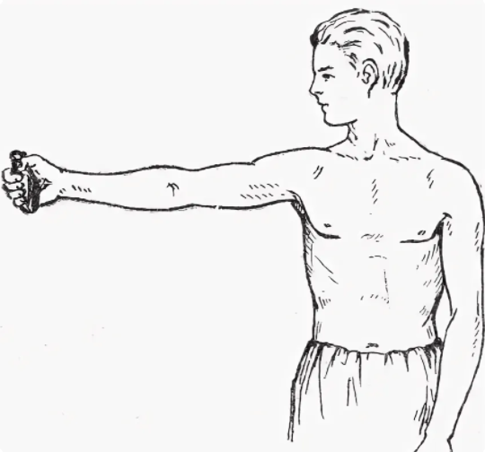
Starting position when performing hand dynamometry

Slide 5
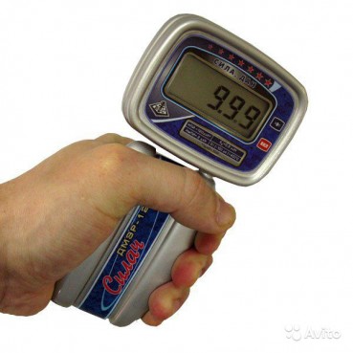
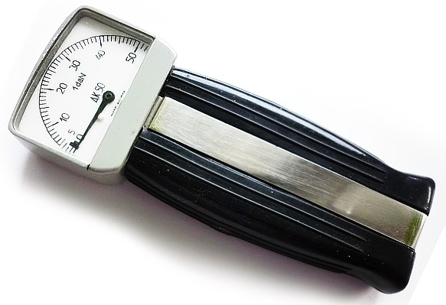
Types of hand dynamometers
A – electronic
B-mechanical

Slide 6
The purposes of the work
1. A determine the strength
2. A determine the level of performance
3. A determine the indicator of reduced performance of the muscles of the hands

Slide 7
1. A determine the strength
Method of performance of work: the subject in a standing position withdraws the outstretched arm with a dynamometer at a right angle to the torso. The second free hand is rounded and relaxed. At the signal of the experimenter, the subject performs the maximum force on the dynamometer. Record the readings and repeat the testing. The strength of the muscles is evaluated by the best result – S.

Slide 8
2. A determine the level of performance – P
Then the subject performs 10-fold efforts with a frequency of 1 time in 5 seconds. The results are recorded and determine the level of muscle performance according to the formula where P is the efficiency level in kg,
A1, A2, A3-dynamometer indicators for individual muscle forces, kg;
n– number of attempts, times

Slide 9
3 - A determine the indicator of reduced performance of the muscles of the hands - C
The indicator of reduced performance is estimated by the formula
C = ((A1-Amin) / Amax) x 100
where C is an indicator of reduced muscle performance, %;
A1 – the value of the first force, kg;
Amin– minimum force value, kg;
Amah– the maximum amount of force, kg.
If the decrease in muscle performance is from 10 to 19%, then the muscles are adapted to work for endurance.
If the decrease in performance is more than 20%, then the muscles are adapted to speed-power work.

Slide 10
Results of the work:
Calculate and enter into the results table an indicators of strength - S, a level of performance - P and an indicators of reduced performance based on the results of 10-fold efforts - C.
Draw a graph that reveals the nature of the decrease in muscle performance: on the OX (abscissa axis) - the ordinal numbers of the effort, on the OY (ordinate axis) - the dynamometer indicators for each effort - A.
The analysis is carried out and the conclusion on the work is formulated

Slide 11
Results Table

Slide 12
Conclusions
1 - Compare your left and right hands according to the received Indicators: - S, - P, - C using a graph.
2 - Determine a Muscles Type of Adaptation of your left and right hand
3 – Compare male and female indicators

