Slide 1
WOMENS SPOTS
Tokyo 2020
Kayak K4 women
500 m
Silver medal

Slide 2
Differences between Gender chromosome's
Man
male
XY
Women
female
XX

Slide 3
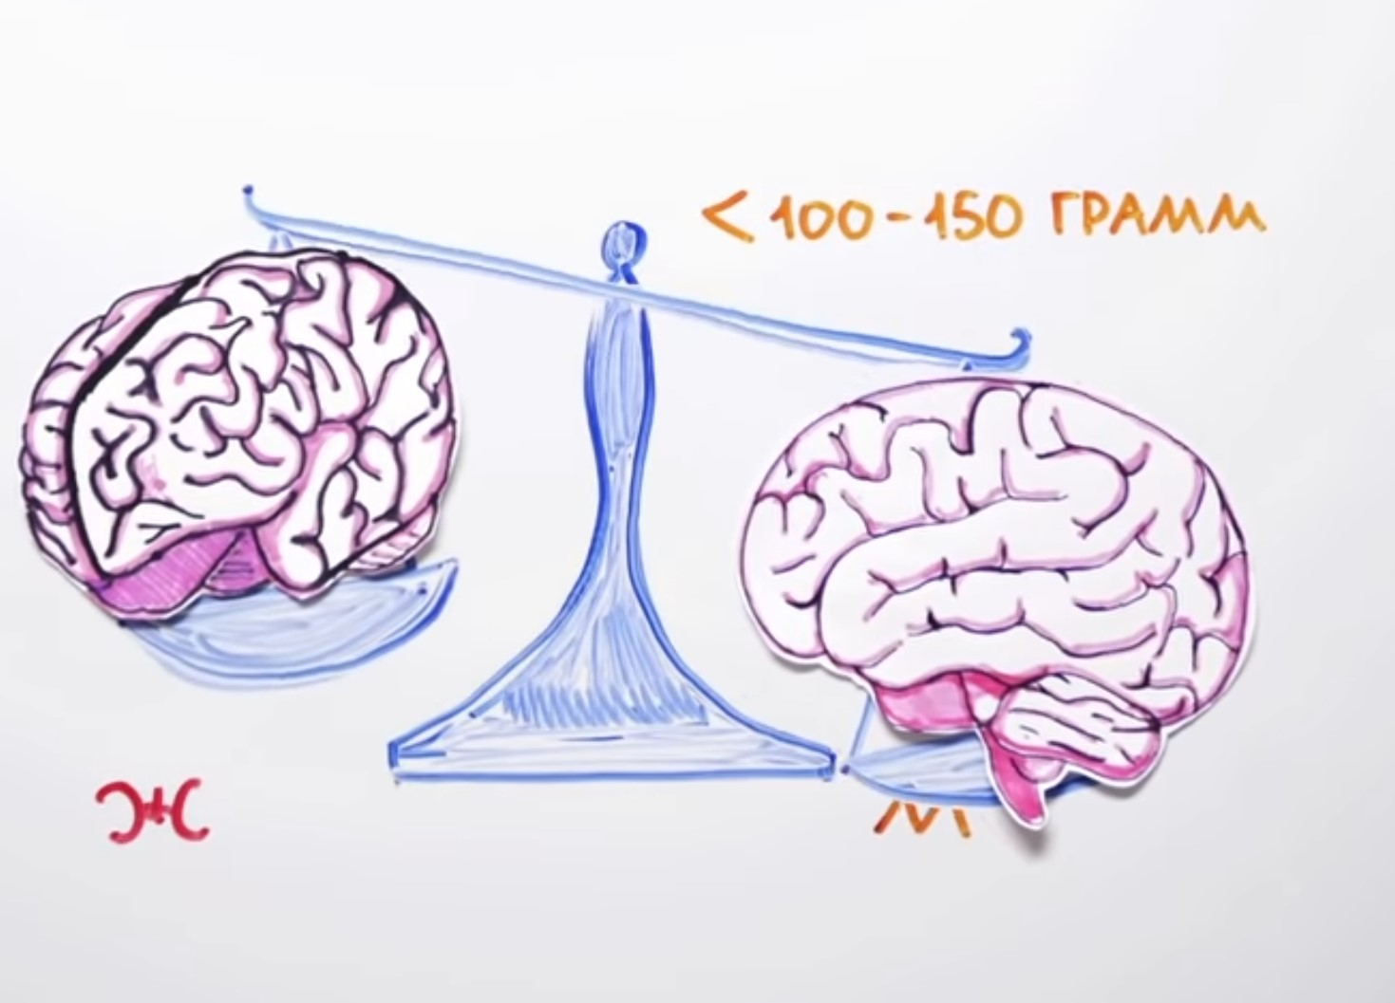
10 most important differences
1 The Brain
Female brain is 100 – 150 grams LIGHTER than mail
Has fewer Neurons
Has an another
construction that
provides female
Social Functions
(reproduction and
raising offspring
(children))

Slide 4
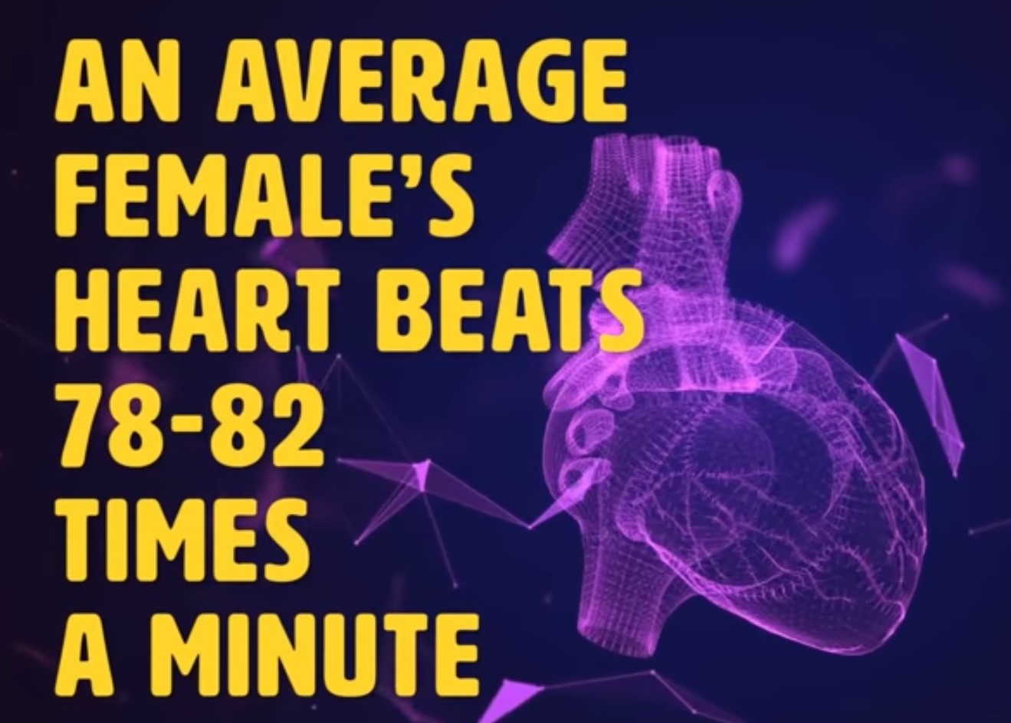
2 The Heart

Slide 5
2 The Heart

Slide 6
2 The Heart

Slide 7
2 The Heart

Slide 8
2 The Heart

Slide 9
2 The Heart
A blood pressure in 10 – 15 mm lover than man (average systolic 100 – 115mm, diastolic 55 – 70mm)
A blood pressure change more quickly during the physical exercise and rest.
The same situation with HR chnges.

Slide 10
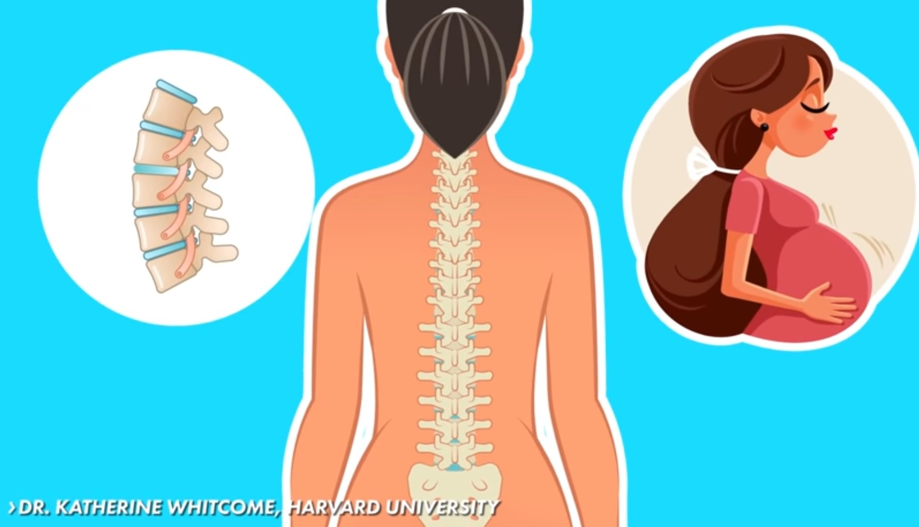
3 Flexibility and Posture
More flexible vertebral column

Slide 11
4 The Skin
A women's skin is much thinner than men's.
Aging changes begin earlier, after 35
Its more drier than men's, has greater electrical resistance
Its Conditions depends from hormonal background (that change cyclically)
More sensitive to various irritants

Slide 12
5 Smell and Taste feelings
Women have better sense of Smell
Women have better sense of Taste
It helps to determine the composition of food
It helps to determine children's health conditions

Slide 13
6 Color vision and Hearing
All women have excellent color vision capabilities
Distinguish 1000000 shades of color (use corns cells in color reception) in day light
Has excellent peripheral vision
Has a problems in night vision, reception of fast moving objects
All women hear a wider range of sounds

Slide 14
7 External breathing
Has lover total lungs volume – 1/3 lover than man
Has a mixed type of breathing with chest domination
Has a weak breathing muscles
Has higher tide rate (breathing rate)

Slide 15
8 Immune system's
Women's immune systems more stronger

Slide 16
8 Immune system's

Slide 17
9 Emotions

Slide 18
9 Emotions

Slide 19
10 Body Composition

Slide 20
Pregnancy

