Slide 1
Respiratory system

Slide 2
Breathing stages
External Respiration
Alveolar Gases Exchange (between alveolar Gas and Pulmonary Capillaries)
Blood Gasses Transportation
Tissue Gases Exchange (between blood capillaries and tissue
Tissue oxidation

Slide 3
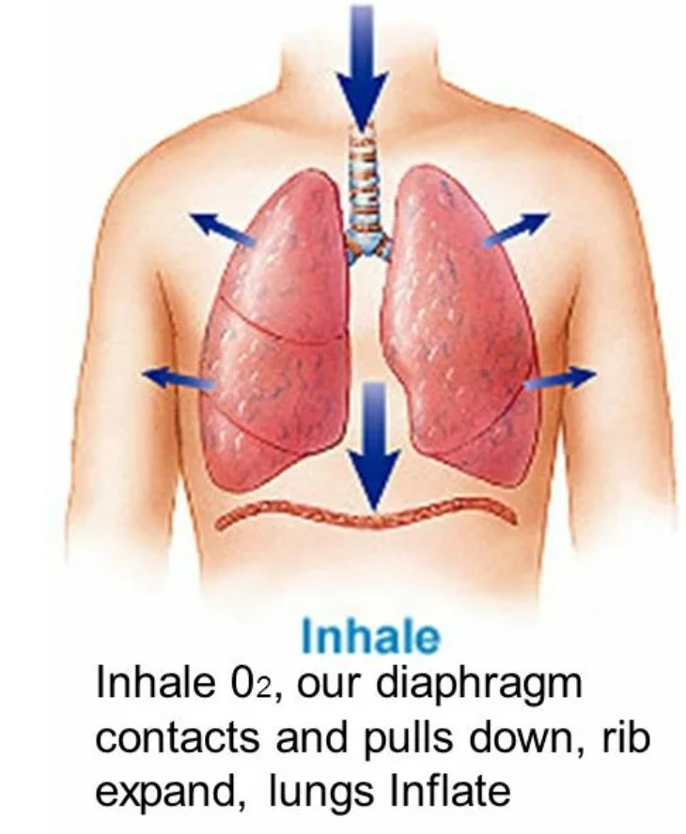
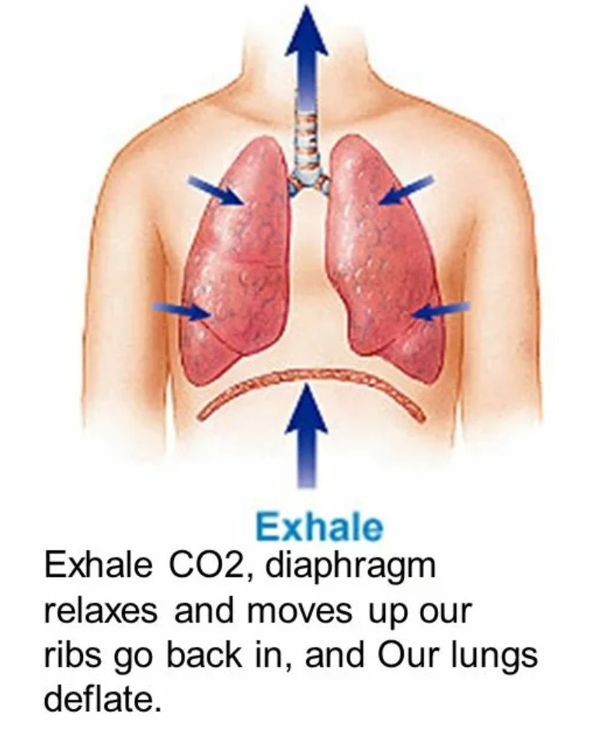
External Respiration
Inhale
Exhale

Slide 4
External Respiration

Slide 5
External Respiration

Slide 6
Alveolar Gases Exchange

Slide 7
Alveolar Gases Exchange

Slide 8
External Respiration (Regulation)

Slide 9
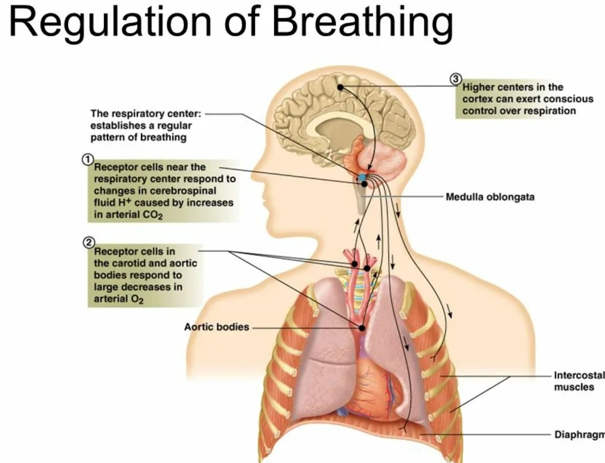

Slide 10
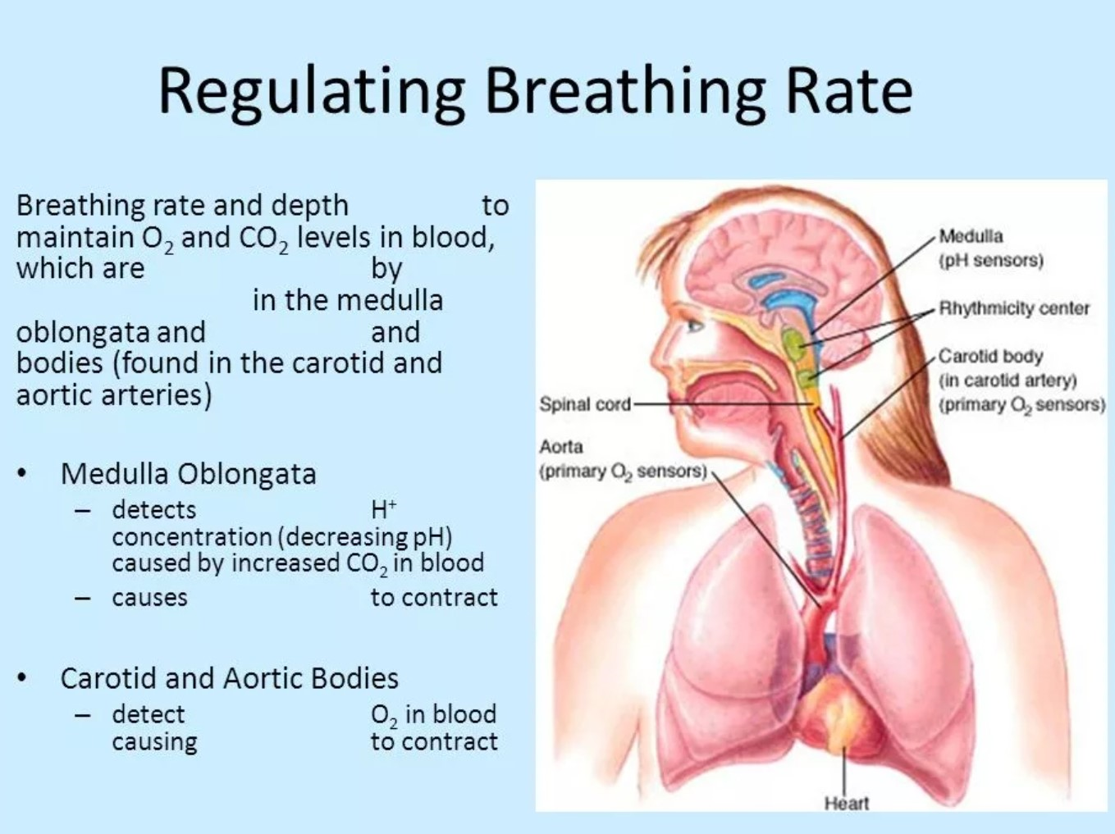

Slide 11
External Respiration (volumes measurement)

Slide 12
External Respiration (volumes)

Slide 13
External Respiration (volumes)
IRV – inspiratory reserve volume – 1.5 – 3.5 L
TV - tidal volume (calm breathing) - 0.4 – 0.8 L
ERV – expiratory reserve volume – 1 – 1.5 L
RV – residual volume – 1 – 1.5 L :
1 – functional residual volume
2 – Anatomic residual volume
VC - Vital Capacity = IRV+TV+ERV

