Slide 1
Topic 7. The author is associate professor A.A. Lytko
Topic 7
Test standardization

Slide 2
Epigraph
Normative data should not be applied purely psychometrically. We must not only measure the child, we must interpret it. Measuring, defining, and equating to standards of developmental symptoms should only be a means of making a diagnosis of development.
A. L. Gesell,
american psychologist who promoted the development of normative medicine in early childhood and the study of the characteristics of the mental development of young children (from birth to 3 years) and adolescence

Slide 3
Lecture plan
1 Concept of test standardization
2 Regulated use of the test
3 Understanding the normal distribution of test scores
4 Representativeness and validity as criteria for assessing test quality

Slide 4
1 Concept of test standardization
Let's recall the main idea of ​​psychometry from the last lecture.
The concept of "measurement" in psychology differs from the corresponding concept in other areas, for example, in everyday life or technology. What they have in common is that all types of measurements are based on a system of objectively existing standards (for example, for measuring length - a reference meter, for measuring time - a reference device called a clock, etc.) The measurement process is a comparison of the object under study or process with a reference.
In physical measurements, the carrier of a measure is a standard - a physical object that stably retains a given value of the measured property. In psychology, there are no such standards: there are no individuals who would be constant carriers of a given value of the measured property. It is obvious that a person cannot act as a "reference subject".

Slide 5
In psychodiagnostics, a psychological test acts as a measuring standard.
Therefore, special requirements are imposed on the test and on the testing procedure. They are due at least to the fact that, unlike measuring, for example, the length of a room, a person whose mental property is measured exhibits not so much object as subjective properties. He can honestly make a mistake, giving information about himself, or he can deliberately mislead the psychologist about his psychological qualities. This is why the test should be a standardized instrument, like a school ruler, designed to measure length in centimeters or meters.

Slide 6
Understanding Test Standardization
Test standardization, firstly, presupposes strictly regulated measurement conditions, secondly, it requires checking the test for the proximity of the empirical distribution of psychological indicators to the theoretical one, and thirdly, it prescribes special requirements for measuring instruments.
Let's dwell on each of these points.

Slide 7
Lecture plan
1 Concept of test standardization
2 Regulated use of the test
3 Understanding the normal distribution of test scores
4 Representativeness and validity as criteria for assessing test quality

Slide 8
2 Regulated use of the test
So, test standardization, firstly, presupposes strictly regulated measurement conditions.
Regularity is ensured by standardizing the procedure for communicating instructions to the subject, presenting standard stimulus material (ie, questions or statements), standard survey forms and methods of recording answers, standard test conditions, etc.

Slide 9
The test very often looks like a set of questions or statements with which one must agree or choose an alternative answer from the proposed answers.
In fact, in such a test there is not just a set of questions or statements, but in a short form in each of these questions-statements, the most typical socio-psychological situations are briefly described, from which it is necessary to assume a way out, due to the individual experience of the subject. The way out is offered in a number of prepared answers, one of which must be chosen.
Of course, the researcher can make observations corresponding to these situations over the real behavior of the subjects. But at the same time, sometimes it is necessary to spend too much time to record the facts.

Slide 10
The tests definitely save time for the researcher by describing the most common socio-psychological situations. If the subject, when choosing an answer, is oriented towards an adequate reflection of his psychological reality in this answer, then thereby he creates for the researcher the grounds for measuring the same signs, which can also be observable.
It is very important here that the test chosen meets the operational definition that was created on the eve of the test.

Slide 11
Lecture plan
1 Concept of test standardization
2 Regulated use of the test
3 Understanding the normal distribution of test scores
4 Representativeness and validity as criteria for assessing test quality

Slide 12
3 Understanding the normal distribution of test scores
As it was said, the standardization of the test, secondly, requires checking the test for the proximity of the empirical distribution of psychological indicators to the theoretical.
A preliminary check of the measurement procedure for the proximity of the empirical distribution of psychological indicators to one of the theoretical ones is usually done in relation to the axiom of normal distribution and leads to the idea of ​​the test norm.
If the standardization of the conditions for applying the test, the proof of the approximation of the empirical distribution to the normal, the transfer of raw points to the standard scale and psychometric requirements are not met, then the use of psychodiagnostic techniques is no less arbitrary procedure than the spontaneous "feeling" of the psychologist into the personality of the subject. Moreover, the result may turn out to be absurdly dependent on a complex of accidental and collateral circumstances.

Slide 13
Test measurements are statistical in nature. A typical measurement test is a sequence of items that results in a sequence of responses by the subject, which is then quantitatively interpreted.
Examples of interpretation in the case of personality questionnaires, consisting of statements offered for confirmation to the subjects: "confirmation" (the answer is "true"), "rejection" (the answer is "incorrect"), "doubt" (the answer is "I do not know").
The total score for the test is calculated using a key: the key sets the numerical value of the answer for each item. For example, two points are given for the correct solution of a task, one for a pass, and zero for an incorrect solution. Then their sum is literally close to the number of correct answers, if the subject is warned about the undesirability of evasive answers.

Slide 14
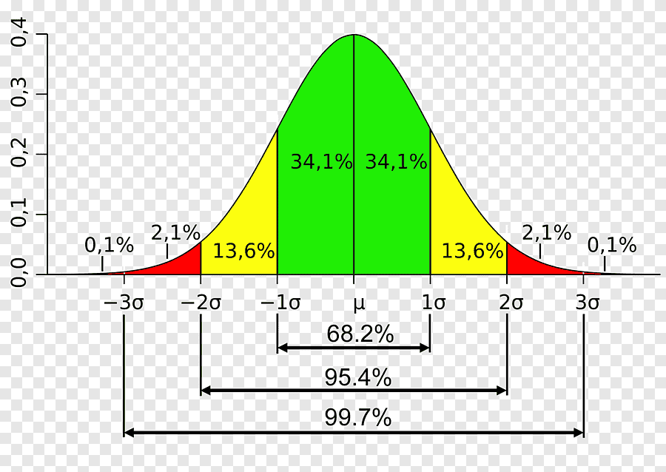
Mathematical models describing the situation of test measurement in science are represented by three classical types of distribution of indicators: binomial, normal and Poisson distribution. In principle, any approximation to the theoretical distribution can be used. In the vast majority of cases, in practice, the role of such a theoretical model is the normal distribution model.
The normal distribution is some ideal (bell-shaped) symmetric distribution. Its graphical expression is as shown in the figure. The test scores of the subjects are distributed on the horizontal X-axis, and the frequency of these points in the experimental group on the vertical Y-axis. The bell-shaped curve connects the points representing the coordinates of the position of individual points relative to the frequency of their occurrence in the group. This is called the bell curve.

Slide 15
The µ (mu) value is the score that occurs most frequently in the group. This is the group average, calculated as the arithmetic mean
The normal distribution in the case of a histogram has the form of a symmetric bell-shaped curve, the axis of symmetry of which is the vertical drawn through the point µ.
σ (sigma) – standard deviation. It is calculated as the standard deviation
In these formulas, X_{i} is the individual test score of each i-th subject, is the
average score in the group, n is the number of subjects in the group.

Slide 16
If through the points – 1σ and + 1σ , located at a distance σ to the left and to the right of the average value µ, draw perpendiculars up, then from the area of ​​the figure below the normal distribution curve, an area equal to approximately 68 % (34.1 + 34.1 ).
The interval from – 1σ to + 1σ is called the test norm, it contains points for 68% of the subjects.
The interval from – 3σ to + 3σ contains the scores of almost all 100% of the subjects.
So, if the normal distribution curve has two features – bell-shaped and symmetry, then the test has an ideal measurement ability.

Slide 17
From the point of view of psychology, within one sigma to the left and one sigma to the right of the general average on the abscissa axis, the raw scores of 68% of the subjects are located. That is why the interval µ ± σ is considered to be the norm of the test. The statistical norm is understood as the average range of values ​​on the scale of the measured property, that is, the proximity of the property value to the level that characterizes the statistically average individual. Going beyond the norm is called a deviation. The more pronounced the deviation (3 sigma region to the left or to the right of the norm), the more pronounced one or another personality property is considered, up to the appearance of pathocharacterological signs.
Thus, test indicators are described in units of deviation from the general average. For example, it is concluded that subject X₁ showed a result that exceeded the average (on the X-axis to the right) by 2σ, and subject X₂ - a result that turned out to be lower (on the X-axis to the left) of the average score by 1,5σ, etc. etc. The sigma scale, on which any individual primary score is easy to display, is called the normal scale. Usually the normal scale is used in scientific research; in practical psychodiagnostic activity, psychologists use standard scales, the principles of which go beyondour theme.

Slide 18
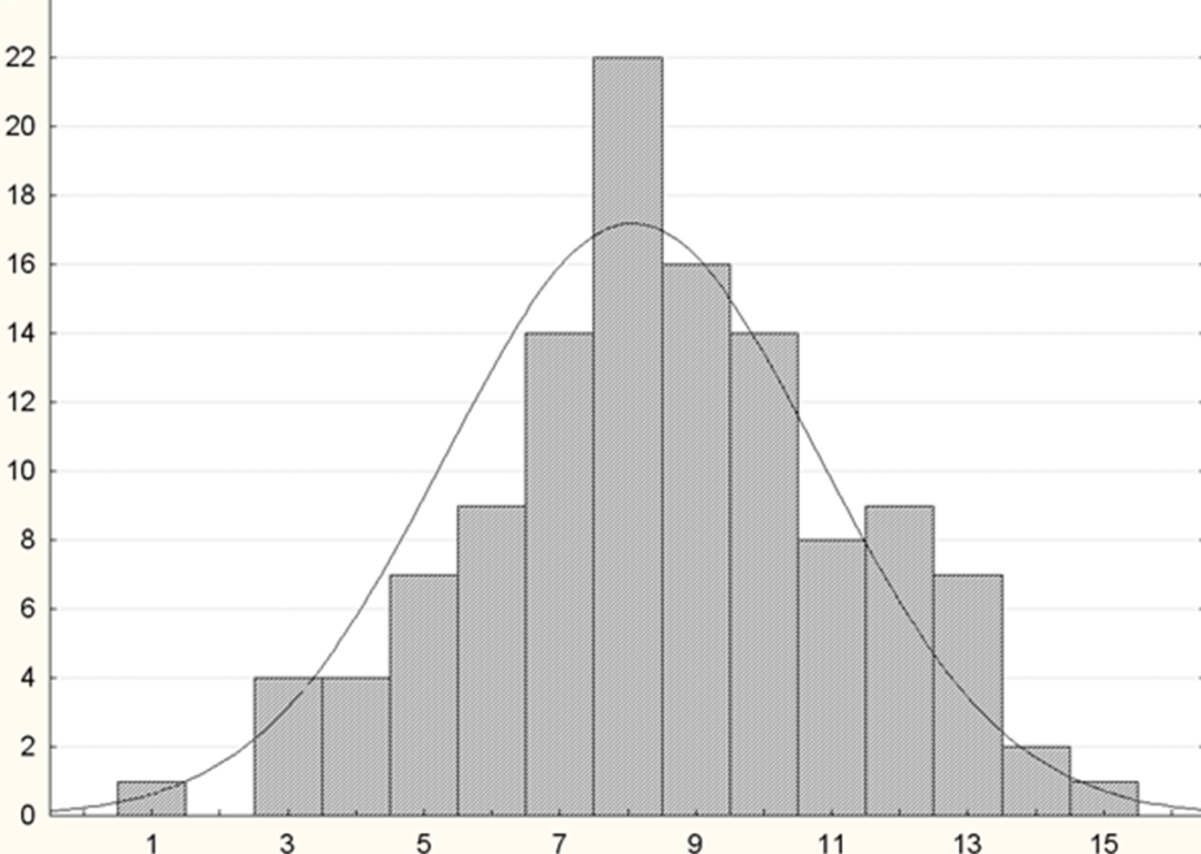
An example of one of the tests
The figure shows the data when checking the test for the normality of the distribution of points. In this case, on the abscissa axis, "raw scores" are plotted - that is, the primary indicators of the total scores possible for a given test, on the ordinate - the frequency of occurrence of scores in the group. The highest score of 8 was received by 22 subjects. Points 1 and 15 were received by one of the subjects. Nobody got two points, etc.
The normal distribution is shown by a bar graph and generally looks like a symmetrical bell-shaped curve. True, the curve is slightly asymmetrical, which reflects small measurement errors. However, sometimes they can be
neglected.
Number of subjects
Self-esteem scale from the self-actualization test

Slide 19
Lecture plan
1 Concept of test standardization
2 Regulated use of the test
3 Understanding the normal distribution of test scores
4 Representativeness and validity as criteria for assessing test quality

Slide 20
4 Representativeness and validity as criteria for assessing test quality
Finally, let us return to the fact that test standardization, firstly, presupposes strictly regulated measurement conditions, secondly, it requires checking the test for the proximity of the empirical distribution of psychological indicators to the theoretical one, and thirdly, it prescribes special requirements for measuring instruments.
The third paragraph states that the standardization of the test prescribes special requirements for measuring instruments. These special requirements for measuring instruments are expressed in representativeness, reliability, validity and reliability, that is, in the criteria for assessing the quality of the test.

Slide 21
Representativeness
Primary test results are meaningless without comparing them to mean and standard deviation. These values ​​- respectively μ and σ - must be previously determined before using the test for research purposes on the set of results obtained when testing people who together make up the standardization sample. The standardization sample is a sample of subjects selected according to special rules from the population of people who are planned to be tested.
The sampling of standardization according to certain rules is done in order to ensure one of the test quality criteria, called representativeness. Representativeness is the correspondence of the test norms of the standardization sample to the test norms of the studied population.
Therefore, by the way, any professional psychological test is always preceded by a description of the standardization sample, and the norms are also indicated. By ensuring representativeness, an important condition is achieved: in terms of its psychological characteristics, the standardization sample resembles the population of people on which the test will be applied.

Slide 22
Representativeness rules
This compliance is achieved by fulfilling the following four conditions:
each member of the population must have an equal probability of being included in the sample (random choice);
2) in order to avoid a directed selection of people, their choice is made regardless of the studied mental property (for example, if musicality is studied as a personality property, this does not mean that the sample is formed only from musicians);
3) selection is made whenever possible from homogeneous populations (by sex, age, education, etc.);
4) the number of people in the standardization sample should be large enough (for example, the famous scientist Max Luscher designed the test on the standardization sample, numbering about 40 thousand people).
The problem of the representativeness of the standardization sample is of great importance as the problem of the legitimacy of extrapolation (distribution) of the conclusions obtained from the analysis of the sample to the entire population of people.

Slide 23
Representative sample
So, the degree of severity of a particular mental property in the subject can be assessed only by comparing his individual results with the norms of the test. These norms are empirically determined when the same test is performed by a sample group of subjects.
Due to the fact that the standardization sample is drawn up by the specified mechanism (compliance with four selection conditions), in the literature it is often called a representative sample.
It is accepted that approximately every 5 years any test is rechecked on a new sample of standardization in connection with a change in the psychological characteristics of a particular population.

Slide 24
Validity of psychometric drugs
According to A. Anastasi, validity is a test quality criterion indicating “what the test measures and how well it does it” [1, p. 133]. The synonyms of validity are reliability, validity, adequacy. The more valid the test, the better it displays the property for which it was created.
For example, the validity of measuring intelligence depends on the theoretical (author's) concept of "intelligence", on the composition of test problems, on empirical criteria (length of service, education, profession, etc.).
To establish the validity of a psychometric technique, it is necessary to systematically check its content for the correspondence of the measured area of ​​the psyche to a representative sample.
Two types of validity are distinguished: direct, or primary, and derivative, or secondary.
Within the immediate validity, external and internal validity are distinguished.

Slide 25
External validity
The presence of external validity means that the impression given to non-specialists when familiarizing with the instructions, incentive material and testing procedure is consistent with the declared content of the test.
External validity can be in different ways to the true psychological content of the test. In some cases (for example, in intelligence testing), external validity corresponds to this content. In other cases (in personality tests), it helps to mask the true content of the test - the subject must believe in the falsified content deliberately indicated in the instructions. This prevents the emergence of an attitude toward issuing socially normative responses.
For example, R. Cattell's 16 PF test is convenient for use - it does not "scare away" clients with the implicit content of the points, does not cause an accentuated categorization of the diagnostic situation as an examination situation.
Other personality questionnaires, which, to a greater or lesser extent, have a pathocharacterological background in the content of the questions, inform the subjects about the possible direction of the diagnosis of mental disorders
(for example, an MMPI questionnaire).

Slide 26
Internal validity
Internal validity, due to its specificity, is also called immanent, or meaningful validity.
Validation is carried out on the basis of the application of "internal" criteria, which are the features specified in the definition of the measured mental property. The presence of these and only these signs is established by analyzing all the main components of the test (instructions for the test subject, stimulus material, testing procedures, raw scoring system).At the same time, no complex mathematical and statistical procedures are used, and the developer is limited to observing the behavior of subjects from the standardization sample, interviewing them, as well as evaluations of experts who have theoretical knowledge of the studied properties and states.

Slide 27
Expert validity
Derived, or secondary, validity is characterized by the comparison of test methods with some relevant (relevant, relevant) external criterion. This comparison is expressed through correlation statistical methods. There are a number of types of derived validity.
Evaluative, or expert, validity is based on the calculation of the correlation coefficient between the test scores and the indicators of evaluative judgments of experts. The experts are persons who have a fairly long and close communication with the subjects from the standardization sample: teachers, class teachers, social educators, parents, classmates, etc. The expert is asked to give an individual opinion based on the usual 5- or 10-point rating scale.
A common way to obtain estimated validity is a weighted average. In this case, each subject is assessed by several experts so that the assessments given to the subject by one expert are unknown to others. Then the resulting estimates are averaged. High correlation between test scores and indicators of value judgments of expertsindicates the validity of the test.

Slide 28
Construct validity
Construct validity indicates that this is a theoretical construct, a construct by which test results can be checked for validity. The point of construct validity is to theoretically explain how a given test was designed and measured.
For example, suppose we want to use a test to measure our fear of exams. The extent to which this measurement is valid can only be determined by verifying the possibility of confirming the positive or negative reactions predicted theoretically. In particular, 1) whether, under the influence of a time factor, the academic performance of a student experiencing a feeling of fear of exams falls especially strongly; 2) whether in such situations the reaction of persons with highly developed intellect differs from the reaction of intellectually less developed people; 3) whether it is possible to confirm the appearance of concomitant physiological manifestations (sweat, tremors), etc.

Slide 29
When explaining the connection between the obtained test results and a theoretical construct, it is necessary to use a variety of information about the dynamics of the development of the measured property, as well as about its interaction with other mental phenomena.
Constructive validity reflects the degree of representation of a particular theory in the test design, that is, in the instruction for the subject, stimulus material, testing procedure and, first of all, in the methods of interpreting the results. Obviously, this kind of validity is very close in its content to internal validity.

Slide 30
Convergent validity
Convergent (converging) and discriminant (separating) validities are related to construct validity.The most optimal situation when creating a new test is when there is already a procedure with known validity for measuring a given property in psychology. In this case, the developer conducts his own and someone else's tests through the standardization sample, and then looks for a mathematical correlation between the scores of the two tests.If this correlation turns out to be high, then the new test is said to have convergent validity with respect to the old one, or the tests are converging with each other. If it proves to be more portable and economical in conducting and scoring, then it is usually preferred. For example, if an intelligence test is created, then the results are often compared with the Wechsler scale or other methods.

Slide 31
Discriminant validity
Testing the test by the criterion of discriminant validity is inseparable from the criterion of convergence. If the created diagnostic construct adequately reflects psychic reality, then the correlation between convergent tests should be higher than the correlation between each of these tests and any third measure of the property. Hence, it follows that construct validity is characterized not only by the connections of the tested test with tests that are in a theoretically known relationship, but with those where hypothetically significant relationships should not be observed.
Convergent and discriminant validity are also manifested in the following. The measured mental property has not one, as a rule, but several external behavioral manifestations, which should naturally be highly correlated with each other. In this regard, the creation of an adequate construct should mean that its author is able to predict exactly which external manifestations of a given mental property will converge with each other.

Slide 32
Practical validity
Practical validity is considered in the form of current (diagnostic) and prognostic (predictive). They characterize the test in terms of its value in relation to the achievement of a certain practical goal (diagnosis, classification, forecasting). Quantitatively, these types of validity are determined by calculating the correlation coefficient between the assessments of the representatives of the standardization sample according to the test, on the one hand, and the indicators of their educational or professional activities, taken as an external criterion, on the other.
Predictive validity is the degree to which the test is consistent with the task of predicting the appearance of neoplasms in the psyche and the behavior of the subject in the future, for example, the success with which the subject will perform a certain activity in the future. For example, it is necessary to make a forecast about the performance of schoolchildren at the university. The forecast should be made by the end of primary school in the form of test results. After a certain time, on the eve of graduation from the university, academic performance is determined and the relationship between test scores and data is established grade books of students.

Slide 33
Current validity
The diagnostic (current) validity differs from the prognostic one in terms of the temporal relationship between testing and the current state of the studied mental phenomenon. It is used in solving problems of classifying subjects or diagnosing problems they have.
Current validity is one of the leading in characterizing the validity of any psychodiagnostic technique. However, the highest requirements of this criterion must be met by clinical tests that serve to clarify the differential diagnosis, screening techniques, achievement tests, and intelligence tests.
Thus, a test with predictive validity allows us to answer the question "What is the probability that individual X will eventually acquire property Y?"
And if the test has diagnostic validity, we can get an answer to the question “What is the probability that individual X has the property Y?”.

Slide 34
Conclusion on validity
Different types and types of validity are not alternative to each other, but complementary. It is obvious that an effective test method can only be created on the basis of a systematic approach.
First, it is necessary to ensure the validity of the content-theoretical type (immanent - for tests with relatively simple content and evaluative or constructive - for tests with more complex content).
Then, based on the data on the psychological content of the test, it is necessary to find out its compliance with one or another practical goals (prognostic and / or diagnostic).
Finally, in the last step, steps are taken to give the test external validity.
We will talk about reliability and validity as criteria for assessing the quality of tests in the next lecture.

Slide 35
Lecture plan
1 Concept of test standardization
2 Regulated use of the test
3 Understanding the normal distribution of test scores
4 Representativeness and validity as criteria for assessing test quality
Lecture completed

