Slide 1
Topic 5. The author is associate professor A.A. Lytko Observation method
Alphonse Daudet (French novelist):
The days are so long and the years are so short!
What is the observation error?

Slide 2
Lecture plan
1 General definition of observation method
2 Main purposes of gathering facts and types of observation
3 Logging and provisioning reliability of observation results
https://journal.ib-bank.ru/files/images/posts/2018-02-26_8.jpg

Slide 3
Observation and introspection
The observation method in psychology exists in two main forms: how introspection (introspection) And How external (objective) observation from the side researcher.
In the first case, the researcher receives information from the subjects using most often survey methods.
In in the second case, he relies on his own sensory-perceptual capabilities, subjectively studying the external world of social phenomena.
In this lecture, we will focus on the specifics of the observation method, taking into account the fact that these two forms are inextricably linked with each other.

Slide 4
Observation as purposeful perception
In its most general form, observation is primarily a purposeful perception, i.e. the process of generatingimages. Images indifferent theories are described in different ways: for example, as a feeling [E. B.Titchener], gestalt [K. Koffka], primary image [J. and E.Gibson], signs of perceived phenomena [J. Bruner] and etc.
Not certain cognitive structures of the observer also play a less important role in observation, for example, representations [G. Helmholtz], categories [J. Bruner], schemes [W. Neisser], meanings and meanings [A. N. Leontiev]. They present the researcher's knowledge of social and psychological phenomena and events.
When this important, what's the truth knowledge is based on both multiple successful interaction practices researcher with the outside world of people, and on a solid possession of the theory of the relevant branch of psychology.

Slide 5
Ordinary and scientific observation
Obviously, one must distinguish between ordinary and scientific observation. For example, an ordinary person, as a rule, does not realize that the results of his perception have varying degrees of validity of conclusions that have the status of facts, which, in turn, can be subdivided into obvious and established facts.
Specificity obvious facts is that their refutation is minimal for most observers. Therefore, the truth of the obvious facts, i.e. their correspondence to the perceived reality does not cause doubts among such observers.
Plain example. The observer sees a person's face in the drawing. At the same time, he does not doubt, since the sensory data perceived by him and the accumulated cognitive experience do not contain grounds for refuting this conclusion, but, on the contrary, unequivocally testify in his favor. And no other observer will dispute this conclusion.

Slide 6
Established facts
Established facts are not so certain, therefore, to substantiate their truth, a special conscious activity of the observer is required.
for instance, one of the observers examines the person's face and reports that this person has a wide forehead. At the same time, another observer perceives the same forehead as medium in size.
clearthat a certain criterion is needed to substantiate this or that conclusion. Suppose, on the basis of anthropometric studies, such a criterion has already been developed, namely: the forehead is considered wide if it is at least a third of the length of the face in width.
AND then, if in the example under consideration the person's face meets this criterion, then his forehead can reasonably be considered wide, and this will be an established fact.

Slide 7
Plausible hypotheses
Other observation results can be designated as plausible hypotheses. A characteristic feature of these results is that they cause at least some observers to doubt their truth. Orthey have alternative conclusions about the same observed reality.
therefore unlike established facts, plausible hypotheses only pretend to be so. To become established facts, they needadditional justification.
for instance, one of the observers looks at the person's face and sees by his facial expressions that he is glad of his arrival. Another observer, looking at the same face, comes toto another the conclusion - this person is just very skillfully portrays a joyful look.
Clearthat to substantiate any of these conclusions, i.e. translation in established facts, additional information is required. Until it is received, these conclusions will remain plausible hypotheses.

Slide 8
Subjective opinions
Finally, there are results that cannot be considered as sound observer experience, so they can be called subjective opinions.
for instance, the observer looks at the person and perceives him as a criminal. Obviously, this conclusion can hardly be justified by the features of a person's appearance.
Secondly, with ordinary observation, the conclusions of a person about the observed reality for the most part occur involuntarily and unconsciously.
for instance, ask observer who perceived a person as a criminal, on what is based its conclusion? Rather in all, he will say that he did not think about it, but just saw him like that.
Given these features mundane observations, it is not surprising that the observer ideas about reality quite often they may turn out to be insufficiently substantiated, as is the case in the given example, and, therefore, not quite corresponding to it.

Slide 9
Scientific observation
Unlike ordinary research observation as a method of scientific and practical activity necessarily implies:
1) understanding possible varying degrees of validity of observation results;
2) based on this understanding, the purposeful and conscious collection of only such observation results that can be recognized as sufficiently reasonable.

Slide 10
Only obvious and established facts are substantiated
Therefore, the end result of professional observation is only sound conclusions about the observed reality, i.e. obvious and established facts. Therefore, a professional observer, examining a person's appearance, will never say that he is a criminal. Descriptions of the results of his observations will always be substantiated, consisting of obvious and established facts.
for instance:
and) possible obvious facts: I know this person well, his name is NN, he has short-cropped hair, combed back, slightly curly, bald patches begin from the forehead, two deep wrinkles run from the wings of the nose to the edges of the lips, over the entire upper lip are located in a continuous strip mustache;
b) possible established facts: his face is thin, since depressions are clearly visible on his cheeks, his forehead is wide, since it takes up almost a third of his face, his eyebrows are thick, as they completely cover the skin, his expression is calm, since there is no pronounced facial expression on his face, his look is rather aloof, so no matter how directed towards anything, etc.

Slide 11
Determination of the observation method
Based the above, the observation method can be defined in the very first approximation as a purposeful and conscious way of collecting facts about the observed external reality, which are sufficiently justified by certain senses and the cognitive experience of the observer related to them.
More a detailed description of the observation method should include a description, first of all, the main purposes of collecting observation facts, the subject, conditions and methods of observation, methods of recording the results of observation, as well as the main problems of the method of observation and ways to overcome them.

Slide 12
Lecture plan
1 General definition of observation method
2 Main purposes of gathering facts and types of observation
3 Logging and provisioning reliability of observation results
https://journal.ib-bank.ru/files/images/posts/2018-02-26_8.jp

Slide 13
The main goals gathering facts observation
The observation method is one of the most common in psychology. It is widely used in scientific and practical professional activities both as the main method and in combination withothers...
Collected this method uses facts for research, diagnosis and exposure.

Slide 14
The main goals gathering facts observation: research
When holding research facts provide a basis for the advancement and verification of scientific hypotheses. As examples of the application of observation for research purposes, we can cite the phenomena known in psychology that were used by the authors of theories to empirically support their individual positions.
So, in behaviorism, the phenomenon of behavior change observed in experiments from by two young children Albert and Peter, used by J. Watson as a substantiation of the possibilities of the theory of human behavior development based on the mechanism conditioning... In gestalt psychology, phenomenabackground shapes used as evidence, that consciousness has special properties of the whole, which are not a simple sum of their properties. INactive theory A.N. Leontyev's so-called bitter candy phenomenon was used to illustrate provisions about the hierarchy of motives that form a person's personality. Other examples arefamous in the psychology of the theory of personality types E. Kretschmer, W. Sheldon, K. Cabin boy,
which were also developed using observation facts.

Slide 15
The main goals gathering facts observations: diagnostics
When conducting diagnostics with the preparation of a psychological conclusion, the observation method is used to collect facts that can serve as a basis for a conclusion about the belonging of the object survey to some previously known category. In psychology, such a subject is usually the characteristics of a person's personality, his mental processes, states and properties, and the term "category" is used to denoteclass, to which the examined object can be attributed on the basis of its characteristic signs.
for instance, facts of observation about how a person fulfills the instruction of the Vygotsky-Sakharov test to diagnose the level of his ability to form concepts [L. S. Vygotsky].This test was originally developed by in in order to study the problem of the development of the meanings of words in human ontogenesis.
IN As a result, clearly observed specific features of the implementation of instructions by children of different ages were revealed, which allowed the authors to describe the main stages of the emergence of concepts, as well as
criteria their attribution to these different stages.

Slide 16
The main goals gathering facts observations: impact
In practice impact Observation facts are often used by psychologists to plan, evaluate and correct the behavior of the people with whom they work.
IN an example is the classic study B... V. Zeigarnik, dedicated to the problem of memorizing completed and incomplete actions.
More a common example is psychological counseling, during which the psychologist, as a rule, constantly monitors the behavior of his client, purposefully observing his reactions to his influences.

Slide 17
Characteristic method: subject
Subject observation in psychology are various aspects of human behavior, which include, in a narrow sense, any external manifestations of their activity in the form of postures, actions or reactions, and more broadly, to these include such manifestations activitythat are not necessarily perceived visually, for example, characteristics human speech.
The choice of the subject of observation (what to observe) is determined, first of all, by the psychologist's knowledge about which aspects of external reality are the most informative for achieving the goal of research, diagnosis or impact, as well as theoretical concepts and methodological principles that he is guided by.
Often, the choice of the subject of observation requires special theoretical and empirical work to substantiate it. In those cases when the specific purpose of observation is not completely clear to the psychologist or is formulated only in the most general form and the psychologist does not yet know exactly what to himselect as a subject of observation, he is forced to
maximally describe in detail the reality that interests him.

Slide 18
Characteristic method: conditions
According to the most famous classification of observation conditions, they differ into field (natural) and laboratory. This distinction is made according to two important criteria. One of them is the degree to which the observation conditions correspond to the real conditions of human life. The greater this correspondence, the more likely the psychologist's conclusions based on observation facts will correlate with their real life, i.e. will be more environmentally sound.
FROM From this point of view, observation in the field is more valuable than in the laboratory, since it is precisely what happens in real life conditions. Examples of such observations are observations of a person's work activity at his workplace, the behavior of students in the classroom, etc.
In laboratory conditions, the problem of environmental validity solved by creating a model of real living conditions human. However, between the real conditions of their life and the model of these conditions in the laboratory, never not there can be complete identity, but only more or less correspondence.

Slide 19
Observation classifications
There are many classifications species observation [P.Fress and etc.]
we consider only the three most famous of them. All of these classifications are independent, so they can be used to characterize any particularway of observation at the same time.

Slide 20
Types of observation by degree of openness: open
In the first classification observation methods are subdivided according to the degree of their openness to the observed person into open, hidden and implicit.
With open observation the person being watched is aware of it and is being watched conducted with his consent. It has one significant drawback is that a person's knowledge that he is an object of observation can change his usual behavior for these conditions. Behavior may become, for example, more socially desirable, disorganized due to excitement, more motivated, etc.
Understanding this, the psychologist must take on a case-by-case basis measures to eliminate negative influence of this factor a: arrange test subject to yourself, demonstrating a benevolent attitude, calm down if he is worried, explain what must lead yourself ordinary way. You can motivate this bythat otherwise the results of observation will have no value either for him or for science.
If a the influence of this factor cannot be eliminated, then absolutely necessary
take account him in his conclusions based on observation facts.

Slide 21
Types of observation by the degree of openness: hidden
With hidden - the observed person does not see the psychologist and does not know that he is being monitored. This method of observation absolutely does not prevent him from behaving realistically, i.e. to show in his behavior all his real psychological characteristics. Obviously, covert observation allows the psychologist to collect facts that are more consistent with the real behavior of a person in certain conditions.
Together however, this type of observation raises a certain ethical problem, namely: to what extent is it permissible to observe a person's personal life without his consent. And in each specific case, the psychologist needs an ethical justification for the use of covert surveillance, including relying on the ethical professional code. So, for example, in accordance with the code of ethics of the American Psychological Association, covert surveillance is quite acceptable, "if the behavior is studied in a public place (and not in someone's bedroom), people are not exposed to any influence and the information is kept confidential."
[J. Goodwin,from. 426].

Slide 22
Types of observation by the degree of openness: implicit
Implicit observation occupies an intermediate position between open and hidden. This is the most common method of observation among psychologists. It consists in the fact that the psychologist invites the observed person to perform some task in his presence or to talk with him on a certain topic, making it clear that he is interested, first of all, in the result of this task or the topic of the conversation, and he himself at this time gradually, imperceptibly observes his behavior.
When by implicit observation, the indicated main disadvantages of the open and hidden methods are eliminated.
FROM on the one hand, this is due to the fact that observed it is difficult to notice that the psychologist is purposefully observing him, since he does not show this in any way, which means that the factor of "knowledge of observation" is often absent here... FROMon the other hand, the psychologist implicitly observes such forms of human behavior that he himself demonstrates to him, i.e. they are not a secret of his private life, and therefore, implicit observation does not need special ethical justification.

Slide 23
Types of surveillance by the role of the psychologist: outside
Second classification distinguishes between the methods of observation according to the role in which the psychologist appears before the observed person. By this criterion, external and included observation are distinguished.
Third-party surveillance - This is the traditional and most common method of observation in psychology, which is usually conducted openly or implicitly, in the field or laboratory. With this method, the psychologist acts for the observed, first of all, as a specialist performing his professional work. They meet once or periodically only to resolve those issues that fall within the scope of the professional competence of a psychologist, and they have no other reasons for meetings.

Slide 24
Types of observation according to the role of a psychologist: included
Enabled surveillance carried out, as a rule, covertly or implicitly and, mainly, in the field. With the included observation, the psychologist is specially introduced into some formal or informalgroup. Togetherfrom her he lives a fairly significant part of his life, entering with members of this group in various kinds of business and interpersonal relationships.
it the introduction is due to the professional motivation of the psychologist, first of all, his desire to learn more deeply and more fully about the people of the group of interest to him and their relationships. This kind of observation is used in psychology much less often, since it often requires a great deal of courage and self-sacrifice from the psychologist due to the fact that for this he has to change his usual way of life for quite a long time.

Slide 25
Types of surveillance by categorization
In the third classification different views categorizedobservation. As was convincingly shown in the works of J.Bruner, human perception always presupposes a process of categorization, the content of which is the assignment of single perceived objects according to their characteristics to a more general class, i.e. to a certain category of them. The category is defined by him "as a set of features, depending on which objects are grouped as equivalent"[J. Bruner, from. thirty].
Across assignment to one category or another, single perceived objects acquire a certain meaning. An important conclusion follows from these works thatuncategorized observation, at least in a person who has mastered a language, does not exist.
Collected observer in the process of observation, facts are always categorized facts.

Slide 26
Types of observation by categorization: degree of planning
The ways categorized observations that are actually used in psychology can be classified on two grounds.
one... The degree of planning in the choice and use of certain categories by the psychologist for observation. On this basis, the following two methods are distinguished: with the use of categories that arise spontaneously in the course of observation and those pre-selected.
With the method using spontaneously emerging categories in the course of observation, the psychologist begins observation without any pre-compiled list of them. The need to use certain categories arises from him in the course of observation, depending on the results obtained. This method is used, for example, in search studies, when the specific goal of observation is not completely clear to the psychologist or is formulated only in general terms.

Slide 27
Types of observation by categorization: degree of planning
The observation method using pre-selected categories involves the use of a limited number of categories by the psychologist, a list of which is compiled before the observation begins.
A striking example of the real application of this method can serve as a very well-known method in social psychology by R. Bales, in which 12 standard categories are used to observe the interaction of people in a small group.
The theoretical construct, embodied in the diagram on the next slide, allows you to both qualitatively and quantitatively assess the main signs of interaction between members of a small group.
https://kbimages1-a.akamaihd.net/6b0d5e69-c5d9-4b05-8989-907df12431ec/1200/1200/False/social-interaction-systems.jpg

Slide 28
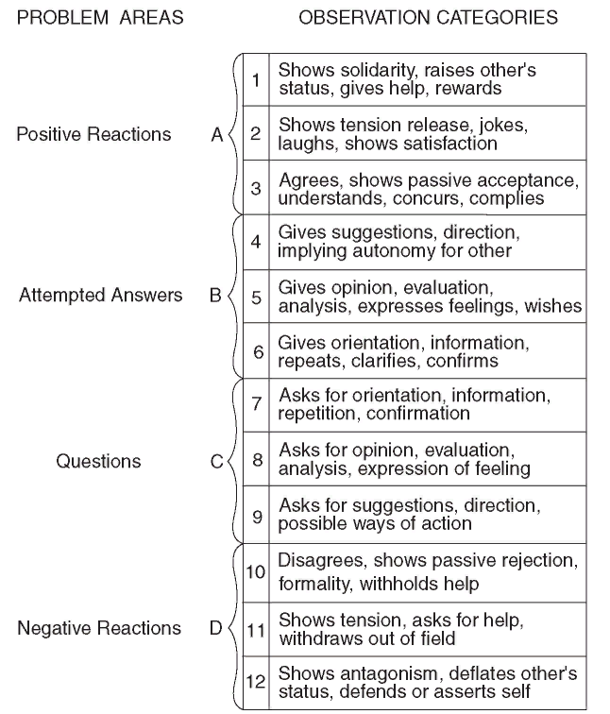

Slide 29
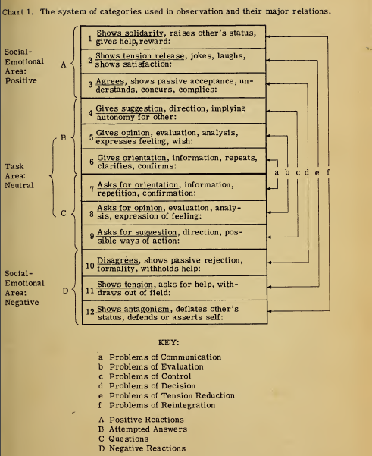

Slide 30
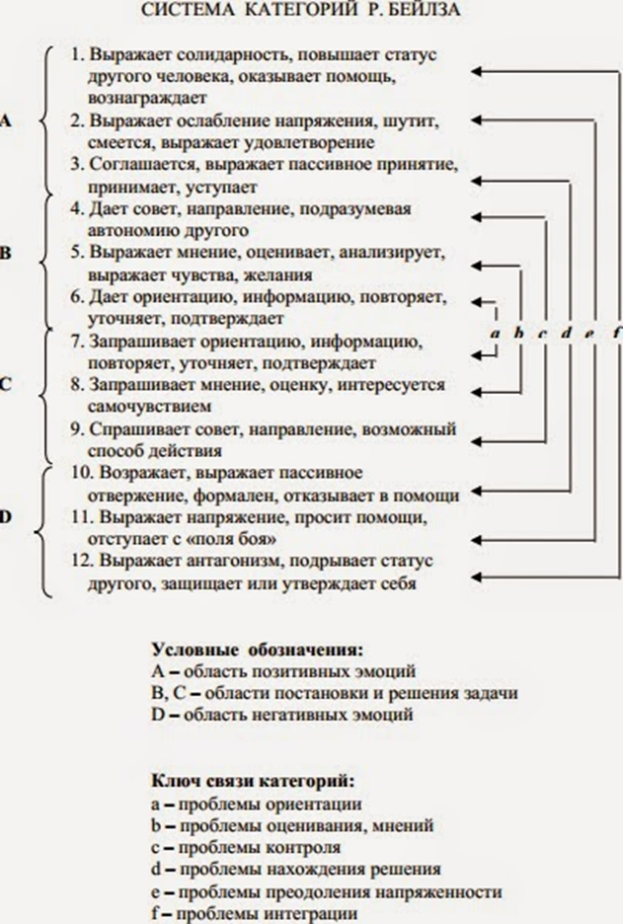

Slide 31
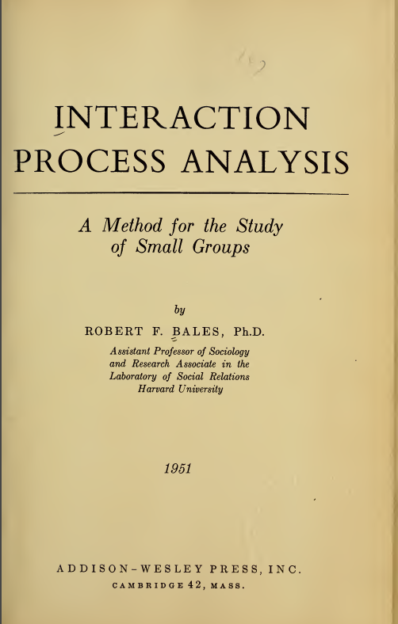
When performing a certain common task, the activity of the group, according to R. Bales, develops as a sequence of phases:
a) orientation of group members in a common task (exchange of information);
b) assessment of the progress of the task by team members (assessment of opinions);
c) control (an attempt by group members to influence each other);
d) finding a group solution;
e) relaxation of interpersonal and intrapersonal tensions;
f) an expression of solidarity (or a split between them).

Slide 32
Categorization: an example
The basis for summing up the observed action under one category or another is the content of the participant's utterance, his intonation characteristics, facial expressions and appeals to other participants, as well as the relationship of the utterance with the previous ones.
Subcategory can be thought of as a two-step process: first, the domain of the phenomenon is identified, and then the more specific category.
An example of subcategory.
Participant 1: "I wonder if we have the same facts?" (asks for an opinion). “Apparently, we should start by clarifying this issue” (expresses an opinion).
Participant 2. “Yes” (agrees). “We will be able to fill the gaps in the information we have” (expresses opinion, assessment). "Let everyone in turn report the data they have" (makes a proposal, an assessment).

Slide 33
Types of surveillance by categorization: no feature definitions
2. The absence or presence of the observer of definitions of signs by which the subject of observation can be attributed to one category or another. This basis is used to distinguish two other ways of categorical observation: without definitions and with definitions of category attributes.
Categories without feature definitions represent such categories, the signs of which are either not at all recognized by the observer, or are not fully understood by him, and, in addition, they are used in the process of observation involuntarily. So, observing a person's behavior, a psychologist may, for example, involuntarily perceive that he smiled, and at the same time he may not have a conscious definition of all the signs of the category "smile". The use of this type of category is appropriate in cases where the psychologist believes that his experience is quite sufficient to unambiguouslycategorize facts of observation.

Slide 34
Types of observation by categorization: there are definitions of signs
Categories with definitions of features are characterized by the fact that these definitions, on the contrary, are fully realized, and are arbitrarily used in the process of correlating them with observed facts. It is quite obvious that this kind of categorization process will be more accurate and reasonable. Such categories are widely used in the procedure for assessing or recruiting personnel, where it is required to assess the degree of compliance of the level of competence of employees or candidates for a position with the requirements necessary for the position held [1]. In turn, categories with definitions of features may differ in the degree of clarity of their formulations and the degree of theiroperationalization... The clearer and the moreoperational there are these definitions, the more accurate will be the categorization of the units of observation of interest to the psychologist.

Slide 35
Lecture plan
1 General definition of observation method
2 Main purposes of gathering facts and types of observation
3 Logging and provisioning reliability of observation results
https://journal.ib-bank.ru/files/images/posts/2018-02-26_8.jp

Slide 36
Results logging
Logging of observation results during the study is an, usually, compulsory. This is doneso that in the future these results can be processed, analyzed and used as a basis for subsequent conclusions.
It can be carried out in different ways, the choice of which depends on the content of specific goals, the subject, the means and methods used observation.
Logging can be written or using special technical means of registration (photovideo, tape recorder, polygraph and etc.).
Obviouslythat when observing fast flowing events use technical funds is more preferred. In thatcase, the observer always has the opportunity to check their observations, which contributes to a more thorough collection and analysis of facts.

Slide 37
Results logging
The protocol is kept either during the observation, or immediately after its completion. Record keeping during observation is preferable because the person's memory is imperfect. Of all that a person perceives, many observations, after a fairly short time, are irretrievably lost, and some of them may be recorded inaccurately or even in a distorted form.
but this method of logging is not always possible, for example, with enabled or implicit monitoring.

Slide 38
Problem credibility observation results
Psychologists use observation facts as a basis for conclusions in research, diagnostic examination or influencing. Moreover, it goes without saying that they should bereliable, i.e. correspond to the observed external reality.
As noted by W. James, one of the fundamental properties of consciousness, and therefore of conscious perception, is its selectivity, which consists in the fact that consciousness is always “interested in some parts of its object, but not in others, and all the time it either accepts, or rejects certain parts, i.e. chooses among them "[IN. James,from. 157].
By For this reason, in a number of cases, for example, when observing complex behavior that requires the attention of the observer simultaneously to several of its aspects at once, the observation results may not be complete enough to adequately describe external reality.

Slide 39
Problem credibility observation results
Observer always perceives world the way it appears to him, i.e. from his personal point of view, which is mainly determined by the so-called non-sensory factors: the pastexperience, anticipatory cognitive schemes, needs, attitudes, level of development intelligence and dr.
Wherein personal point of view observer can correspond to external reality to varying degrees. With incomplete correspondence in perceptionappears a certain degree subjectivity. As a result, the observercan erroneously perceive as really existing what is objectively absent in external reality, and, on the contrary, not perceive what is objectively present in it.

Slide 40
Problem credibility observation results
There are different ways to deal with the possible manifestations of subjectivity in observation. [J. Goodwin].
So, for example, one such method is the use of clear operational definitions of attributes used in observation categories.
Other the method involves participation in the observation the behavior of the subjects of several observers with the subsequent identification of the degree of consistency of the facts collected by them.

Slide 41
Observation reliability problem
Another criterion is the degree of controllability of the observation conditions. In this case, control is understood as active actions of the observer aimed at organizing conditions for the purpose of controlling influence various variables for observation. Lack of control is undesirable in view of the fact that some side effects on the subject of the survey can distort its results.
Maximum complete control is provided in laboratory experiments, where the observation method can be used to describe the dependent variable when different conditions are presented independent.
Field conditions are less preferred to provide control over the effects of various variables on the subject of observation.
therefore when choosing observation conditions, psychologists, as a rule, seek to find some kind of compromise option that optimally combines in the dignity of field and laboratory conditions.

Slide 42
Lecture plan
1 General definition of observation method
2 Main purposes of gathering facts and types of observation
3 Logging and provisioning reliability of observation results
Lecture plan implemented
https://journal.ib-bank.ru/files/images/posts/2018-02-26_8.jp

Slide 43
List of sources used
1 Bass M. Ya. Methodology of psychological observation of children // Basov M. Ya. Selected works on educational psychology. SPb .:Aletheia, 2007.
2 Bruner J. Psychology of cognition. Moscow: Progress, 1977.
3 Helmholtz G. About perception in general // Psychology of sensations and perception / Ed. Yu.B.Gippenreiter, V. V. Lyubimov, M. B. Mikhalevskaya... M .:CheRo, 1999. S. 21–46.
four Gibson J., GibsonE. Perceptual learning - differentiation or enrichment? // Psychology of sensations and perception / Ed. Yu.B.Gippenreiter, V. V. Lyubimov, M. B. Mikhalevskaya... M .:CheRo, 1999. S. 547–562.
5 Goodwin J. Research in Psychology: Methods and Planning. SPb .: Peter, 2004.
6 Gems B. Scientific foundations of psychology. Minsk:Harvest, 2003.S. 157.
7 Kapustin S.A. Observation method // Basic Methods of collecting data in psychology / Ed. S. A. Kapustina. - M.: Aspect Press, 2012 .-- 158 p.
8 Kornilov T.V. The method of observing the process of interaction of people in a discussion (method of R. Bailes) // General workshop on psychology: Method of observation. Part II / Ed. M. B.Mikhalevskaya... M .: Publishing houseMosk... University, 1985. S. 35–51.
9 Koffka K. Perception: An Introduction to gestalt theory// Psychology of sensations and perception / Ed. Yu.B.Gippenreiter, V. V. Lyubimov, M. B. Mikhalevskaya... M .:CheRo, 1999. S. 126-143.
ten Leontiev A.N. Psychology of the image // Bulletin Mosk... un-that. Series 14. Psychology. 1979. No. 3. P. 3–13.
eleven NeisserW. Cognition and reality. Moscow: Progress, 1981.
12 TitchenerE.B. Textbook of psychology. M .: Mir, 1914.
thirteen FressP. Observation // Experimental psychology / Ed. P.Fress, J. Piaget. Moscow: Progress, 1966.Issue... 1-2. S. 106-115.
13 Bales, R. F. Interaction Process Analysis; A Method for the Study of Small Groups, Cambridge, Massachusetts: Addison-Wesley Press, 1950.

