Slide 1
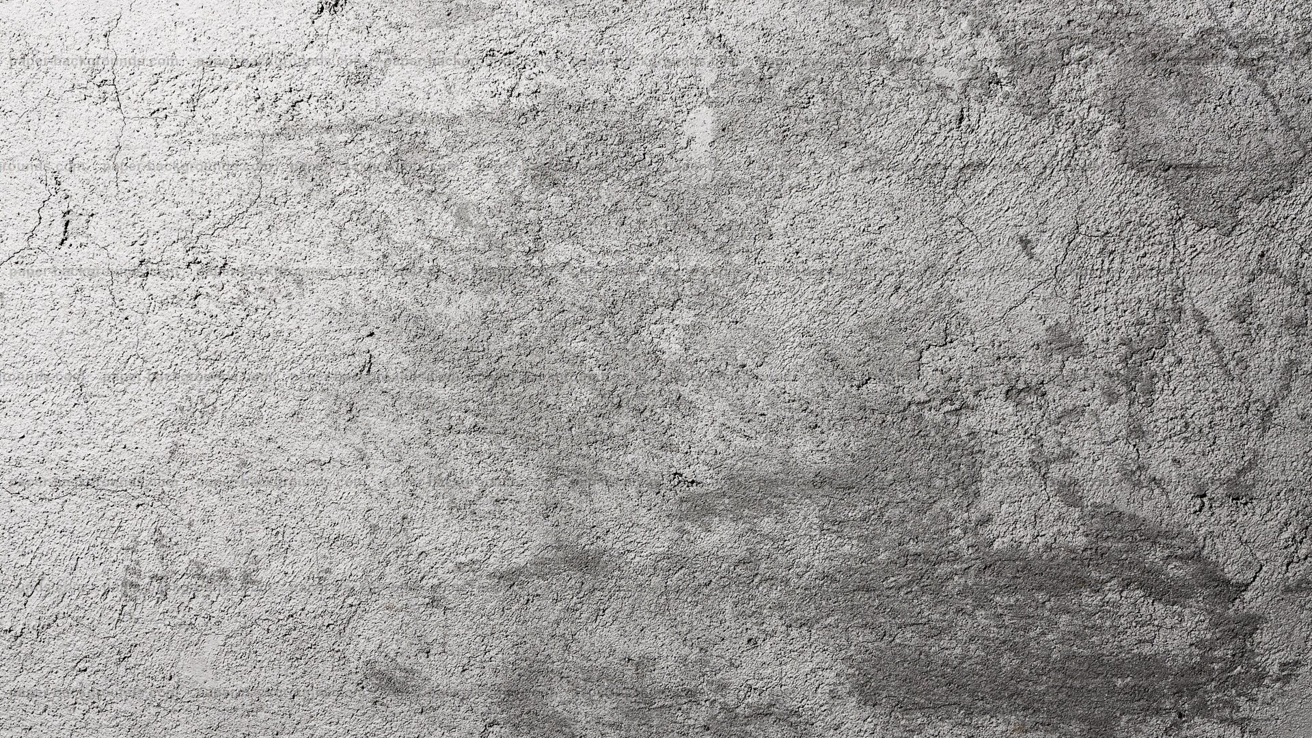
Topic 6. Aggression and violence in family relationships

Slide 2
1. The system of family relationships
Being one of the most important factors of socialization, the family has a significant impact on the direction of the child's behavior.
It may be influenced by the features of the two levels of family relationships.
Level 1. The system of interpersonal relationships. This level consists of a variety of dyadic and triadic relationships.

Slide 3
1. The system of family relationships
Level 2. The system of interactions in the family.
It includes:
marital relationship (between the spouses),
parent-parent relationship ( between the spouses, but as parents),
parent-child relationship (from parent to child),
child-parent relationship (from child to parent) and
children-children relationship (between children).

Slide 4
1. The system of family relationships
Behavioral disorders in children can occur both as a result of the direct and indirect influence - through the system of family relationships or through the developement of negative emotional state.
Studies show [I. A. Furmanov, 1999] that many behavioral disorders are determined not so much by the flaws of the actual system and style of upbringing, but by the peculiarities of the child's perception and interpretation of certain actions of the parent.

Slide 5
1. The system of family relationships
D. Olweus [1980] studied the link between the aggressiveness of the child and such parameters as:
1) mother's hostility, alienation, coldness and indifference to the child;
2) mother's tolerant attitude to the child's aggression directed at peers or family members;
3) the use of forceful disciplinary methods by parents — physical punishments, threats, scandals;
4) the child's temperament — the level of his activity and quick temper.

Slide 6
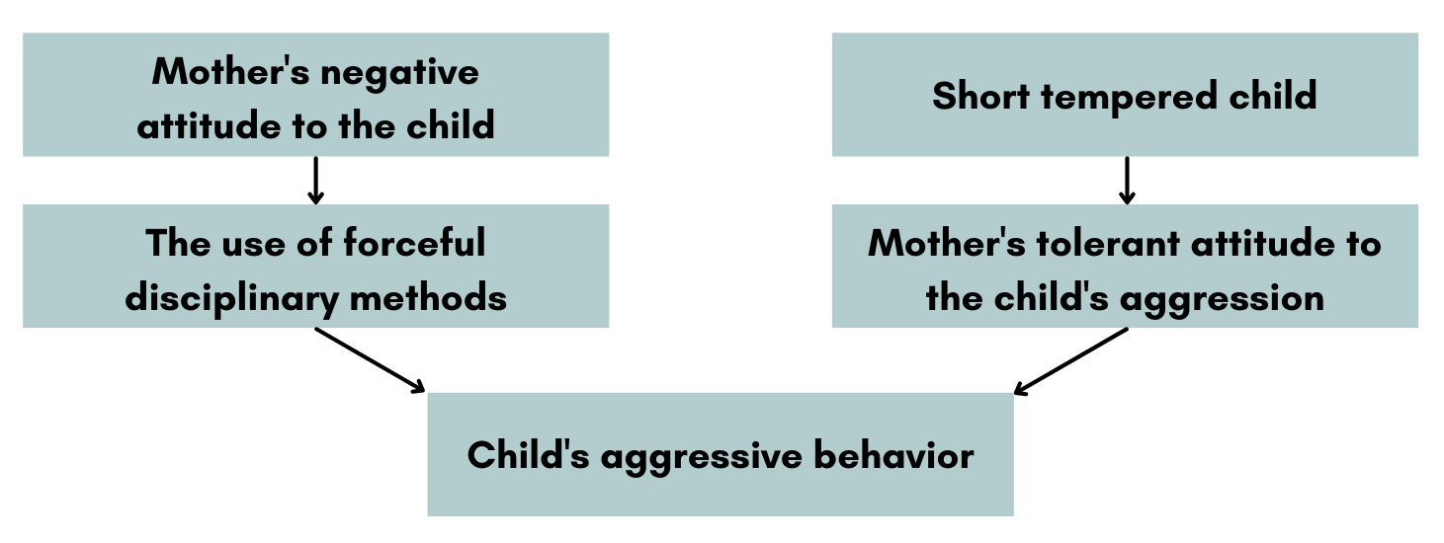
1. The system of family relationships
Mother's negative attitude to the child correlates with the use of forceful disciplinary measures, which, in turn, provoke child's aggressive behavior.
The likelihood of aggression increases if parents show too little interest and love for their child and give them too much freedom while not restricting their aggressive behavior.

Slide 7
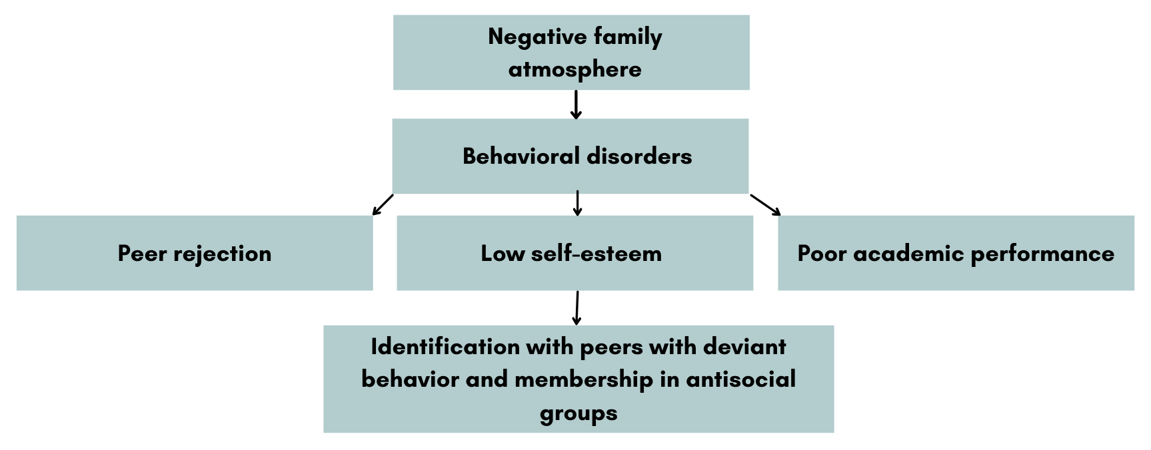
1. The system of family relationships
G. R. Patterson (1976) described a model of connection between the nature of family leadership and aggressiveness, the so-called Compulsion model.

Slide 8
1. The system of family relationships
G. R. Patterson: the child's tendency to antisocial behavior develops when the parents use aversive measures in order to prevent child's undesirable actions directed against them or their other children.
For example, when the parent asks the child to do some chores, the child start to resists. As the parent increases the pressure, the child increasingly refuses to do what he is being forced to do. He then starts yelling at the parent and eventually just runs off. If the parent doesn't react to such a behavior, then this behavioral model is fixed. The more often this type of parent-child interaction will occur, the more erratic child's behavior will become, and the less attention and positive feedback they'll receive from the parent.
A decrease in both positive and negative reinforcement leads to many psychological problems for both the child themself and their family members.

Slide 9
2. Criteria for parenting style assessment
The level of protection in the process of upbringing. It includes the effort, attention and time parents devote to raising a child. Two levels can be distinguished.
Hyperprotection is a situation when parents devote an extremely large amount of time, effort and attention to the child, and their life is built around that child's upbringing.
Hypoprotection is a situation when the child doesn't get enough of the parents' attention. The child often falls out of their sight. They pay attention to them only time to time, when something serious happens.

Slide 10
2. Criteria for parenting style assessment
2) The level of need satisfaction, an extent to which the parents’ efforts are aimed at meeting both the material (food, clothing, entertainment) and psychological (communication with parents, their love and attention) needs of their child. This parenting feature is fundamentally different from the level of patronage, since it measures not the degree of parents’ involvement in child’s upbringing, but the degree of child’s satisfaction. The so-called "Spartan upbringing" is an example of a high level of patronage (since the parents are actively engaged in the process of upbringing) and a low level of satisfaction of the child's needs. There are two extreme degrees of need satisfaction:
Pandering. It is characterized by the parents’ unconditional and uncritical attitude to the satisfaction of their child’s needs. Any child’s wish becomes the law.
Ignore. It is characterized by the parents’ insufficient or non-existing desire to fulfill the needs of the child. The psychological needs are more likely to be neglected, especially the need for emotional contact and communication with a parent.

Slide 11
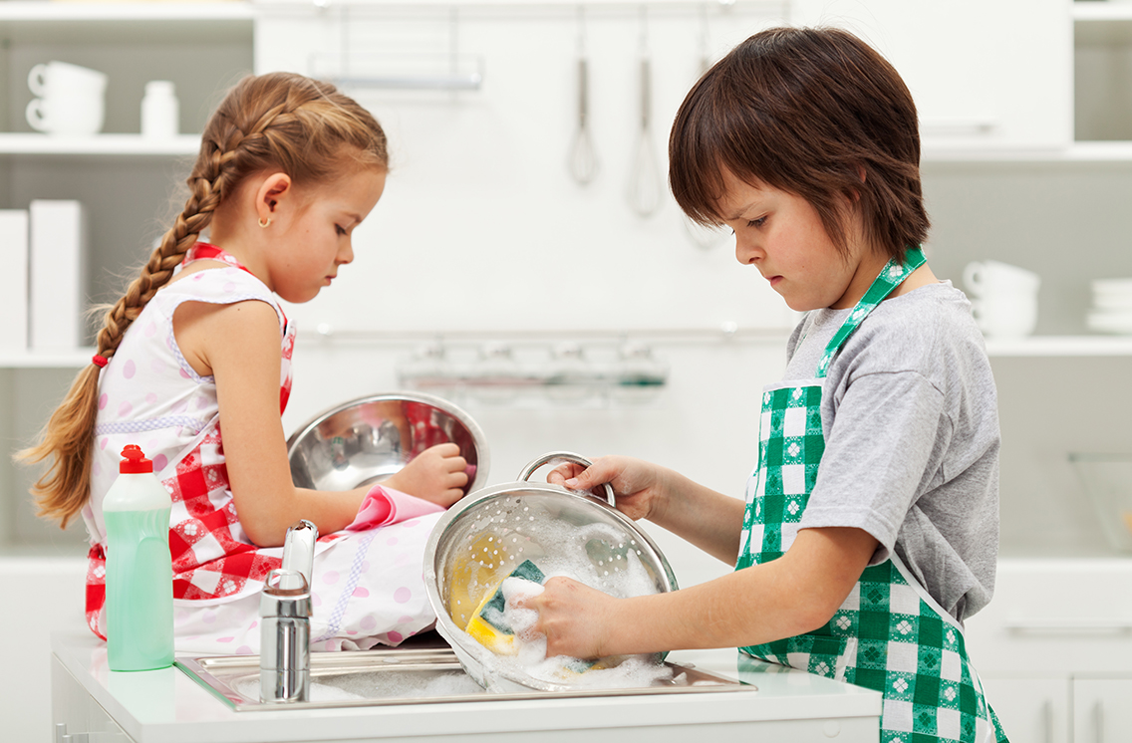
2. Criteria for parenting style assessment
3) The amount and level of requirements for a child.
Excessive requirements-responsibilities. In this case the requirements are very high. And the child is unable to meet them. Not only they don’t contribute to the development of the child’s personality, but, on the contrary, create a risk of psychological trauma.
Insufficient requirements-responsibilities. In this case, the child has a minimum number of responsibilities in the family. This feature of education is manifested in the statements of parents about how difficult it is to attract a child to any business at home.

Slide 12
2. Criteria for parenting style assessment
3) The amount and level of requirements for a child. Excessive sanctions. These parents tend to use strict punishments and overreact even to minor act of misbehavior. Minimal sanctions. Parents prefer either to do without punishments at all or use them extremely rarely. They rely on rewards and doubt the effectiveness of any punishments. Based on various combinations of the above criteria, it is possible to describe a number of parenting strategies that provoke behavioral disorders.

Slide 13
3. Parenting styles and behavioral disorders in children
Authoritarian hyperprotection.
In this style of parenting, the child is given a lot of time and attention, but not provided with emotional support. The child’s needs are ignored, and the parents often use punishments.

Slide 14
3. Parenting styles and behavioral disorders in children
2) Dominant hyperprotection.
The child is put at the center of attention. The parents strive to fulfill their every need while setting the exorbitant, often unrealistic expectations for them. In case if the child fail to meet the requirements, the parents resort to very strict punishment. Strict control over child’s behavior even in minor aspects and excessive imposition of parental will are depriving the child of the independence, initiative, sense of responsibility and duty.

Slide 15
3. Parenting styles and behavioral disorders in children
3) Demanding hyperprotection.
Parents are ready to devote a lot of time, effort and attention to the child, but at the same time they set extremely high expectations for him, often not corresponding to his real possibilities. Excessive worries and responsibilities are put on the child, which can result in neurotic symptoms.

Slide 16
3. Parenting styles and behavioral disorders in children
4) Limiting hyperprotection.
The only difference from the previous parenting style is the degree of child’s independence. In the previous parenting style, the child is given the opportunity to choose the way of behavior, while in this case the freedom to make decisions and choose actions is significantly limited by a huge number of requirements. It such a situation the child can develop not only aggressiveness, but also emancipation reactions, which are manifested in open disobedience, rudeness, and disregard for conventional norms.

Slide 17
3. Parenting styles and behavioral disorders in children
5) Condescending hyperprotection.
Children are under constant supervision, parents control everything: the choice of friends, clothes, entertainment. Children are placed under high demands and numerous prohibitions that significantly restrict their freedom and independence. With such upbringing, the child becomes indecisive, fearful, lacking initiative and self-confidence. The dominant emotion is resentment for not being allowed to do what others do, which results in the rebellion against parental dominance and the tendency to confront other people.

Slide 18
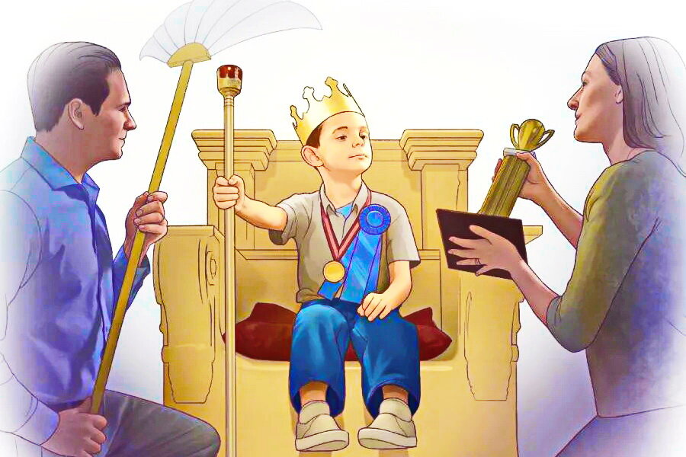
3. Parenting styles and behavioral disorders in children
6) Indulgent hyperprotection is characterized by the close attention that parents pay to the issues of upbringing and fulfilling the child’s needs. The child is treated as the idol of the family. Parents rather patronize than control them, trying to free the child from the slightest difficulties or from boring unpleasant chores. they constantly admire the child’s imaginary talents and exaggerate their real qualities.

Slide 19
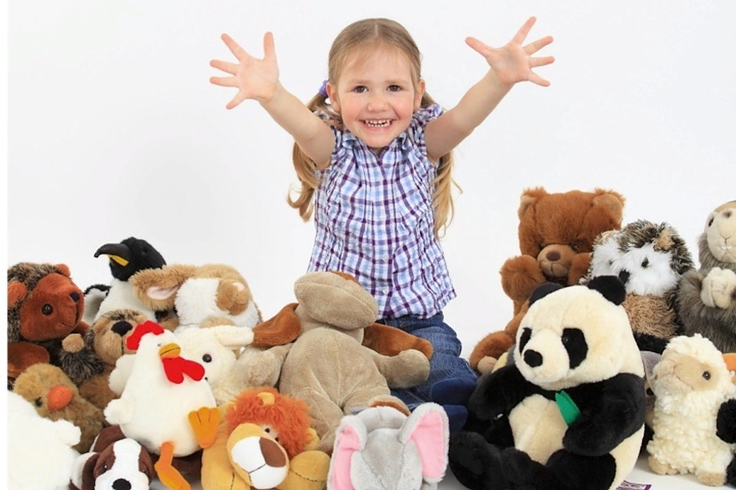
3. Parenting styles and behavioral disorders in children
7) Indulgent hypoprotection.
This style of parenting is characterized by the lack of interest and control on the parents’ part. The practice of "cajoling" children and uncritical attitude to the satisfaction of their needs are quite common in such families.

Slide 20
3. Parenting styles and behavioral disorders in children
8) Hidden hypoprotection.
This style is typical for families where parents are too busy to pay enough attention to their children. The requirements for the children are quite high though, sometimes unrealistically so. But the child's contribution to the family responsibilities is formal, since it’s not controlled by the parents in any way.

Slide 21
3. Parenting styles and behavioral disorders in children
9) Hypoprotection with ill-treatment. In this style of parenting, the child doesn't get enough of the parents' attention. The child often falls out of their sight. The parents pay attention to them only from time to time, when something serious happens. The parents do not seek to fulfill the child’s needs and overreact to any misbehavior.

Slide 22
3. Parenting styles and behavioral disorders in children
10) Hidden hypoprotection with ill-treatment.
It is characterized by the parents’ complete refusal to solve parenting problems, by the ignore of the child’s interests and needs, and the emotional coldness. All interactions with the child are based solely on the presentation of excessive, exorbitant demands and strict punishments for failure or disobedience. Based on the lack of sympathy and love for the child, this parenting style not only strengthens the emancipation reaction, but also causes strong affective reactions of the extrapunitive type (open expression of anger and irritability).

Slide 23
3. Parenting styles and behavioral disorders in children
11) Severe hypoprotection.
The child is left to their own devices. Parents have no interest in raising a child nor the desire to involve him in family affairs. At the same time, parents are characterized by an overreaction to minor violations of behavior (commitment to the use of strict punishments).

Slide 24
3. Parenting styles and behavioral disorders in children
12) Brutal hypoprotection is the case of parents’ complete detachment from the process of raising a child, who is severely punished for the slightest misdemeanor or disobedience. This kind of parents’ behavior creates an atmosphere of despotism and tyranny. As a result, the child may become cruel and bitter.

Slide 25
3. Parenting styles and behavioral disorders in children
13) Emotional rejection.
This parenting style is characterized by the emotional rejection, indifference and coldness on the parents’ part, so the child feels like a burden to their parents. In this case, two models of upbringing are possible.
Certain requirements are set for a child, freedom and independence are limited by a rigid system of prohibitions and restrictions, the violation of which is severely punished. This situation may lead to personality accentuation, neuroticism, excessive frustration sensitivity and anger.
Permissiveness, on the contrary, prevails. Everything is allowed. If there are any prohibitions in the family, a child can easily break them, knowing that there will be left scot-free. A child has complete freedom to choose their own life rules, friends, addictions.

Slide 26
3. Parenting styles and behavioral disorders in children
14) Increased moral responsibility.
It is characterized by a combination of high requirements for a child and a lack of attention from the parents. Cases like this occurs in families which have an atmosphere of emotional indifference and permissiveness, but at the same time parents expect from their children much more results than they can really achieve. In addition, parents often apply severe punishment even for minor misbehavior. As the result, a child develops a stable opposition reaction, which manifests itself in categorical refusals to carry out any assignments, to engage in an disliked activity, deliberate rudeness and disobedience. Slowly accumulating resentment often manifests itself in pre-planned actions aimed at taking revenge on the offenders: children can spoil their parent's things, slander them, write obscene words on walls, etc.

Slide 27
3. Parenting styles and behavioral disorders in children
15) Demanding treatment.
This parenting style is characterized by parents' insufficient desire to satisfy the child's needs, both material and psychological. But at the same time, overly high demands are imposed on a child, which often do not correspond to their real capabilities.
Unfulfilled needs(especially for emotional contact, love and attention) and inadequately high demands disrupt child's development and create a risk of psychological trauma.

Slide 28
3. Parenting styles and behavioral disorders in children
16) Brutal attitude.
The distinctive feature of this style is the complete restriction of child's freedom and independence. In such a situation children may develop a reaction of emancipation, that is, a strong need to break free from parental control and guardianship in order to gain self-affirmation and independence. Thus, children show disobedience, ignore the adults, sabotage the existing order and traditions.

Slide 29
3. Parenting styles and behavioral disorders in children
17) Ill-treatment.
The whole method of education is built on a system of punishments, often physical.

Slide 30
The correlation between the parenting style and behavioral disorders in children and adolescents
 | Parenting style | Behavioral disorders
 |  | Boys | Girls
1. | Authoritarian hyperprotection | Verbal aggression, general aggressiveness | General aggressiveness, asocial aggressiveness, indirect aggression
2. | Dominant hyperprotection | Destructive aggressiveness
3. | Demanding hyperprotection | General aggressiveness, asocial aggressiveness, physical aggression, verbal aggression
4. | Limiting hyperprotection | General aggressiveness, asocial aggressiveness
5. | Condescending hyperprotection | Physical aggression, verbal aggression | Destructive aggressiveness
6. | Indulgent hyperprotection | Destructive aggressiveness | Asocial aggressiveness, verbal aggression, negativism, destructive aggressiveness
7. | Indulgent hypoprotection |  | Destructive aggressiveness
8. | Hidden hypoprotection | Destructive aggressiveness | Physical aggression
9. | Hypoprotection with ill-treatment |  | General aggressiveness, negativism, asocial aggressiveness
10. | Hidden hypoprotection with ill-treatment |  | Physical aggression
11. | Severe hypoprotection | Destructive aggressiveness | Indirect aggression
12. | Brutal hypoprotection | Physical aggression

Slide 31
The correlation between the parenting style and behavioral disorders in children and adolescents
 | Parenting style | Behavioral disorders
 |  | Boys | Girls
13. | Emotional rejection | Asocial aggressiveness, general aggressiveness | Asocial aggressiveness, general aggressiveness
14. | Increased moral responsibility | Indirect aggression, negativism | General aggressiveness
15. | Demanding treatment | General aggressiveness, indirect aggression, destructive aggressiveness | Destructive aggressiveness
16. | Brutal attitude | Destructive aggressiveness | Destructive aggressiveness, asocial aggressiveness
17. | Ill-treatment | General aggressiveness, asocial aggressiveness | Negativism, general aggressiveness, asocial aggressiveness

Slide 32
4. Parenting-related factors and behavioral disorders
Instability of parenting style.
A sharp change in style or methods of parenting may indicate parents' hesitation, for example, shifting from a very strict style to a liberal one and back. The inconsistence of parenting style contributes to the development of such character traits as stubbornness and a tendency to oppose oneself to any authority.

Slide 33
4. Parenting-related factors and behavioral disorders
2) Expansion of the area of parental feelings.
Typically, this phenomenon is observed in cases of parenting disorders such as indulging or dominant hyperprotection. It happens when the marital relationships between parents are broken: one of the spouses is gone (death, divorce), or their relationships does not satisfy the parent who plays the main role in child rearing. At the same time, parents (mother more likely than father) often unconsciously want the child to become something more than just a child. They want their child to (at least partly) satisfy the needs that in ordinary family must be satisfied in the relationship between spouses, that is, the need for mutual exclusive affection, partly erotic. Mothers can even reject the possibility of remarriage.

Slide 34
4. Parenting-related factors and behavioral disorders
3) Preference for childish qualities in a growing child. This type of parenting disorder is caused by indulging hyperprotection. Parents ignore the growth of their children and encourage such childish qualities as spontaneity, naivety, playfulness. They often openly admit that older children are no longer as interesting to them as small ones.
Considering a child as "still small", the parents reduce their requirements, thereby stimulating the development of mental infantilism.

Slide 35
4. Parenting-related factors and behavioral disorders
4) Uncertainty of a parent as a caregiver. It is usually observed in cases of such parenting disorders as indulging hyperprotection or reduced level of requirements. In this case, there is a power redistribution in the family between a parent and a child in the favor of the last one. The parent is inferior even in those matters in which, in one's opinion, it is unacceptable to concede. This happens because the child is able to find an approach to the parent, find his weak point and achieve the "minimum requirements, maximum rights" situation. The most typical combination in such a family is a lively, self-confident child who boldly puts forward their demands, and an indecisive parent who blames themself for all the parenting failures.

Slide 36
4. Parenting-related factors and behavioral disorders
5) Child loss phobia. This factor is usually based on indulging or dominant hyperprotection. Parent's weak spot is heightened uncertainty, fear of making mistakes, exaggerated ideas about the child's fragility, etc. Such experiences may be related to the child's birth - parents have been waiting a child for a long time, they were born fragile and painful, and so on. Serious illnesses can also be the cause.

Slide 37
4. Parenting-related factors and behavioral disorders
6) Underdeveloped parental feelings.
This type of parenting implies hypoprotection, emotional rejection and abuse. Adequate upbringing of children is possible only if there are sufficiently strong motives: duty, sympathy, love, the need to realize oneself in children. Weakness and underdevelopment of parental feelings is often found in parents of children with pronounced character traits. However, this phenomenon is very rarely recognized, and even less often acknowledged. Outwardly, it manifests itself in a unwilling to deal with a child, in a superficial interest in their affairs.
The reason may be in the rejection of a parent oneself in childhood. Another reason may be in characteristics of the parent's character, for example, in pronounced schizoidism.
It has been noticed that parental feelings are often much less developed amongst too young parents and tend to increase with years.

Slide 38
4. Parenting-related factors and behavioral disorders
7) Projection of one’s own unwanted qualities onto a child.
This factor usually forms the basis of emotional rejection and abuse. Often the reason is that the parents see child's character traits which they feel, but do not recognize in themselves (aggressiveness, laziness, craving for alcohol, negativism, incontinence, etc.). Fighting with the same (real or imaginary) child's qualities, a parent (more likely the father)gets emotional benefit for himself. Fighting an undesirable quality in someone else helps to believe that one does not have this quality oneself.

Slide 39
4. Parenting-related factors and behavioral disorders
8) Extending the conflict between spouses into the parenting area.
This factor is the reason of the conflicting upbringing. Parenting often turns into a battlefield for conflicting parents even in relatively stable families. Here they get an opportunity to openly express their dissatisfaction with each other, hiding behind the concern about the welfare of the child. At the same time, parents' opinions are most often diametrically opposite: one insists on a very strict upbringing, while the other tend to feel sorry for the child. A typical manifestation is the expression of dissatisfaction with the upbringing methods of the other spouse. At the same time, it is easy to find out that both are more interested in winning the dispute than in raising the child.

Slide 40
4. Parenting-related factors and behavioral disorders
9) Preferences for masculine or feminine qualities in a child.
Parent's attitude to a child is often determined by the traits of their gender. Thus, with a preference to female qualities in a child, there is an unconscious rejection of male attributes. In this case, one may encounter stereotypical negative judgments about men: “Men are generally rude and unkempt. They give in easily to animal urges, they are aggressive and overly sexual, prone to alcoholism. Any person, be it a man or a woman, should strive to the opposite qualities - to be gentle, delicate, neat, restrained in feelings." These are the qualities that parents want to see in women.

Slide 41
5. Family structure and communication model as risk factors
Incomplete and/or large families. Often, an incomplete or large family creates more prerequisites for stress than an ordinary family. It happens due to a more difficult financial situation, parents’ lack of free time, and an uneven distribution of attention between children. The instability of the family, which significantly complicates the development of the family system, is a serious stress factor for both the parent and the children, for example, when the mother often changes partners. In this case, the relationships between the children and the parent’s partner develop differently and are often impermanent and unstable due to the status of the new family member; some difficulties can also be caused by the specific partner-centered position of the parent.

Slide 42
5. Family structure and communication model as risk factors
2. Families with stepfathers or adoptive parents.
Numerous studies show, that the risk of sexual violence against girls increases in families with stepfathers.

Slide 43
5. Family structure and communication model as risk factors
3. Conflicting or abusive relationships between family members.
As it was already noted, parents who solve conflicts with each other through violence tend to use it for the purpose of submission in relationship with children too. Women who are abused by their husbands are significantly more likely to be violent with their children.

Slide 44
5. Family structure and communication model as risk factors
4. Spousal relationship problems.
Financial, psychological, sexual dissatisfaction, as well as lack of emotional support and warmth can affect the mother’s psychological well-being and ultimately determine her attitude towards children. Abandoned women or those who are dissatisfied with their relationships are more likely to be unable to show affection and establish close and trusting relationship with their children.

Slide 45
5. Family structure and communication model as risk factors
5. Parent-child relationship problems.
The risk of violence significantly increases in families where there is no attachment between parents and children. In addition, at a later age a child may have difficulties in showing independence and forming close relationships since there are no role models and suitable conditions for acquiring basic skills in communication, acquisition of existing moral norms, developing an ability to solve one's own problems and establish necessary emotional connections.

Slide 46
5. Family structure and communication model as risk factors
6. Emotional and physical isolation of family. Isolation manifests itself in the absence of social contacts, formal and informal support. In particular, the lack of someone close to the family with whom one could share one's problems or leave a child in order to take time for oneself, the distancing of one of the parents from raising a child, etc.

