Slide 1
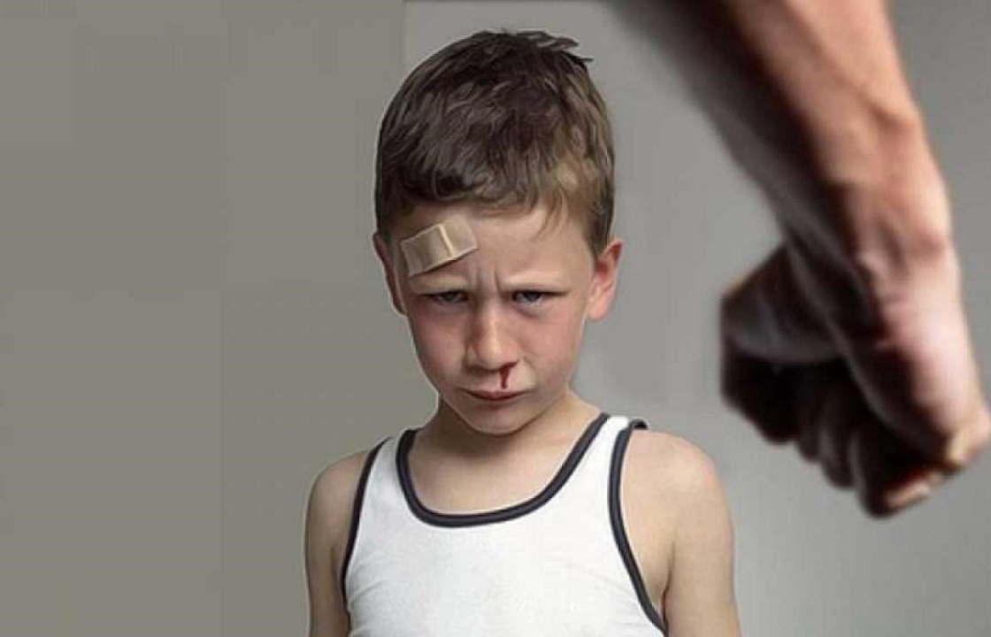
Topic 4: Child abuse

Slide 2
1. Child physical abuse
Child abuse is quite common. It can be carried out both in explicit, open (sexual, physical violence), and in hidden (psychological violence) forms. The most frequent victims of violence, both from adults and peers, are: 1) children who are neglected, abandoned and emotionally rejected, do not receive sufficient care and emotional warmth, as well as have a lag in psychophysical development, are easily indoctrinated, are not able to assess the degree of danger and resist violence; 2) street kids;

Slide 3
1. Child physical abuse
The most common victims of violence from both adults and peers are: 3) children who are brought up in the abusive athmosphere, who see the world as hostile, and are ready to become victims of violence from the strong and show it to the weak themselves; 4) children who are brought up in an environment of unquestioning submission and do not know how to say "no", with unclear internal boundaries of personality that make them unable to resist violence, fearful and anxious; 5) children with neuropsychiatric disorders (oligophrenia, personality disorders-psychopathy, the consequences of organic brain damage, etc.) and physical disabilities; 6) small children due to their helplessness.

Slide 4
1. Child physical abuse
According to various international studies, 3 children die every day due to child abuse or lack of proper care. In more than half of all cases of bodily harm to children, they were physically abused by their parents, and fathers and mothers are involved in this approximately equally.
Among other persons convicted of child abuse, the number of men exceeds the number of women by 4 times.
Boys are more likely to be physically abused.
Young children suffer more severe physical injuries than the older ones. About half of all cases involving serious bodily injury or death occur in children under the age of 3 years

Slide 5
1. Child physical abuse
Many abused children are considered difficult, «mentally retarded», bad, selfish, and disobedient by their parents. Hyperactive children are most often subjected to physical punishment, especially if their parents are not able to provide them with proper care.
Physical abuse is usually woman’s fault, not man’s. One of the parents initiates the use of force, and the other passively puts up with it. The average age of mothers who use physical force against children is 26 years, and fathers are 30 years old.
In most cases, physical punishment of children occurs in families with low socio-economic status.

Slide 6
1. Child physical abuse
Physical abuse is an intentional act of violence that cause physical and mental pain and suffering to a child. It can include beatings, burns, bites, choking, whipping with a belt or other objects, bone fractures, scarring, serious internal injuries as well as damage to physical development, health and vital body functions.

Slide 7
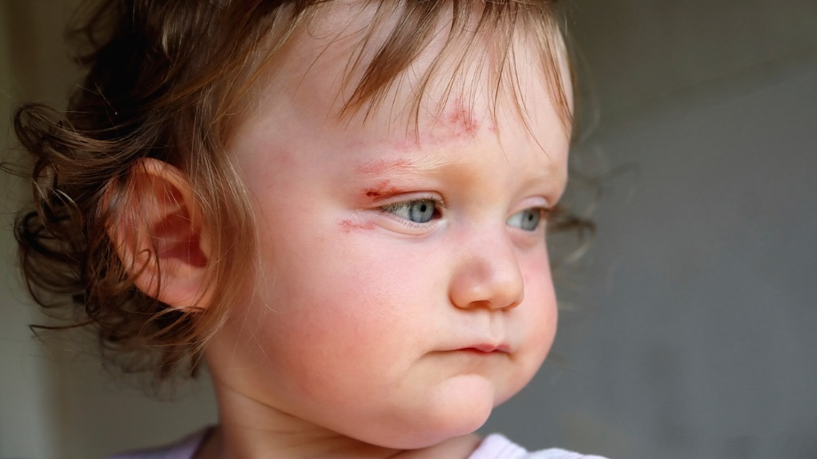
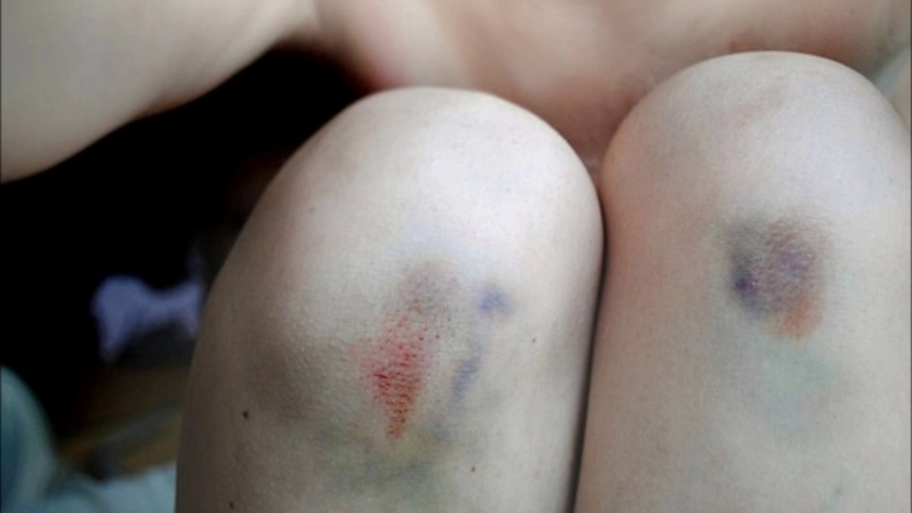
1. Child physical abuse
Signs of physical violence Physical (externally observable) signs include: bitemarks, bruises, scratches, scars, binding marks, nail marks, and finger compression marks;
traces of blows from objects (belt, stick, rope, etc.);
burns;
hairless areas of skin on the head;
fractures in unusual places;
swelling on the face or limbs;
pallor;
injuries to internal organs (ruptured liver, bruised kidneys, bladder as a result of a blow to the stomach or side);
an unusual condition of the child after forcibly taking alcohol or medication;
On repeated physical violence can be the judge in the case, if on the child's body there are traces of different prescription (wounds, bruises, etc.).

Slide 8
1. Child physical abuse
Signs of physical violence Behavioral signs include:
avoiding physical contact with other people;
frozen, frightened look (even in babies);
fear at the sound of other children screaming or crying;
wearing clothes that don’t show much skin to hide bruises etc;
refusing to change clothes in front of others;
unintelligible or contradictory explanations of the causes of the damage;
fear of parents;
constantly arriving late or skipping school;
early arrival at school/kindergarten and very late departure home;
difficulties in communication with other children;
disrespect to others;
excessive obedience;
passivity, isolation, or increased aggressiveness;
aggressive games, often causing damage to peers;
self-destructive behavior (alcohol, drug use, smoking);
unexplained changes in behavior (previously cheerful child is now constantly sad, thoughtful, withdrawn);
complaints of pain during movement or contact;
long-term experience of running away from home;
child's desperate pleas not to tell his parents about his failures at school;
stories about parental violence.

Slide 9
1. Child physical abuse
Family-related signs include:
personal and marital problems;
financial stress;
a situation when the parents themselves were subjected to violence as children or grew up in a family with a strict discipline;
high level of moralization;
long-term alcohol or drug use;
mental instability;
social isolation, lack of support from family or friends;
viewing the child as the source of all ills or evils;
little or no interest in the child's well-being;
the inexplicably contemptuous, dismissive attitude of a parent towards a child;
indifference to the child's pain;
family traditions of strict discipline;
inconsistent, contradictory or evasive explanation of the reasons for child’s injuries; assigning responsibility for the damage to the child;
constant criticism, unreasonable demands from the child.

Slide 10
1. Child physical abuse
Consequences of physical abuse.
1. Traumatic stress reactions. Fear and anxiety are quite typical reactions to the threat of physical violence. The reaction can also manifest itself in sleep disorders, insomnia, poor appetite, and psychosomatic complaints. Often the fear is generalized, that is, it extends not only to the abuser, but to other adults too.

Slide 11
1. Child physical abuse
Consequences of physical abuse.
2. Increased aggressiveness and impulsive behavior. Physically abused children often show aggressive destructive behavior both at home and at school. It can include bullying, pugnacity, aggression towards their peers and siblings, and uncontrolled behavior. Such behavioral disorders are often associated with a lack of impulse control or are based on the children’s identification with their parents who are prone to violence (identification with the aggressor) as a basic defense against feeling of anxiety and helplessness. Abused children are often involved in criminal and antisocial activities. They usually have few friends, because, on the one hand, their peers are often afraid of their explosive, impulsive behavior, and on the other hand, these children try to distance themselves from others out of fear of hurting them..

Slide 12
1. Child physical abuse
Consequences of physical abuse.
3. Suspicion and distrust. For these children who have experienced parental betrayal, violence, physical punishment, verbal abuse, it is very difficult to establish relationship based on trust, especially with adults. They often don’t expect any support, care or help from their parents and may believe that all potential objects of love are dangerous and unpredictable.

Slide 13
1. Child physical abuse
Consequences of physical abuse.
4. Depression and suicidal behavior. These children often have symptoms of depression, accompanied by sadness and inability to feel joy. Sometimes physically abused children show self-destructive behavior: self-harm, suicidal attempts or desires.

Slide 14
1. Child physical abuse
Последствия физического насилия
5. Low self-esteem. Victims of physical violence often think of themselves with discontent and contempt. Over time, low self-esteem can be disguised in a many ways, for examole with fantasies of omnipotence.

Slide 15
1. Child physical abuse
Последствия физического насилия
6. Developmental and cognitive disorders. Children who have been constantly punished for crying and shouting often have speech disorders.

Slide 16
1. Child physical abuse
Последствия физического насилия
7. Problems with communication. Abused children have poor control over their emotions and behavior and generally don’t trust much in society. As a result of a long-term study on 5-year-old children who were subjected to physical abuse, psychologists found that these children experienced more difficulties in relationships with their peers than children of their age who were brought up in a normal environment. They were less popular with their peers and more withdrawn, and their problems in communication with peers grew every year of the observation. Kraig, 2000].

Slide 17
1. Child physical abuse
Consequences of physical violence
8. Nervous system problems. While not having any head injuries, these children may have symptoms of nervous system problems. It is likely that the multiple hardships, such as parental abuse, neglect, nutritional deficiencies, and incomplete sensory stimulation, that can lead to such symptoms.

Slide 18
1. Child physical abuse
Consequences of physical violence
9. Loss of interest in school. Children who grow up in the atmosphere of physical violence often fail at school due to a decrease in cognitive motivation and increased distraction, hyperactivity, and specific learning difficulties. These children often cause conflicts at school due to their low self-control and aggressive behavior towards peers and adults. Peers often try to avoid them or, on the contrary, to take revenge on them. It affects negatively their school motivation.

Slide 19
1. Child physical abuse
Consequences of physical violence
10. Poor academic performance of children with post-traumatic stress disorder is often due to difficulties in concentration, as their thoughts are constantly occupied with the problem of their existence as a victim, as well as the titanic efforts aimed at repressing the emerging traumatic memories. The social isolation of the child can spread to the entire school environment and gradually lead to the avoidance of learning, to the refusal to attend school.

Slide 20
1. Child physical abuse
The causes of ill-treatment of children The psychiatric model.
The psychiatric model focuses on the personality and family history of the parents. The basic idea is that abusive parents are mentally ill and require psychiatric treatment. However, researchers haven’t been able to identify a set of personality traits associated with a tendency to abuse children.
The only fact they were able to establish is that many adults who have shown cruelty towards children were subjected to such treatment themselves. It is not clear why the baton of child abuse passes from one generation to the next. One of the most plausible explanations is that people who were abused in childhood, start imitating violent role models and simply reproduce their parents’ abusive behavior in relationship with their own children. Perhaps, in childhood they were taught that it is unacceptable to rely on their care or, on the contrary, not to take them into account; that crying and asking for help is useless, inappropriate, or is a sign of a bad character. Having learned the lessons of cruelty at an early age, people often apply the same "education“ methods to their children.

Slide 21
1. Child physical abuse
The causes of ill-treatment of children Sociological model. The emphasis here is on the propaganda broadcast in the media and the suggestion that violence is a perfectly acceptable way to resolve conflicts. Besides, the likelihood of physical aggression in the parent-child relationship increases due to such factors as the physical aggression in quarrels between husband and wife and the widespread opinion that physical punishment is an effective form of education. The majority of parents still physically punish their children, although many of them try to do it moderately. The comparison with more peaceful societies, where disciplinary measures are mainly focused on love, shows that violence here is much less common, including children abuse.

Slide 22
1. Child physical abuse
The causes of ill-treatment of children
Poverty also plays an important role in child abuse. Although child abuse can be found in all classes of society, it is almost 7 times more common in poor families. This statistics can be partly explained by the fact that cases of child abuse in middle-class families are often successfully hidden. It is also true, however, that any tension in the family (and poverty is undoubtedly the source of such a tension) increases the risk of ill-treatment of the child.

Slide 23
1. Child physical abuse
The causes of ill-treatment of children
Another risk factor is unemployment. During the periods of high unemployment level, the number of cases of men abusing their wives and children increases significantly. Parents who suddenly lose their jobs begin to take out their anger and irritation on their children. Unemployment not only brings financial problems, but also reduces the social status and damages self-esteem of the person who lost his job. The unemployed father can try to make up for these losses by achieving unquestioning submission of family members with the use of physical force.

Slide 24
1. Child physical abuse
The causes of ill-treatment of children
Another common feature of abusive families is social isolation. The parents often live in isolation from their relatives, friends and local organs of social welfare. It is difficult for them to maintain friendly relationships with others, and they rarely become members of any public organizations or associations. Sometimes they simply have no one to ask for help in difficult situations, and they take their irritation and anger out on their own children.

Slide 25
1. Child physical abuse
The causes of ill-treatment of children
Situation model.
According to this model, the causes of child abuse lie in environmental factors. The most important of them is the form of interaction between family members, where children are considered as active participants of the process. In families with frequent child abuse parents tend to single out one child as a scapegoat. The most frequent objects of parental cruelty are young children, those with physical and mental health problems, extremely resentful children and constantly crying babies who often become a source of irritation for parents. In other cases, the cause may lie in the discrepancy between parental expectations and child's reaction. For example, a mother who’s used to express her love physically finds out that her child doesn’t like being touched. In some cases, parents have an unrealistic idea about children behavior. For example, a father may get angry if a 3-year-old child does not clean their room. Such misconceptions can also lead to child abuse.

Slide 26
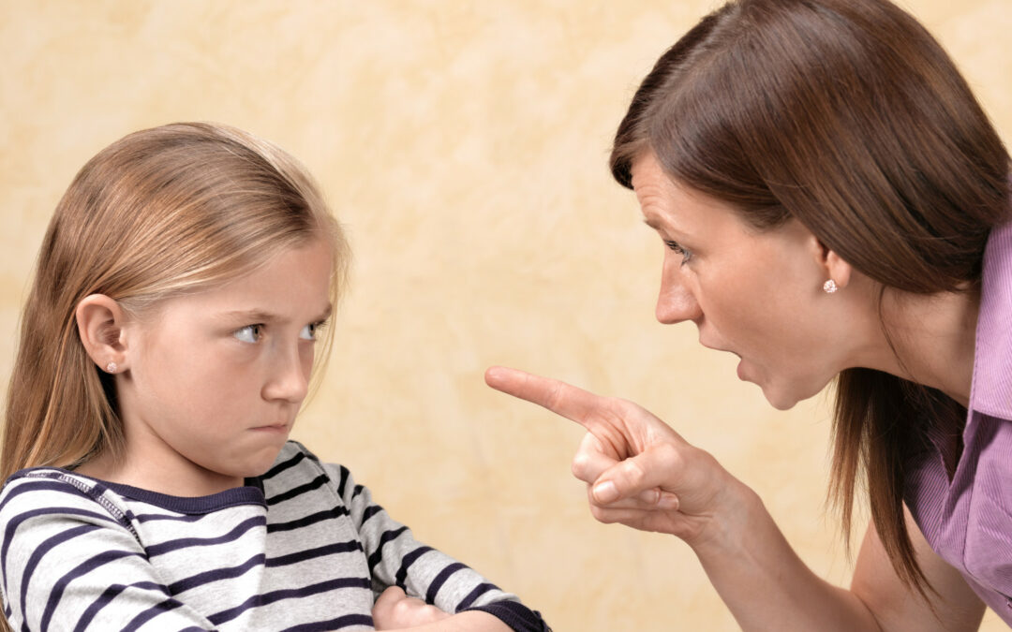
2. Child psychological abuse
Psychological abuse = emotional abuse. Child psychological abuse include a periodic or constant insulting, humiliation, threats, yelling.

Slide 27
2. Child psychological abuse
Neglect is a deliberate ignore of child's biological needs or creation of unfavorable conditions for their satisfaction, as well as unacceptable actions that damage child's development and life.
Ill-treatment of children exists in the context of interpersonal relationships, and these relationships are psychologically abusive: manipulative, rejecting or demeaning. It can result in severe psychological trauma.

Slide 28
2. Child psychological abuse
Forms of psychological abuse
1) Rejection. When active rejection takes place, a parent refuses to fulfill with child's requests or needs, while demonstrating strong dislike.

Slide 29
2. Child psychological abuse
Forms of psychological abuse
2) Denial of emotional response. A passive form of abuse when the child is denied any warm feelings. It consists in excessive coldness, unwillingness or inability to respond to the child's communication attempts.

Slide 30
2. Child psychological abuse
Forms of psychological abuse
3) Humiliation of a child in the presence of others or a constant mocking, use of the offensive nicknames and obscene language towards them. Frequent insults to a child's dignity or mental abilities cause lack of self-esteem and self-respect.

Slide 31
2. Child psychological abuse
Forms of psychological abuse
4) Intimidation. Parents itentionally keep the child in the state of fear and constant tension, intimidate them, force to witness abuse of a loved one, or threaten to use violence against the child.
A child who hears such threats as: "If you misbehave, I will tear your head off!", live in constant fear. One of the intimidation forms is to leave a misbehaving child on the street, where he or she is exposed to danger.

Slide 32
2. Child psychological abuse
Forms of psychological abuse
5) Isolation. Isolation from normal communication, prohibition of playing with friends or taking part in family activities, all of it can be a form of psychological abuse. Such isolation methods as locking a child in a dark room, wardrobe, closet, or shed can also be considered as intimidation.

Slide 33
2. Child psychological abuse
Forms of psychological abuse
6) Exploitation. Excessive, not age-appropriate demands from a child or the exploitation of the child's innocence or weakness (the most obvious example of exploitation is sexual abuse).

Slide 34
2. Child psychological abuse
Forms of psychological abuse
7) Bargaining. Manipulating a child with the use of negative reinforcement (for example, a ban on watching TV or playing with friends if the child didn’t do homework).

Slide 35
2. Child psychological abuse
Signs of psychological abuse
Physical (externally observable) signs include:
thumb sucking,
monotonous swaying (autoerotic actions);
Nocturnal and/or daytime enuresis;
psychosomatic complaints: headache, abdomen or heart ache, saying that they are ill;
slowing down of the physical, mental or general development of a child.

Slide 36
2. Child psychological abuse
Signs of psychological abuse
Behavioral signs include :
emotional insensitivity, indifference or excessive vulnerability;
lack of self-esteem and self-respect;
frustration;
sadness or severe depression;
self-absorption, thoughtfulness, or aggressiveness;
"Stickiness" to any adult in search of attention and warmth;
social helplessness;
night fear attacks, poor sleep;
lack of interest in games.

Slide 37
2. Child psychological abuse
Signs of psychological abuse
Social indicators (that is, the characteristics of the family environment that speak for child psychological abuse) include:
excessive demands from a child which they are not able to cope with;
unpredictable parental behavior towards a child;
severe punishment;
extremely critical attitude, constant accusations;
Taking the anger out on a child or intimidating a child.

Slide 38
2. Child psychological abuse
Praise, gratitude, joy and pride are natural parental responses to a child's success. However, it happens that parents are indifferent or irritated. At first, it gives the child mixed feelings. The child who repeatedly has to deal with such a response to their positive behavior and feelings, will lose motivation for achievement. The conclusion drawn is that it’s unacceptable and sometimes even dangerous to show joy and pleasure in one's accomplishments.
Because of the unstable, inconsistent attitude from parents, a child experiences emotional deprivation and often becomes a victim of emotional and psychological abuse. Constant experience of negative emotions due to the conflicts and violence in the family, as well as the inability to share their feelings with anyone or somehow reduce stress level leads to the emotional blunting. The so-called reduced affect display is a defense mechanism that becomes necessary for survival in such a situation.

Slide 39
2. Child psychological abuse
Studies show that children who have experienced violence have great difficulties with experiencing and expressing emotions, their empathy is less developed and they are not able to understand the feelings of other people. Growing up, these children often do not know how to express their feelings, are afraid of them, and tend to avoid the situations where the feelings are affected.

Slide 40
2. Child physical abuse
Raising a child under conditions of emotional and psychological abuse can lead to personality disorders:
low self-esteem,
stable sense of self-worthlessness,
deep feelings of guilt and shame for one’s existence.

Slide 41
2. Child physical abuse
If a child constantly expects humiliation, insults and punishment or perceives parents as the main source of danger, they may develop pessimism, a feeling of hopelessness. They often don’t believe in themselves, become indecisive, and therefore will tirelessly try to gain authority at any cost.
The feeling of worthlessness can make some of the children leave their home and become street children.

Slide 42
2. Child psychological abuse
Punishments and their consequences
A lot of parents have to punish their children, even those who think they shouldn't do this. However, the effect of punishment is highly doubted. Parents think that if they resort to punishment, they can force their children to obey and change, but in reality it can only show their impatience and anger.

Slide 43
2. Child psychological abuse
Punishments and their consequences
According to Erich Fromm, there is a number of dangers that arise when parents use punishments. 1) Punishment very often does not correct the child's behavior, but only transforms it, one act of misconduct is replaced by another. But the behavior itself is still wrong and can lead to even more disastrous consequences. 2) Punishment make the child afraid of losing parental love. They feel rejected by parents and often become jealous of their siblings. The punished child may develop hostility towards the parents.

Slide 44
2. Child psychological abuse
Punishments and their consequences
Frequent punishment in one way or another make the child to remain immature. Usually they are punished because of some childish tricks. But the desire to achieve the forbidden does not disappear, and a child decides that, perhaps, it is not worth giving up on it, if they can pay off with just a punishment. That is, he suffers punishment in order to pay off, clear his conscience and keep this up, and so on.
Punishment can help the child to get attention of their parents. Although children primarily need parental love, they often look for attention as a poor imitation of love. After all, sometimes it is much easier to attract parents' attention by misbehaving than by remaining kind and obedient all the time.

Slide 45
2. Child psychological abuse
As the result of constant punishments, there is nothing left of the love for relatives but the appearance or the habit of it - or nothing at all. Children’s actions become directed against the family. They behave as if they lack a sense of solidarity, they don’t develop relationships with others and perceive the neighbors as being hostile. They are always on the alert, afraid of deception. Mistrust is present in all respects, that is why the number of difficulties in communication increases all the time and destructive inclinations can arise.

