Slide 1
Topic: 4 MECHANISMS OF DEVELOPEMENT OF THE BEHAVIORAL DISORDERS:
AGE-RELATED AND GENDER-SPECIFIC FEATURES OF AGGRESSION

Slide 2
1. Age-related features of aggression
Aggressive behavior shows from an early age.
The most common causes of human aggression, regardless of age, are the desire to commit retribution, non-compliance with the rules and the intention to take possession of toys, things (property) or territory.

Slide 3
1. Age-related features of aggression: Babies (0-1)
In infancy, aggression manifests itself almost exclusively in impulsive bouts of stubbornness, often beyond the control of adults. It is most often expressed in outbursts of anger, accompanied by shouting, kicking, biting, pinching, pugnacity. The reason for this behavior, on the one hand, is the blocking of desires or the planned course of actions as a result of either improper care of the child or the educational influence, which limits or restricts the enjoyment of pleasure. The child resists and becomes stubborn and hostile.

Slide 4
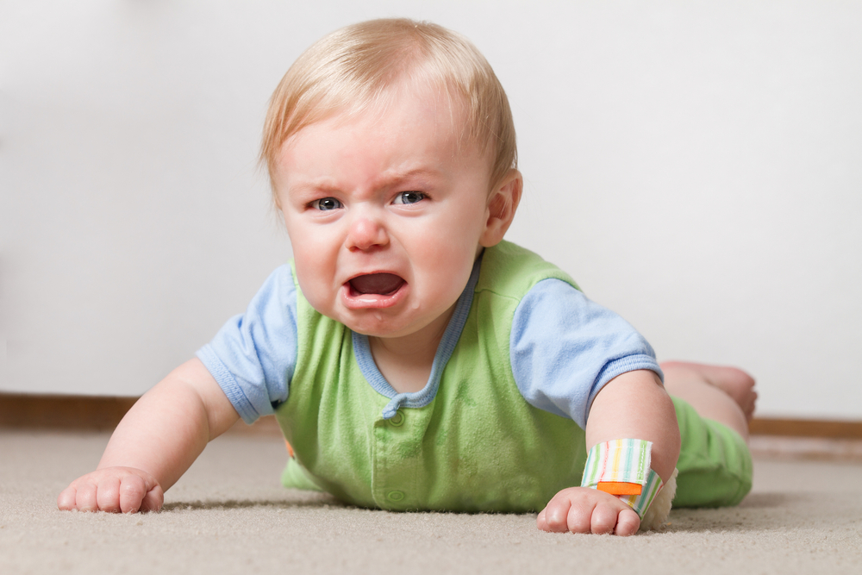
1. Age-related features of aggression: Babies (0-1)
Aggressive manifestations at this age are nothing more than a motor-affective process of releasing the instinctive impulses for which there is no other way out.

Slide 5
1. Age-related features of aggression: Babies (0-1)
Babies’ aggressive actions are initially directed at themselves, as they scratch and bite themself, but during the first month of life the aggression is redirected outwards.
Due to the fact that the babies are not yet able to clearly distinguish between the inner and the outer, they may abuse mother's breast, face, hands or hair, as if they are parts of their own body.
This behavior can be considered conditionally aggressive, since the child has no intention to cause harm to others, and such behavior is caused by a state of discomfort, frustration or helplessness. It is rather an expression of displeasure.

Slide 6
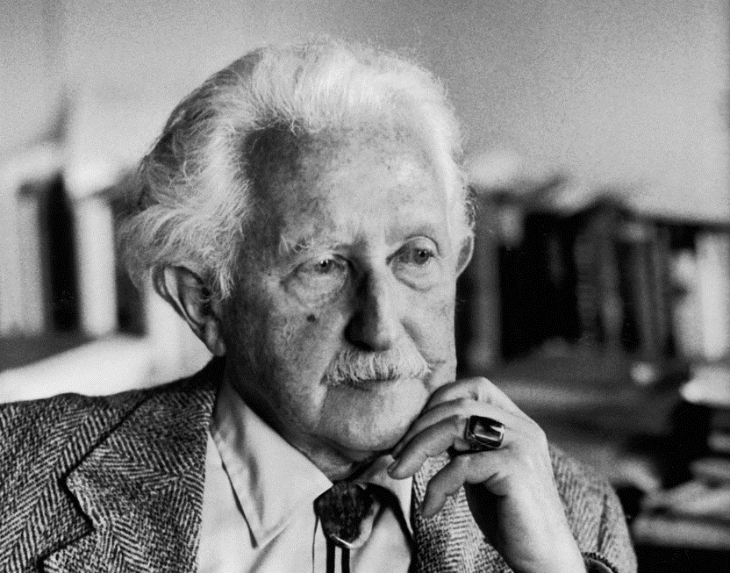
1. Age-related features of aggression: Toddlers (1-3)
In early childhood, conflicts and quarrels related to the ownership of things, most often toys, are increasingly brought to the fore. They make 78% of all conflicts between 18 months old children. During this stage of development, the number of cases of physical violence amongst children increases more than fivefold, outbursts of rage become more targeted, and the child's behavior can be clearly identified as an attack. According to E. Erikson, it probably happens because of the certain adaptation mechanisms, which prevail at this stage and are called "holding" and "letting go".

Slide 7
1. Age-related features of aggression: Toddlers (1-3)
Conflicts between "possess" and "give" can lead to the development of either hostile or benevolent attitude. Holding can become both destructive (a rough grip or refusal to part with the favorite toy) and constructive (taking care of the toy, trying to keep it safe). Letting go can also turn into a desire to give free rein to your destructive passions, or a passive willingness to "leave everything as it is" and rely on the natural course of events.

Slide 8
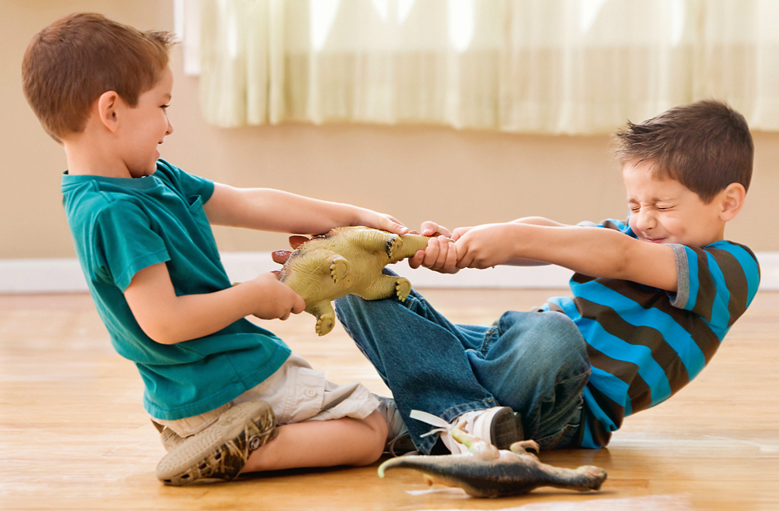
1. Age-related features of aggression: Toddlers (1-3)
The vast majority of children of 1.5-2 years do not voluntarily share their toys or do so only because they yield to the authority of their parents while crying or showing obvious reluctance and resentment. Most importantly, as soon as the opportunity arises they try to take back these toys, often applying physical force.

Slide 9
1. Возрастные особенности проявления агрессии: раннее детство (1-3)
Children place their things within the inner boundaries of the Self and see them as parts of themselves. The inability to differentiate and the merging of all parts of the "Self" can lead to the inability of establishing contact with others in this area of relationship.
Mother's request to “let this boy play with your car" will be perceived as close to “tear off your hand and let another child wear it".

Slide 10
1. Возрастные особенности проявления агрессии: раннее детство (1-3)
Observations of children's conflicts during play activities suggest that each child has its own circle of toys, which it includes in the internal boundaries of the “Ego". The selectivity of the child in relation to toys is obvious and is in itself of some diagnostic and psychotherapeutic value. Conflicts between children related to the possession of things and toys arise when these boundaries intersect, that is, several children "put their eyes" on the same toy, or one child tries to expand their boundaries by seizing other people's toys.

Slide 11
1. Age-related features of aggression: Toddlers (1-3)
By the age of 3 the child gradually learns to control the aggressive impulses and express them in an acceptable way. Manifestations of aggression at this age mainly depend on the parents’ reaction and attitude to certain forms of behavior. If parents don’t tolerate any kind of overt aggression, then child will resort to symbolic forms of aggression, such as whining, snorting, stubbornness, disobedience, and other types of resistance.

Slide 12
1. Age-related features of aggression: Toddlers (1-3)
At this age, the "research instinct" is strengthened and the child's social contacts expand significantly. At the same time, the child faces an entire new system of prohibitions, restrictions and social responsibilities.
Getting into a conflict situation between insatiable curiosity, spontaneous interest in everything new and unusual and parental prohibitions, the child experiences the strongest deprivation — the restriction of the ability to meet their needs. He perceives this situation as rejection on the part of his parents.

Slide 13
1. Age-related features of aggression: Toddlers (1-3)
The inability to resolve this conflict leads to anger, despair and aggressive tendencies in child’s behavior.
Previously parents reacted to the child’s aggressive behavior with a display of affection or attempts to distract the child and turn everything into a joke, now they often resort to threats and punishment such as deprivation of pleasure, isolation.

Slide 14
1. Age-related features of aggression: Toddlers (1-3)
The child thinks about how to react to the increasing sanctions from the parents, how to behave in the future to minimise the parental counter-aggression.
Most often, the child is unable to find a way out of this situation. It can lead to all sorts of mental disorders, which can be manifested in such reactions as loss of appetite, not asking for a potty, restless sleep.

Slide 15
2. Age-related features of aggression: Preschoolers (3-6)
Children’s aggressive behavior is connected to the process of gender and role identification or the "oedipal situation" in the family.
The use of the "Doll-play" technique (when a child plays with dolls that represent family members) allowed to establish that the boys are more aggressive towards dolls than girls.
The highest level of aggression in boys was observed in their reaction to the "father" doll, while the lowest was expressed in reaction to the "mother" doll (vice versa for the girls).
Boys who grow up with a father are more aggressive and independent than boys who grow up without a father.

Slide 16
2. Age-related features of aggression: Preschoolers (3-6)
During this period, parents take a more differentiated position in relation to the child, that is, they start perceiving the child as a boy or a girl.

Slide 17
2. Age-related features of aggression: Preschoolers (3-6)
"Identification with aggressor»
This is a defense mechanism that is triggered when a child faces a threat. At this age, it is usually criticism, verbal or physical aggression on the part of the parents. The child begins to identify themselfs with the aggressor by imitating physical and moral appearance of the aggressor, borrowing some symbols of his power. As Anna Freud noted, there is an effect of role reversal: the victim presents themself as the aggressor and often becomes one in order to protect themself, to avoid suffering and thinking of themself as a victim.

Slide 18
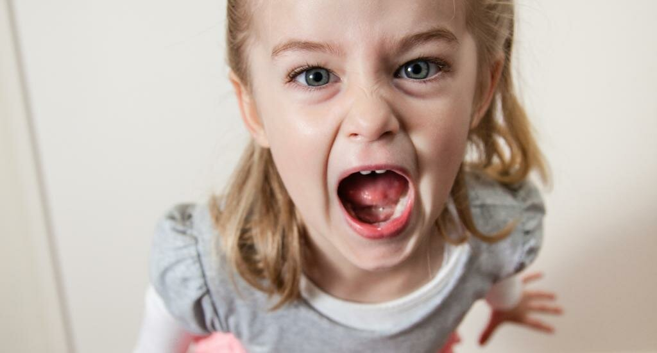
2. Age-related features of aggression: Preschoolers (3-6)
The influence of the immediate environment and the processes of awareness of one's own gender identity on the formation of aggressive behaviors can be easily traced if we compare the behavior of both boys and girls. At the age of 2 the arsenal of means of displaying aggressiveness include approximately the same proportion of crying, screaming and mutual slapping for boys and girls alike. By the age of 4 frustration and failures cause different reactions: boys mostly fight, while girls mostly scream.

Slide 19
2. Age-related features of aggression: Middle childhood (6-10)
During middle childhood stage girls tend to express aggression verbally, while boys prefer physical aggression.

Slide 20
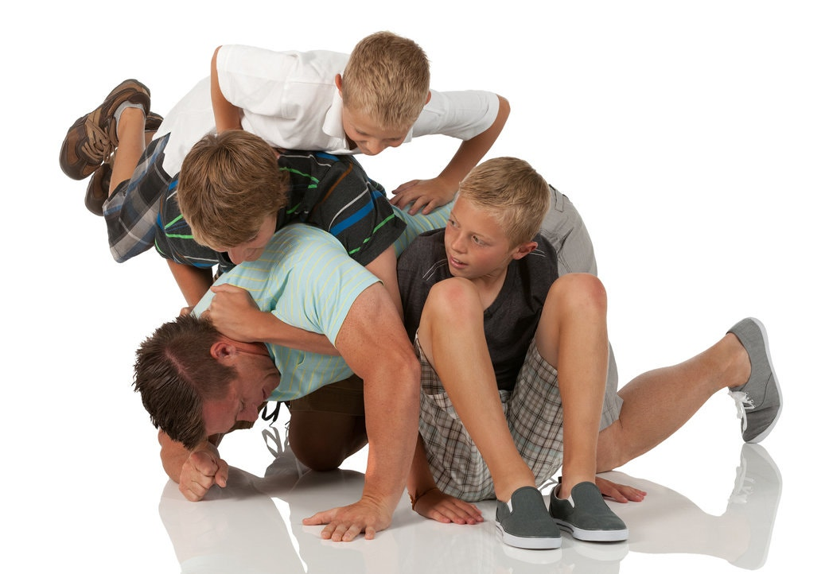
2. Age-related features of aggression: Middle childhood (6-10)
Brawl games. They are especially popular with the boys and are usually accompanied by blows, chasing each other, fighting, which usually become a source of irritation for parents and teachers. However, this behavior can hardly be considered aggressive. This is just a form of play, it is voluntary and brings children pleasure, one can often see smiles on children’s faces. In addition, if children were dissatisfied for some reason, they would rather try to avoid the aggressor. Brawl games ensure the development of certain positive qualities in children, such as motor skills, social affiliation, cooperative problem solving etc.

Slide 21
2. Age-related features of aggression: Middle childhood-adolescence
Adolescence, the existence of significant gender and age differences in the ways of expressing aggressiveness is even more clearly traced. Girls at the age of 11-15 mostly express aggression indirectly, in contrast to boys of the same age who resort to direct methods (physical aggression).

Slide 22
2. Age-related features of aggression: Middle childhood-adolescence
In early adolescence the tendency changes: boys' verbal aggression becomes dominant and they also more often resort to a verbal way of expressing negative feelings than girls of the same age.
At the same time, one notable feature of children's behavior is noted: children's aggressiveness becomes more and more hostile as they get older.

Slide 23
2. Age-related features of aggression: Middle childhood-adolescence
Regarding gender differences, it can be stated that boys of all ages have more propensity for physical aggression than girls.
Indirect aggression shows more in girls of all ages.

Slide 24
2. Age-related features of aggression: Adults
A numerous amount of studies has shown that tendencies in childhood and adolescence also appear in adulthood. Thus, men show more physical aggression, while women prone to verbal and indirect one.
The variation of the aggressive behavior is determined by such characteristics as irritability, emotional susceptibility and absent-mindedness in respond to an aggressive stimulus, as well as a tendency to hostile attribution (that is, to interpret the behavior of others as hostile one) and inadequately high self-esteem.

Slide 25
3. Gender-specific features of aggression
Numerous studies of individual development show that gender differences in aggressive behavior occur at about the third year of life.
It was found on the basis of a number of experimental studies that there are no differences for girls and boys in the frequency and duration of negative emotional reactions in the first years of life, but with years frequency and intensity for boys increase, and decrease for girls. This is explained by the fact that girls, having the same aggressive tendencies as boys, are afraid to show them because of their fear of punishment, while the aggression of boys is more acceptable is more acceptable by people around them. With years these patterns become established: the number of manifestations of aggression in the girls' behavior gradually decreases and they become less aggressive, even if they were very pugnacious in their early childhood.

Slide 26
3. Gender-specific features of aggression
R. Loeber and M. Stouthamer-Loeber’s research (1998) clearly indicate the existence of gender differences in aggressive behavior in different periods of child development
Gender differences in aggression in childhood and adolescence
Individual development stage | Manifestation | Gender differences
Baby | Frustration and anger | No
Toddler | Instrumantal aggression | Insignificant
Preschooler | Personal aggression. Physical aggression | Yes
Middle childhood | Indirect aggression | Yes
Adolescent | Group assault. Grave assault. Sexual assault. Murder. | Yes

Slide 27
3. Gender-specific features of aggression
The results of a large-scale cross-cultural study show more or less same trends
The ratio of manifestations of physical, verbal and indirect aggression in the behavior of children of different ages [according to K. Osterman, 1998]
Age | Girls | Boys
8 y.o. | indirect > verbal > physical | physical = verbal > indirect
11 y.o. | indirect > verbal > physical | physical = verbal > indirect
15 y.o. | indirect > verbal > physical | verbal > physical > indirect

Slide 28
3. Gender-specific features of aggression
According to traditional ideas about the features of the developments of male and female aggressiveness in ontogeny, both boys and girls learn to regulate their own aggressive impulses to varying degrees, but boys still have more opportunities to manifest their aggressiveness freely. Besides, if a child doesn't learn how to control their aggressive impulses in the development process, in the future this will lead to a predominant orientation towards peers in adolescence and to a tendency to riotous behavior in adolescence.

Slide 29
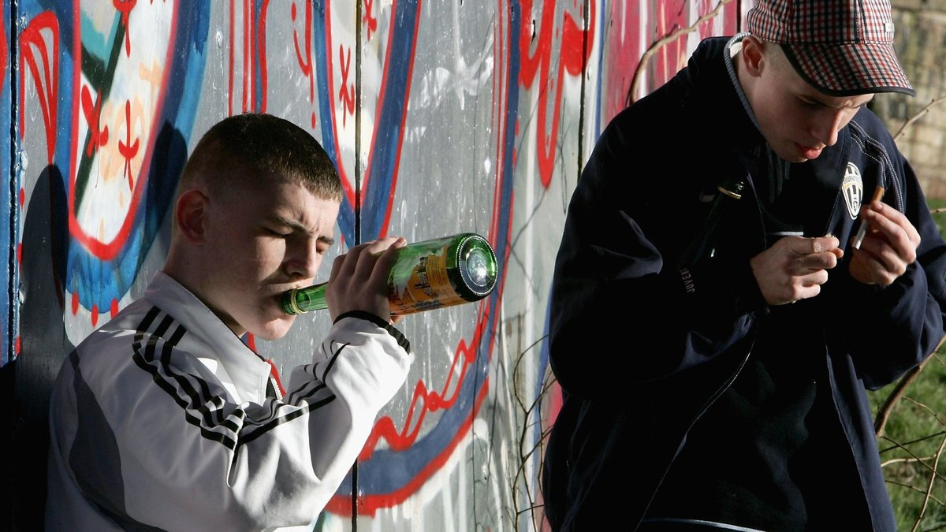
3. Gender-specific features of aggression
It was found [Pulkkinen, L, 1987] that the spontaneous expression of anger and the use of violence towards others at the ages of 8 to 14 lead to the use of physical force against others, wandering the streets, seeking pleasure in smoking, drinking alcohol and communicating with the opposite sex, and by the age of 20 it lead to the destructive actions, conflicts with parents, need for meetings with friends, drinking, smoking and having sex.

Slide 30
3. Gender-specific features of aggression
As the result of the assimilation of sociocultural experience, men and women have different models of aggressive behavior.
Thus, men prefer the use of physical aggression, while women prefer the indirect one. Verbal aggression is widely used by both men and women.

Slide 31
3. Gender-specific features of aggression
At the same time, significant differences were found between feelings and assessments of aggression.
Women often consider aggression as the result of excessive stress and loss of self-control. However, they experience stronger feeling of guilt and anxiety after aggressive actions.
Men consider aggressive actions as a way to regain lost control over others when their self-esteem, honor, dignity and integrity are threatened. At the same time, aggression is considered by men as an action of positive and instrumental nature.

Slide 32
3. Gender-specific features of aggression
Stability of aggressive behavior
While children are growing up, transformation and socialization of aggressiveness occurs in the process of age development and acquisition of social experience as the result of interaction with the outside world. Children change. Adults. According to longitudinal studies, aggressive behavior is indeed relatively stable. From the results of 16 studies of the stability of aggressiveness among men, D. Olveus [D. Oiweus, 1979] has concluded that the stability coefficient (r) at the age interval of 1 year is 0.76 (0.69 at the interval of 5 years and 0.60 at the interval of 10 years).These figures suggest that aggression level is almost as stable as intelligence, and stays so even over significant periods of time [R. L. Thorndike, 1933]. Female aggressiveness is also quite stable. However, the stability coefficients for women are significantly lower than for men: r=0.44 vs. r=0.56 [N. Zumkley, 1992].

Slide 33
3. Socialization of aggressiveness
Socialization of aggressiveness is a process of learning how to control one's own aggressive impulses or expressing them in forms that are acceptable in a particular community or civilization.
In this regard, it is necessary to consider in more detail main mechanisms of learning various forms of behavior: mimicking, copying, imitation and identification.

Slide 34
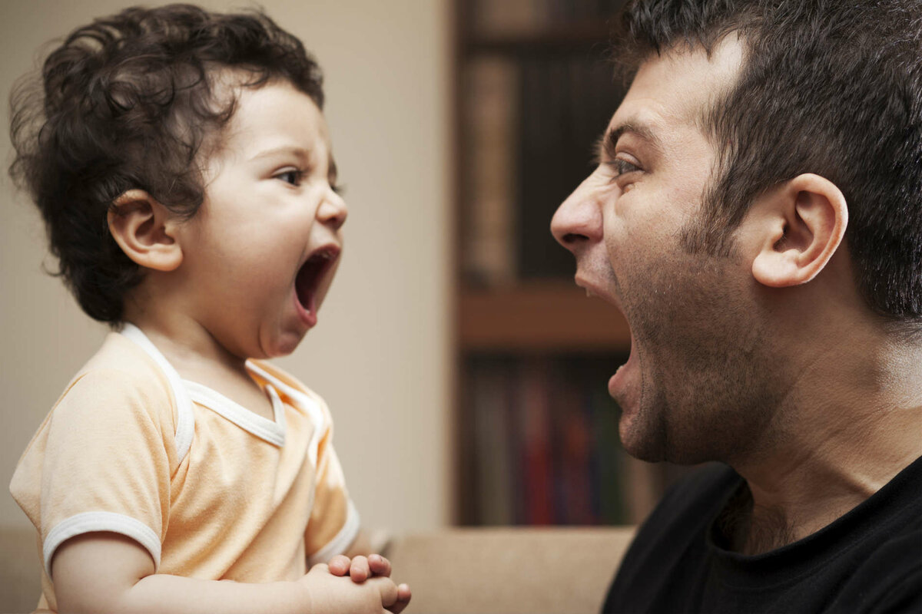
3. Socialization of aggressiveness
Mimicking is a reflection of mimic and pantomimic movements (sticking tongue out, opening/closing mouth, clenching fists, throwing objects, etc.), reproduction of pre-speech and speech vocalizations (intonation, tempo, volume, speech rhythm, etc.). Most often it is carried out on the basis of an infection mechanism. It already appears at 5 months, when a child can imagine oneself at the place of the one he imitates.

Slide 35
3. Socialization of aggressiveness
Copying is a reproduction of specific movements of an adult or movements which are connected with certain objects. To copy effectively, certain conditions must be met:
repeated demonstration of the model (sample);
designation of the model (sample) with a speech label;
giving a child an opportunity to manipulate (experiment) with the sample;
emotionally intense adult approval of reproduction (positive reinforcement).
This learning mechanism appears in the second half of infancy.

Slide 36
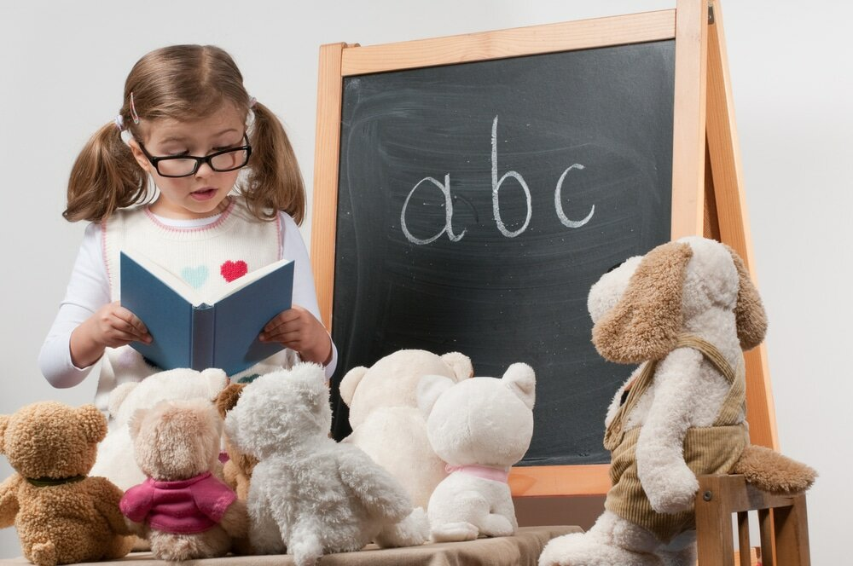
3. Socialization of aggressiveness
Imitation is a child's active reproduction of action methods, when an adult acts as an object of observation; as an example both in the objective and interpersonal sphere (relationships, assessments, emotional state, etc.). In general, it is to follow a model, but more conscious since it requires the selection not only of the model, but also its individual sides, features, and behaviors. Also, a comparison of oneself with the model and with the Ego ideal takes place.

Slide 37
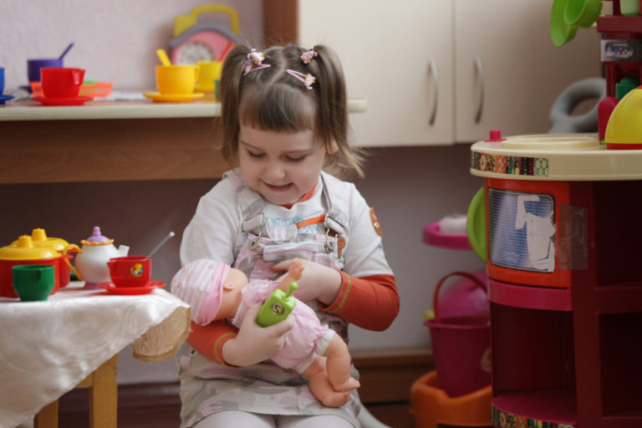
3. Socialization of aggressiveness
Identification is a process of assimilation, equating with someone or something. In general, it is an unconscious psychological process by means of which the subject assumes the properties of another person and transforms oneself (in whole or in part) according to one's model.
Identification covers three intersecting areas of psychic reality:
the processes of the subject uniting oneself with another individual or a group on the basis of stable emotional connection, when a person begins to behave as if they were the other; of uncritical and holistic inclusion in one's inner world; of acceptance another person's values and behavior models as one's own;
the subject's perception of another person as an extension of oneself; the projection, that is, endowing one with one's own features, feelings and desires;
the subject placing oneself in the other's place by immersion and transferring oneself into the space and time of another person, that allows one to explore and assimilate other people's personal meanings and experience.

Slide 38
3. Socialization of aggressiveness
There are two important factors in the socialization of aggression:
condescension (parental willingness to forgive the child's misdeeds)
the severity of the parental punishment for the child's aggressive behavior

Slide 39
3. Socialization of aggressiveness
The survey of mothers who used different methods of raising children, and an assessment of the child aggression level showed:
Children of the most indulgent parents and children of the most demanding parents differ a little in terms of their level of aggressiveness.
The least aggressive were those children whose parents were neither condescending nor prone to punishment. The position of these parents was to condemn the aggression and bring it to the attention of the child, but without severe punishment in case of misconduct.
Parents of the most aggressive children behaved as if any behavior of their children was acceptable. They didn't show their negative attitude towards aggressive manifestations. But at the same time the child who committed an offense was severely punished.
The conclusion is, a severe punishment in an uncertain situation causes child's hostility(since one does not understand what he was punished for) and further aggressiveness.
Besides, a punishing parent unintentionally sets an example of an aggressive behavior for the child.

Slide 40
3. Socialization of aggressiveness
There is an interesting pattern of parental violence and aggression in children:
Boys whose parents used harsh parenting methods were very aggressive in their interactions with peers and adults outside of home, while showing little direct aggression towards their parents.

Slide 41
3. Socialization of aggressiveness
Parental attitude to the children's behavior also differs depending on the gender of the child.
Fathers console and encourage daughters more often than sons, while mothers are more forgiving and tolerant to the sons (allow them to be more aggressive towards parents and other children) than to daughters.
Fathers prefer physical punishments while mothers prefer psychological influence.
In general, boys are more likely to be subjected to physical punishments than girls. At the same time boys show more resistance to frequent and severe punishments.

Slide 42
3. Socialization of aggressiveness
Thus, according to the social learning theory, the aggressive behavior can develop in several ways.
1) Parents encourage the aggressiveness of their children directly or set an example through the corresponding behavior towards others and the environment. Children who observe adult’s aggressive behavior (especially if said adult is a significant and authoritative person for them) usually adopt this form of behavior.
2) Parents punish children for manifestations of aggressiveness, but:
a) parents who severely suppress aggressive behavior will cause an excessive aggressiveness in their child, which will manifest itself later;
b) parents who don’t punish their children for being aggressive are likely to raise them to be overly aggressive;
c) parents who reasonably suppress aggression tend to successfully teach their children self-control in situations that can provoke aggressive behavior.

