Slide 1
Topic 3 PSYCHOLOGICAL THEORIES OF THE PRIGINS OF AGGRESSION
BEHAVIORAL AND COGNITIVE MODELS

Slide 2
1. BEHAVIORAL MODEL
Unlike others, the social learning theory says that aggression is a behavior learned in the process of socialization.
We can say that socialization of aggression is a process of learning to control one's own aggressive impulses or to express aggression in forms that are acceptable in a particular community or society.

Slide 3
1. BEHAVIORAL MODEL
The natural aggressive potential doesn't disappear when a person gets older. It's just that as a result of socialization, most people learn to control their aggressive impulses and adapt to the demands of society.
Some people remain very aggressive, but learn to manifest aggression more subtly: through verbal insults, hidden coercion, veiled demands, vandalism and in other ways.
Other people learn nothing and manifest their aggressive impulses through physical violence.

Slide 4
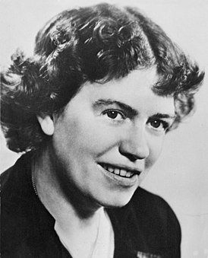
1. BEHAVIORAL MODEL
Margaret Mead found out that the socialization of aggression depends on three basic factors:
The child's early experience of living in a particular cultural environment
Family traditions
Emotional background of parents' relationship with the child.

Slide 5
1. BEHAVIORAL MODEL
While studying primitive societies M. Meed noted interesting facts.
In those societies where children have many negative experiences (rare contacts with their mothers, being alone for a long time, frequent punishments and no encouragement, adult’s indifference to children’s hostility toward each other), they tend to develop negative personality traits: anxiety, suspiciousness, high level of aggressiveness, selfishness and cruelty.

Slide 6
1. BEHAVIORAL MODEL
A completely different phenomenon was observed in communities where the whole structure of life was built on mutual support and cooperation: since birth parents and relatives surround children with care and attention, communication between adults and children is positive, punishments are rare.
The only thing that cause parents’ strictness and displeasure is children's aggressiveness. Fights and quarrels between children were immediately stopped and children were taught constructive behavior, for example, to transfer anger mainly to inanimate objects. As the result, children developed soft skills and an altruistic attitude towards others.

Slide 7
1. BEHAVIORAL MODEL
Thus, from the obtained empirical data, we can conclude that the socialization of aggression is influenced by two main factors:
observing an appropriate behavior
social reinforcement.

Slide 8
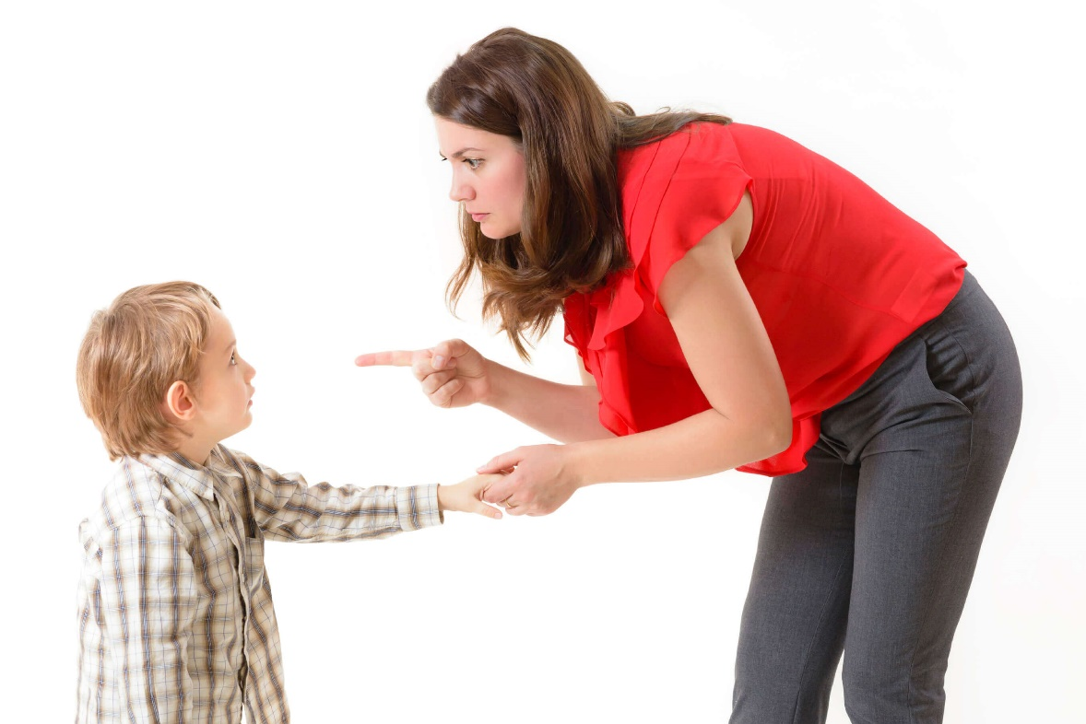
1. BEHAVIORAL MODEL
Social learning theory is, first of all, the study of pattern-oriented human behavior.
Considerable attention in this is paid to the study of the influence of parental relations and behavior on the children's aggressive behavior.
Parental behavior is a pattern of aggression, and aggressive parents usually have aggressive children.

Slide 9
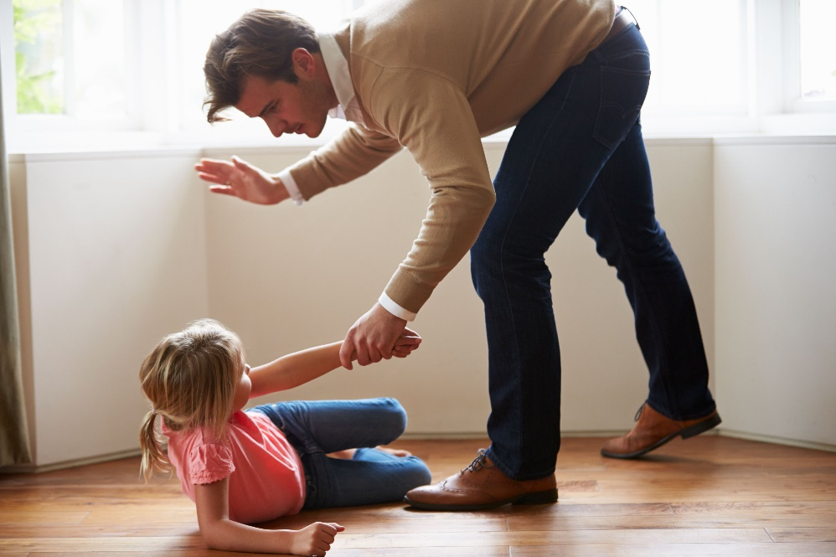
1. BEHAVIORAL MODEL
Baton of violence in the family
Children who have witnessed acts of physical violence in relationships between their own parents tend to reproduce similar behavior in communication with other people. This phenomenon is extended over time: people with such experiences in childhood become inclined to use physical abuse in relationships with their partners in adulthood. Moreover, fighting between spouses increases the probability of physical violence being used against their own children.

Slide 10
1. BEHAVIORAL MODEL
The cycle of violence
Abusive relationships in family (between spouses or between parents and children) are cyclical. There are several phases in the relationship between the "aggressor" and the "victim".
Build up phase
Honeymoon phase
Standover phase
Abuse
Pursuit phase
Remorse phase

Slide 11
1. BEHAVIORAL MODEL
1. Build up phase is characterized by a growing tension in the relationship. This phase is characterized by an growing tension in the relationship. Communication breakdown occurs (quarrels and scandals become more frequent). The aggressor is getting angry, threat of violent actions increases. The victim feels the need to calm the aggressor. Tension grows till its limit. The victim has a bad feeling. 2. Standover phase. The aggressor uses psychological violence (verbal attacks, coercion, intimidation) in order to gain control over the victim.
3. Explosion. Any act of physical, sexual or psychological abuse.

Slide 12
1. BEHAVIORAL MODEL
4. Remorse phase. The aggressor feels guilty, tries to minimize the consequences and does everything possible to prove that the violence will never happen again (begin to apologize, make promises, give gifts and in every possible way appease the victim). Blaming the victim for provoking violence is also possible. 5. Pursuit phase. The aggressor tries to The aggressor tries to convince the victim that he/she needs him/her and cannot live without him/her. If it doesn't work, the aggressor may turn to threats and violence
6. Honeymoon phase. The relationship between the aggressor and the victim become even closer than it was before the recent isolation. The aggressor keeps all the promises they made. The victim begins to believe and hope that the violence is over once and for all. Ultimately, however, the cycle of violence resumes.

Slide 13
1. BEHAVIORAL MODEL
When parents demonstrate an aggressive behavior by themselves, they "give children a lesson" about violence. In this case, the following effects may occur: Adaptation effect. A phenomenon when a child witnessing parental violence discovers a completely new behavior. By observing parents, they learn verbal and/or physical reactions that were previously absent in their behavior and with the help of which they can harm others or protect their interests (imitation and copying).

Slide 14
1. BEHAVIORAL MODEL
Lift of prohibitions
The child may conclude: "If others show aggression with impunity, then I am allowed to do the same."
Numbing or loss of emotional sensitivity is the phenomena when a child gets used to violence, its consequences and other people's pain so much that they stop to consider aggression as a special, extreme form of behavior.
Changes in the image of reality is a phenomena when children who observe endless violence become inclined to expect it at any moment, and therefore, begin to perceive the world around them as hostile towards them.

Slide 15
1. BEHAVIORAL MODEL
An important element of social learning theory is the reinforcement of aggressive behavior by others.
Reinforcement means an action designed to enhance a specific reaction. When it comes to social reinforcement, one should keep in mind intangible reinforcement, verbal and non-verbal communication controlled by other people. It can be praise and reprimand, smile and ridicule, friendly and hostile gestures.

Slide 16
1. BEHAVIORAL MODEL
There are many ways of reinforcement.
The most common are reward (pleasant stimuli) and punishment (unpleasant stimuli).

Slide 17
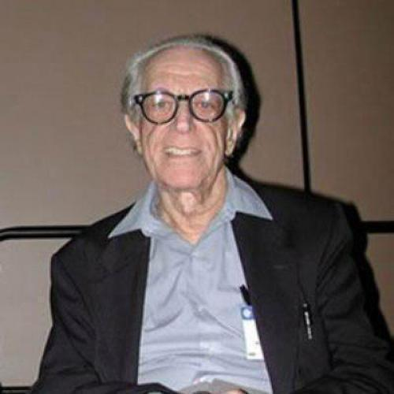
2. COGNITIVE MODEL
This approach is based on the theory of psychological dysfunction. It’s author, Albert Ellis, believed that the three main psychological aspects of human activity are cognition, emotion, and behavior (ABC theory).
All three aspects are connected, and a change in one of them often causes a change in the others.
If a person changes the way they think, that is, begins to think about an event in some other way, it is very likely that their emotional response to the event will change as well, and possibly their behavior will change as well.

Slide 18
2. COGNITIVE MODEL
Albert Ellis:
There are four main goals that people strive for:
1. survival, or the preservation of one's own life;
2. happiness, or life with the ultimate goal of maximizing pleasure or satisfaction and minimizing suffering or dissatisfaction;
3. social acceptance, or life in a community or a society where one feels good and accepted by others;
4. intimate relationships, or the affection for the loved ones.

Slide 19
2. COGNITIVE MODEL
Albert Ellis: Any thoughts, emotions or actions that contribute to the achievement of these goals are rational, reasonable or healthy.
Those that block or hinder the achievement of these goals are irrational, or unhealthy.
On this basis we distinguish two types of aggression: healthy and unhealthy.
Healthy aggression implies a person's aspiration to preserve their own life, to be happy, to adapt successfully in a social group, to establish close relationships with peers.
Unhealthy aggression blocks or hinders the pursuit of these basic human goals.

Slide 20
2. COGNITIVE MODEL
Albert Ellis:
The basic manifestations of human aggression include a wide variety of personality traits:
Irritability
Tendency to argue
Arrogance
Rage
Hostility
Tendency to insult
Violence

Slide 21
2. COGNITIVE MODEL
According to A. Ellis, assertiveness is the healthiest manifestation of aggression because it is not just desirable, but necessary for human survival.
Assertiveness is a person's ability to assert their rights with confidence and dignity without violating the rights of others. An assertive person is aware of their feelings, desires, and is able to express them, to stand up for their values, feeling comfortable while communicating with others.

Slide 22
2. COGNITIVE MODEL
According to the Ellis’ ABC theory, there are many events (A - activating event) in each person's life to which they respond with certain emotional and behavioral reactions (C - Consequences), and the stimulus (event) is not always the cause of that reaction (consequence).
Rather, the cognitive-emotional processing of information about the event (B - system of Beliefs) results in perception and interpretation of the Activating Event.
For example, if a person has been deceived by someone (A) and feels angry and aggressive (C), then they are really angry and resentful because they’re convinced (B) that they have been treated unfairly.

Slide 23
2. COGNITIVE MODEL
For the occurrence of healthy or unhealthy aggression it matters which belief, rational (rB) or irrational (iB), caused the emotional consequences.
For example, the emotion of irritation or annoyance at being cheated may arise in a person based on their rational belief: "I don't like being cheated upon. I'm annoyed because I've been treated so unfairly!"
But the same situation can also provoke anger based on an irrational belief: “I can’t be treted like that! The person who cheated on me is a scoundrel!"

Slide 24
2. COGNITIVE MODEL
Thus,
according to A. Ellis, the main criteria for distinguishing between healthy and unhealthy forms of aggression and emotional reactions are the presence or absence of the so-called neurotic set of feelings and reactions, which arise as a result of irrational and unrealistic thinking.

