Slide 1
Topic 1 PSYCHOLOGICAL THEORIES OF THE ORIGINS OF AGGRESSION
PSYCHODYNAMIC MODEL

Slide 2
1. The urgency of the problem
There has been an increased propensity for violence all over the world related to a particular cruelty, explosions in public places, hostage-taking, vandalism and mockery of people in the past few decades.
Such social dangerous phenomena, which are usually connected with the concepts of AGGRESSION and AGDRESSIVENESS, are of serious concern.
The problem of growth of juvenile delinquency and asociality, acts of violence against children, aggression and disruptiveness of family relationship is particularly acute.

Slide 3
1. The urgency of the problem
There is still no common vision of the phenomenon of aggression.
There is a common point of view that any act of aggression has a negative, destructive connotation. A particular attention was received by the socially dangerous consequences of aggressive behaviour and gave this term negative connotation, leading to the denial of the socially approved aggression.

Slide 4
1. The urgency of the problem
A lot of people feel completely helpless in the face of their own aggression. The inability of people to understand, realize and accept the nature of their own aggression causes fear and the desire to get rid of it as soon as possible.

Slide 5
1. The urgency of the problem
In any society it is often considered that aggression must be “eradicated”, “prohibited”, “overcome”.
They offer to tackle the aggression through violent methods. This develops violent thinking. However, every action causes opposite reaction so as any act of Aggression causes Counteraggression.

Slide 6
1. The urgency of the problem
But the fact is that negative attitude towards aggression is wrong. Why?
Aggression is an integral dynamic characteristic of a human activity and adaptability. Aggression is a part of human existence, its biological component.
There are two natural ways of adaptation: aggression and flight.

Slide 7
1. The urgency of the problem
But the fact is that negative attitude towards aggression is wrong. Why?
2) Benign aggression and Malignant aggression should be distinguished.
Benign aggression is a social interaction in which the adaptation is successful and the need is met in a socially acceptable way.
Malignant aggression (hostile, asocial) is a social interaction in which the need is met in a socially unacceptable way, and the adaptation is associated with causing suffering, harm, damage to the outside world or to self.

Slide 8
1. The urgency of the problem
But the fact is that negative attitude towards aggression is wrong. Why?
3) Any person should have a certain degree of aggressiveness. Otherwise, the lack of aggressiveness leads to compliance, conformity and passive behavior.

Slide 9
Next we will consider
PSYCHOLOGICAL THEORIES OF THE ORIGINS OF AGGRESSION AND VIOLENCE PROPENSITY
In psychological theories explaining the nature and etiology of aggressiveness there are a number of different approaches. All of them reflect the views and empirical experience of specific researchers and psychological schools during different time periods.

Slide 10
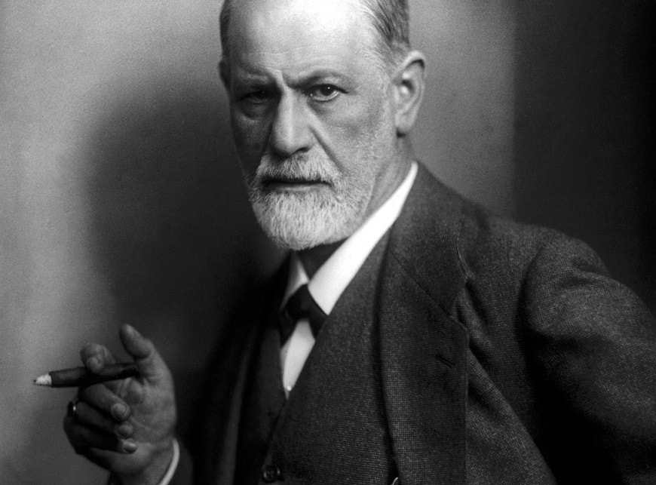
2. The origins of aggression. Sigmund Freud’s Drive Theory
According to Freud, human behavior is determined by two most powerful drives: sexual drive (Eros) and death drive (Thanatos).
Sexual drive is considered as desires related to creative development in human behavior: love, care, intimacy.
Death drive carries the energy of destruction. Its task is to "bring everything organically living to the state of lifelessness" - it is anger, hatred, destructiveness.

Slide 11
2. Sigmund Freud’s Drive Theory
The origins of aggression and Drive Theory by Sigmund Freud
Я
Thanatos
Destruction
Safety
Eros
«Ego» threat
Protection
Other-directed aggressive behavior

Slide 12
2. Sigmund Freud’s Drive Theory
Due to the antagonistic nature of these drives, they represent a source of continuous intrapsychic conflict that can be resolved only by diverting the destructive energy from the person themself and directing it to others (image above).
Thus, aggressive and hostile attitude towards others is seen as a mechanism of unreleasing the destructive energy through the displacement, that protects the intrapsychic stability of a person.

Slide 13
2. Sigmund Freud’s Drive Theory
According to Freud, the formation and further development of the aggressiveness is connected to the stages of child's development. Aggressiveness already appears at the first stage of the development – the oral one. The coming in of the first baby teeth and breast sucking during the feeding are related to the first manifestations of aggressiveness, since biting and ingestion involve the destruction of the object.

Slide 14
2. Sigmund Freud’s Drive Theory
Fixation plays an important role in the ontogenetic development of the aggression. Fixation is a process by which a person remains attached to an object, method and conditions of drive satisfaction that are appropriate for an earlier stage of development. Fixation on the oral stage of development may lead to the formation of an oral personality and such aggressive traits as tendency to sarcasm and gossip, as well as insistence, impatience, envy, greed, and vengefulness

Slide 15
2. Sigmund Freud’s Drive Theory
Aggressiveness is also present at the next stage of the development – the anal one. Fixation at the anal stage may lead to the formation of an anal-retentive personality with such distinctive features as stubbornness, greedy, proclivity for rage and vindictiveness. The opposite of this is anal-expulsive personality. This type includes such traits as destructive tendencies, anxiety, impulsivity and even sadistic cruelty.

Slide 16
2. Sigmund Freud’s Drive Theory
Character traits formed as a result of fixation on the phallic stage of development: aggressiveness and provocative behavior as anticipation of attacks on oneself. In addition, that is ambitiousness, bragging, self-importance, demonstrativeness, striving for success; in behavior - an emphasis on male virility, masculinity. Subsequently, aggressiveness manifests itself at the phallic stage of development in the form of asocial and destructive behavior, that is, a violation of social norms.

Slide 17
2. Sigmund Freud’s Drive Theory
Thus, according to the Drive Theory by Freud Aggression is one of the fundamental components of motivation of the human behavior

Slide 18
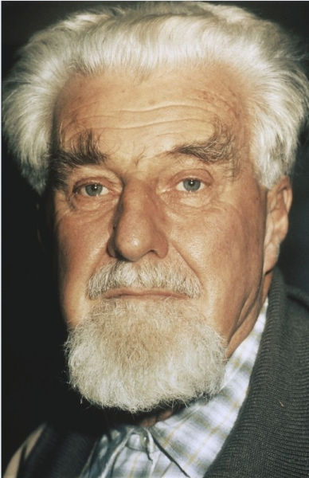
3. Konrad Lorenz's theory of aggression
Konrad Lorenz is the founder of ethology.
Ethology is a discipline of zoology which studies genetically determined animal behavior (instincts) including humans.
Ethology emphasizes the causation of human aggression mainly by biological factors. Konrad Lorenz claimed that aggressive instinct had meant a lot in the process of evolution, survival and adaptation of human being.

Slide 19
3. Konrad Lorenz's theory of aggression
His main assumption is that the body is continuously accumulating aggressive energy. The manifestation of aggression depends on the interaction of two factors: the amount of aggressive energy accumulating in the body at the moment external influence which is able to cause an aggressive reaction.

Slide 20
3. Konrad Lorenz's theory of aggression
"Psychohydraulic model" of aggression by K. Lorentz The lower the energy level, the stronger stimulus is required to elicit an aggressive response. On the contrary, if the energy level reaches the critical value and is not released by an external stimulus, the release of spontaneous aggression takes place.
K. Lorenz compared this process with the work of a steam boiler with continuously increasing pressure until it either releases the steam under the workers' control or explodes spontaneously..

Slide 21
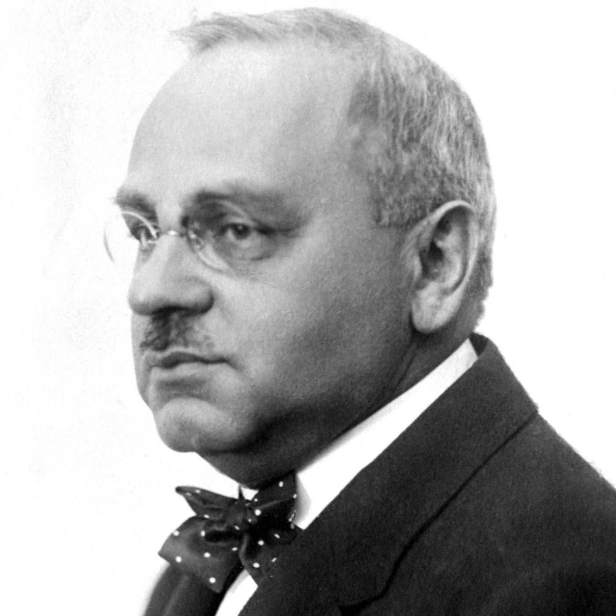
4. The origins of aggression in the Alfred Adler’s Individual Psychology
Alfred Adler was one of the first psychologists who began to consider the social (not just biological) nature of aggression. He postulated the existence of an aggressive motive and acknowledged that aggressiveness is an inherent quality of mental life that organizes human activity.
The emergence of aggressive motive is due to the difficulties in obtaining organic satisfaction. The aggressive motive is a mixture of sensations, excitations and their discharge.
Unstable psychological balance is always restored by the fact that primary motives are satisfied through the excitement and release of aggression.

Slide 22
4.The origins of aggression in the Alfred Adler’s Individual Psychology
The aggressive motive dominates the motor behavior, which more often manifests itself in the childhood. Crying, screaming, anxiety, throwing objects to the floor, biting and pinching are the simplest forms of aggression which are often take place later in life. The aggressive motive also prevails over consciousness (e.g in anger). It controls attention, interests, feelings, perception, memory and reproducing, imagination, while being realized in the form of explicit or altered aggression.

Slide 23
4.The origins of aggression in the Alfred Adler’s Individual Psychology
The aggressive motive can be directed outward and manifest itself in an explicit, open form: fight, battle, cruelty, duels, war, thirst for power, religious, social, national, racial struggle, martial arts. When aggressive motive is directed inward, i.e. turns against the person themself, it manifests itself in such character traits as obedience, submission, humility, loyalty, timeserving and masochism.

Slide 24
4.The origins of aggression in the Alfred Adler’s Individual Psychology
А. Adler pointed out several ways of implementing the aggressive motive. A restrained aggressive motive leads to creation of harsh images in art and imagination, description of numerous horrors of human history and individual life..
A strong aggressive motive influences the choice of a profession. Other than criminals, revolutionaries and adventurers, people with a high desire for power and superiority are often choose professions such professions as a judge, policeman, teacher, minister or doctor. These preferences are clearly visible in children's games..
An aggressive motive is usually embodied in politics with its countless ways to be active and many opportunities to explain logically any aggressive manifestations..
A repressed aggressive motive and latent cruelty can be manifested in an interest in funerals and cemeteries, attention to death and superstition, fear of diseases and infections, and fear of being buried alive.

Slide 25
4.The origins of aggression in the Alfred Adler’s Individual Psychology
Later A. Adler revised his theory and stopped considering the aggressive motive to be innate and independent. He declared that it obeys to a stronger motive - the desire for supremacy. A. Adler considered aggression a reactive form of behavior.

Slide 26
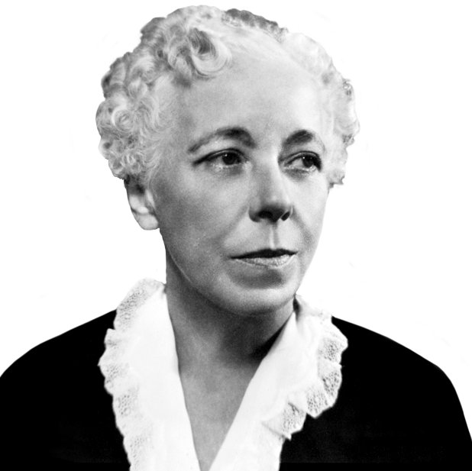
5. Aggression in the K. Horney’s Psychoanalytic Social Theory
Another psychoanalytic thinker, Karen Horney, noted that aggression could result from a variety of situations when a child acknowledges and accepts the hostility of others and consciously or unconsciously decides to fight to protect themself and take revenge.
Aggressiveness and the desire to cause pain are interpreted by K. Horney as a neurotic defensive reaction of a person who sees a threat (real or imaginable) to their values, their dignity, the satisfaction of their needs; who consider themself rejected, humiliated, deceived. A constant source of such a threat is a competition in sexual, professional and other areas of life.

Slide 27
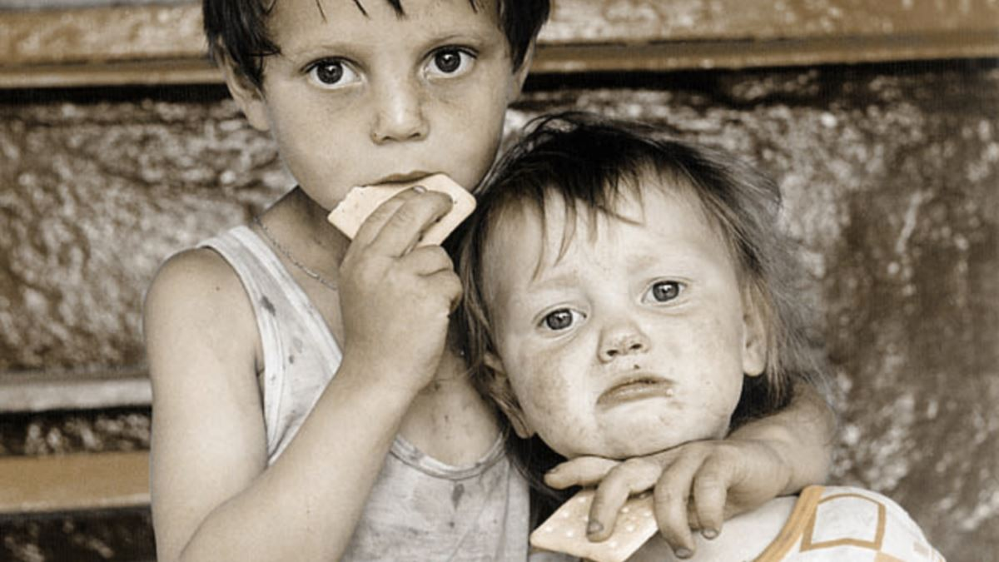
5. Aggression in the K. Horney’s Psychoanalytic Social Theory
K. Horney built her theory on the belief that children have two innate needs: for safety and for satisfaction. Whether these needs are met or not depends entirely on their parents and caregivers.
As a result of frustrating these needs (untimely feeding, violation of sleep and rest, unkept promises, ridicule and punishment, excessive guardianship, etc.), the child develops basic hostility toward their parents.

Slide 28
5. Aggression in the K. Horney’s Psychoanalytic Social Theory
If children are loved, accepted, and cared for by their parents, they feel safe and are more likely to develop normally.
Without the sense of safety children may develop hostility towards their parents and, as a consequence, suffer from basic anxiety, which is directed at the people around them (hostility towards others)

Slide 29
5. Aggression in the K. Horney’s Psychoanalytic Social Theory
K. Horney describes an aggressive type of personality, whose inability to resolve a neurotic conflict makes them move against people.
Such a person believes that life is a struggle for survival, and all the people around them are aggressive and cruel. Therefore, it is necessary to take a dominant position to feel safe.
The main feature of this type of personality is an excessive need for control over people, for exploitation of others and for power.

Slide 30
5. Aggression in the K. Horney’s Psychoanalytic Social Theory
K. Horney describes a person with aggressive and sadistic tendencies.
She believes that hostility towards others can simply be a response (reaction). Despite the fact that other people may suffer from aggressive behavior, causing resentment or damage is more of a byproduct, rather than a primary intention.
Most often, elements of sadism are found in the behavior of people who don’t have any internal prohibitions against expressing their sadistic tendencies towards others.

Slide 31
5. Aggression in the K. Horney’s Psychoanalytic Social Theory
K. Horney lists a number of signs of sadistic tendencies in humans:
The enslavement of the victim. A sadistic person hold themself to impossibly high standards, and, subconsciously recognizing their own failings, try to force their partner to achieve those standards, leading to a “molding” or a “shaping” dynamic between a “Superman” and his “victim”, wanting to deprive their partner from their own desires, feelings, goals and initiative.
Playing with the victim's feelings. People with sadistic tendencies are extremely sensitive to their partners’ reactions and therefore tend to cause those of them that they want to see at the moment. They know when to show interest in the victim and when to remain indifferent, they are able to generate violent joy or plunge into despair by their actions.

Slide 32
5. Aggression in the K. Horney’s Psychoanalytic Social Theory
3) Frustrating the victim. Another sadistic trait is the urge to destroy other people’s plans, hopes, and prevent them from satisfying their desires. A person with sadistic tendencies always contradicts others and does everything so they lose all hope. Their main goal is to somehow ruin another person’s life.
4) Bullying and humiliating the victim. The sadistic type personality is extremely good at noticing others’ flaws and weaknesses. But most importantly, the sadistic type accurately determines which of them are most painful or most carefully hidden and targets them with a scathing criticism.

Slide 33
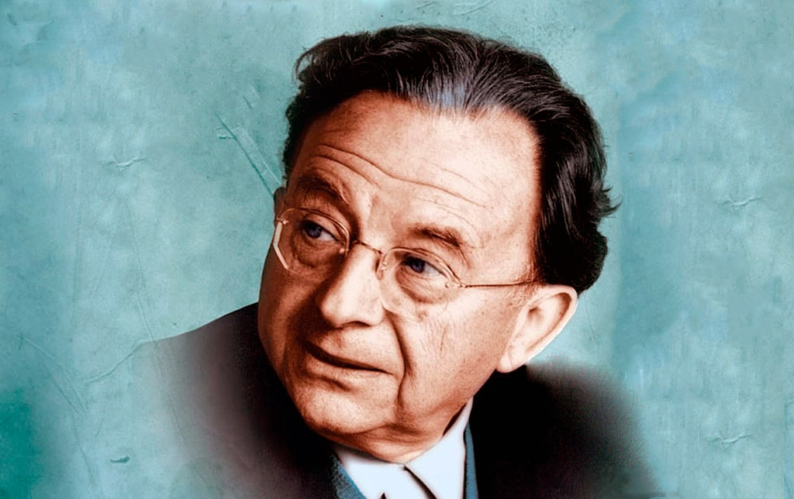
6. Erich Fromm’s Theory of Human Destructiveness
E. Fromm distinguished two completely different types of aggression.
The first is defensive, benign aggression, which serves the cause of human survival. It has biological roots and fades as soon as the danger disappears.
The second type, malignant aggression, represents destructiveness and cruelty, which are inherent only in man and are determined by various psychological and social factors.

Slide 34
E. Fromm : types of aggressive behavior
1) The most normal and non-pathological form of aggression is playful violence. It is exercised to display skill, strength and dexterity, not in the pursuit of destruction, not motivated by hate or destructiveness. Playful violence includes various kinds of war games, martial arts, sport competitions.

Slide 35
E. Fromm : types of aggressive behavior
2) Reactive violence is the most frequent form of aggression that is employed in the defense of life, freedom, dignity, property – one’s own that of others. It is rooted in fear of losing something valuable and meaningful. This type of violence is in the service of life, not death; its aim is preservation, not destruction.

Slide 36
E. Fromm : types of aggressive behavior
3) Hostility arising from envy and jealousy. Both envy and jealousy are specific types of frustration. The former can be caused by a conflict of possession, when one person owns something that the other would like to have. The latter may be caused by an interpersonal conflict, a vivid illustration of which is the love triangle. In both cases, the rejected person reacts with hatred and hostility.

Slide 37
E. Fromm : types of aggressive behavior
4) Vengeful violence. The difference between vengeful violence and reactive violence is that in the first case the damage is already done and the force is no longer used for protection. The motive for revenge is usually inversely proportional to the productivity of an individual or a group. A helpless person has no other way to restore the destroyed self-esteem except for taking revenge on the offender. On the contrary, a productive person has almost no need for it. Due to the productivity of their life, they easily withstand harassment, insults or humiliation.

Slide 38
E. Fromm : types of aggressive behavior
5. Destructiveness motivated by broken trust usually occurs as a consequence of the violated parent-child relationship. In the beginning of their lives, children believe in love, goodness and justice. They trust their mothers and rely on them to always provide them with care food and clothes. That trust can be extended to all the people who care for these children: their fathers, their grandmothers and grandfathers, etc.
For many, this violation of trust happens in early childhood. Children don't receive proper care, suffer from broken promises, are left alone or unfairly punished. Their unhappiness and fear are often overlooked or ignored, even though their parents are supposed to be concerned about their well-being.

Slide 39
E. Fromm : types of aggressive behavior
6 Sadism. Fromm’s interpretation of this concept is broader than the colloquially used meaning. He understands sadism as a passion to have an absolute and unrestricted control over a living creature, whether an animal or a person. At the same time, the desire to cause pain is not essential and determining. The basis of sadism is the sadist’s wish to completely subdue another person to his power, to turn them into a helpless object, his property, while he becomes their god and is able to do anything to them. The desire to humiliate and enslave is only a means to this end. The psychological essence of sadism is:
– to make the victim suffer;
– to make them endure that suffering;
– to deprive them of the opportunity to defend themself or to get out of this situation;
– to experience the joy and pleasure of completely dominating another person.

Slide 40
Conclusion:
Both Freud's followers and most modern psychoanalysts do not share his fatal view of human behavior.
Opinions differ as to whether aggression is an instinct or whether it only supplies the energy that allows the Ego to effectively implement the "reality principle" and to overcome obstacles on the way to the satisfaction of other drives.
Within the framework of the modern psychoanalytic direction, it’s widely believed that aggressiveness is the force which expresses a person's love and hatred for others or for themself. Due to it, they try to satisfy their instincts.
Aggression is the mechanism by which these instinctive impulses are directed outwards, mainly at other people, with the aim of conquering them.

