Slide 1
Exposure therapy
This behavioral therapy helps you safely face both situations and memories that you find frightening so that you can learn to cope with them effectively. Exposure therapy can be particularly helpful for flashbacks and nightmares. One approach uses virtual reality programs that allow you to re-enter the setting in which you experienced trauma.

Slide 2
Exposure therapy
9-12 sessions (1-2 contact and planning);
The rest 7-10 confrontation
First confrontation at least 60 minutes Support the patient and make him clear that with anything can be dealt
From 0 to 100 ask to determine the level of fear
Efficiency due to: the extinction of fear (habitualization) of all elements and due to the fact that in the process of multiple exposure there is an improved organization of the memory (elaboration) of what happened, there is a decrease in disorganization and unfinished thoughts.

Slide 3
Foa & Kozak, 1986
This model is based on classical conditioning: in addition to conditioned emotional and physiological responses to an event, new content (components) of trauma also arise in semantic memory.
The larger the network of memories (components), the more key stimuli (sensory and semantic) can be activated. This network is formed when an extremely emotionally significant stimulus (fear of death) is associated with a variety of cognitive elements and physiological responses.
Fear memories contain information about stimuli, responses, meaning

Slide 4
Before treatment
I go shopping
evening
dark
Cognitive elements
outdoors
man
bodily assault
perceptible perspiration
Physiologic reactions
excitation
aversion
suddenness
fear
emotional sense
at risk of one's life

Slide 5
After Treatment
I go shopping
evening
dark
Cognitive elements
outdoors
man
bodily assault
perceptible perspiration
Physiologic reactions
excitation
aversion
suddenness
fear
emotional sense
at risk of one's life

Slide 6
Dual Representation Theory (Brewin, et al 1996)
Based on multiple memory systems to explain features of trauma memory. According to this theory trauma memories are stored in two formats
Verbally accessible memory (VAM)
Situational accessible memory (SAM)

Slide 7
Dual Representation Theory (Brewin, et al 1996)
VAM contains information of factual type that occurred before, during and after the trauma. Can be accessed through normal autobiographical memory processes and discussed with others – but contains limited information.
SAM contains much more extensive data about the traumatic event from sensory input from eyes, ears, olfactory & touch receptors, plus emotional and physiological changes.
SAM are retrieved automatically in situations where the person is exposed to trauma-related cues. Does not contain a verbal code and therefore is hard to communicate with VAM.

Slide 8
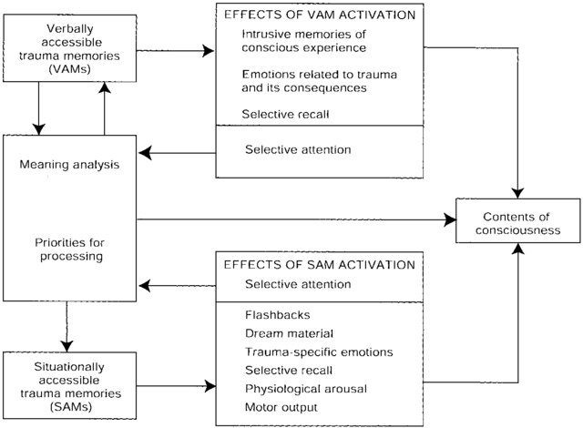
Dual Representation Theory (Brewin, et al 1996)

Slide 9
Dual Representation Theory (Brewin, et al 1996)
Verbally Accessible Memory VAM contains information of factual type that occurred before, during and after the trauma
VAM can be accessed through normal autobiographical memory processes and discussed with others – but contains limited information. High arousal narrows attention only allows limited information to be registered andtransferred to VAM.

Slide 10
Dual Representation Theory (Brewin, et al 1996)
Situational Accessible Memory SAM contains much more extensive data about the traumatic event from sensory input from eyes, ears, olfactory & touch receptors, plus emotional and physiological changes.
SAM are retrieved automatically in situations where the person is exposed to trauma-related cues. Does not contain a verbal code and therefore is hard to communicate with VAM.

Slide 11
Dual Representation Theory
Treatment involves transferring information from SAM to VAM, thus constructing a VAM memory that exerts control over SAM.

