Slide 1
Stabilization and regulation of affect
function of the amygdala, medial prefrontal cortex, and hippocampus in posttraumatic stress disorder

Slide 2
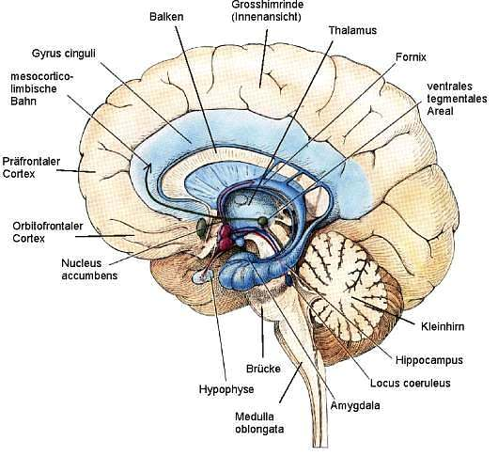
Three brain regions that may be involved in the pathophysiology of PTSD: the amygdala, medial prefrontal cortex, and hippocampus

Slide 3
The amygdala is involved in the assessment of threat‐related stimuli and is necessary for the process of fear conditioning
Medial prefrontal cortex is involved in the process of extinction of fear conditioning and the retention of extinction. Extinction does not occur normally when medial prefrontal cortex is damaged.
A third region of interest is the hippocampus, which is involved in explicit memory processes and in the encoding of context during fear conditioning. Importantly, the hippocampus appears to interact with the amygdala during the encoding of emotional memories.

Slide 4
PTSD & amygdala
functional neuroimaging studies of PTSD have provided evidence in support of heightened amygdala responsivity to both traumatic reminders and more general affective stimuli. Amygdala hyperresponsivity in PTSD has been reported during the presentation of personalized traumatic narratives and cues, combat sounds, combat photographs, and trauma‐related words

Slide 5
PTSD & medial prefrontal cortex
Several morphometric MRI studies have reported decreased volumes of prefrontal cortex in PTSD
Neurochemistry studies have provided data consistent with medial prefrontal cortex abnormalities
Functional neuroimaging studies have also yielded findings consistent with decreased activation and/or a failure to activate medial prefrontal cortex in PTSD (a relatively diminished responsivity in medial prefrontal cortex)

Slide 6
PTSD & medial prefrontal cortex
the majority of studies has found decreased hippocampal volume or decreased hippocampal NAA levels in PTSD
hippocampal volumes have been inversely associated with verbal memory deficits, combat exposure severity, dissociative symptom severity, depression severity,and PTSD symptom severity.

Slide 7
Thank You very much!

