Slide 1
Early intervention

Slide 2
Cognitive therapy
This type of talk therapy helps recognize the ways of thinking (cognitive patterns) that are keeping you stuck — for example, negative beliefs about yourself and the risk of traumatic things happening again. For PTSD, cognitive therapy often is used along with exposure therapy.

Slide 3
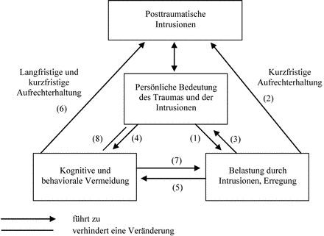
In a Cyclical Process: Negative Interpretation of Trauma and Its Consequences Ehlers, 2000
Feelings of perceived constant threat and processes of avoidance and suppression of thoughts lead to increased intrusions and increased symptoms

Slide 4
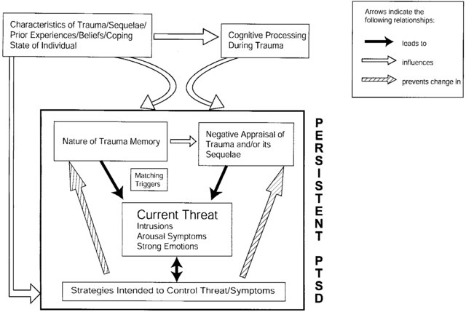
Ehlers & Clark 2000

Slide 5
Ehlers & Clark 2000
Negative assessment of what happened “I was and will become a victim”, negative assessment of myself “I deserve only bad things” and my post-traumatic symptoms (“My symptoms will never go away”) are of great clinical significance. Further, the model points out that the fear of “not thinking it through” due to avoidance leads to fragmented recollection of what happened and an increase in PTSD symptoms.

Slide 6
Cognitive therapy
Intrusions and related thoughts
Avoidance-behavior
Normalization of symptoms: reduce the feeling of catastrophization, the symptoms he (patient) is experiencing are normal reactions for such a situation

Slide 7
Normalization of symptoms
T: “Have you already noticed that in certain situations you more often remember what happened? What situations lead to this? " "If these memories, thoughts, feelings appeared, what did you usually do?"
T: "Are you doing something to stop these memories?" “Are you trying to distract yourself? Are you doing something to get the thoughts out of your head? "
T:”Do you think about something specific over and over again? And what exactly? "

Slide 8
Diary (homework)
Time | Intrusions | What did you think while doing this? | 0-100 How did you feel? | what did you usually while doing? What was the trigger? | What have you done to stop the memories? What helped you?

Slide 9
Identification of «hot spots»
Identification of «hot spots» and their cognitive treatment
T. “You are sure that only you are to blame for what happened. What evidence is there for this? Is there anything else that could lead to the event? Could XXX be responsible for this? Could just chance play a role? From external objects / phenomena could at least something matter? “
T. “If this happened to your friend, would you have the same thoughts?”

