Slide 1
explanatory models

Slide 2
Foa & Kozak, 1986
This model is based on classical conditioning: in addition to conditioned emotional and physiological responses to an event, new content (components) of trauma also arise in semantic memory.
The larger the network of memories (components), the more key stimuli (sensory and semantic) can be activated. This network is formed when an extremely emotionally significant stimulus (fear of death) is associated with a variety of cognitive elements and physiological responses.
Fear memories contain information about stimuli, responses, meaning

Slide 3
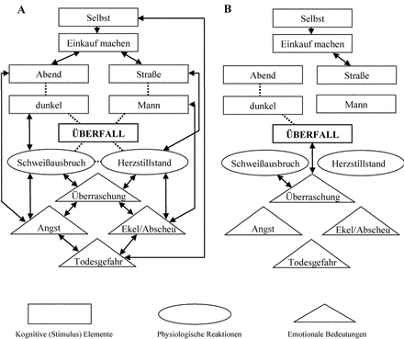

Slide 4
Before treatment
I go shopping
evening
dark
Cognitive elements
outdoors
man
bodily assault
perceptible perspiration
Physiologic reactions
excitation
aversion
suddenness
fear
emotional sense
at risk of one's life

Slide 5
After Treatment
I go shopping
evening
dark
Cognitive elements
outdoors
man
bodily assault
perceptible perspiration
Physiologic reactions
excitation
aversion
suddenness
fear
emotional sense
at risk of one's life

Slide 6
Dual Representation Theory (Brewin, et al 1996)
Based on multiple memory systems to explain features of trauma memory. According to this theory trauma memories are stored in two formats
Verbally accessible memory (VAM)
Situational accessible memory (SAM)

Slide 7
Dual Representation Theory (Brewin, et al 1996)
VAM contains information of factual type that occurred before, during and after the trauma. Can be accessed through normal autobiographical memory processes and discussed with others – but contains limited information.
SAM contains much more extensive data about the traumatic event from sensory input from eyes, ears, olfactory & touch receptors, plus emotional and physiological changes.
SAM are retrieved automatically in situations where the person is exposed to trauma-related cues. Does not contain a verbal code and therefore is hard to communicate with VAM.

Slide 8
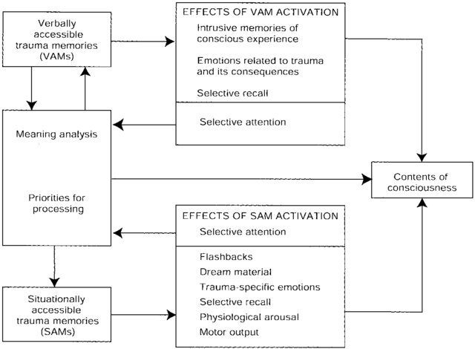
Dual Representation Theory (Brewin, et al 1996)

Slide 9
Dual Representation Theory (Brewin, et al 1996)
Verbally Accessible Memory VAM contains information of factual type that occurred before, during and after the trauma
VAM can be accessed through normal autobiographical memory processes and discussed with others – but contains limited information. High arousal narrows attention only allows limited information to be registered andtransferred to VAM.

Slide 10
Dual Representation Theory (Brewin, et al 1996)
Situational Accessible Memory SAM contains much more extensive data about the traumatic event from sensory input from eyes, ears, olfactory & touch receptors, plus emotional and physiological changes.
SAM are retrieved automatically in situations where the person is exposed to trauma-related cues. Does not contain a verbal code and therefore is hard to communicate with VAM.

Slide 11
Dual Representation Theory
Theory is that in PTSD people have failed to create a detailed VAM representation, therefore considerable amounts of information reside in SAM, producing the characteristic intrusions.
Treatment involves transferring information from SAM to VAM, thus constructing a VAM memory that exerts control over SAM.

Slide 12
Ehlers & Clark 2000
the model, explored the paradox that while the trauma is long overdue, fear spreads to the future.
They explain this by the peculiarities of information processing, which gives an assessment of what happened and indicates the threat to the individual and his future.
Negative assessment of what happened “I was and will become a victim”, negative assessment of myself “I deserve only bad things” and my post-traumatic symptoms (“My symptoms will never go away”) are of great clinical significance. Further, the model points out that the fear of “not thinking it through” due to avoidance leads to fragmented recollection of what happened and an increase in PTSD symptoms.

Slide 13
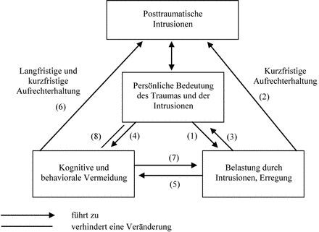
In a Cyclical Process: Negative Interpretation of Trauma and Its Consequences Ehlers, 2000
Feelings of perceived constant threat and processes of avoidance and suppression of thoughts lead to increased intrusions and increased symptoms of PTSD

Slide 14
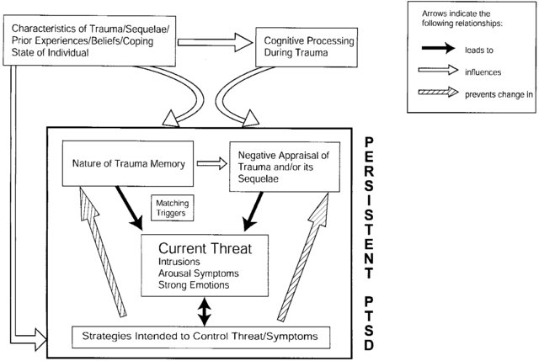
Ehlers & Clark 2000

Slide 15
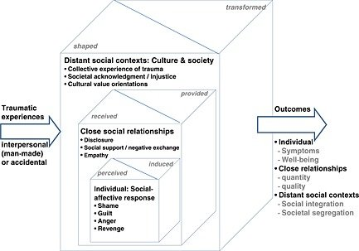
The social-interpersonal model Maercker & Horn, 2013

Slide 16
The social-interpersonal model Maercker & Horn, 2013
The first level includes intrapsychic processes after trauma, which are reflected in social emotions and cognitions. At the second level, the interaction of the individual with close people comes to the fore. In doing so, the disclosure of the traumatic image and perceived social support from family and friends are most important for trauma handling.

Slide 17
The social-interpersonal model Maercker & Horn, 2013
At the third level are the processes that affect the post-traumatic integration of the individual and organize his cultural and environment. These include, among others, political, religious, legal and social relations, as well as social and health systems that interact with the survivors of the traumatic event.
The authors of this model emphasize that the most important factors for the development and prolongation of post-traumatic stress disorder are, first of all, factors of the second and third levels (Maercker & Horn, 2013).
It is important to remember that factors from the above three levels interact with each other, influence each other and form new connections.

Slide 18
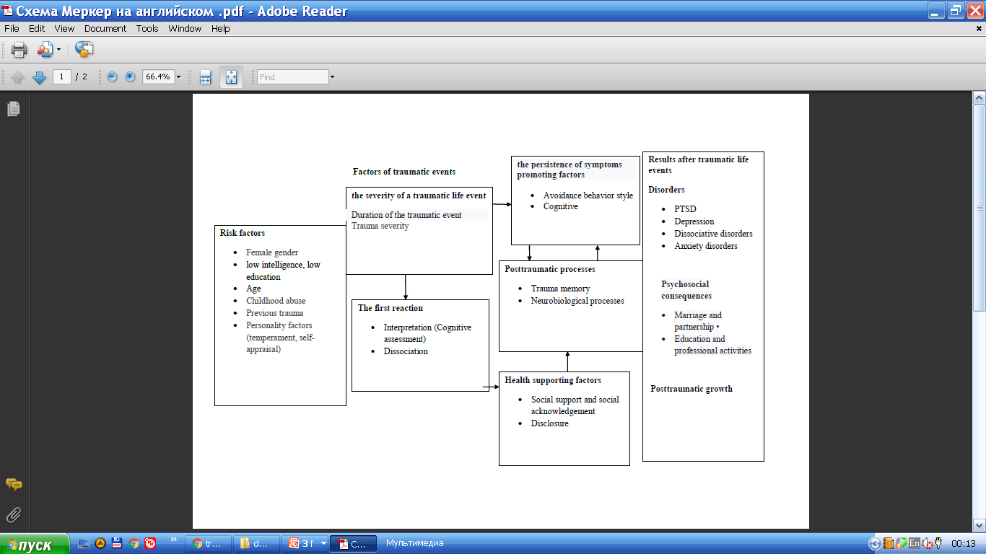
The multifactorial framework, Maercker 2009

Slide 19
The multifactorial framework model, Maercker 2009
The multifactorial framework model of the etiology of the consequences of traumatic events includes components of biological, cognitive models, the theory of social learning, in the generally accepted biopsychosocial perspective.
The model takes into account both aspects of the traumatic event and individual risk factors, protect- factors, as well as factors that influence the processing of trauma and the maintenance of the mental health factor.

Slide 20
Thank you very much!

