Slide 1
Psychic phenomena in traumatization

Slide 2
Post-traumatic stress disorder is a complex, specific set of disturbances of several mental processes: affective presentations, conditioning, memory, dissociation, cognitive processes, social-interpersonal processes

Slide 3
Phenomenon's after trauma affects
Affect, strong emotions (overwhelm an individual's sense of safety and security and feeling vulnerable and to be insecure in their environment, anxiety)
shame, anger, disgust, revenge, feelings of injustice
feelings of complete defeat, self-denial are high risk factors in the development of PTSD
These emotional states manifest themselves not only during the trauma and almost always in the period in social and interpersonal relationships

Slide 4
Phenomenon's after trauma Unwanted trauma memories
repeated reliving of the trauma in intrusive memories ("flashbacks"), dreams or nightmares
flashbacks are a typical PTSD phenomenon (sensory details of trauma in the form of pictures or sounds) are experienced fragmentarily. What is especially frustrating is that they are not the result of volitional action. Not in the context of autobiographical memories
the victims have very emotional memories of the trauma, but they are disorganized and with gaps
amnesia as regards the details of the traumatic event

Slide 5
conditioning (two factors theory)
neutral stimulus within the traumatic situation is associated with a traumatic situation
Maintenance of the disorder is associated with operant conditioning (avoidance of stimuli is reinforced)

Slide 6
two factors - theory
During the trauma (psychological model "two factors - theory", Mowrer 1960 classical and operant conditioning) a neutral stimulus is associated with a traumatic situation (fear reaction and autonomic manifestations), later there is a generalization of the reaction to various stimuli (stimuli).
Maintenance of the disorder is associated with operant conditioning (avoidance of stimuli is reinforced)

Slide 7
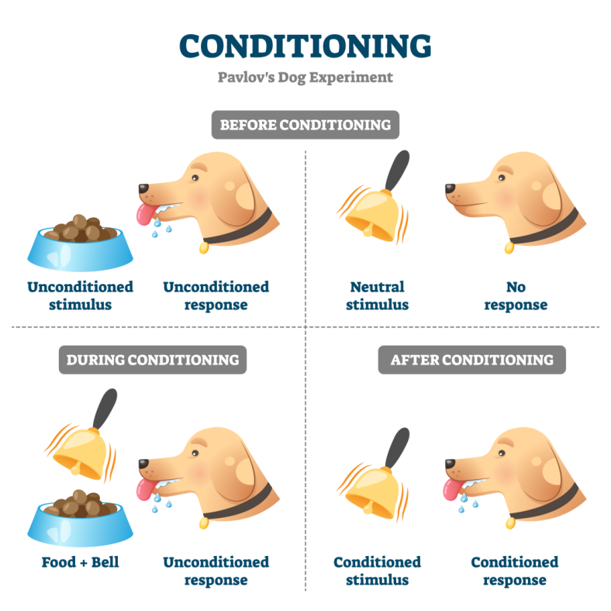
classical and operant conditioning

Slide 9
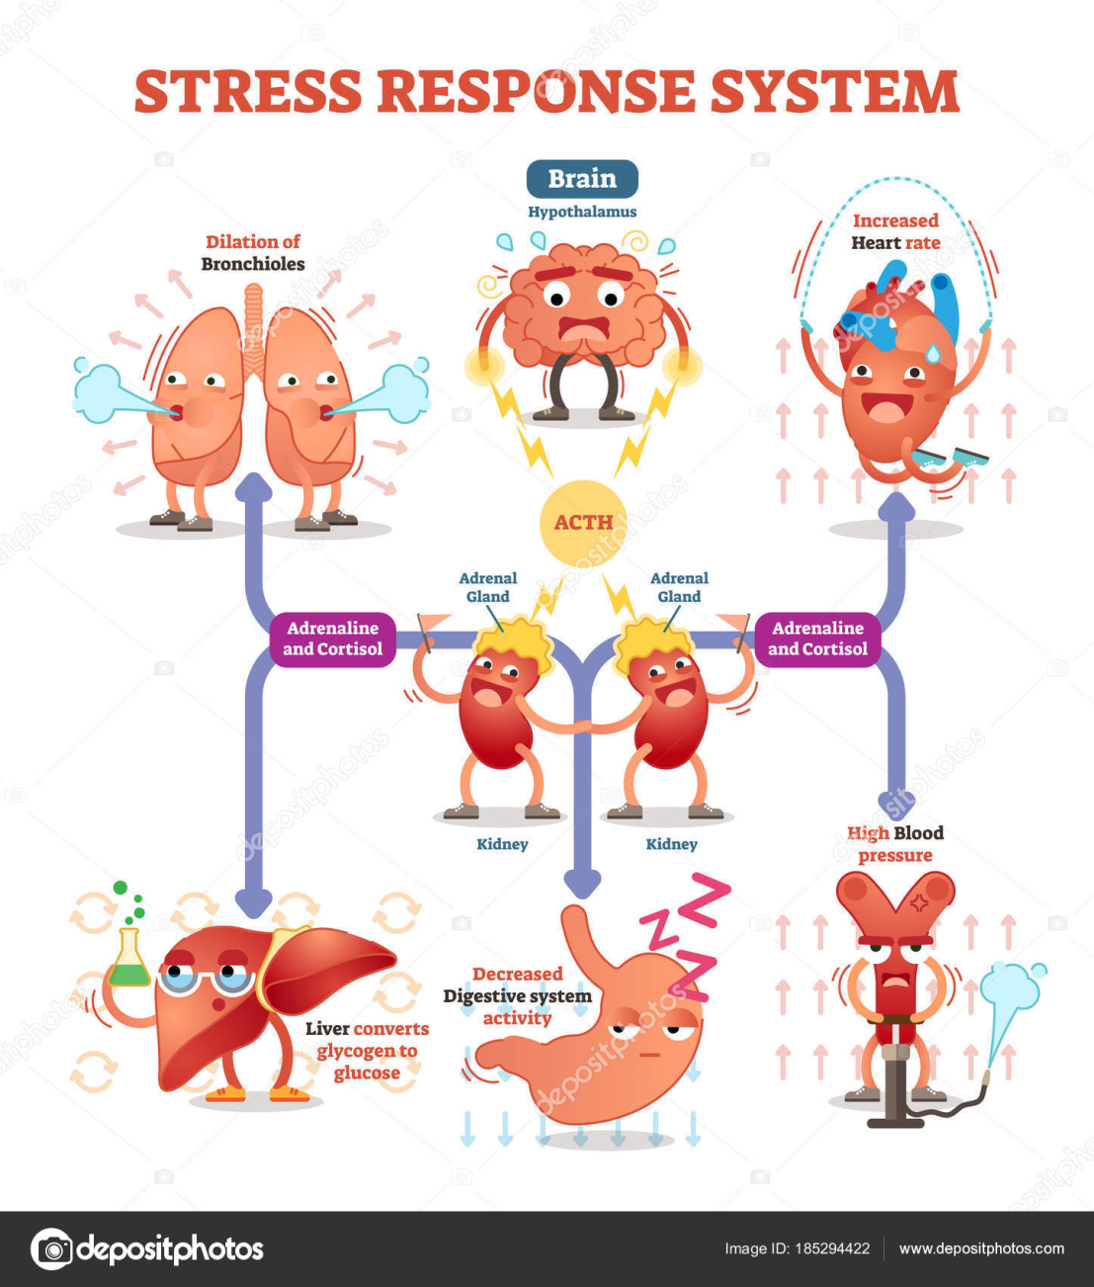

Slide 11
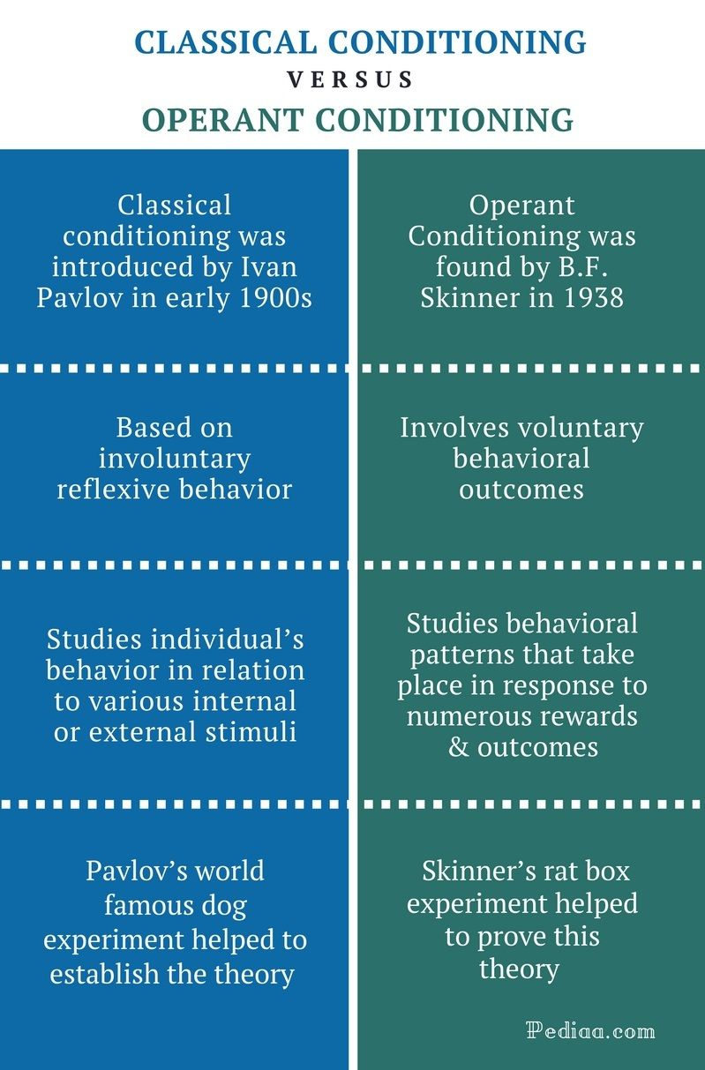

Slide 12
Cognitive processes
Appraisal (Lasarus &Folkman, 1984)
Assessment of threats and own resources to cope with the threat
Cognitive model: negative assessment of a traumatic event and its consequences leads to the development and chronic manifestation of PTSD.
The world is not perceived as fair and controlled, with meaning, and a person is perceived in the world as vulnerable.

Slide 13
social-interpersonal processes
The most severe traumas occur in an interpersonal context
After trauma, many patients perceive their social environment as unfriendly and positive. They don't trust other people
Social support as a protective factor (stronger than the severity of a traumatic life event and the patient's personality)

Slide 14
Dissociation
«Freezing» in animals (evolution conditioned process)
As a phenomenon of PTSD consists of emotional dullness, derealization, depersonalization, «out of body» states
It arises during very complex events with a massive threat, when it is impossible to influence the situation by fighting. Necessary for the survival of the organism in cases whene the fight is impossible

Slide 15
Thank You very much!

