Slide 1
Posttraumatic Growth

Slide 3
Introduction
Many people have the potential for development (growth)
Despite growth, there is nothing "good" about traumatic situations
Traumatic events are not a prerequisite for growth
Growth and resilience (resilience) are not universal and not taken for granted

Slide 4
Resilience
Keeping functioning in high-risk environments
Ability to “walk away” and return to normal functioning after a traumatic event (s)
This is not a stable personality characteristic, but a dynamic, contextually related, intra- and interindividual characteristic of the adaptation process.

Slide 5
What helps maintain resistance?
Social network
Avoid judging events as "impossible to survive“
Changes in life are happening, you need to accept it
Find your own goals;
be proactive in making decisions
Open up opportunities to "find yourself“
Develop and maintain a positive self-image
Take care of yourself and be considerate of yourself
Keep the installation hopeful

Slide 6
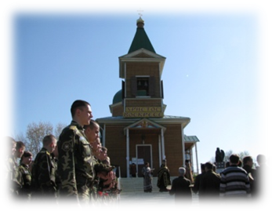
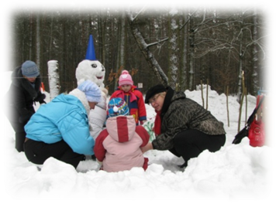
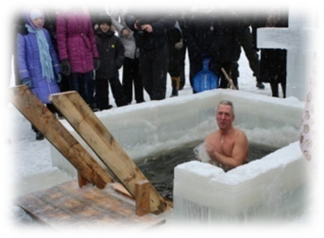
What is a posttraumatic growth?
increasing the value of life,
increasing the importance of personal relationships,
opening up new opportunities,
awareness of one's own strength,
intensification of spiritual consciousness

Slide 7
Psychodiagnostic
PGS Posttraumatic Growth Scale (Tedeschi & Calhoun, 1996)

Slide 8
Posttraumatic Growth study Dekel, S., Ein-Dor, T., & Solomon, Z. (2012)

Slide 9
The illusory nature of post-traumatic growth Zoellner, T. & Maercker, A. (2006)
post-traumatic growth is not a salutogenic factor,
not associated with a decrease in psychopathological symptoms,
not associated with a decrease in PTSD symptomatology,
cannot be "caused" in the survivor of a traumatic event artificially or at the request of a psychotherapist, psychologist,
persistence in identifying it in the victim can lead to aggressive behavior and the development of depressive disorders.

Slide 10
How can we help?
The mood, sensitivity of the psychologist (psychotherapist) to the growth processes (support, but not forcing)
Help Imaginative techniques, cognitive-behavioral elements, wisdom therapy
With children, it is important to develop autonomy, initiative, the ability to act, the ability to develop resilience, stable and reliable social relationships;

Slide 11
With adolescents, develop hope for a successful future, for the development of "resilience", firmness, psychosocial health, integration into significant systems of relationships, fairness in relationships, controllability, identification
Adults: problem solving, self-regulatory competence, ability to maintain consistency (density), balance between autonomy and being part of a collective process, wisdom therapy

Slide 12
Thank You!

