Slide 1
Lecture 3. Consequences of stress for the individual and organization
1. Positive and negative consequences of stress for the individual and the organization.
2. Unfavorable socio-psychological climate because of organizational stress.
1. Positive and negative consequences of stress for the individual and the organization.

Slide 2
1. Positive and negative consequences of stress for the individual and the organization.
Hans Selye called the phenomenon of a nonspecific reaction of the body in response to various damaging influences an adaptation syndrome, or stress. The effect of stress on the body can be considered as a single process. H. Selye identified three stages of this process:
- anxiety stage;
- stage of resistance (adaptation);
- stage of exhaustion.
It should be noted that Hans Selye received the Nobel Prize for the discovery of stress reactions - the activation of the adrenal cortex, which helps the human and animal body to overcome various difficulties with the help of special anti-stress hormones. Further development of events depends on how quickly the body will be able to cope with stress, which consistently passes through the above stages of anxiety, adaptation and exhaustion.

Slide 3
In the first stage, the body tries to adapt to or overcome stress. If the stress factor continues to affect the body, then adaptation occurs - the stage of balance between the stressor and protective mechanisms, at which the body manages to more or less compensate for the damage from the negative impact. This stage can be experienced by an athlete in the middle of a long distance, the head of a company during the execution of a responsible project, a student in the first half of the examination session.
However, being in a state of stress cannot last indefinitely, since the reserves of adaptive energy, according to Selye's teachings, are limited. Therefore, if the stress factor continues to affect the body, physiological stress changes to pathological, in other words, the person gets sick.

Slide 4
Proceeding from this, the founder of the doctrine himself identified two forms of stress: useful stress - eustress and harmful - distress. However, more often stress is understood as the body's reaction to the negative effects of the external environment, which is reflected in the definitions that various researchers give to this phenomenon.
Nevertheless, according to the opinion of Hans Selye himself, stress can also be beneficial, in which case it "tones up" the body's work and helps to mobilize the defenses (including the immune system).
Eustress is always short-term, motivates and improves performance, is relatively easily tolerated both physically and psychologically, ends with relaxation and positive emotions.
Examples of eustress: having a child, wedding day or promotion, going to university, etc.
For stress to take on the character of eustress, certain conditions must be present.

Slide 5
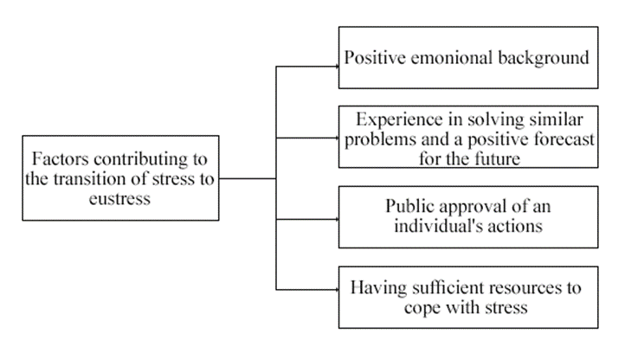
At the same time, in the absence of these conditions or with a significant negative impact on the body, the primary stress transforms into its damaging form - distress. His features are completely different: both chronic and acute forms of the course; suppression, decrease in labor productivity; loss of the ability to adapt to the surrounding world; physiological malaise against the background of negative emotions; the development of somatic and mental illnesses.

Slide 6
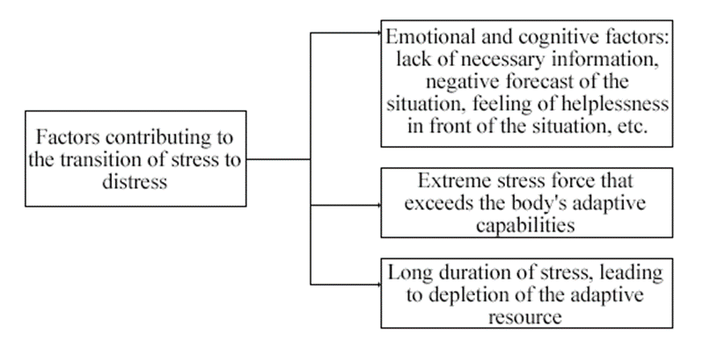
Factors contributing to the transition of primary stress to distress are:

Slide 7
Thus, the stress caused by positive emotions or “light stress mobilizing the body” has a positive effect on a person, mobilizes him, improves attention, reactions, mental activity, and increases the capabilities of the body. Distress has a negative effect on the body. It destroys human health and can lead to serious illness.
The negative effects of stress affect all aspects of a person's life: emotions, behavior, thinking ability and physical health. Because people deal with stress differently, the symptoms and severity of stress may differ. However, the signs of stress in different people have a lot in common, these are:
- vegetative-vascular symptoms - headache, tremors, sweating, cold extremities, fatigue;
- tachycardia and chest pain, tension of other muscles, bruxism;
- gastrointestinal disorders - colic, diarrhea, constipation, nausea;
- eating disorders leading to weight gain or loss; colds and infectious diseases arising from a decrease in immunity;
- emotional problems - feelings of depression, anxiety, isolation, inability to relax, pessimism, decreased libido;
- cognitive impairment - forgetfulness, low concentration of attention; sleep problems.

Slide 8
2. Unfavorable socio-psychological climate because of organizational stress.
A prolonged state of stress can easily aggravate many health problems or cause the development of new ones, including: hypertension, arrhythmias, heart attacks - people with existing diseases of this group are at a special risk group, since stress, as studies show, significantly worsens their course ; acquired immunodeficiency - increased activity of stress hormones, which are secreted by the adrenal cortex, inhibits the work of cells of the immune system; irritable bowel syndrome, ulcerative colitis, gastritis; psoriasis, acne, hair loss; metabolic syndrome - long-term hormonal imbalance can reach such proportions that weight cannot be controlled independently even with the help of diets; depression, neurosis, cognitive and behavioral disorders - activity hormones suppress stem cells in the hippocampus, there is a violation of connections between neurons, as well as the process of formation of new nerve cells and the work of nerve circuits; alcohol and drug addiction - studies have shown that there is a link between constant stress and substance abuse.

Slide 9
These physiological manifestations of stress lead not only to serious physiological disorders (diseases), but also to a decrease in social activity, the effectiveness of professional activity, and because of the work of organizations.
Today stress is one of the major management problems for organizations around the world. It is precisely because of stress that there is a decrease in labor productivity, the quality of products, an increase in staff turnover rates, an increase in the number of disciplinary violations, industrial injuries, employees are more likely to get sick. Eliminating the consequences of organizational stress is costly. For example, in the United States alone, companies annually spend more than $ 60 billion on measures to deal with the consequences of stress (paying for sick leave, creating psychological support services for staff, etc.).

Slide 10
Group stressors include a lack of group cohesion and the presence of intrapersonal, interpersonal and group conflicts. Organizational causes of stress include factors such as overload or too little workload, uncertainty about roles, interpersonal conflicts, uninteresting work, unsatisfactory working conditions, lack of independence in work, low pay, etc. Psychosocial factors are due to a specific combination of work, organizational and social characteristics of the workplace. Stressors associated with the work environment are: lack of confidence in the future, the nature of the work performed, the inability to influence the content of one's work, specific organizational structure, stressful management style, and busy work schedule and role conflict.

Slide 11
Behavioral signs of organizational stress include changes in productivity, increased conflict, absenteeism, an increase in the number of mistakes in the usual work, workaholism (complete immersion in work problems at the expense of rest and family obligations), unreasonable fits of anger, antisocial behavior.
Absenteeism (from Lat. Absentia - absence): an indicator of the social climate at the enterprise, the level of workload and the unproductive expenditure of working time. Its elements: temporary absence from work (illness, accident, childcare with the permission of the administration), late arrivals, family leave; absence of an employee from work, absence from work without a valid reason; reason for dismissal.

