Slide 1
Lecture 5. Biofeedback module "Wilddivine" - as a modern means of psychological self-improvement of personality
1. Theoretical and methodological foundations for the use of biofeedback modules in the process of psychological support of a person.
2. Teaching the management of psycho-emotional state, self-regulation and relaxation skills by working with the module "Wilddivine".

Slide 2
1. Theoretical and methodological foundations for the application of the module "Wilddivine" in the process of psychological support of the individual.
Biofeedback (biofeedback) is understood as such methods of self-regulation of human vegetative functions, which allow you to directly observe your own physiological parameters and consciously influence them. Traditionally, it was believed that the possibilities of conscious regulation of many physiological systems of the body are very limited.

Slide 3
Only as a result of many years of practice, some Indian yogis managed to slow down the heart rate, control the tone of peripheral blood vessels, or influence the biorhythms of the brain. Until recently, it was believed that a person can voluntarily control only skeletal muscles, and smooth muscles and glands are regulated by the autonomic nervous system, which does not obey the control of consciousness. Heart, blood vessels, stomach, kidneys - all these organs work according to certain programs, a conscious influence on which is almost impossible. True, with the help of self-hypnosis formulas used in the process of autogenic training, some of the trainees learned to influence some physiological processes, however, control over these procedures was carried out at a subjective level and did not make it possible to really assess the nature and intensity of the changes taking place.

Slide 4
Many trainees complained that it was difficult for them to understand in which direction to move, since in classical auto-training there is no visual feedback between the result of the exercises and the indicators of the sense organs. When a person says, “My hands are getting warmer and warmer,” he is not completely sure that the feeling of warmth in his hands is not a figment of his imagination, but an accomplished reality. To accelerate the learning of self-regulation skills, some researchers began to develop various technical devices that would allow patients to directly observe their physiological processes.

Slide 5
Therefore, back in the 80s of the twentieth century, various models of skin electrothermometers began to be introduced into the practice of auto-training, which significantly accelerated the process of mastering self-regulation skills. If without devices it took patients 2-3 weeks to master the ability to raise the temperature of the hands, then with an electrothermometer this happened already in the first or second lesson. In fact, these first fairly simple devices were the prototypes of modern biofeedback devices that allow humans to actually monitor certain physiological parameters.

Slide 6
A serious breakthrough in the development of this method began after the creation of modern computer technologies that allow the patient to actually see what was previously impossible to see - indicators of heart rate, electrical activity of the brain or galvanic skin response. It turned out that if a person is presented with these parameters on a computer screen and taught him some techniques of self-regulation, then he will be able to consciously influence the previously involuntary processes of his body, relieving stress, improving the state of the cardiovascular system, restoring damaged muscles or overcoming alcohol addiction.

Slide 7
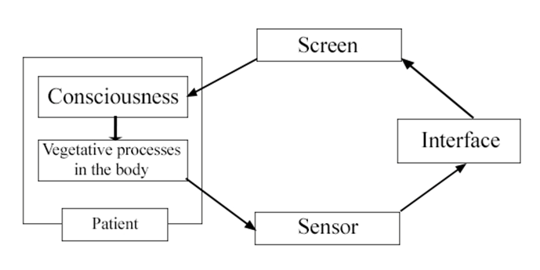
According to one of the definitions, "biofeedback is a complex of ideas, methods and technologies based on the principles of biological feedback (BFB), aimed at developing and improving the mechanisms of self-regulation of physiological functions in various pathological conditions and for the purpose of personal growth." It is indicated here that the biofeedback method can be successfully applied to normalize high blood pressure, which is provoked by chronic psycho-emotional stress, i.e., stress. The principle of biofeedback operation is shown in the figure.

Slide 8
In accordance with the basic position of biofeedback, in order for a person to learn to influence some physiological or biochemical process, he must receive information about the results of his actions. For example, if, as a result of stress, a person develops persistent tachycardia and the doctor asks him to slow down his pulse, he is unlikely to be able to do this, and even if he accidentally succeeds, it will be difficult for him to fix and repeat the result. It is another matter if the patient is equipped with a biofeedback device.

Slide 9
Then he will quickly learn to associate changes in his body with changes on the computer screen and lowering his heart rate will become quite simple. It should be noted that recently, computer consoles for game biocontrol, with the help of which the patient learns to control their physiological functions, by influencing the characters of the game, have become increasingly popular in the world. A person can win the competition only if he learns to control his physiological function in a situation of virtual competitive stress. For example, the more he relaxes his muscles, the faster the car rushes on the monitor screen, the calmer and less frequent the heart works, the more successful the diver finds the hidden treasures, etc. As a result, the treatment session turns into an exciting activity that both adults and children. Working with such a simulator has a beneficial effect on the work of the cardiovascular system, normalizing the work of the heart and lowering blood pressure.

Slide 10
In the process of playing training, a person acquires the ability to withstand stress, learns to react in a new way to conflict situations, to reduce excessive internal stress when increased performance is required. Recently, it has been proven that with the help of the biofeedback method, people can consciously reduce the heart rate either by activating the parasympathetic system, or by inhibiting the sympathetic nervous system. The method developers describe the features of game biocontrol in this way.

Slide 11
“A person can win a game or achieve a positive development of a plot only by learning to control their own self-regulation mechanisms, using muscle relaxation techniques in combination with a high degree of consciousness control, constant scanning of internal sensations and monitoring the dynamics of indicators on the monitor screen. Overcoming the apparent contradiction between the psycho-emotional load and the need to maintain a state of calmness, the player learns to maintain resistance in the stressful situation of the game, without falling into panic, into a state of passion. Thus, he creates a model of effective behavior - a system of skills for constructive resolution of such situations that prevent the development of stress-induced states and their consequences ”.

Slide 12
To date, there is compelling evidence of the high efficiency of the biofeedback method in reducing stress levels and treating diseases such as hypertension, Raynaud's syndrome, migraine, alcoholism and drug addiction. In addition, the biofeedback method has shown high efficiency in the treatment of phobias, anxiety, insomnia and depression. In this case, the most important advantage of the method of biological self-management is that in it the patient from a passive object of medical intervention turns into an active subject who himself determines the level of his physiological state and his recovery.

Slide 13
Teaching the mechanisms of human self-regulation using a biofeedback signal (BFB) is one of the rapidly developing areas of scientific research in the field of medical informatics. The use of bio-controlled gaming systems allows solving a number of problems that usually arise in the course of training and are associated with the activation of the patient's activity. Based on the analysis of the literature, the following two classes of computer game systems with biofeedback can be distinguished, choosing the number of biofeedback parameters as a criterion: one-parameter; multiparameter.

Slide 14
However, an equally important characteristic of biofeedback systems is the number of communication channels. While existing one-parameter complexes use only one communication channel, since they control a single functional indicator, multi-parameter gaming systems have as many communication channels as control parameters. Each communication channel has its own input and output, is an independent unit and does not affect the operation of other channels and, therefore, is controlled by only one parameter. At the same time, it is known that the human body reacts to changes in the external environment by changing a number of parameters of the functional system. This means that in order to accurately determine the state of the human body, it is necessary to track not only the change in the values ​​of several individual indicators, but also the influence of these changes on each other. In this case, it is important that the controlled parameters belong to a separate functional system of the body, i.e. were interconnected.

Slide 15
The organization of biofeedback according to the dynamics of a set of parameters is possible in a multiparametric single-channel biofeedback complex. In this case, the only communication channel will have several inputs depending on the number of measured indicators and one output regulated by the ratio of these indicators.
Respiration and heart rate are often chosen as such interrelated parameters. To date, the literature describes devices controlled by the ratio of the rhythm of breathing and heartbeat, but among them there are only a few that would be based on game plots. This fact testifies to the need to develop this direction of biofeedback technology and to carry out research work aimed at finding new methods to increase the effectiveness of managing the functional state of a person in a situation of virtual competitive stress.

Slide 16
The use of various algorithms of color impulse exposure along with biofeedback models for teaching self-regulation skills expands the range of possibilities for modifying the functional status of an organism. This is due to the fact that color stimuli contribute to the activation of the parasympathetic or sympathetic nervous system, depending on the shades of color, and the impulsive nature of the impact makes it possible to enhance the stimulating effect in the development of inhibition or excitation processes, depending on the rhythm.
Thus, the urgent task is to develop multiparametric biocontrolled gaming systems based on the fundamental principles of chronobiology using optimization algorithms using color pulsed signals.

Slide 17
2. Teaching the management of psycho-emotional state, self-regulation and relaxation skills by working with the module "Wilddivine".
Wilddivine is a home-based computer training program that uses three IomPe sensors to measure a user's heart rate and skin conductance — general indicators of stress or anxiety. Based on this, Wilddivine outputs heart rate variability, skin relative conductance, skin conductance direction, skin conductance stability, blood volume pulse, and relative heart rate. Together, these indicators provide a holistic view of the stress levels a user needs to monitor while using the game.

Slide 18
In this computerized tutorial, Wilddivine players navigate mystical, idyllic environments. Along the way, they learn meditation and breathing exercises based on Eastern philosophy. The practitioners perform breathing actions, consciously making their bodies calmer or more alert, as indicated by the IomPe sensor. If the player is disappointed, the game will prevent him from moving on. The game reacts to the player's excitement and heartbeat state, fed into the program by a sensor, not by mouse clicks. The potential benefit of the Wilddivine module is increased mental control, as well as reduced stress, increased energy and focus with regular practice.

Slide 19
During the session, in the bio-controlled game module "Wilddivine", the feedback elements transmit the readings of the pulse and respiration sensors to a special area of ​​the interface on the monitor screen, and their ratio to the game block as a control parameter. Thus, the method of informational influence is implemented, which consists in visually notifying the user during the game about his current state, as well as the method of associative influence based on the control of game algorithms according to the ratio of the selected indicators. The patient can win the competition only if he learns to control his physiological function, namely the heart rate and respiration rate, in a situation of virtual competitive stress.

Slide 20
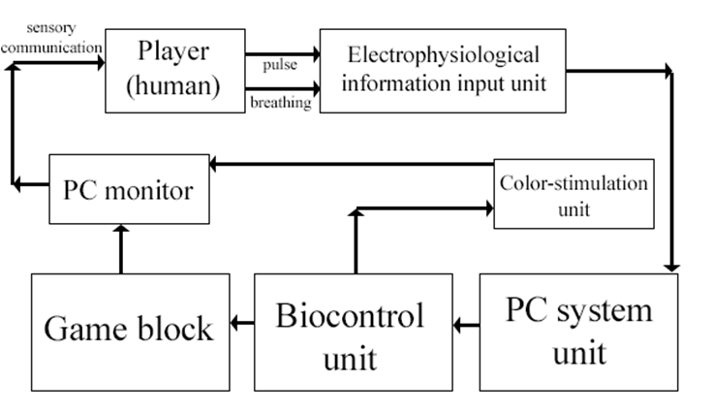
The use of various algorithms of color impulse exposure along with biofeedback models for teaching self-regulation skills expands the range of possibilities for modifying the functional status of the body by creating new training conditions, in connection with which the module structure includes a biocontrolled color stimulation unit.
The work of the game module "Wilddivine" is shown as a diagram in the figure.

Slide 21
The structure of the module "Wilddivine" includes blocks: play, input of electrophysiological information in on-line mode, biocontrol and color stimulation.
The basis of the game block is the model and algorithms of the arcade game
To implement the tasks associated with the transfer of bioparameters, the student puts on his fingers an input unit for electrophysiological information, including:
- a system of sensors consisting of an optocoupler (LED and photodiode) and a reed switch. The optocoupler-pulse sensor allows you to determine the duration of the pulse-to-pulse interval;
- a circuit for interfacing the sensor system with a computer;
- input 1, registering the first physiological signal - the duration of the interpulse interval;
- intermediate output carrying converted into electrical form and combined physiological signals from inputs 1 and 2;
- a common output designed to transmit to the receiver an electrical signal adapted in amplitude and shape from the interface circuit, carrying information about the pulse and respiration rates.

Slide 22
The system unit of the computer with the installed sound card containing the line input acts as a signal receiver from the input unit.
The biocontrol unit is a subroutine consisting of procedures:
- procedure 1, which is designed to read and process information coming from the electrophysiological information input unit to the line input of the PC sound card through the interface circuit. With the help of this procedure, the electrophysiological signal at the input of the biocontrol unit is converted into digital form and decomposed into two components: the duration of the pulse interval (and, accordingly, the current heart rate - HR) and the breathing flag corresponding to inhalation or exhalation.
- procedure 2 is used to create a single-channel biofeedback environment in two parameters. As the control value used in the game block, the ratio of the pulse and respiration was selected, as an indicator "T" equal to the number of heart impulses per one respiratory cycle. The breathing cycle is determined by the first appearance of the 1 breath at the flag - inhalation, after changing the previous unit to 0 - exhalation.

Slide 23
- the input of procedure 3 receives the calculated value of the indicator T, in accordance with which the values ​​of the input parameters of the game block are determined: the background color of the heart rate output area and the color of the controlled object - the player, the speed of movement of hard and soft balls.
- procedure 4 is a biological timer that counts the number of respiratory cycles and generates a control signal at the output that provides a change in the operating mode of the color stimulation unit. Thus, the procedure implements the biocontrol of the color stimulation unit.

Slide 24
To solve the problems of biocontrol, two models were developed that characterize the dependence of the values ​​of the input parameters of the game block on the indicator T. The first biocontrol model has a strategy aimed at mobilizing reserve capabilities and activating physiological processes of the body. The second model is based on a strategy aimed at achieving success, the target function of which is to minimize energy costs. Optimization of playing training can be carried out by using a color stimulation block, including models based on activation and relaxation algorithms, in the form of codified light patterns containing subsensory color stimulation signals. The light stimuli of the developed models are implemented by controlling the pulse and pause duration, which allows changing the signal duty cycle. The subsensory level of perception of stimuli is achieved by increasing the duration of the pauses between impulses.

Slide 25
The purpose of biocontrol in the game module "Wilddivine" is informational and associative impact on a person through the game environment, which provides training stimulation of the activation and relaxation processes of the body. The success of the educational impact of training is determined by assessing the ratio of two biological parameters: pulse rate and respiratory rate.

Slide 26
However, to enter information about the pulse frequency into a computer, it is necessary to represent these signals in digital form using specialized analog-to-digital converters. One of these converters is a sound card, which is found in almost all modern computer system units. In addition, the sound card contains the corresponding controls that provide the process of transferring analog information from devices connected to one of its inputs (line or microphone) directly to the computer. To enter into RAM, as well as to process this information on a computer, it is enough to measure the amplitude of the signal transmitted in the form of wave oscillations to the selected input of the card using the appropriate software. The use of a sound card as a means of communication between the computer and the sensors of the module makes it possible to speed up the development process of the latter, as well as to reduce the monetary costs for assembling the corresponding electronic circuits.

Slide 27
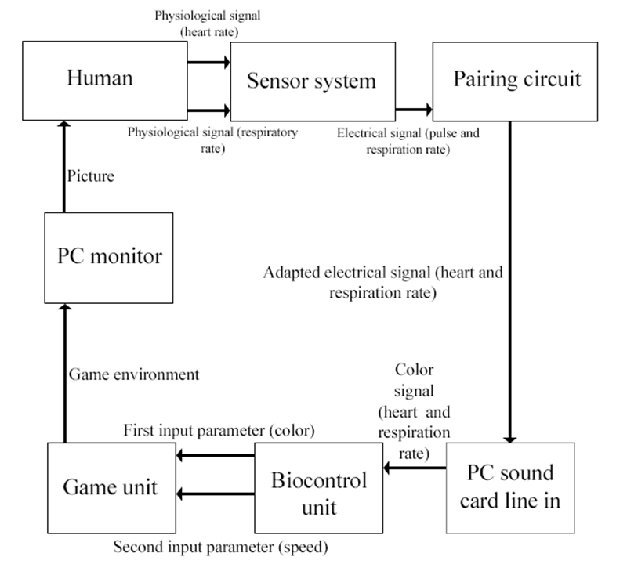
Thus, the path of the control signal carrying biological information can be represented in the following form.

Slide 28
Thus, working with the "Wilddivine" biofeedback module in on-line mode contributes to the development of the ability to return from a tense, unstable state, into a rhythmic, stable one, characteristic of good health. Systematic training with the module allows you to increase stress resistance, get rid of anger, frustration, anxiety, fear, and significantly improve psychosomatic indicators. To form a sustainable effect and develop self-regulation skills, 10 to 15 sessions are recommended.

