Slide 1
Lecture 1. The concept and essence of stress in management
1. The problem of stress in psychology, biology and medicine.
2. The role of the study of stress in management.
3. The concept and essence of organizational stress.
4. Constructive and destructive stress.

Slide 2
1. The problem of stress in psychology, biology and medicine.
In recent decades, stress has been a subject of research in various branches of science: biology, medicine, psychology and sociology. The complexity and variety of forms of stress determines the variety of approaches to the study of this state, however, for a better understanding of this phenomenon, it makes sense to turn to the original concept of stress proposed by Hans Selye.

Slide 3
We can say that the concept he proposed was revolutionary for science in the mid-20th century. At that time, among biologists and doctors, the prevailing opinion was that the reaction of a living organism to environmental factors is of a purely specific nature and the task of scientists is to detect and record precisely the differences in reactions to various influences of the external world. H. Selye went the other way and began to look for general patterns of biological reactions, as a result of which he discovered a single, nonspecific component of biochemical changes in the human and animal body in response to a variety of influences.
He wrote: “A businessman under constant pressure from customers and employees, an airport dispatcher who knows that a momentary loss of attention means hundreds of deaths, an athlete madly thirsty for victory, a husband helplessly watching his wife die slowly and painfully from cancer , - they all experience stress. Their problems are completely different, but medical research has shown that the body reacts stereotypically, with the same biochemical changes, the purpose of which is to cope with the increased demands on the human machine.”

Slide 4
Before the appearance of the works of this author, it was believed that the body's reaction to cold and heat, movement and prolonged immobilization are diametrically opposite, however, H. Selye managed to prove that in all these cases the adrenal cortex secretes the same "anti-stress" hormones that help the body adapt to any stressor. He called the phenomenon of a nonspecific reaction of the body in response to a variety of damaging influences the adaptation syndrome, or stress.

Slide 5
Physiological manifestations of stress.
The hypothalamus has a number of important functions in the human body that are directly related to stress:
- is the highest center of the autonomic nervous system;
- is responsible for the coordination of the nervous and humoral systems of the body;
- controls the secretion of hormones of the anterior pituitary gland, in particular adrenocorticotropic hormone that stimulates the adrenal glands;
- forms the emotional reactions of a person;
- regulates the intensity of food, sleep and energy metabolism.
On the one hand, it increases the activity of the sympathetic nervous system, and on the other, it induces the secretion of anti-stress hormones of the adrenal cortex.

Slide 6
Increased activity of the sympathetic nervous system.
Nervous regulation of metabolism in the human body is the result of the dynamic balance of two subsystems of the autonomic nervous system: its sympathetic and parasympathetic divisions. The task of the sympathetic department is to help the body survive at a critical moment, to give it as many resources as it needs to fight (if it is possible to win) or escape (if the enemy is stronger). When the sympathetic section is activated, the heart beats faster, the pupils dilate, adrenaline (with fear) or norepinephrine (with anger) appears in the blood, the muscles tense and work more intensively, but over time, the body's energy reserves run out and you need to think about replenishing them. When the reserves of nutrients and energy in the body are depleted, the parasympathetic department is excited, the task of which is to restore and preserve resources, and its activation occurs during sleep, food and rest.

Slide 7
The inclusion of hormonal mechanisms.
It should be noted that Hans Selye received the Nobel Prize for the discovery of this very aspect of stress reactions - the activation of the adrenal cortex, which helps the human and animal body to overcome various difficulties with the help of special anti-stress hormones. This reaction is also triggered by the hypothalamus, but differs significantly from the previous one. The adrenal cortex under stress increases the release of two groups of hormones: glucocorticoids and mineralocorticoids. The most important hormone of the first group is cortisol, which enhances all metabolic processes, increases the concentration of glucose in the blood (which is formed from amino acids in the liver), suppresses inflammation and reduces sensitivity to pain. In addition to glucocorticoids, stress increases the amount of mineralocorticoids, which can increase blood pressure due to sodium and water retention in the body. As a result of all these processes, the degree of adaptation of the organism to the increased requirements of the external environment increases, however, it should be remembered that these reactions were well suited to overcoming the physical factors of the environment, contributing to the reactions of "Fight or flight", but they do not help a modern person with social stress.

Slide 8
The role of the cardiovascular system in the formation of stress reactions.
According to the results of numerous clinical observations and experimental studies, the cardiovascular system primarily responds to stress, and also becomes one of the first targets of stress. According to most researchers, the leading pathogenic factor in relation to the cardiovascular system under stress is a violation of the permeability of the membranes of cardiac cells leading to disorders of their metabolism and hypoxia. At the same time, the researchers emphasize the two-way relationship between stress and ischemia of the heart muscle: on the one hand, ischemia often occurs as a result of a stress reaction that causes spasm and thrombosis of the coronary vessels, and on the other hand, ischemia caused by any cause causes pain, fear of death, and as a result, expressed emotional stress.

Slide 9
Features of psychological stress.
Psychological stress, in contrast to the biological stress described in the classical works of H. Selye, has a number of specific features, among which several important ones can be distinguished. In particular, this type of stress can be triggered not only by actually acting, but also by probabilistic events that have not yet occurred, but the occurrence of which will soon come. Unlike animals, a person reacts not only to a real physical danger, but also to a threat or a reminder of it. As a result, it happens that in a poorly performing student, the mere thought of a likely unsatisfactory grade/mark sometimes causes stronger autonomic reactions than receiving it on the exam. This determines the specificity of human psychoemotional stress, to which the patterns of its course, described in detail in experiments on laboratory animals, are not always applicable.

Slide 10
Another feature of psychological stress is the essential importance of a person's assessment of the degree of their participation in actively influencing a problem situation in order to neutralize it. It has been shown that an active life position, or at least awareness of the possibility of influencing the stress factor, leads to the activation of the predominantly sympathetic part of the autonomic nervous system, while the passive role of the subject in this situation determines the predominance of parasympathetic reactions.

Slide 11
The mechanism of development of psychological stress can be demonstrated by the example of a student preparing to defend a thesis project. The severity of the signs of stress will depend on a number of factors: his expectations, motivation, attitudes, past experience, etc. The expected forecast of the development of events is modified in accordance with the already available information and attitudes, after which the final assessment of the situation takes place. If consciousness (or subconsciousness) assesses the situation as dangerous, then stress develops. In parallel to this process, an emotional assessment of the event takes place. The initial triggering of an emotional reaction develops on a subconscious level, and then an emotional reaction is added to it, made on the basis of rational analysis.
In this example (waiting for the defense of the diploma), the developing psychological stress will be modified in the direction of increasing or decreasing intensity, depending on the following internal factors.

Slide 12
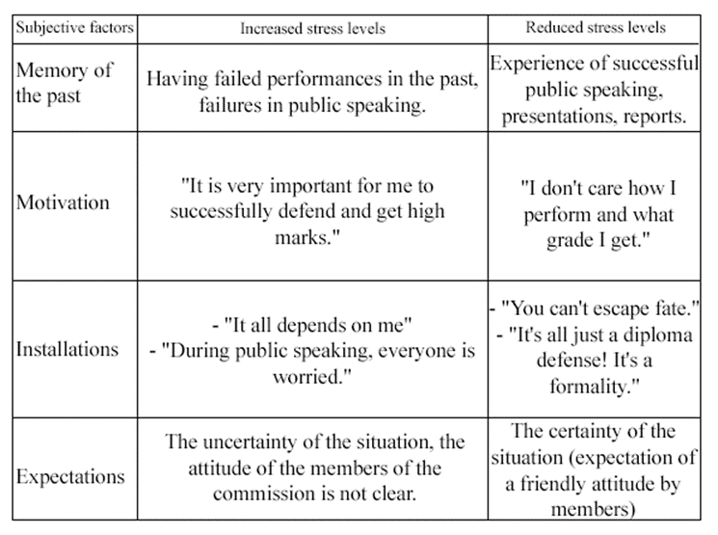

Slide 13
The concept and essence of stress.
Stress is a psychological state of a person in which he feels intense tension and suffering. Stress significantly reduces the efficiency of a person's work, so it is important for a manager to create such working conditions in which his employees will feel calm and confident. Stress directly or indirectly increases the cost of achieving the goals of the enterprise.
No one manages to avoid stress, therefore they acquire danger only if they turn out to be too long.
Some management experts believe that stress can also have a positive meaning, as it can be caused by a complex new situation, which will give an impetus to the mobilization of all forces to solve it or open a new stage in human development.
There are several signs of stress that are common to most people:
- inability to concentrate on work;
- frequent mistakes;
- weakening of memory;
- constant fatigue;
- unnaturally fast or slow speech;
- frequent headaches, cramps in the stomach that have no organic cause;
- increased irritability and sensitivity;
- abuse of bad habits;
- loss of a sense of humor;
- a constant feeling of hunger or lack thereof.

Slide 14
The duration of stress and the consequences for the body are different for each person. In general, it is believed that small and short-term stress can even be beneficial for the performance of work and harmless to humans, while long-term and significant stress can lead to various undesirable consequences. According to research by physiologists, if stress lasts a month, a year and has already become the cause of any disease, it is almost impossible to return the physiological functions of the body to normal. In general, stress is a fairly common phenomenon. Minor stress is inevitable and harmless, but excessive stress creates problems for both the individual and the organization in performing the assigned tasks.

Slide 15
Experts identify five types of stress:
Physiological stress - arises from physical fatigue caused by heavy exertion, lack of sleep or malnutrition. Methods to eliminate this stress are the most simple, but if measures are not taken in a timely manner, it can worsen;
Psychological stress - caused by unfavorable relationships with others, uncertainty about the future;
Emotional stress - happens due to excessively strong feelings (fear, joy), that is, this type of stress occurs when a person is in danger of death or loss of a loved one. A person can get stress as a result of very great and unexpected joy;
Information stress - occurs in a person who has too much or too little information. So, an unnecessarily large amount of negative information about the real state of affairs makes a person worry. The lack of complete information makes a person speculate about the possible outcome of the case of interest to him and constantly keeps him in suspense;
Managerial stress - occurs when the responsibility for actions or the risk of decisions made is too great and does not correspond to the person's position or moral stability.

Slide 16
2. The role of the study of stress in management.
Minor stress is inevitable and harmless; excessive stress creates big problems for the person with disabilities and the organization.
The causes of stress are associated with two groups of factors.
Organizational factors:
- overload of the employee during the working day
- too little workload of the employee during the working day
- uninteresting work
- making conflicting claims
-Uncertainty of roles with fuzzy formulation of tasks and powers for the use of resources.
Personal factors accompanying any change:
-positive events
-negative events
The negative effects of stress are manifested in:
-physiological reaction of the body (development of various diseases)
- psychological reaction (irritability, insomnia, depression)
Stress can be categorized into:
- emotionally positive and emotionally negative;
- short-term and long-term, or, in other words, acute and chronic;
- physiological and psychological. The latter, in turn, are subdivided into informational and emotional
- emotionally negative and emotionally positive

Slide 17
Joyful events such as a wedding or winning your favorite team are also stressors, causing a storm of emotions and an adrenaline rush. In the case of emotionally positive stress, the stressful situation is short-lived and controlled, usually in these cases there is nothing to fear
Short-term (acute) and long-term (chronic) stress.
They affect health in different ways. Long-term has more serious consequences. Acute stress is characterized by the speed and surprise with which it occurs. The extreme degree of acute stress is shock. There were shocking situations in the life of every person. Shock, acute stress almost always turn into chronic, long-term stress. The shock situation has passed, you seem to have recovered from the shock, but the memories of the experience come back again and again.

Slide 18
Long-term stress is not necessarily a consequence of acute, it often arises due to seemingly insignificant factors, but constantly acting and numerous (for example, dissatisfaction with work, tensions with colleagues and relatives, etc.).
Physiological stress occurs as a result of the direct impact on the body of various negative factors (pain, cold, heat, hunger, thirst, physical overload, etc.)
Psychological stress is caused by factors that act with their signal value: deception, resentment, threat, danger, information overload, etc.
Emotional stress - occurs in situations that threaten human security (crimes, accidents, wars, serious illnesses, etc.), his social status, economic well-being, interpersonal relationships (job loss, family problems, etc.).
Information stress - arises during information overload, when a person who bears great responsibility for the consequences of his actions does not have time to make the right decisions. Information stresses are very frequent in the work of dispatchers, operators of technical control systems.

Slide 19
There are several ways to manage stress. You can change the objective reality to remove the stressor, or change the psychological environment in which a person is. In other cases, stress symptoms can be altered so that they do not have a long-term effect. Highlight organizational and individual stress management methods. Organizational methods include: employee wellness programs; changing the working environment, etc. Individual methods include: psychological (changing the environment in which stress exists; changing the cognitive assessment of the environment; changing behavior to change the environment) and physiological methods (improving a person's physical condition in order to increase the effectiveness of dealing with stress).

Slide 20
Creating a favorable organizational climate is a painstaking task, in which there are no trifles. To solve this problem in practice, such forms are used:
- organization of a feedback system through the corporate press or website;
- attracting personnel to participate in decision-making related to the reorganization of the structure or technological process;
- the use of project and team forms of labor organization.
Nowadays many people rely on corporate trips and holidays, which unite the organization and strengthen the corporate spirit. However, I would like to warn those who like a schematic approach: using standard approaches and solutions in the field of creating favorable relationships, you can run into a number of troubles.

Slide 21
Personalized stress management measures
Individual measures to prevent, mitigate and prevent the negative effects of stress can be learned in special training courses organized in enterprises, as well as individually. These measures include primarily the ability to relax (relaxation) and behavior modification. Maintaining physical health and physical activity is also critical. Those organizations that run gyms, rent gyms for outdoor games or buy their employees a subscription to the pool, provide them with the acquisition of greater physical endurance, increase their vitality and energy, and reduce the risk of cardiovascular disease.
The ability of relaxation techniques to reduce stress has been proven as early as the 1930s. Patients were taught to consistently concentrate on different parts of the body, alternately relaxing and contracting muscles. By focusing their attention on the sensations that arise during relaxation, they gradually achieve more and more complete relaxation. Over time, these basic techniques have been improved. Relaxation in a modern interpretation combines two approaches - auto-training and meditation.

Slide 22
The second way of the anti-stress program at the individual level is behavior modification, this applies especially to people of type "A", whose characteristics include excessive assertiveness, a constant feeling of time pressure and increased activity. Modification includes the formation of a positive emotional response to stressful circumstances and new forms of behavior. It should be emphasized that the solution of specific development problems in the organization of anti-stress programs must be taken after a thorough study of stress factors and the level of stress in the organization. There are many questionnaires for this.

Slide 23
3. The concept and essence of organizational stress.
The concept of "organizational stress" can be defined as follows - it is mental stress associated with overcoming the imperfection of organizational working conditions, with high loads in the performance of professional duties in the workplace in a specific organizational structure (in an organization or in its division, a firm, corporations), as well as with the search for new extraordinary solutions in case of force majeure.
Organizational stress is caused by intra-organizational factors of three levels:
1) individual characteristics of personnel,
2) group interaction,
3) organizational environment, as well as external (macroenvironmental) stress factors.

Slide 24
Cooper and Marshall investigated the sources of stress in white collar workers and identified the following groups:
1. Factors of occupational stress associated with work:
- too much work (overload);
- poor physical working conditions;
- lack of time (when all the time you do not have time for something);
- the need for independent decision-making.
2. Stress factors associated with the employee's role in the organization:
- role uncertainty, for example, lack of awareness of professional responsibilities and related expectations on the part of colleagues and superiors;
- role conflict, when the subject believes that he is doing what he should not, or what he does not want to do;
- responsibility for other people and for some things (equipment, budget, etc.), while responsibility for people is more stressful;
- too low responsibility (painfully hitting on pride and very discouraging at work);
- a small degree of participation in decision-making in the organization.

Slide 25
3. Stress Factors Associated with Relationships at Work:
- relationships with management, with subordinates, with colleagues. Interestingly, for leaders with a scientific and technical orientation, relationships with other people are less important than for leaders with a human contact;
- Difficulties in delegating authority (for example, refusal of subordinates to follow the orders of the head).
4. Factors associated with a business career:
- two main stress factors: professional “failure”, fear of early resignation; inadequacy status, slow or too fast progress, frustration at reaching the "limit" of your career;
- lack of guaranteed work (constant expectation of some changes);
- inconsistency of the level of claims to this professional status.
5. Factors related to organizational structure and psychological climate:
- ineffective counseling (inability to receive timely qualified assistance on a number of important issues);
- restriction of freedom of behavior, intrigue, etc.
Organizational stresses also include role conflicts, high professional requirements, extreme conditions of activity for certain professions (pilots, cosmonauts, NPP dispatchers, etc.).

Slide 26
A common feature and the main cause of organizational stress is the existence of an internal conflict between the requirements of the organization, the attractiveness of work in it, the expectations and real capabilities of the employee.
Stressor concept
Stressor - a factor that causes a state of stress - (synonym for stress factor, stress situation) - an extreme or pathological stimulus, significant in strength and duration, adverse effects that cause stress. An irritant becomes a stressor either by virtue of the value attributed to it by a person (cognitive interpretation), or through the lower cerebral sensory mechanisms, through the mechanisms of digestion and metabolism. There are various classifications of stressors. In the most general form, physiological stressors are distinguished (excessive pain and noise, exposure to extreme temperatures, taking a number of medications, for example, caffeine or amphetamines) and psychological (information overload, competition, threat to social status, self-esteem, the immediate environment, etc.).

Slide 27
The concept of stress resistance
“It’s not stress itself that kills us, but our reaction to it” (Selye Hans). This quote perfectly describes the concept of stress resistance.
Resistance to stress is the ability of an individual to actively resist problems, difficulties, shock and unpleasant situations. This is the quality that allows you to carry significant emotional and volitional loads without harming your health and those around you.
In psychology, stress resistance is a component concept and includes the following indicators:
The volitional component - shows how a person is capable of self-regulation, control over thoughts and emotions.
Psychophysiological element - covers the features of the psyche, temperament, the state of the nervous system.
Intelligence - is responsible for the ability to analyze situations, make the right decisions.
The emotional component is characterized by the volume of personal experience of previous experiences.

Slide 28
Stress-resistant behavior levels:
High level of stress resistance. A person remains calm under any circumstances, even those in which most of us panic or, at the very least, experience mental confusion. This does not mean that a person is made of iron, he also has feelings and emotions. Through experience and self-improvement, such a person has learned to cope with stress in any form.
The main signs of a person with a high level of stress resistance:
Ability to navigate and make instant decisions in critical situations. Ability not to be led to provocative actions of others, adequate (not painful) perception of criticism. Control of emerging emotions, their rationalization, submission to reason. Ability to abstract from unnecessary, unnecessary external factors (information about disasters, rising prices, complaints of neurotic individuals, etc.). Maintaining the ability to act in an irritating environment (people criticize, shout, distract).
It is much easier for such people to minimize the consequences of shocking or unpleasant events. It is known that panic blocks the mind; in a state of panic, a person makes mistakes that do not solve the situation, but only exacerbate its negative impact. Maintaining self-control is the path to success.

Slide 29
Average level of stress resistance. A person with an average level of stress resistance is able to withstand problems and troubles, albeit after a certain time, but lets go of critical situations: job loss, breakdown of relationships. He is not heroic, but he also does not panic, is able to soberly assess the problem, looking for ways to overcome difficulties.
Low degree of stress resistance. The considered level is typical for anxious individuals with an increased emotional background. Such people perceive most stressful situations as posing a threat to their safety and comfort. Outside, such reactions are manifested in the form of anxiety, mental and physical stress, nervousness. Reactive anxiety is accompanied by impaired ability to analyze and reflect, a low degree of concentration. A person may behave inappropriately: start crying, screaming, conflict: emotions get out of control.

Slide 30
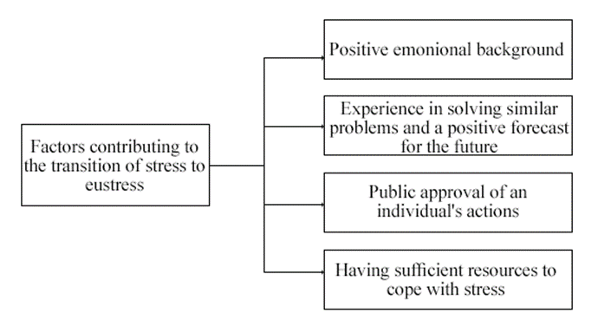
4. Constructive and destructive stress.
In recent decades, the attention of psychologists has been concentrated around the factor that the same stressful stimuli can have a mobilizing and disorganizing effect on human behavior and activity. The concept of destructive stress or distress and constructive stress or eustress has become widespread.
In order for stress to take on the character of eustress, certain conditions must be present.

Slide 31
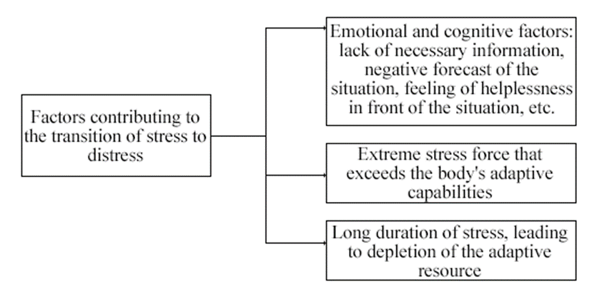
At the same time, in the absence of these conditions, or with a significant force of negative impact on the body, primary stress turns into its damaging form - distress. This can be facilitated by a number of factors, both objective and subjective.

Slide 32
Hans Selye wrote: “Contrary to popular belief, we should not, and indeed cannot, avoid stress. But we can use it and enjoy it if we get to know its mechanism better and develop an appropriate philosophy of life.”
An example is the exam stress that students and schoolchildren face during their studies. It should be noted that although within the framework of the traditional educational process the process of preparing and passing exams in universities is accompanied by certain negative emotions, this state of affairs is not the only possible one.
With a properly organized pedagogical process, study can be enjoyable, and exams can serve as a means of self-affirmation and an increase in personal self-esteem.

Slide 33
Active and passive stress.
Active stress - activation of the sympathetic-adreno-medullary system when it is possible to control the situation.
Passive stress - activation of the pituitary-adrenocortical system when it is impossible to control the situation.
Despite significant individual differences in the level of excretion of catecholamines, the excretion of catecholamines in each person correlates with the degree of stress-induced stress. In a series of experiments where the subjects had the opportunity to influence the course of the experiment, the Swedish physiologist Frankenhäuser showed that if the subject was exposed to electric shocks unexpectedly and could not affect their frequency, then the excretion of adrenaline in the urine increased 3 times. If he controlled the situation and thereby prevented another electric shock, then the level of adrenaline excretion decreased. An interesting report by Frankenhäuser and her co-workers on the effect of exercise on a bicycle ergometer on the excretion of catecholamines: an increase in exercise caused an increase in urinary excretion of both adrenaline and norepinephrine.

Slide 34
At the same time, the experiments carried out by Frankenhauser seem to indicate the specificity of the stress response. Some situations cause changes in the excretion of adrenaline, others affect the urinary excretion of both adrenaline and norepinephrine. In the first case, the situations, apparently, by their very nature, cause a passive form of reaction, in the second - an active one.
Stress is accompanied by increased blood and urinary glucocorticoid levels. Such an increase was noted under various types of stress: driving a car, flying an airplane, space flight, medical examination, waiting for surgery, psychological tests, etc.
Henry and Stephens showed that different types of stressors activate different hormonal systems and lead to different types of diseases. If a person has the ability to control the situation, the sympathetic-adreno-medullary system is activated, and overloads here lead to diseases such as heart failure (active stress). When a stressor is uncontrollable, the pituitary-adreno-cortical system is activated, which, with prolonged exposure, causes diseases associated with malfunctions in the immune system (passive stress).

