Slide 1
Typology of English

Slide 2
Lexical typology
of English

Slide 3
Questions to discuss
Typology of English words.
Typology of English word-formation.
Typology of English idioms.

Slide 4
Question 1
Typology of English words

Slide 5
Lexical units
↙ ↘
Words Idioms

Slide 6
A word is the basic andsemantically indivisible unit of the language performing the nominative (naming) function.

Slide 8
Types of language
(in terms of number of words)
↙ ↓ ↘
a big № an average № a small № of
of words (English – 500,000 – 5,000 000 words, of words (Latin, Sanskrit – 100-200,ooo words) words (10,000, native tribes’ languages)
Chinese, Russian,
French, German)

Slide 9
Lexical Universals:
words like “black” and “white”,
parts of the body,
metaphors,
names of relatives,
names of animal, etc.,
any language can develop new words

Slide 10
Guess the part of the body
Finnish | Portuguese
Silmä Pää Korva Kasivarsi Jalka Suu | olho cabeça orelha braço perna boca

Slide 11
Specific lexical features:
Lots of names for snow (in the Eskimo language);
See English examples in the next slide.

Slide 12
Specific English words
Serendipity (An event which occurs by way of a happy accident),
Silly (amusingly stupid),
Facepalm (The act of slapping one’s head with the palm of your hand in a show of exasperation),
Pimp (To make something extra fancy and special).

Slide 14
Silly

Slide 15
Facepalm

Slide 16
Pimp

Slide 17
Question 2
Typology of English word forming

Slide 18
Word formation is the creation of a new word.

Slide 19
Types of word formation
affixation (derivation);
conversion (zero affixation);
compounding (blending).

Slide 20
Affixation (derivation) is the creation of a new word with the help of affixes.
Height – height-en,
Possible – im-possible

Slide 21
2. Conversion (zero affixation) is a shift from one part of speech to another.
A word – to word
A dream – to dream
Round – a round
To try – a try
To drive – a drive
Столовая – столовая
Рабочий - рабочий

Slide 22
3. Compounding (blending) is combining two roots (stems):
adjunction/adjoinment: postcard, snowball;
with an infix: sportsman;
- with the help of functional words: son-in-law,
jack-of-all-trades.

Slide 23
Conclusion
Derivation is more widely spread in Russian than in English,
Conversion is more popular in English than in Russian,
It is suffixation (not prefixation) that is more distributed in both English and Russian.

Slide 24
Question 3
Typology of English idioms

Slide 25
An idiom is a set expression used figuratively.

Slide 26
To have eyes in the back of one’s head

Slide 27
Have all Christmases at once

Slide 28
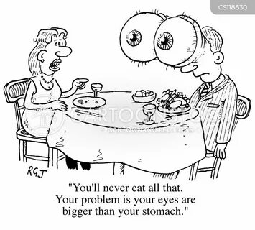
To have eyes bigger than one’s stomach

Slide 29
Types of idioms

Slide 32
Structural types of idioms
Comparatives: as merry as a cricket, as poor as a church mouth
Nominal (couch potato, Jack-of all trades)
Verbal (to kick the bucket, to beat about the bush)
Proverbs and sayings (No pain, no gain. An apple a day keeps a doctor away)
Exclamations (Wake up and smell the coffee! Break a leg!)

