Slide 1
Typology of English

Slide 2
Typology of English phonetics

Slide 3
Questions to discuss
Phonemes.
Stress.
Syllables.

Slide 4
Question 1
English phonemes

Slide 5
A phoneme is …

Slide 6
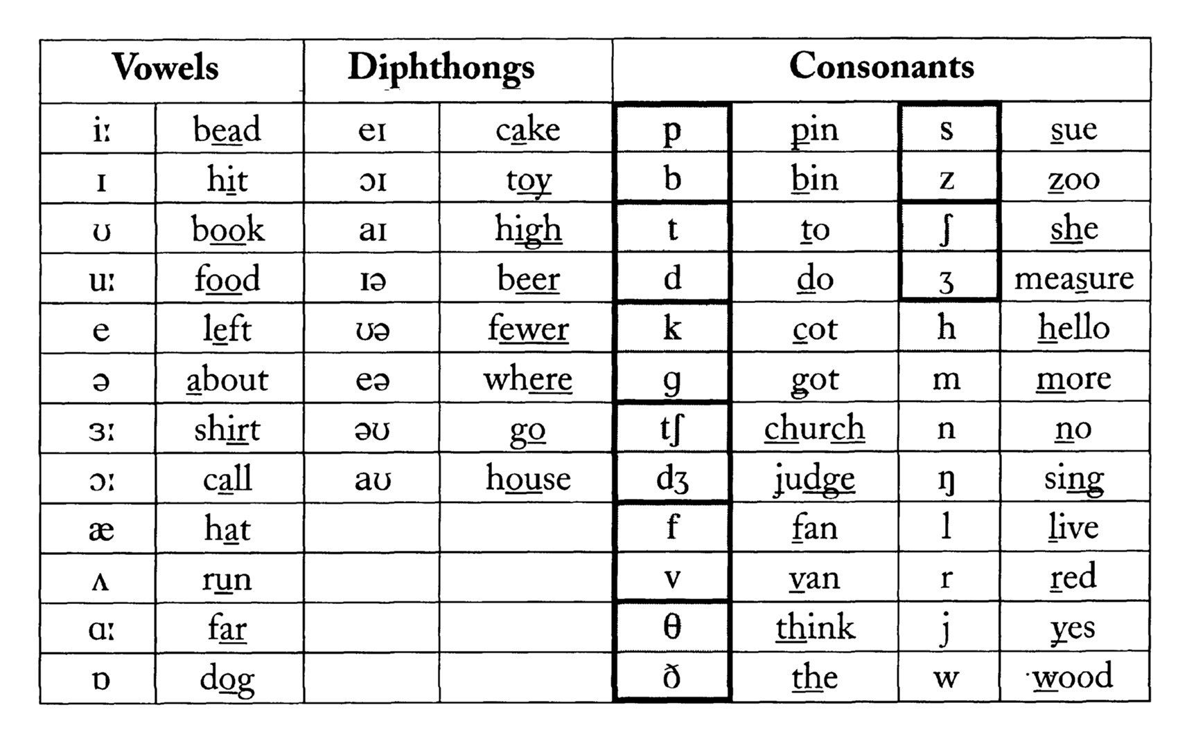

Slide 7
English phonemes
↙ ↘
20 vowels 24 consonants

Slide 8
Languages of the world
↙ ↘
Consonantal languages vocalic language
Language | Total | Vowels | Consonants
Russian | 41 | 6 | 35
English | 44 | 20 | 24
Turkmen | 30 | 9 | 21
Belorussian | 45 | 6 | 39
German | 4 | 18 | 24
French | 35 | 15 | 20

Slide 9
Specific English vowels:
Diphthongs;
Long and short vowels;
æ; ɒ, etc.

Slide 10
Specific English consonants:
there are no palatalized consonants;
Ɵ, ð, p, h, ŋ, r, w, ʒ, ʤ, etc.
m, n, ŋ
t,d,n,s,z
P, t, k
[Ŋ] can be used only at the end of the word or syllable, while [h] is never used at the end of the word.

Slide 11
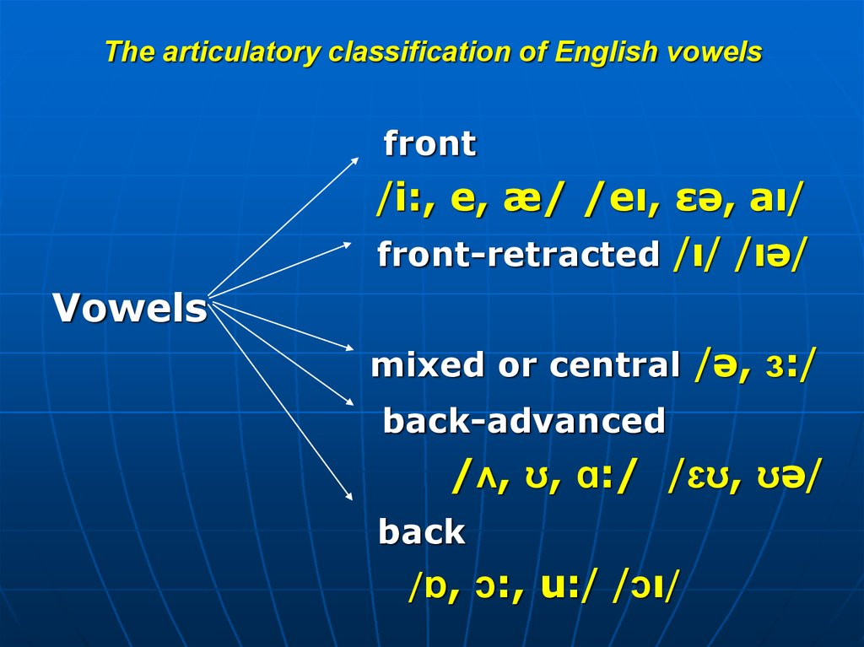

Slide 12
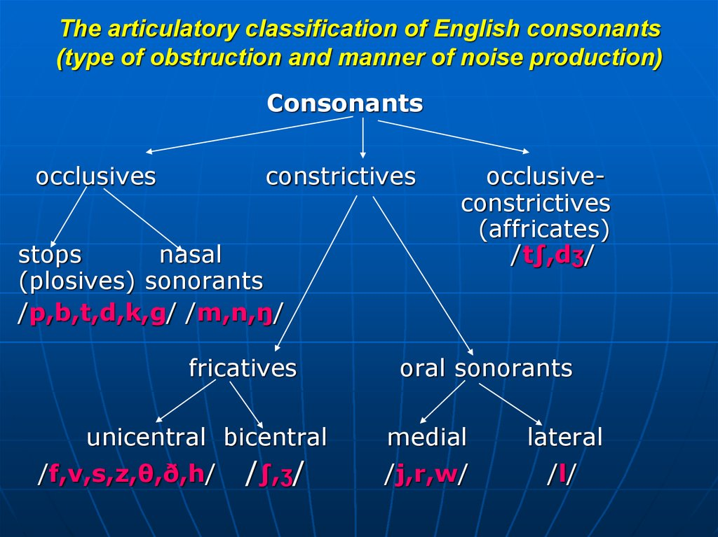

Slide 13
Question 2
English word stress

Slide 14
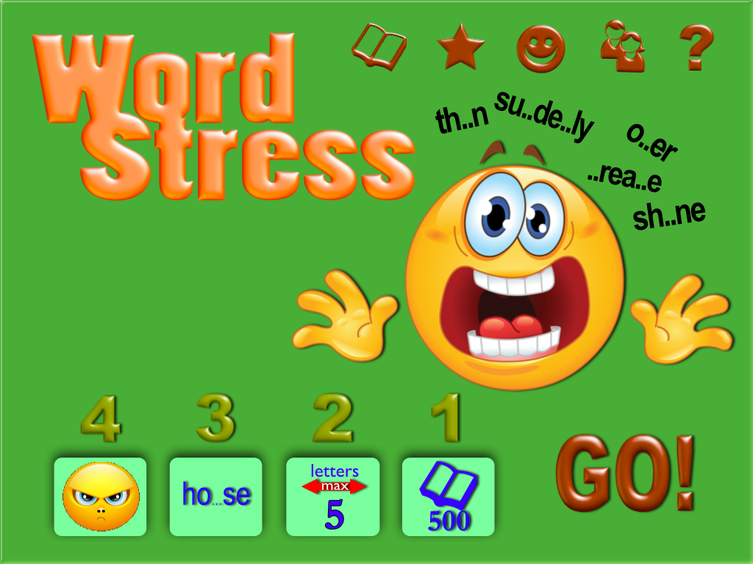

Slide 15
Stress or accent is the relative emphasis or prominence given to a certain syllable in a word.

Slide 16
cli·mate
(/ˈklaɪ.mɪt/)
crit·ic
(/ˈkrɪt.ɪk/)
dia·mond
(/ˈdaɪ.mənd/)
el·e·phant
(/ˈɛl.ə.fənt/)
en·ve·lope
(/ˈɛnvəˌloʊp/)

Slide 17
des·sert
(/dɪ.ˈzɜrt/)
di·sease
(/dɪ.ˈziz/)
ex·tent
(/ɪk.ˈstɛnt/)
ho·tel
(/hoʊ.ˈtɛl/)
ma·chine
(/mə.ˈʃin/)

Slide 18
Types of word stress
Dynamic, musical, quantitative
Fixed and free
Primary and secondary
Word-forming and word-changing

Slide 19
English word stress
Dynamic
Fixed
Primary and secondary
word-changing

Slide 20
Teacher
Plastic
Instruction
Television
Dictation
Memorial
Visual
Politician
Sufficient
delicious
Edible
Classify
Biology

Slide 21
Question 3
Syllables

Slide 22
A syllable is a part of a word and the basic unit of English rhythm.
A syllable is a combination of one vowel and one or more consonants. They are building blocks of words.

Slide 23
One English word can have one, two, three or more syllables.

Slide 24
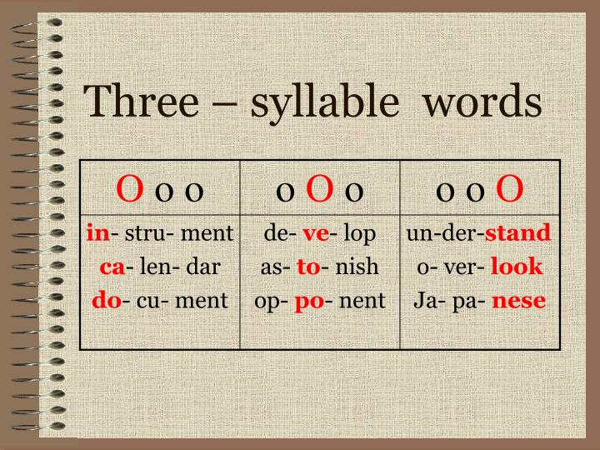

Slide 25
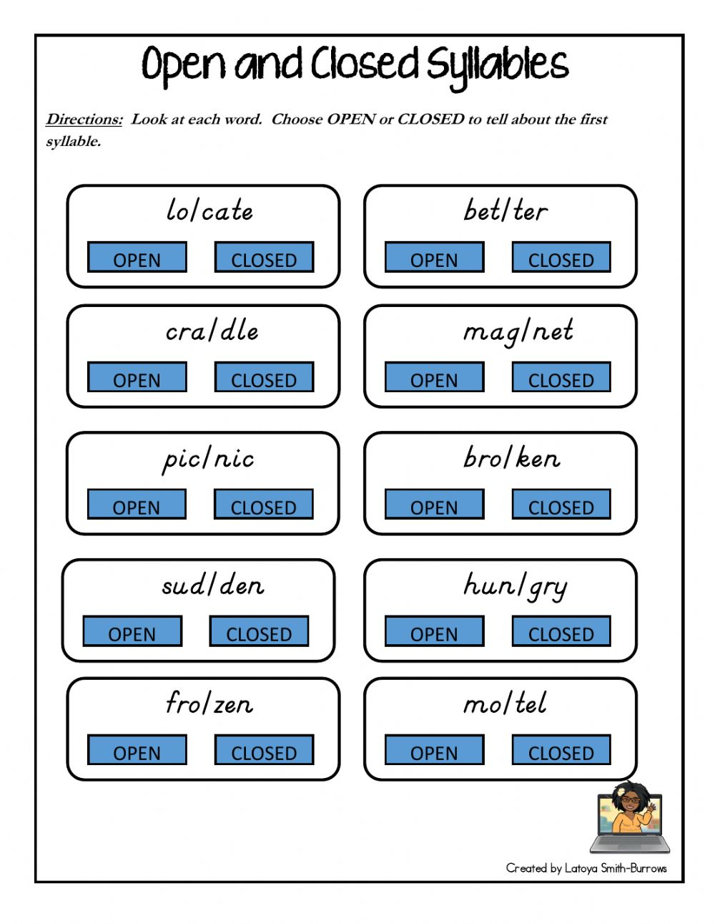

Slide 26
Examples of Closed Syllables:
clock
truck
ask
bin
trim
gym
neck
if

Slide 27
Examples of Open Syllables:
cry
try
no
go
a
chew
brew

Slide 29
