Slide 1
Typology of English

Slide 2
Lecture
What is typology?

Slide 3
Questions to discuss
Typology as a branch of linguistics.
Basic terms of typology.
Methods of typology.

Slide 4
Question 1
Typology as a branch of linguistics

Slide 5
Linguistic typology is the study of the specific character of a particular language.

Slide 6
Linguistic typology shows in what way a particular language is different from another language.

Slide 7
Typology can also be defined as the study of language types.

Slide 8
Examples of morphological types of languages
Synthetic languages – have many affixes (Russian): молок-о, не-до-поним-а-ни-е, пере-вар-ил-а
Analytical languages – don’t have many affixes (English): has come, will do, was built, is walking
Aptotic, or isolated languages (Chinese): have no affixes (super-analytical languages)
Incorporating languages (American Indian languages): have extremely many affixes (super-synthetic).

Slide 9
Question 2
Basic Terms

Slide 10
A type of language
A language type is a set of the main characteristics of the language. For example, we already know four morphological types of languages: synthetic, analytical, isolated (super-analytical), incorporating (super-synthetic).

Slide 11
A Language Universal
A language Universal is a feature typical of all the languages or most languages of the world.

Slide 12
Examples of language universals:
All languages have:
A grammar
Basic word order
Nouns and verbs
Subjects and objects
Consonants and vowels

Slide 13
A few more examples of language universals

Slide 14
Types of language universals:
Absolute (for all languages) and statistical (for most languages);
Synchronic (universals typical for a particular period of time, for example for modern times) and diachronic/historic (universal language changes, mainly in grammar and phonetics: e.g. all languages of the world are eager to become analytical);
Phonological, lexical and grammatical;
Elementary (don’t start with the conjunction “if”) and implicational (start with the conjunction “If”: if the language has unvoiced consonants, it also has voiced consonants).

Slide 15
Unique linguistic feature is a specific feature of a language.

Slide 16
Question 3
Methods of typology

Slide 17
Comparative method
Is about finding common features of different languages.

Slide 18
Typological method
Is about finding different features of different languages.

Slide 19
The method of typological passports
A brief characteristics of a particular language (in terms of its phonetics, vocabulary, grammar).

Slide 20
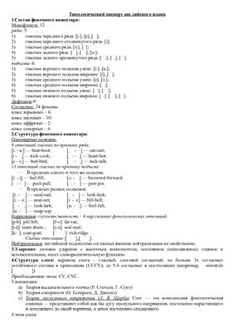

Slide 21
The method of typological indices (a quantitative approach)
(Joseph Greenberg, USA)
This method statistically shows some feature of a language. For example, it can show how analytical or how synthetic a language is: we should take a text of 100 words and to see how many morphemes (roots, suffixes, prefixes and inflections) these 100 words have:
- if a language has more than 200 morphemes per 100 words, this language is known as a synthetic language (e.g. the Russian language is a synthetic language because it has about 237 morphemes per 100 words);
- if a language has less than 200 morphemes per 100 words, this language is known as an analytical language (e.g. the English language is an analytical language because it has about 168 morphemes per 100 words).

