Slide 1
Our course is
Primary areas
of theoretical linguistics

Slide 2
Lecture 6
Modern linguistics

Slide 3
Questions to discuss:
What is modern linguistics about?
Branches of modern linguistics.
2. Pragmatics as a branch of modern linguistics.

Slide 4
Question 1
What is modern linguistics about?
Branches of modern linguistics

Slide 5
Modern linguistics starts in the 1950s.

Slide 6
Basic idea

Slide 7
A language is part of a person and part of some national community.

Slide 8
But the true object of linguistics is not a language but speech, or a speaking person (homo loquent).

Slide 9
Branches of modern linguistics
cognitive linguistics
generative linguistics
cultural linguistics
pragmatics
ethnological linguistics
psychological linguistics
sociolinguistics

Slide 10
Pragmatics

Slide 11
Pragmatics studies the human language as a means of communication.

Slide 12
Generative linguistics

Slide 13
Generative linguistics studies how a language is born in our heads and how it is generated.

Slide 14
Cognitive linguistics

Slide 15
Cognitive linguistics studies a human language:
as a means of understanding and generalizing human experience,
as a means of storing information.

Slide 16
Cultural Linguistics

Slide 17
Cultural linguistics studies a language as a keeper (container) of the nation’s culture.

Slide 18
Psychological linguistics

Slide 19
Psychological linguistics studies a language as a means of representation of thoughts.

Slide 20
Sociolinguistics

Slide 21
Sociolinguistics studies peculiarities of sublanguages.

Slide 22
Ex. 1. Match | modern branches of linguistics with their objectives
1. Communicative linguistics 2. Generative linguistics 3. Cognitive linguistics 4. Cultural linguistics (linguocultural studies) 5. Ethnolinguistics 6. Phycholinguistics 7. Sociological linguistics | A. Analyzes speech development in connection with the development of a personality. B. Studies relations between language and culture, how culture participates in the formation of language concepts. C. Identifies the principles of speech communication D. Studies how a language generates, defines transformations (syntactic operations) that allow to transform innate (nuclear) syntactic structures into an infinite number of secondary (derivative) structures. Е. studies social functions of languages as well as stylistic differentiation of language use F. Reconstructs traditional (archaic) worldview, value system

Slide 23
Question 2. Pragmatics as a branch
of modern linguistics.

Slide 24
Pragmatics studies the contextual meaning of sentences.

Slide 25
The basic idea of pragmatics

Slide 26
A language is a means of communication and an instrument to influence our mind and emotions.

Slide 27
The main objectives of pragmatics:
to define principles
of communication,
2) to classify speech acts.

Slide 28
Principles of communication

Slide 29
Herbert Paul Grice
(The Cooperative Principle)
Geoffrey Leech
(The Principle of Politeness)

Slide 30
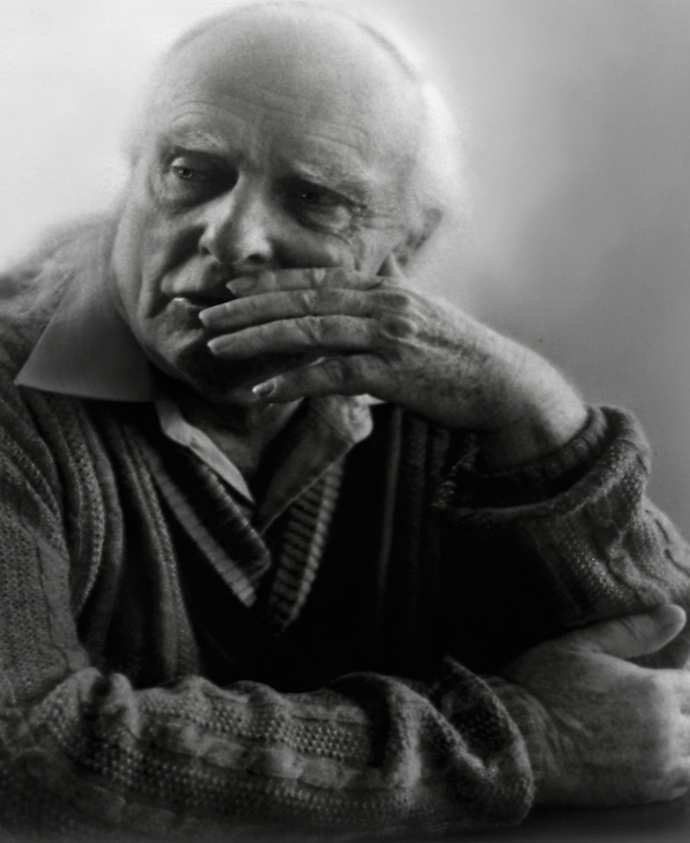
Herbert Paul Grice
(The Cooperative Principle)

Slide 31
The cooperative communication is communication based on several important criteria

Slide 32
What are these criteria (maxims)?

Slide 33
P. Grice’s maxims of cooperation
Maxim of Quantity (Information)
Maxim of Quality (Truth)
Maxim of Relation (Relevance)
Maxim of Manner (Clarity)

Slide 34
Maxim of Quantity (Information)

Slide 35
Maxim of Quality (Truth)
Do not say what you believe to be false.
Do not say that for which you lack adequate evidence.

Slide 36
Maxim of Relation (Relevance)

Slide 37
Maxim of Manner (Clarity)
Avoid obscurity of expression.
Avoid ambiguity.
Be orderly.

Slide 38
P. Grice’s maxims of cooperation
Maxim of Quantity (Information)
Maxim of Quality (Truth)
Maxim of Relation (Relevance)
Maxim of Manner (Clarity)

Slide 39
What maxim is violated?
I am a multimillionaire
(Actually, I’m penniless)

Slide 40
What maxim is violated?
A: When am I going to get back the money I lend you?
B: Boy it’s hot in here.

Slide 41
What maxim is violated?
A: What should I do to get rid of this headache?
B: Take some medicine.
A: What medicine?

Slide 42
What maxim is violated?
A: Where is this language spoken?
B: Somewhere in Africa.
A: What part of Africa?

Slide 43
What maxim is violated?
Student: French comes from English.
Teacher (ironically): While Russian comes from Japanese…

Slide 44
What maxim is violated?
A: I don’t feel really well today.
B: Oh, look at her! What a wonderful dress she is wearing!

Slide 45
What maxim is violated?
A: Excuse me… May I ask you something?
B: Yes, please.
A: How to get to the nearest bank?
B: It isn’t far from here.
A: Sorry..I didn’t …

Slide 46
What maxim is violated?
1. The question is formulated inaccurately.

Slide 47
What maxim is violated?
2. The interlocutor wants to speak about something that is interesting only to him.

Slide 48
What maxim is violated?
3. A message conveys more information than needed.

Slide 49
What maxim is violated?
4. The message is ambiguous, it can be interpreted in different ways.

Slide 50
What maxim is violated?
5. The information that you share hasn’t been verified.

Slide 51
What maxim is violated?
6. The sentence is too long.

Slide 52
What maxim is violated?
7. The message is full of a number of fuzzy words.

Slide 53
What maxim is violated?
8. The message is full of unnecessary details.

Slide 54
Conversational Implicature
A: Would you like to go out to dinner with me tonight?
B: Oh, I’m very busy tonight.

Slide 55
Conversational implicature is the contextual meaning of the message (something that is implied).

Slide 56
Doctor: Everything is all right about your right eye.

Slide 57
What is the true meaning of the message in green?
A: Will Sally be at the meeting this afternoon?
B: Her car broke down.

Slide 58
What is the true meaning of the message in green?
A: Do you like my new dress?
B: Well… Your hairstyle is perfect.

Slide 59
What is the true meaning of the message in green?
Mother: Who ate the cake?
Child: I was in the bathroom.

Slide 60
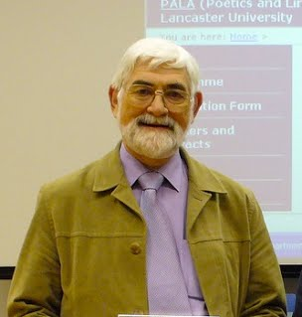
Geoffrey Leech
(The Principle of Politeness)

Slide 61
A polite message (speech act/utterance) is a message that requires no or minimum efforts (physical or intellectual efforts) of the interlocutor.

Slide 62
Go and get some bread.

Slide 63
Can you go and get some bread?

Slide 64
Could you go and get some bread?

Slide 65
Couldn’t you go and get some bread?

Slide 66
The more the efforts that are required on the part of the interlocutor, the more indirect your message should be.

Slide 67
The less the efforts that are required on the part of the interlocutor, the more direct the formulation of the message is.

Slide 68
Make the following request more polite
Model
Go to the bakery.
Go to the bakery, please.
Can you go to the bakery?
Could you go to the bakery?
Couldn’t you go to the bakery.

Slide 69
Make the following request more polite
Drive me home.

Slide 70
Lend me some money.

Slide 71
Give me the book when you finish it reading.

Slide 72
The less the efforts that are required on the part of the interlocutor, the more direct the formulation of the message is.

Slide 73
We would never say
Will you be so kind to let me fix your computer?

Slide 74
So, for G. Leech, polite communication is communication based on several criteria (maxims).

Slide 75
G. Leech’s maxims of the Principle of Politeness

Slide 76
G. Leech’s maxims of the Principle of Politeness:
Tact Maxim (choice),
Generosity Maxim (benifits)
Approbation (approval) Maxim
Modesty Maxim,
Agreement Maxim
Sympathy Maxim

Slide 77
Match the letters with the numbers.
A. we shouldn’t violate the boundaries of the personal sphere of the interlocutor
B. We shouldn’t disturb other people, make them promise you something
C. You should praise other people when they deserve it;
D. don’t praise yourself in public
E. You shouldn’t disagree with somebody only because you don’t like him/her;
F. We should be friendly to each other.
Tact Maxim,
Generosity Maxim,
Approbation (approval) Maxim,
Modesty Maxim
Agreement Maxim
Sympathy Maxim

Slide 78
Summary
Modern linguistics is about a person (a speaking person).
One of the branches of modern linguistics is pragmatics.
One of the objectives of pragmatics is defining principles of cooperative communication.

Slide 79
What maxim of the Principle of Politeness is missing?
Tact Maxim,
Generosity Maxim,
Approbation (approval) Maxim,
Agreement Maxim
Sympathy Maxim

Slide 80
Which of these speech acts should sound more polite?
You can borrow the money from me.
Take the son from the kindergarten.
Take an examination card.
What number (of the bus) is it?
Clean your table.

Slide 81
1. Don’t bother your friend with your problems 2. Be delicate when expressing disagreement. 3. Don’t make somebody to beg his/her pardon. 4. Formulate a request not as a command but as a recommendation. 5. Try and tactfully avoid praises addressed to you. 6. Praise the interlocutor as much as it is appropriate. 7. Try and avoid conflicts. 8. Show your sympathy towards the interlocutor. | Tact Maxim, Generosity Maxim, Approbation (approval) Maxim, Agreement Maxim Sympathy Maxim Modesty maxim

