Slide 1
Linguistics of discourse

Slide 2
Patrik Serio defines discourse as:
- an equivalent to the word “speech, i.e. a particular …;
- a unit which is more than just … ;
- the influence of the utterance on the … ;
- units of the …, their speech representation;
- socially and ideologically … type of utterance, for example cookery discourse or academic discourse;
theoretical…, used for exploring conditions of text production.
construct, sentence, utterance, limited, speaker, language:

Slide 3
Lectures 3-4
Types
of discourse

Slide 4
Questions to discuss
Classification criteria.
Institutional discourse vs. personal discourse.

Slide 5
Question 1
Classification criteria

Slide 6
Classification criteria
the number of participants,
the form of interaction,
the purpose of communication,
the form of representation (information channel),
the degree of formality.

Slide 7
Criterion 1 –
the number of participants

Slide 8
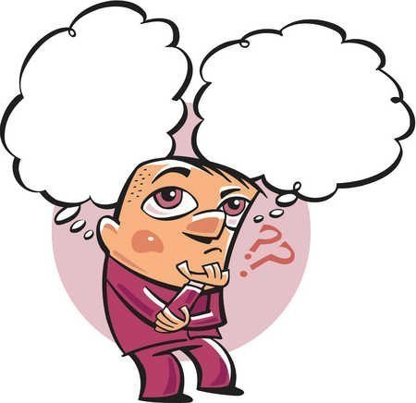
Personal discourse

Slide 9

Discourse in pairs

Slide 10

Group discourse

Slide 11
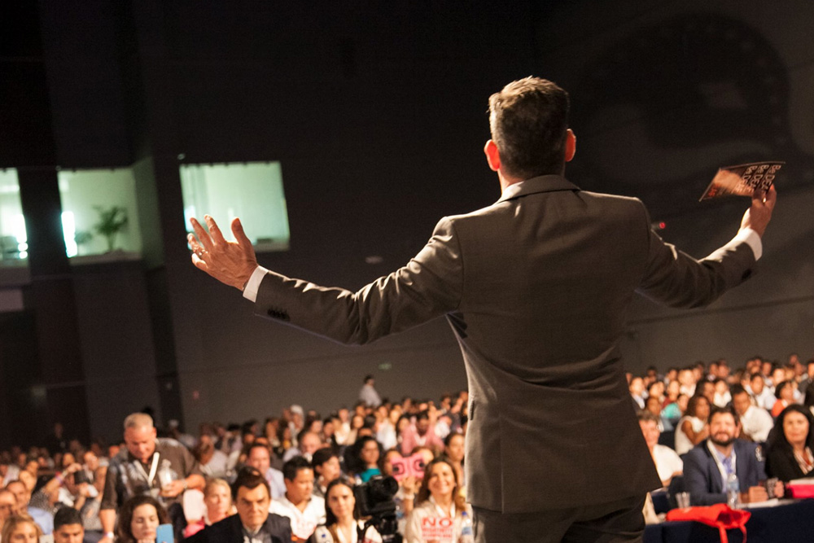
Mass discourse

Slide 12
So, types of discourse by the number of participants are as follows:
personal discourse – discourse of one person,
discourse in pairs – discourse of two people,
group discourse – discourse involving quite a number of people,
mass discourse – discourse involving hundreds or even thousands of people.

Slide 13
Say what type of discourse it is

Slide 14
1.
Wife: Mom has called and said that she is going to visit us today.
Husband: Sorry, whose mother: mine or yours?

Slide 15
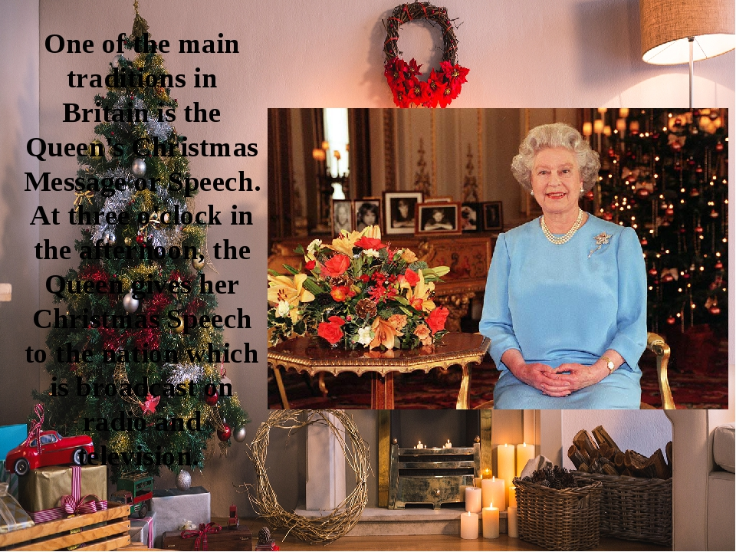
3.

Slide 16
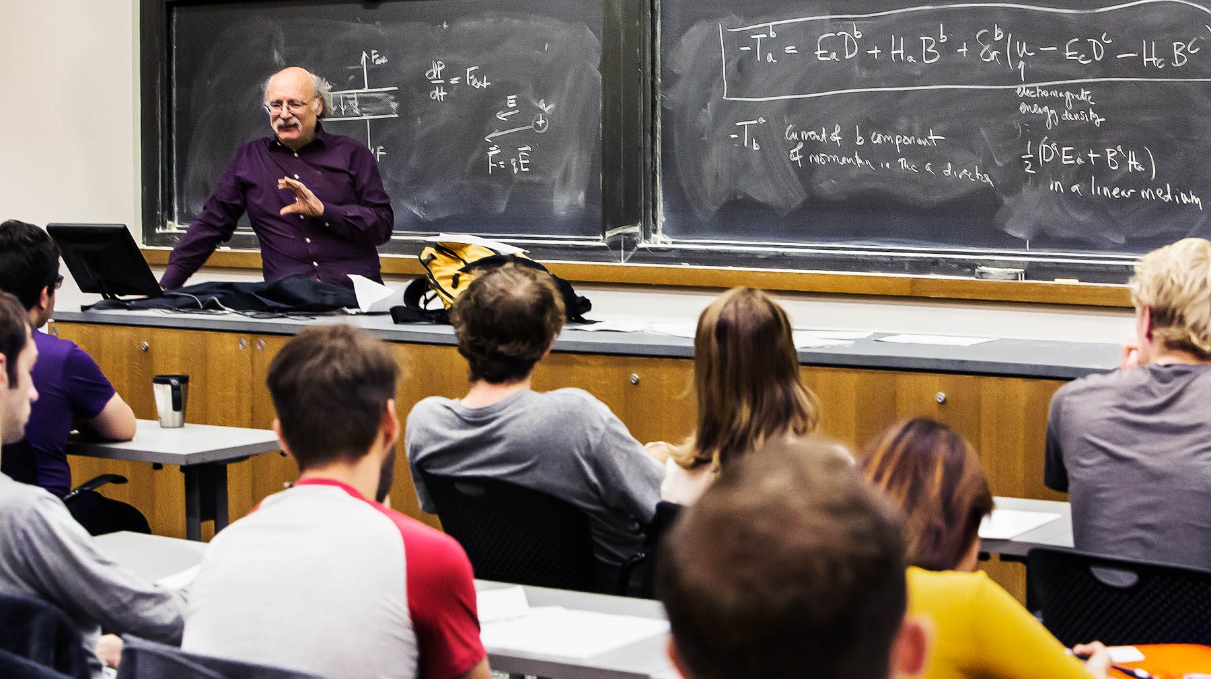
4.

Slide 17
Classification criterion 2 –
the form of interaction

Slide 18

Symmetrical discourse
(homogeneous discourse)

Slide 19
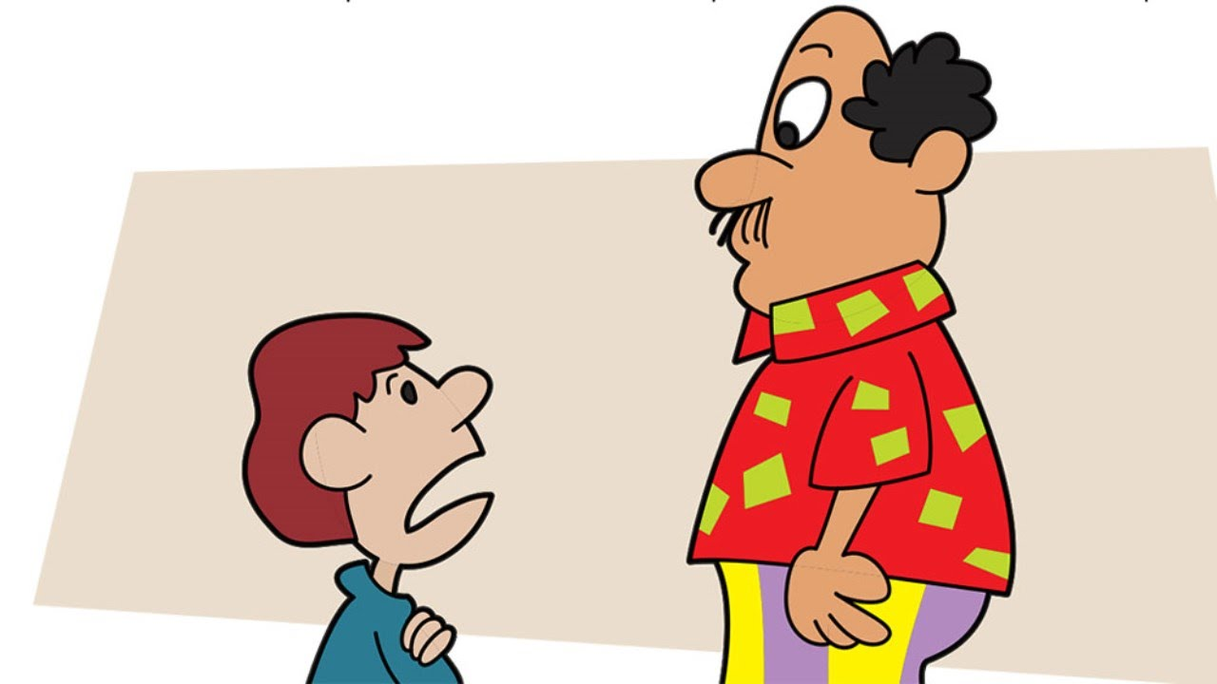
Asymmetrical discourse
(heterogeneous discourse)

Slide 20
So, types of discourse by the form of interaction are as follows:
symmetrical discourse (homogeneous discourse), e.g. discourse between friends, spouses or colleagues,
asymmetrical discourse (heterogeneous discourse) , e.g. between a child and a parent, a boss and an employee.

Slide 21
Classification criterion 3 –
the purpose of communication

Slide 22
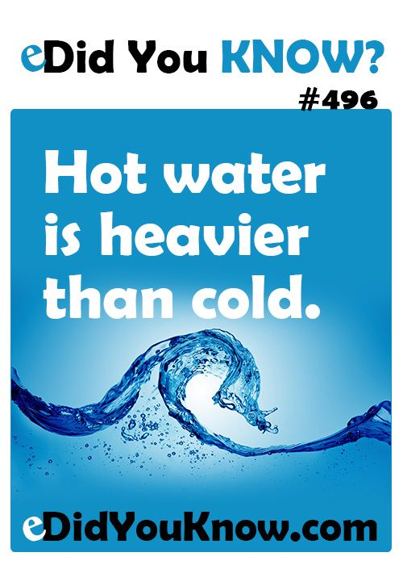
Informative discourse

Slide 23
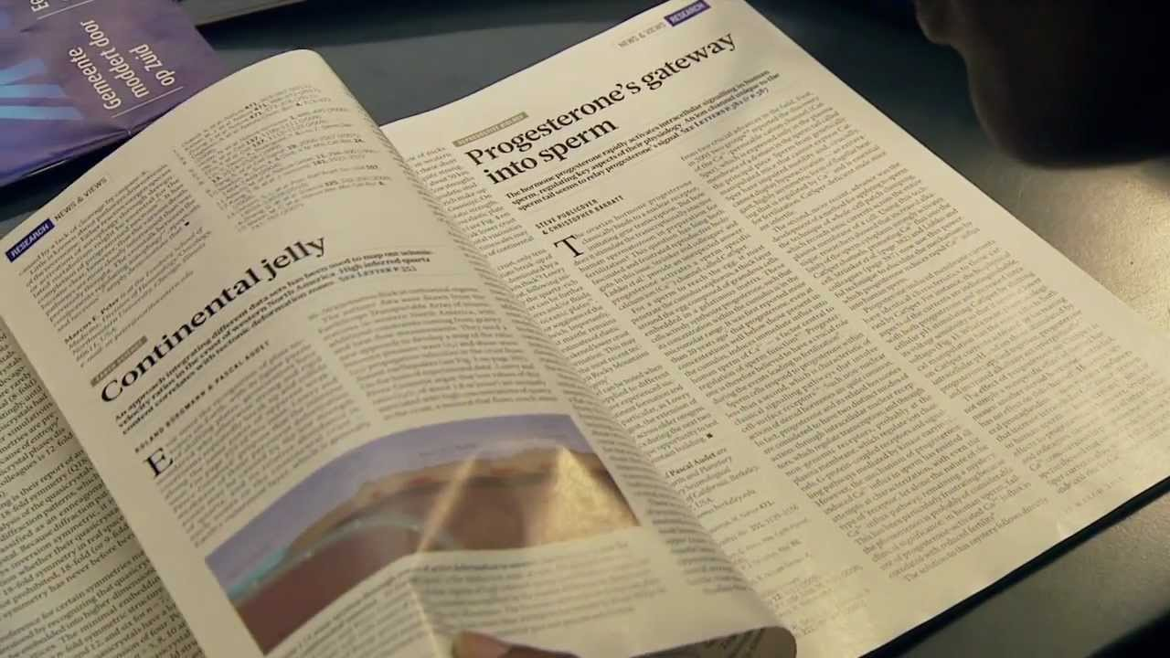
Problem-based discourse

Slide 24

Directive discourse

Slide 25
Axiological discourse
Your hair always looks so fine.
What a wonderful dress!
Nice scarf.

Slide 26
Etiquette discourse
Good morning/afternoon/evening/day!
Pleased to meet you!
Thanks a lot!
Happy holidays!

Slide 27
So, types of discourse by the purpose of communication are:
informative discourse – discourse aiming at providing the necessary information (message, announcement, memo, confirmation, resume, etc.),
problem-based discourse – discourse formulating a problem which is to be solved (e.g., an article in a scientific journal),
directive discourse (advice, recommendation, order, instruction, etc.)
axiological discourse – expressing positive or negative attitude to something (That’s nice. I don’t like it),
etiquette discourse (congratulations, greetings, farewells, expressing gratitude, etc.), etc.

Slide 28
What type of discourse is it?

Slide 29
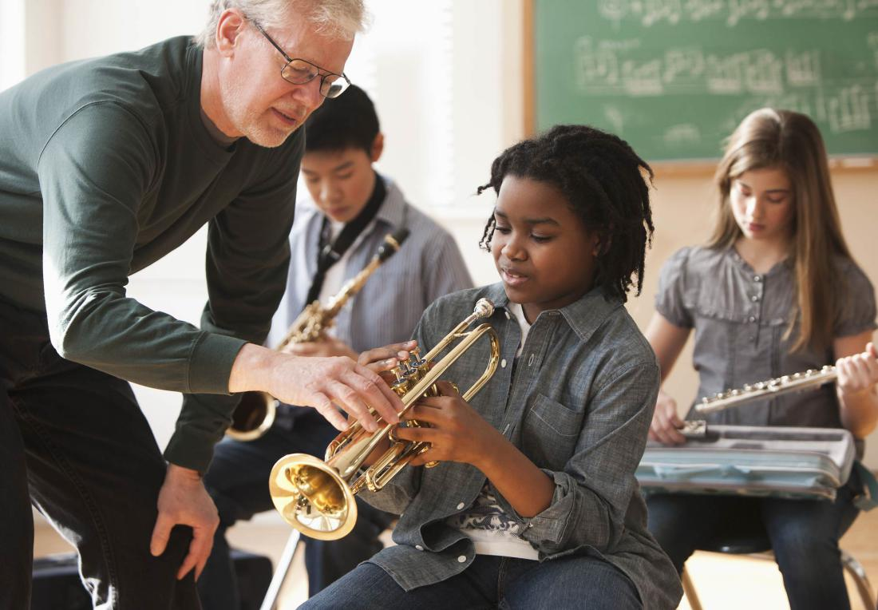

Slide 30
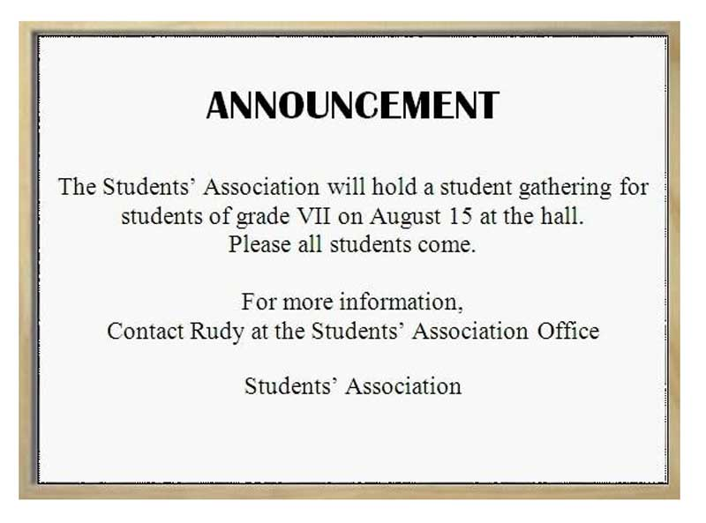

Slide 31


Slide 32
I am completely dissatisfied with today’s programme.

Slide 33
If you intend to use this possibility, you are kindly requested to let me know by 20 October 2011 at the latest (5 days before the opening of the session).
Informative
Directive
Problematic
Axiological
Etiquette

Slide 34
Classification criterion 4 –
the channel of communication

Slide 35


Slide 36
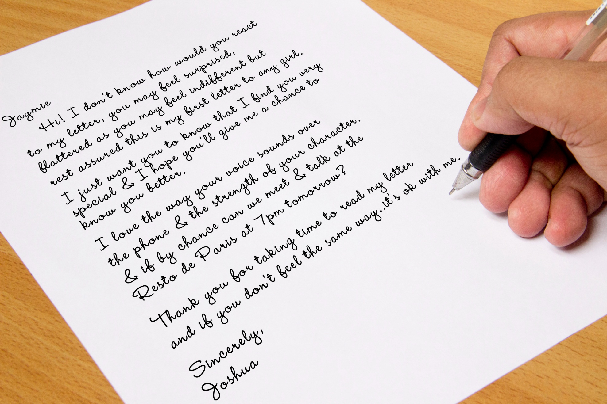

Slide 37
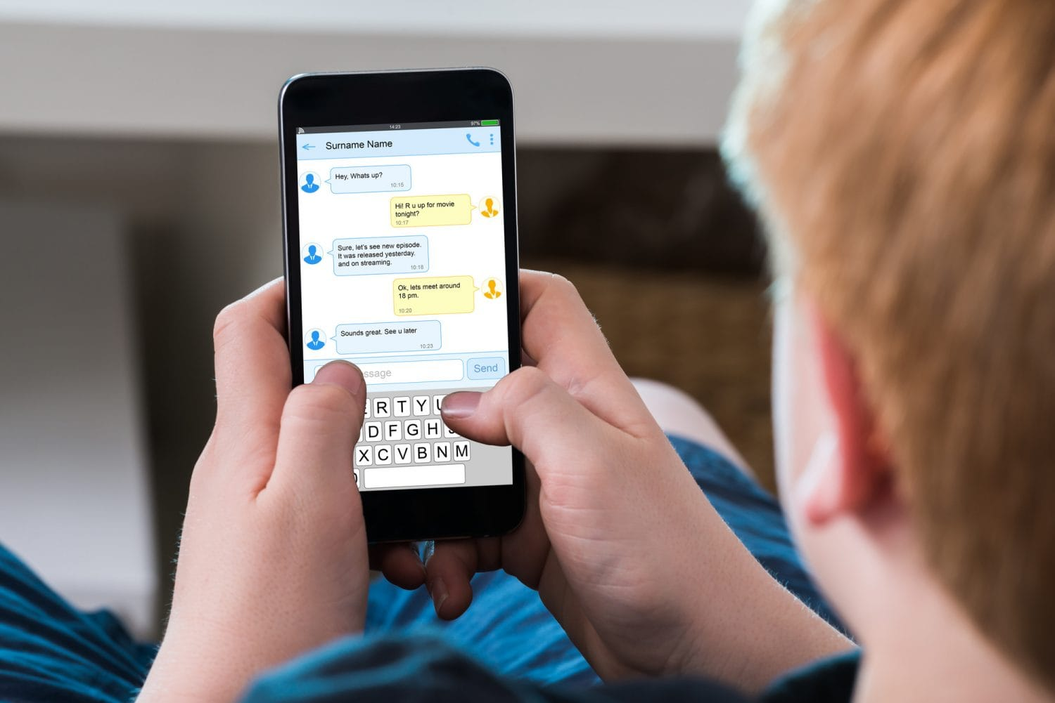

Slide 38


Slide 39


Slide 40
So, the criterion “the information channel” helps differentiate between the following types of discourse:
Spoken discourse ,
written discourse,
electronic discourse,
internal discourse,
sign language discourse.

Slide 41
Classification criterion 5 –
the degree of formality

Slide 42
The criterion “the degree of formality” helps differentiate between the following types of discourse:
- institutional,
- non-institutional (personal).

Slide 43
Question 2
institutional discourse
vs.
personal discourse

Slide 44
Institutional discourse is communication between people of a certain social group, community or organization, between representatives of some social institute.
Non-institutional discourse (personal, personally-oriented) – communication between people acting as individuals in all the complexity of their inner qualities.

Slide 45
Institutional discourse

Slide 46
Institutional discourse is a special stereotyped communication between people who often don’t know each other personally, but have to communicate according to the norms of a particular social group.

Slide 47
So, participants of an institutional discourse are representatives of some social institute, some formal organization, life sphere:
science,
education,
politics,
medicine,
law,
media,
etc.

Slide 48
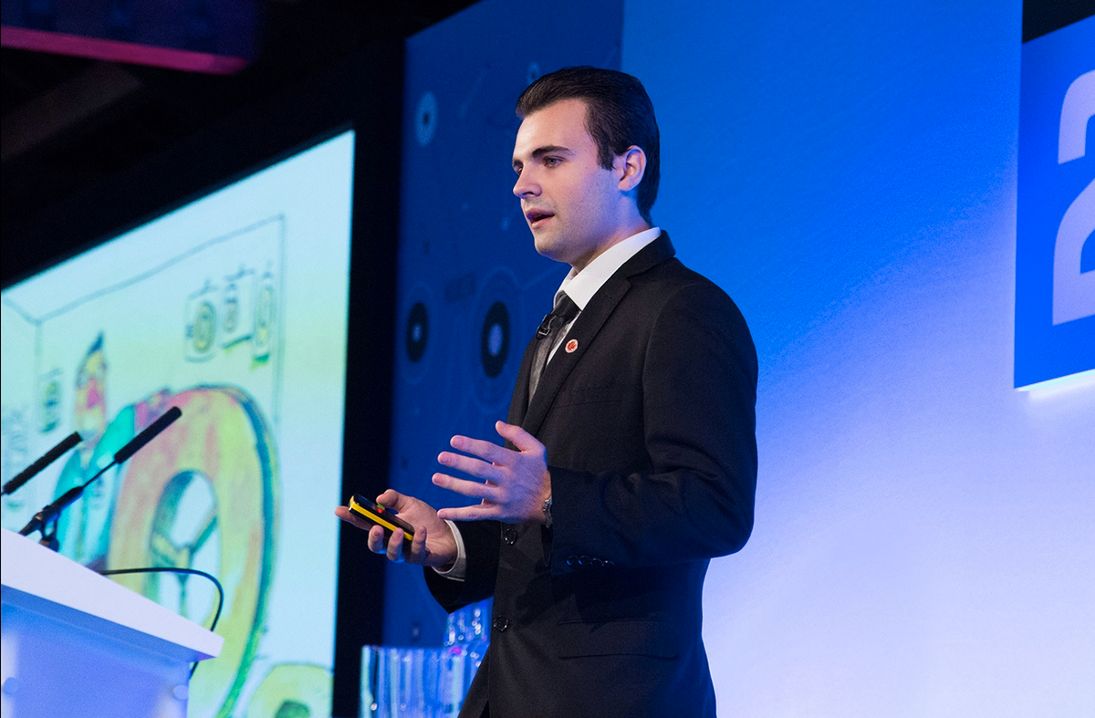
Scientific discourse

Slide 49
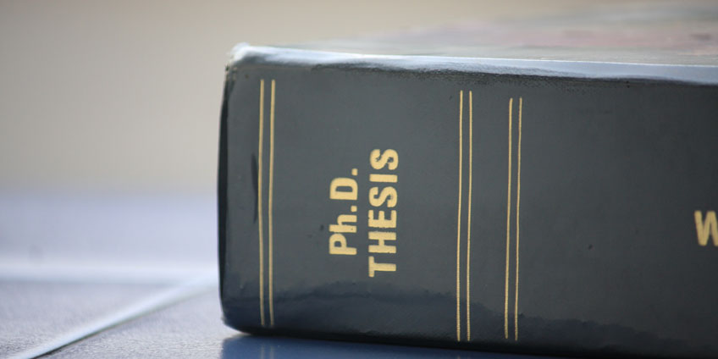

Slide 50
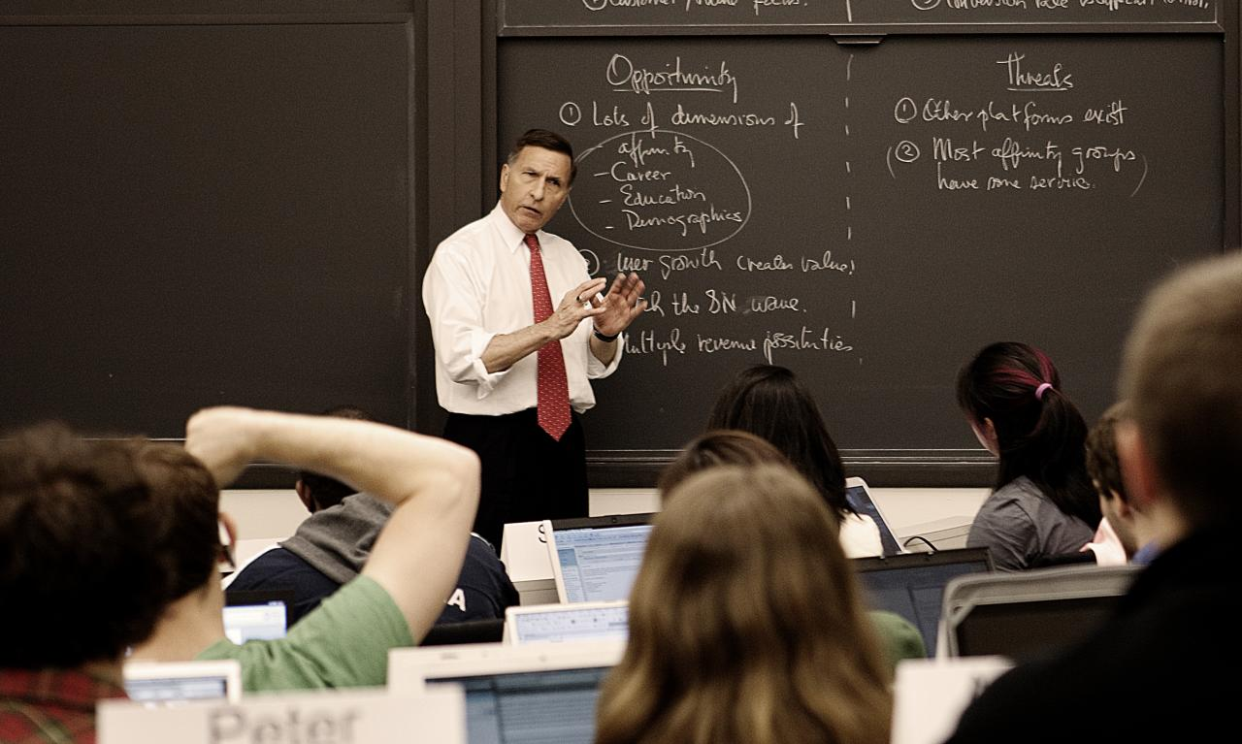
Academic discourse

Slide 51


Slide 52

Political discourse

Slide 53
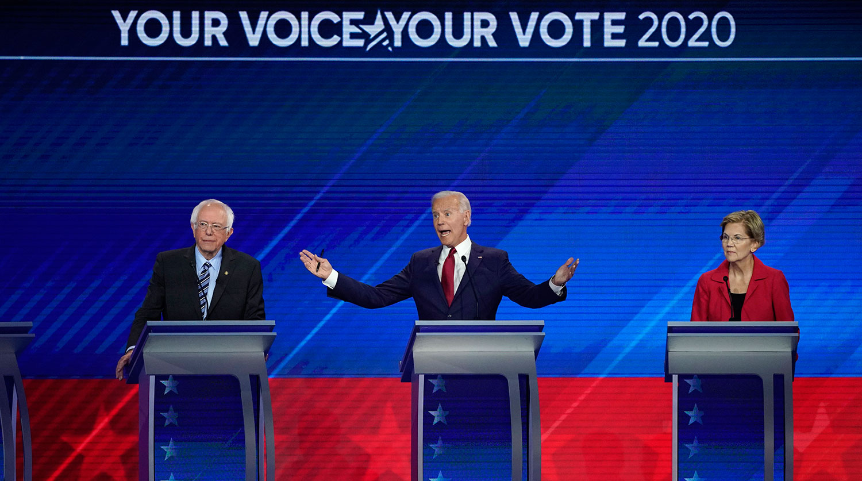

Slide 54

Medical discourse

Slide 55


Slide 56

Media discourse

Slide 57
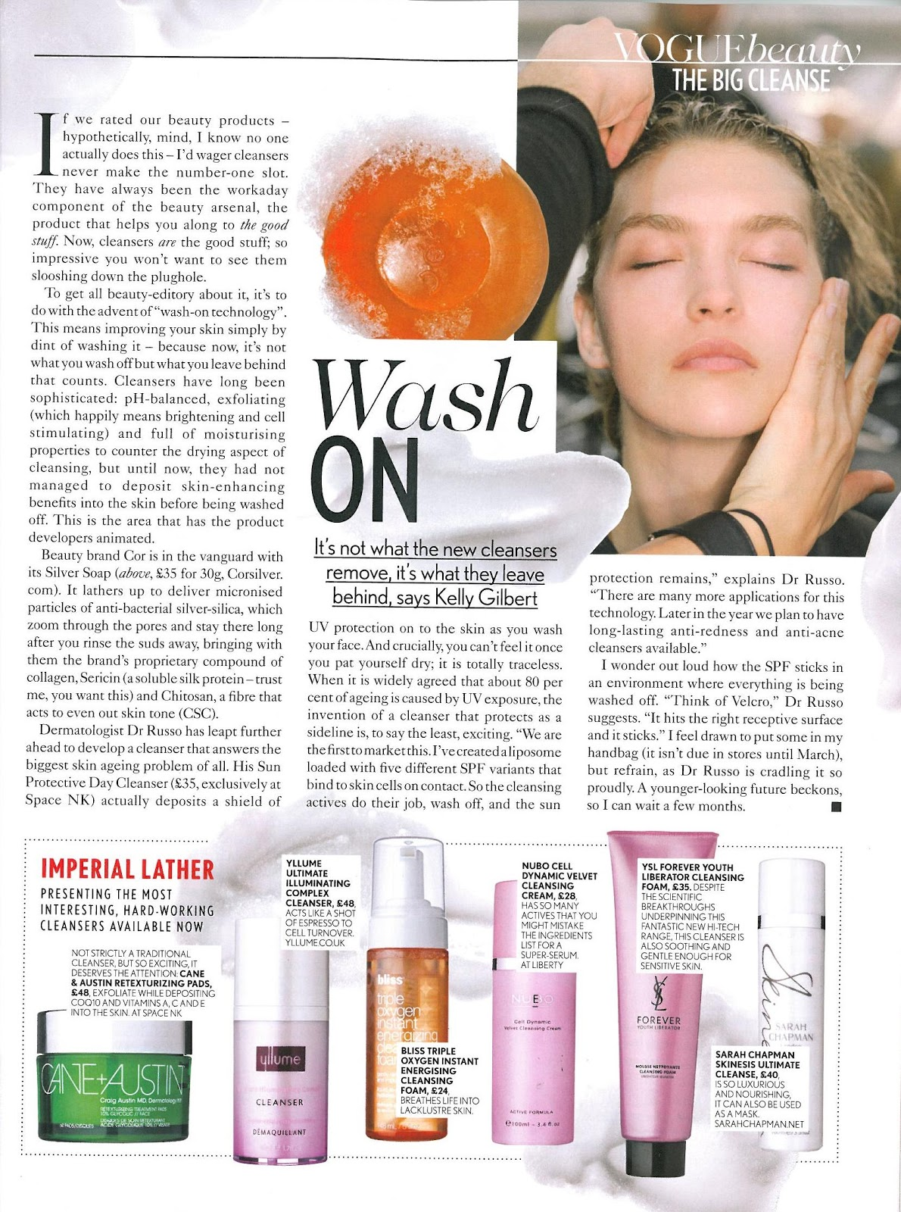

Slide 58


Slide 59


Slide 60
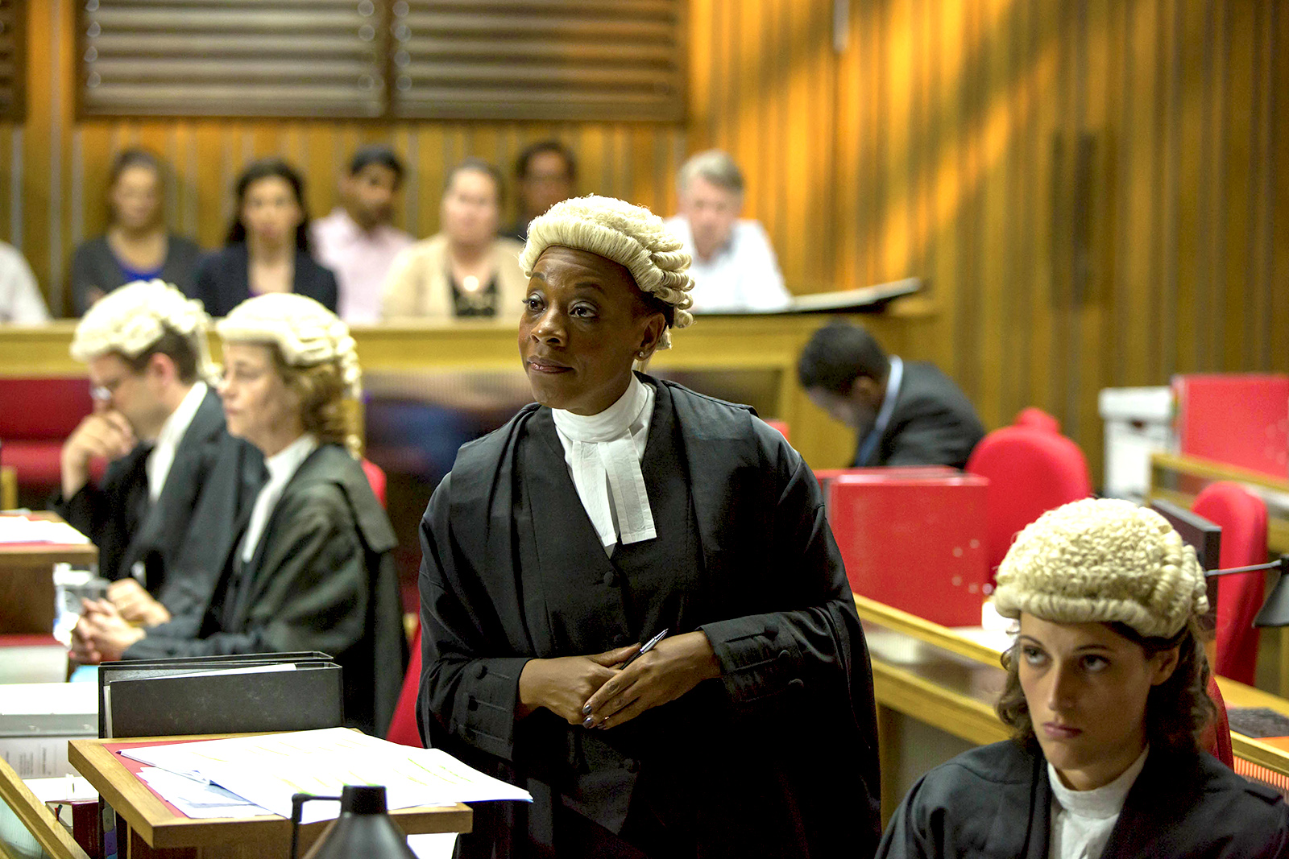
Law discourse

Slide 61
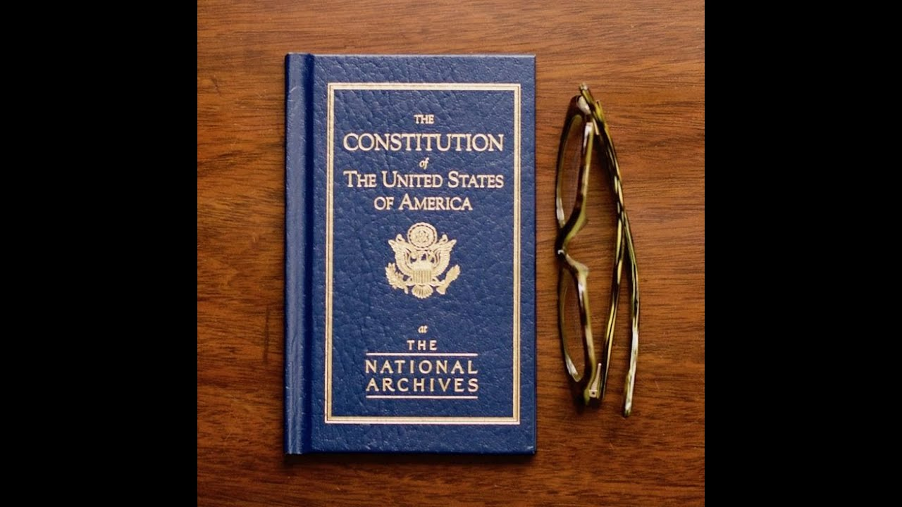

Slide 62


Slide 63
So, the main types of institutional discourse are as follows:
Political discourse
Legal discourse
Scientific discourse
Academic discourse
Medical discourse
Media discourse,
Religious discourse,
etc.

Slide 64
The preferred instruments for pulsed laser radiation are thermally absorbing devices such as calorimeters. The receiver element is often a glass-disk, where the radiation is absorbed in the volume instead of on the surface. The absorptance exhibits an excellent stability under chemical and mechanical stress. This type of calorimeter is described in [70Edw, 74Gun]. The radiative load can be reduced by using glass with a low absorption coefficient which increases the length of the absorption path. On the other hand the heat capacity increases linearly with the thickness of the glass-disk which, in conjunction with the poor thermal conductivity of glass, results in long response and cooling times of these detectors. The radiometric scale for laser radiant energy is usually derived from the scale for cw laser radiant power. In [91Moe] a fast electromechanical shutter is used to produce pulses of known laser radiant energy of up to 5 J. The influence of the pulse duration has to be corrected in the calibration procedure. A laser energy meter not depending on a cw laser radiant power scale is described in [90Yua]. In this instrument the light pressure of the laser beam sensed by two mirrors is converted by a moving coil to an electrical signal. The main advantages of this system are fast response and no interruption of the laser beam. The device has been investigated for single laser pulses of radiant energies between 10 mJ and 6 J. Another method not interrupting the laser beam is the photoacoustic calorimetry [86Kim]. There, the radiant energy incident upon a mirror is absorbed at the mirror surface. The absorbed energy generates elastic strain waves which propagate through the mirror substrate. The strain waves eventually pass through a piezoelectric transducer attached to the back of the mirror substrate. The voltage of the piezoelectric crystal gives a direct indication of the amount of energy absorbed at the mirror surface. Since a priori the absorptance of the mirror is not known the instrument has to be calibrated against a standard energy meter.

Slide 65
A COVID-19 long-hauler details his year of 'hell'
Yahoo News senior editor Ed Hornick has been fighting the lingering symptoms of COVID-19 for over 10 months now. Here, he shares his story.
I circled Jan. 23 on my calendar this year, noting in the box: “Coronavirus Hell Anniversary.” It sounds like Stephen King's next novel — but it’s actually the one-year anniversary of the chilly, damp day I walked into a London hospital with all the telltale symptoms of COVID-19 — only I didn’t know that yet. I would later be diagnosed instead with a viral chest infection and pericarditis (inflammation of the lining around the heart). Coronavirus was barely on the public’s radar at the time. …………

Slide 66
America, I believe we can build on the progress we've made and continue to fight for new jobs and new opportunity and new security for the middle class. I believe we can keep the promise of our founders, the idea that if you're willing to work hard, it doesn't matter who you are or where you come from or what you look like or where you love. It doesn't matter whether you're black or white or Hispanic or Asian or Native American or young or old or rich or poor, able, disabled, gay or straight, you can make it here in America if you're willing to try. (Barack Obama)

Slide 67
Doctor: Your blood pressure is fine.
(He then checks the patient’s throat.)
Doctor: It looks bit scruffy. Not good.
Patient: Yes, it has been quite bad.
Doctor: Do you get sweating and shivering?
Patient: Not sweating, but I feel somewhat cold when I sit under a fan.
Doctor: OK. You’ve few symptoms of malaria. I would suggest you undergo blood test. Nothing to worry about. In most cases, the test come out to be negative. It’s just precautionary, as there have been spurt in malaria cases in the last month or so.
.

Slide 68
The main features of institutional discourse: ritualized character, scripted character, stereotyped character, official character, formal character, status relations, roleplay, insular nature (focus on serving a certain social sphere).

Slide 69
Guess the type of discourse (medical, legal, political, touristic, scientific, religious, academic, etc.) by the values that it advocates.
health, healthy lifestyle
defense and justice
the nation’s prosperity, peace
ecology, travelling, freedom
knowledge, truth, research
faith, virtue
knowledge, education, socializing

Slide 70
Guess the type of discourse (media, medical, advertising, legal, political, touristic, scientific, religious, academic, etc.) by its genres.
Billboards, ads, banners, posters, etc.,
Legal acts, contracts, the prosecutor’s speech, the judge’s verdict, legal advice, article of the Constitution
A sermon (preaching), a prayer, a blessing
Lecture, a chapter from the manual, a pupil’s answer in class, etc.
Debates, election speech, the Queen’s Christmas speech, etc.
Report, article, dissertation, discussion, etc.

Slide 71
Guess the type of discourse (institutional or personal) by its participants.
A pupil and a teacher
A doctor and a patient
A politician and a voter
A priest and a church-goer

Slide 72
Non-institutional discourse (personal, personally-oriented) – communication between people acting as individuals in all the complexity of their inner qualities.

Slide 73
Everyday discourse is communication between people who know each other well, its aim is to maintain contact and solve everyday problems.

Slide 74
Markers of everyday discourse: different topics for discussion, the present moment, speech freedom, privacy, emotional character, a big number of hyperboles, a great number of interjections.
Genres of everyday discourse: dispute, quarrel, conversation, story, reasoning, suggestion, diary, request, advice, confession, apology, personal letter, apology, compliment, etc.

Slide 75
Conclusion.
We seldom deal with “pure” types of discourse: some personal component may be found in institutional communication; at the same time, the features of institutional discourse can be found in everyday communication.

Slide 76
Ex. 1. Pick out all the features of an institutional discourse
Insular nature (focus on serving a certain social sphere), a great number of interjections, different topics for discussion, the present moment, speech freedom, privacy, emotional character, a big number of hyperboles, ritualized character, scripted character, stereotyped character, official character, formal character, status relations, roleplay.

Slide 77
EX. 2. Compare the following definitions (Say what they have in common. Say in what way are they different).
1. G. A. Orlov examines the discourse as a natural speech, materialized in the form of oral or written speech acts, relatively complete in meaning and structure, the length of which is potentially variable: from syntagmatic (short story, conversations, descriptions, instructions, lectures, etc.)
2. Discourse is the line of intersection of the language and reality, vocabulary and experience (M. Foucault 1996).
3. Discourse is a text in terms of its context or communicative space (T. van Dijk, 1997).
4. Discourse is a verbalized speech-thinking activity, understood as a combination of process and outcome, with its own linguistic and extralinguistic plan (Red 2001).
5. Discourse is a coherent text produced in speech, but understood as an event.

